Slide 1

Housing Prices
Based on data from Kaggle
Presented by Zaw Min Tun

Slide 2
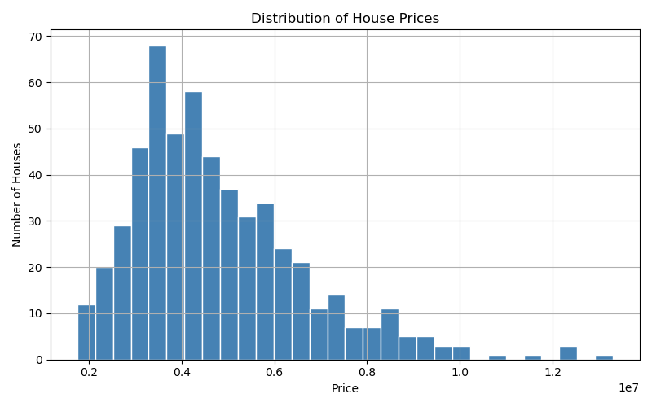
Price Distribution
Influencing factors
? No. of bedrooms
? Furnishing status
? Area
? Others

Slide 3
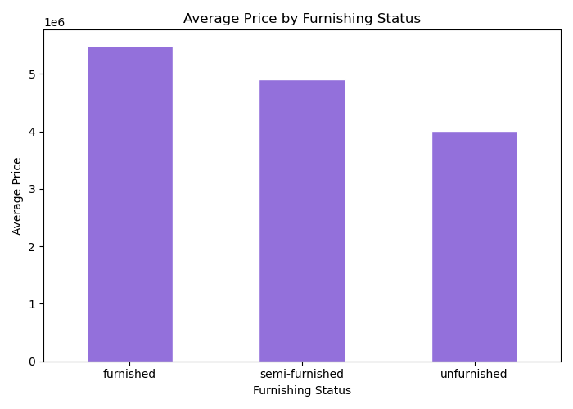
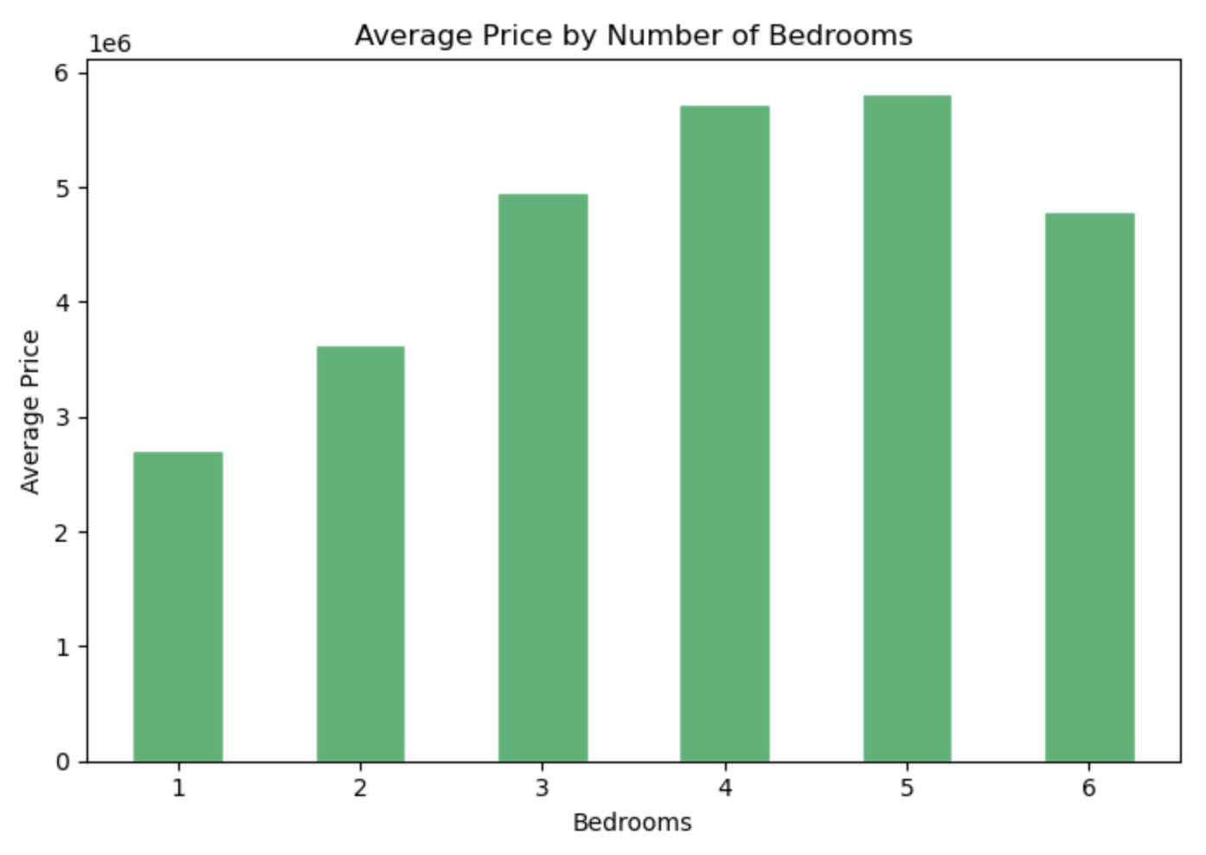
No. of bedrooms & furnishing status

Slide 4
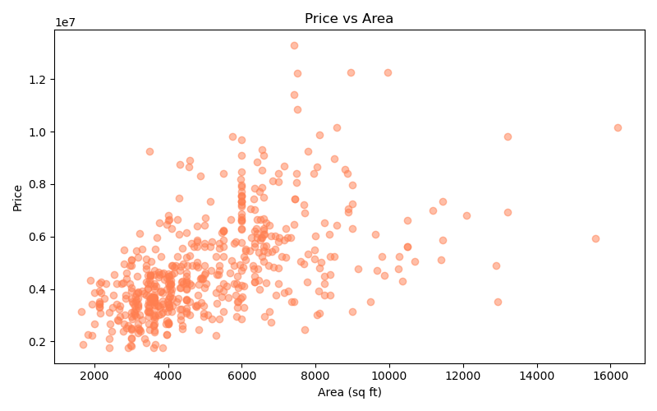
Area

Slide 5
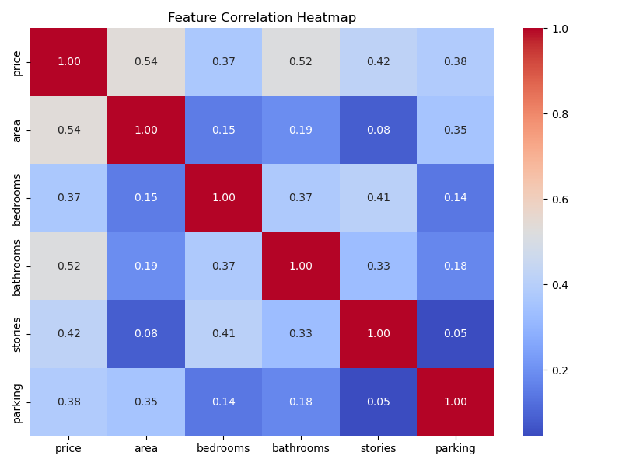
All possible factors

Slide 6
Housing Prices
Thank you!
Based on data from Kaggle
Presented by Zaw Min Tun

