Slide 1
The Battle of Neighborhoods Presentation
IBM Data Science Professional Certificate Course
Capstone Project
Zaw Toe Myint
January 2021

Slide 2
Introduction
Yangon : Capital city of Myanmar
Population: Over seven million
Feature : Strategic place for major business
Role of Data Scientists : To support data-driven evidences for business

Slide 3
Problem Statement
To invest a new business in food and beverage sectors and would like to open new restaurant in Yangon city.
Neither know how many of restaurants has been operating in Yangon nor where exactly and which type of food should be selected for new restaurant.

Slide 4
Data Source
Townships and geocoordinates data from http://themimu.info/place-codes
Foresquare data on the most popular venues in the respective districts

Slide 5
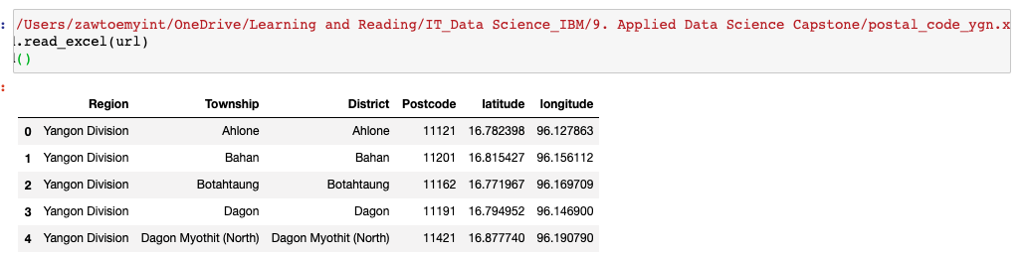
Feature Selection and Data Usage
Step 1 – Download townships data and geocoordinates and generated data frame

Slide 6
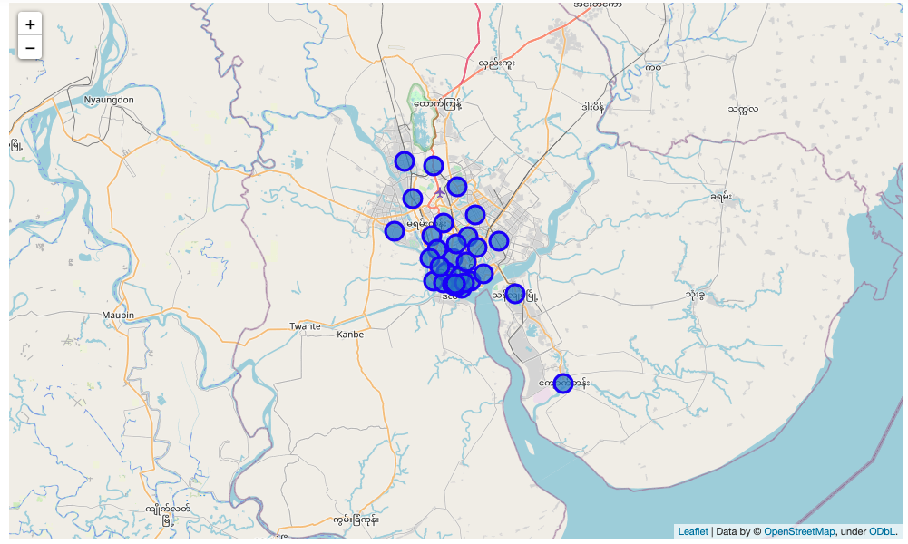
Feature Selection and Data Usage
Step 2 – Visualization on map by using python geocoder library

Slide 7
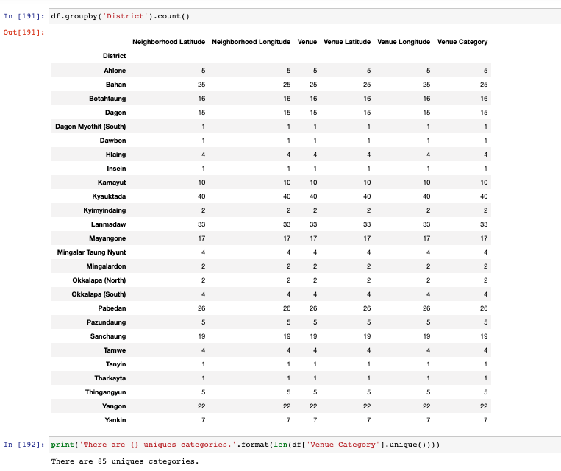
Feature Selection and Data Usage
Step 3 –
1) Linked with FourSquare data
2) Generate total venues and unique
venues

Slide 8
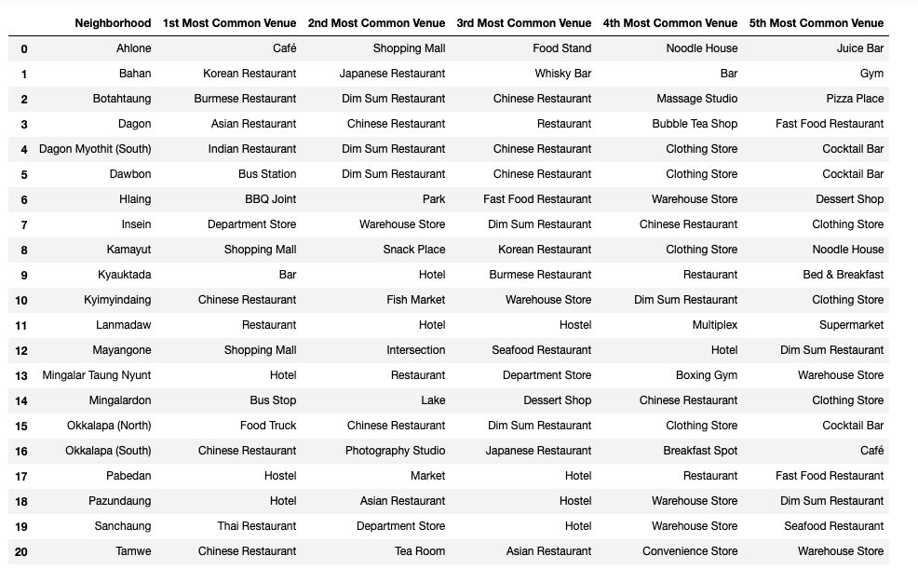
Methodology
Step 1 – Found out top 5 common venues from the data frame in respective locations

Slide 9
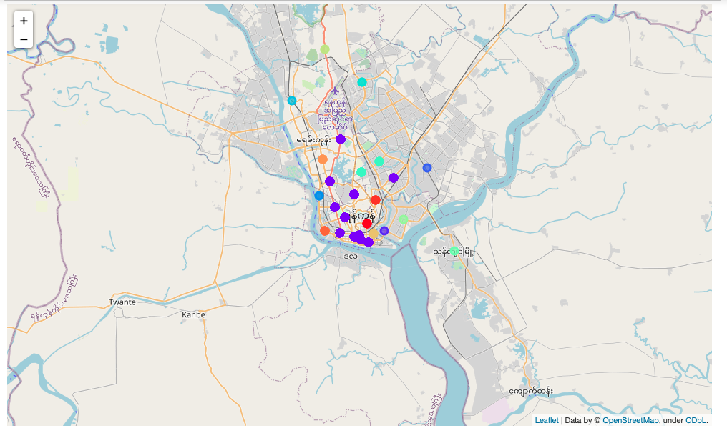
Methodology
Step 2 –
Clustering

Slide 10
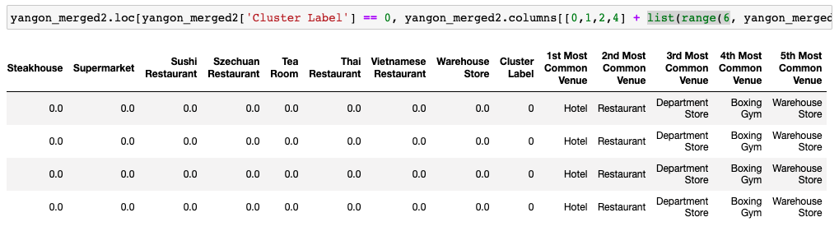
Results
Found out the top 5 common venues in specific location in each cluster for decision making
Cluster 0

Slide 11
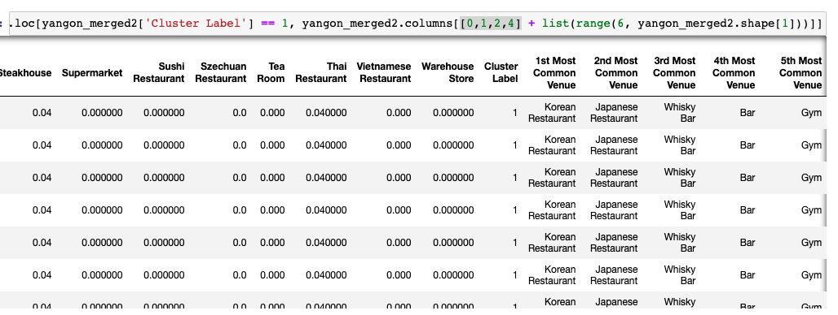
Results
Cluster 1

Slide 12
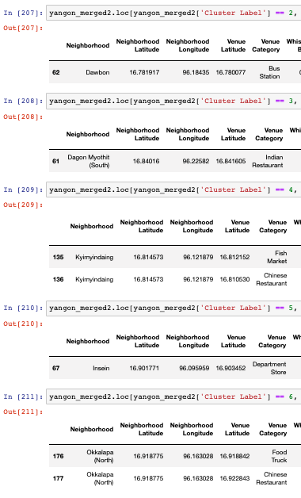
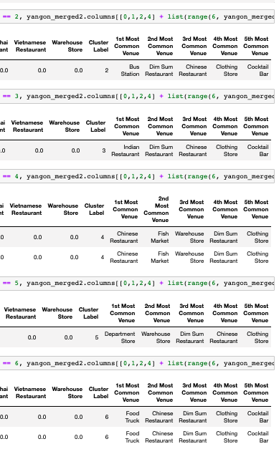
Results
Cluster 2 to 6

Slide 13
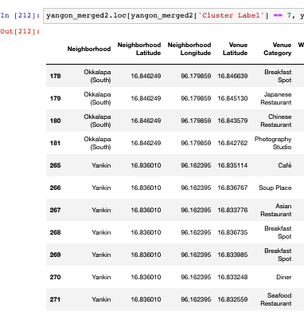
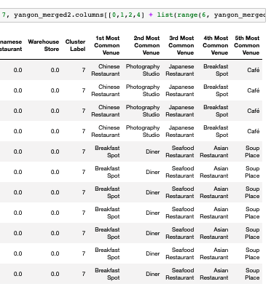
Results
Cluster 7

Slide 14
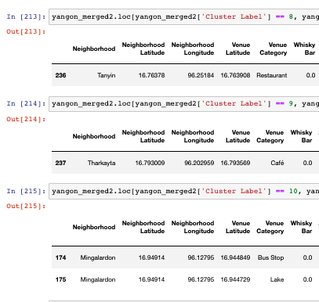
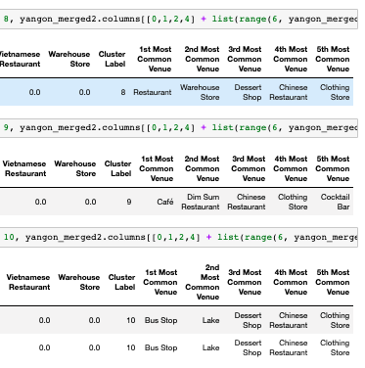
Results
Cluster 8 to 10

Slide 15
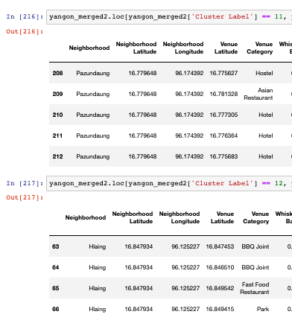
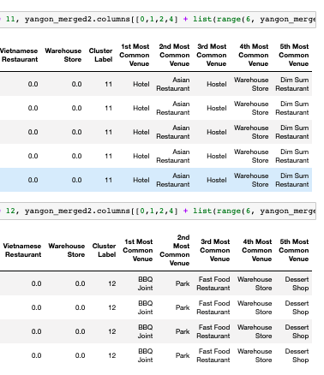
Results
Cluster 11 to 12

Slide 16
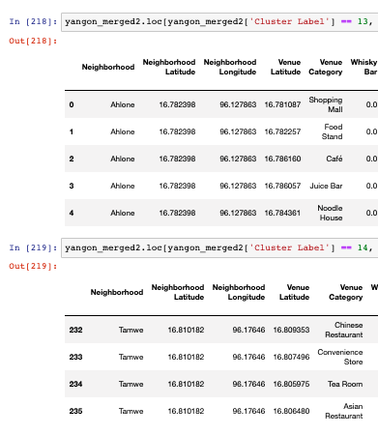
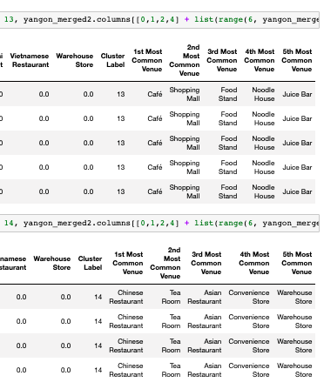
Results
Cluster 13 to 14

Slide 17
Discussion
This analysis mainly focusses on seeking the appropriate location and type of restaurant for starting new restaurant business.
Available data are used for better evidence-based decision for business planning.
Location, top common business and distribution data alone could not generate concrete information for the real situation.
Other factors should be included in this analysis to be more precises decision such as population density, customer's preferences, etc.
According to this analysis result, we can identify which type of restaurants are less competition and which place should be considered for new start up regardless consideration on other factors.

Slide 18
Conclusion
This analysis exercise is the main objective for getting certificate for data science course.
However, we need to make more practices in the real world to be able to generate great result and need to use more variables for better precision.
Be that as it may, this is the good assignment for this course and we had learned a lot from our teammates.

