Slide 1
TRANSMISSION // SUBCONSCIOUS CHANNEL
INTERACTIVE MEMORY MACHINE
v2.4 // NODE-BASED VISUAL PROGRAMMING + 2D-3D PIPELINE
Creative Machine Learning // Term 6 // SUTD
Team 10 JW / NT / VP / ZH
STATUS · PRE-CRIT POLISH
BUILD 2026-04-20 CRIT 2026-04-21

Slide 2
01 // CONCEPT
Glitch = meaningful distortion of spatial recall
The glitch is not aesthetic.
BEFORE -> AFTER
It is how the subconscious warps architecture.
->
Memory is never a photograph.
It omits, compresses, tilts, and fuses.
We map these distortions onto form:
- scored parameters -> geometric operations
- tone archetypes -> starter shape-language
- subject's recall -> their own sculpture
ORDERED
RECALLED
INTERACTIVE MEMORY MACHINE · v2.4 · TEAM 10
02 / 13

Slide 3
02 // EVOLUTION
v1 -> v2 -> v2.4 — three pivots, four weeks
v1.0
2026-03-28
v2.0
2026-04-14
v2.2
2026-04-18
v2.3
2026-04-20
v2.4
2026-04-20
SCAFFOLD
NODE PIVOT
ART DIRECTOR
3D PIPELINE
UI POLISH
- Memory + dream text input
- Claude analysis -> image -> video
- End-to-end pipeline working
- Problem: dream framing felt whimsical
- Dropped dream framing
- Single subconsciousness text
- Node-based visual programming
- 10 operations, Ideogram V2
- Morphological fusion aesthetic
- Instructor-validated
- Claude rewrites mechanical prompt
- 12 nodes (spatial / exp / appearance)
- 7 tone archetypes as starter shapes
- Multi-model: Recraft V4 Pro + others
- fal.ai Trellis + Hunyuan3D V3
- React Three Fiber viewport
- GLB / OBJ / STL export
- Teammates 3D-printed outputs
- Idle/subconscious glitch effects
- Mechanical loaders + telemetry
- Wire draw-in, breath glow
- EB Garamond serif labels
- Film grain + easter eggs
Each pivot addressed a critique. The glitch was never surface.
INTERACTIVE MEMORY MACHINE · v2.4 · TEAM 10
03 / 13

Slide 4
03 // PIPELINE
10 stages — from recalled text to exported mesh
01
02
03
04
05
INPUT
>
ANALYZE
>
CANVAS
>
DIRECT
>
GENERATE
Subject ID + recall text (<=600 chars)
Claude Haiku keywords + 12 scores + archetype
Drag chips Wire to 12 operation nodes
Claude rewrites mechanical prompt -> visual brief
fal.ai Recraft V4 Pro (or Nano/Ideogram)
v
v
06
07
08
09
10
NAME
>
VIEW 2D
>
RECONSTRUCT
>
ORBIT
>
EXPORT
Claude returns {name, explanation} JSON
Image + title + editable explanation
fal.ai Trellis or Hunyuan3D -> GLB mesh
React Three Fiber STUDIO / MOODY lighting
GLB native + OBJ + STL client-side
WHITE = user action · GOLD = model inference (Claude / fal.ai)
INTERACTIVE MEMORY MACHINE · v2.4 · TEAM 10
04 / 13

Slide 5
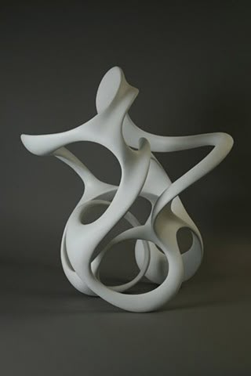
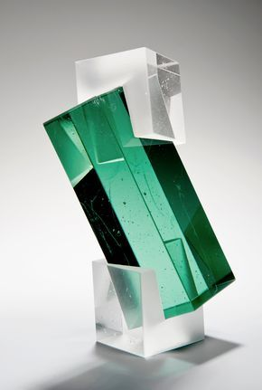
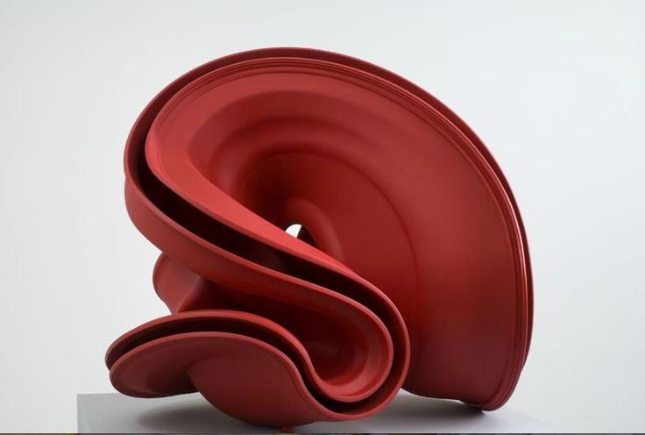
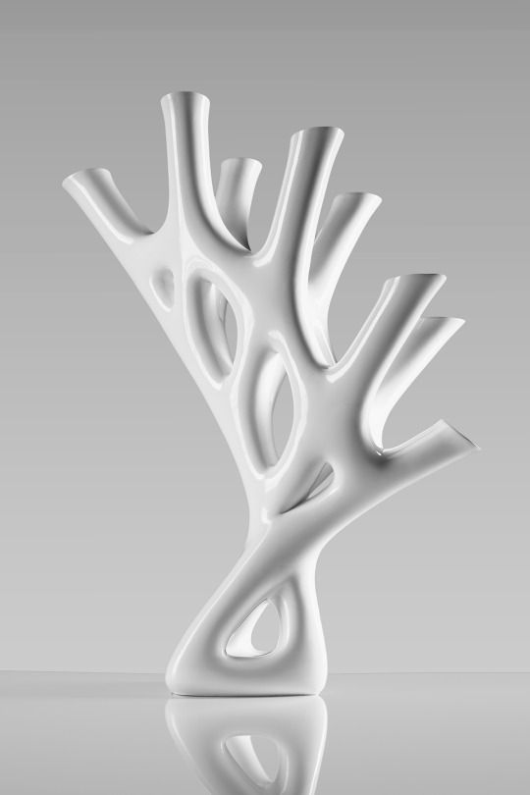
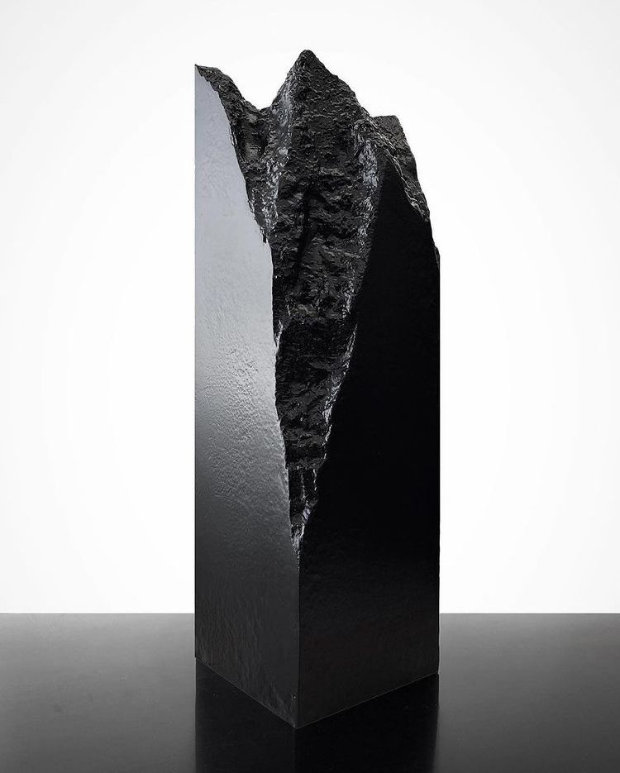
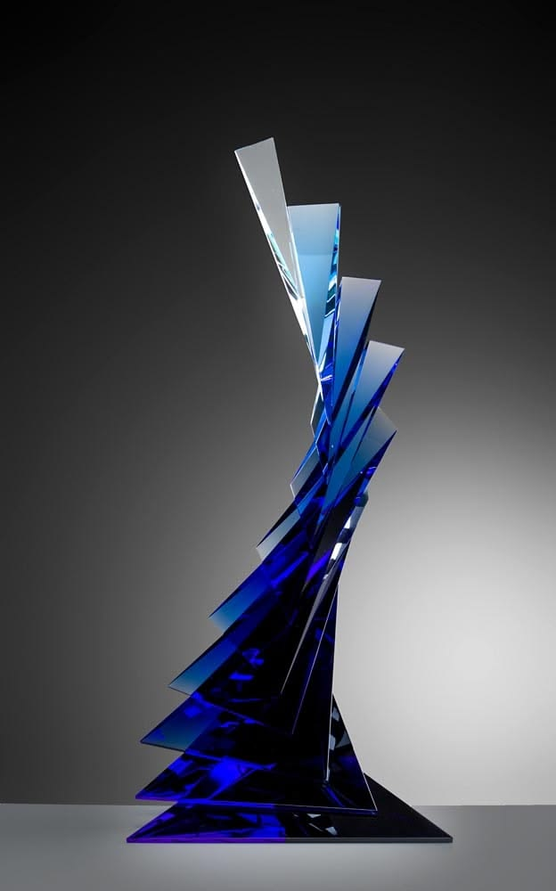
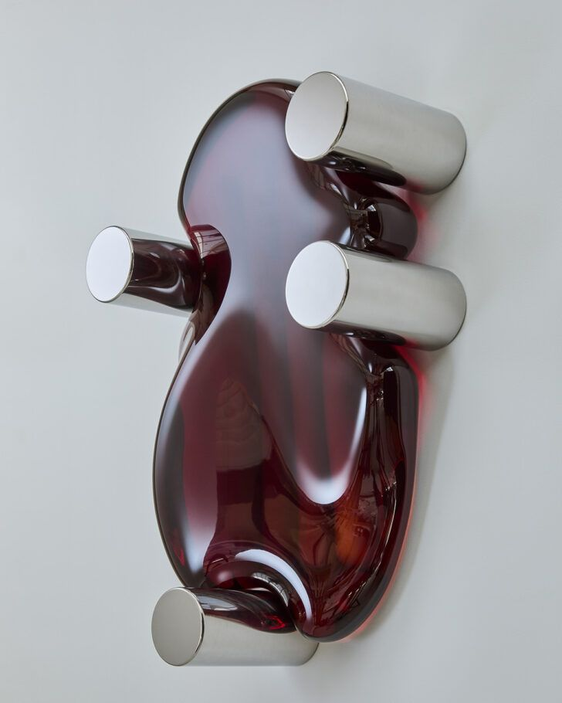
04 // ARCHETYPES
7 tonal starters — shape-language from mood
ORGANIC
CRYSTALLINE
TWISTED
SKELETAL
MONOLITHIC
FRAGMENTED
NESTED
Calm, nostalgic
Tense, anxious
Disorienting, dynamic
Vulnerable, exposed
Oppressive, heavy
Chaotic, traumatic
Introspective
Smooth biomorphic curves
Angular faceted planes
Coiling spirals
Thin branching members
Dense compact mass
Scattered shards
Concentric shells
Claude classifies the recall text into exactly one archetype.
The archetype seeds the starter shape; the 12 nodes deform it.
05 / 13

Slide 6
05 // OPERATIONS
12 nodes — three families of distortion
SPATIAL
EXPERIENCE
APPEARANCE
unipolar 0-1
bipolar, 0.5 neutral
unipolar 0-1
CLARITY
TEMPERATURE
MATERIAL
Boundary Diffusion
Freeze <-> Melt
Substance Identity
Edges dissolve into neighbours
Ice/frost vs molten flow
Connected keywords set material
COMPLETENESS
PRESSURE
TEXTURE
Mass Subtraction
Smooth <-> Shatter
Surface Grain
Voids and hollows carve volume
Glassy polish vs jagged spikes
Roughness / smoothness
STABILITY
LUMINOSITY
COLOR
Gravitational Shift
Shadow <-> Radiance
Chromatic Palette
Tilts and suspends off-axis
Consumed dark vs blinding glow
Palette + saturation
MISASSOC.
Cross-Morph Fusion
Incompatible shapes merge
VULNERABILITY
Interior Reveal
Peels surfaces, exposes inside
INTIMACY
Scale Compression
Mass folds inward, crushing
Each node receives 0+ keyword wires; connection count + keyword content modulate intensity.
06 / 13

Slide 7
06 // CANVAS
How the subject maps recall to form
KEYWORD FRAGMENTS
OPERATION NODES
OBJ
corridor
CLARITY
0.72
OBJ
stove
COMPLETENESS
0.35
PER
mother
STABILITY
0.81
SPA
narrow
DRAG -> WIRE -> DEFORM
EXP
cold
The wiring pattern itself is the subject's testimony of their memory.
MISASSOCIATION
0.28
EVT
shifting
VULNERABILITY
0.55
OBJ
kettle
INTIMACY
0.67
SPA
high
PAN middle-drag · ZOOM wheel · DELETE click wire · MULTI-WIRE per node allowed
07 / 13

Slide 8
07 // ART DIRECTOR
Why Claude rewrites the prompt before generation
MECHANICAL PROMPT
ART DIRECTOR
VISUAL BRIEF
(from connections + scores)
Claude Haiku
(sent to fal.ai)
archetype: CRYSTALLINE
clarity 0.72
-> boundaries dissolve
completeness 0.35
-> heavy mass subtraction
stability 0.81
-> mild tilt
kw(corridor, narrow, high)
-> spatial nodes
kw(cold, shifting)
-> temperature low
...+ 9 more parameters
context-aware
A crystalline sculpture of a narrow corridor, faceted ice-like planes dissolving at the edges, carved with deep hollows where mass has been lost. Tilts gently off-axis. Cold palette, matte frost texture. Studio lighting, clean white background, physically plausible, single sculptural object.
Reads:
+ original recall
+ archetype
+ all 12 scores
+ wiring pattern
Writes:
single cohesive
visual brief for
text-to-image model
Physically plausible
sculpture, clean
background.
->
->
Without the art director, text-to-image models treat mechanical specs as abstract noise.
08 / 13

Slide 9
08 // 2D -> 3D
From generated image to holdable mesh
IMAGE
RECONSTRUCT
MESH
VIEWER
Generated 2D artifact
>
Trellis or Hunyuan3D V3 via fal.ai
>
GLB with geometry + materials
>
React Three Fiber viewport
MODEL TOGGLE — chosen per-generation via UI
MODEL
fal ID
COST / GEN
FIDELITY
WHEN TO USE
TRELLIS
fal-ai/trellis
~$0.02
standard
default, fast iteration
HUNYUAN3D V3
fal-ai/hunyuan3d-v3/image-to-3d
~$0.16
PBR materials
crit / exhibition hero
Exports: GLB (native from fal) + OBJ + STL (client-side via three-stdlib for 3D-print slicers).
09 / 13

Slide 10
09 // UI THEME
Mechanical precision <-> subconscious decay
ACTIVE / MECHANICAL
IDLE / SUBCONSCIOUS
input + mapping + generating
input screen only, >=12s no input
+ Scan bars / elapsed counters
+ Telemetry glyphs + frame counter
+ Wire draw-in animation
+ Node breath glow (connected)
+ Badge pop on connect
+ EB Garamond serif for artifact name
+ Courier Mono for data / code
+ Precise, deliberate, robotic
~ Random letter-fall on headings
~ Gold scan line sweep
~ Periodic TV glitch
(chromatic aberration + jitter)
~ Deep glitch burst at 35s (once)
~ Film grain overlay always on (~6%)
~ Halts immediately on any input
~ Gated to session.status = input
EASTER EGGS · Konami = DEV preset · Midnight (00-04h) = NIGHT SHIFT subtitle · 35s idle = deep burst
10 / 13

Slide 11
10 // STACK
Everything the machine runs on
FRAMEWORK
Next.js 15 (App Router) + TypeScript + Tailwind CSS
UI
React 19 · useReducer · pointer events + SVG bezier wires
3D VIEWER
React Three Fiber + drei (OrbitControls, Bounds, Grid, GizmoHelper, Environment)
EXPORTS
GLB (native) · OBJ + STL (three-stdlib client-side)
CLAUDE API
Haiku (dev / art director / naming) · Sonnet (analysis for production)
TEXT->IMG
fal.ai · Recraft V4 Pro (default) · Nano Banana Pro · Ideogram V2
IMG->3D
fal.ai · Trellis (default, ~$0.02) · Hunyuan3D V3 PBR (~$0.16)
HOSTING
Vercel (pre-deploy) · .env.local for keys (gitignored)
REPO
github.com/ZawYeHtet2001/Glitch_CML_project · branch: master
Rule of thumb: Claude for meaning, fal.ai for pixels / meshes, local JS for export.
11 / 13

Slide 12
11 // STATUS
Ready state + last-mile plan
SHIPPED
LAST-MILE (MON NIGHT)
[x] v1 pipeline (2026-03-28)
[x] Node-based UI pivot (2026-04-14)
[x] Art director + 12 nodes (04-18)
[x] 7 tone archetypes (04-19)
[x] Multi-model 2D (Recraft/Nano/Ideogram)
[x] Trellis + Hunyuan3D 2D->3D (04-20)
[x] R3F viewer + GLB/OBJ/STL export
[x] Editable artifact names
[x] Mechanical loaders + telemetry
[x] Idle / TV glitch effects
[x] Wire draw-in + breath glow
[x] Film grain + easter eggs
[x] Teammates already 3D-printed
[ ] UI optimization pass (tonight)
[ ] Full dry-run demo with all 4 recalls
[ ] Check Claude Haiku -> Sonnet toggle
[ ] Verify all 3 image models
[ ] Re-export hero pieces (Hunyuan3D)
[ ] Slicer test: STL opens in Bambu / Cura
[ ] Deploy to Vercel (staging)
[ ] Crit rehearsal — 5 min pitch
FREEZE: Tuesday morning.
No new features after that.
Only bug fixes + copy tweaks.
CRIT · Tuesday 2026-04-21, evening
12 / 13

Slide 13
12 // TEAM
Who owns what through crit
ZH
JW
NT
VP
Owner / Primary Dev
Recall contributor
Recall contributor
Recall contributor
- Architecture, pipeline, 3D
- UI polish + demo rehearsal
- This deck
- Subconsciousness text
- Crit support
- Subconsciousness text
- Crit support
- Subconsciousness text
- Crit support
TRY IT · localhost:3004 // REPO · github.com/ZawYeHtet2001/Glitch_CML_project
Ping ZH for Claude / fal.ai key access. All feedback welcome before Monday night freeze.
END // TRANSMISSION COMPLETE
13 / 13

