Slide 1


Department:
Computer science and Engineering
Submitted by:
Shaik Zawad Alam (24262-CM-033)
Shaik Yusuf (24262-CM-032)
Pathan Omar Farooq (24262-CM-020)
B Nithin (24262-CM-019)

Slide 2

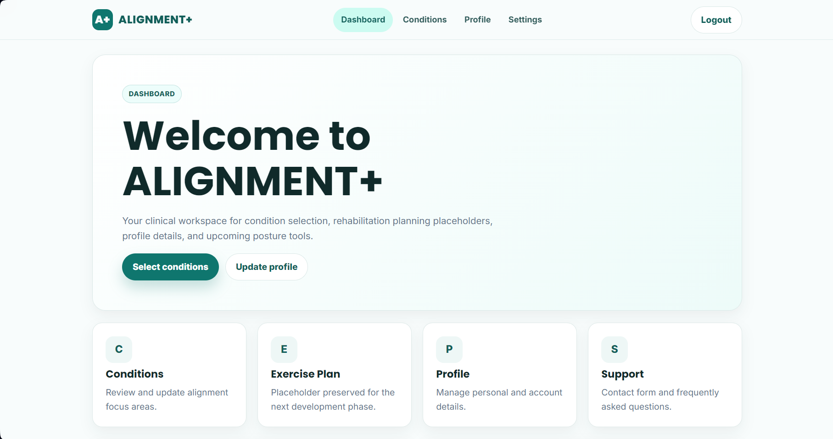
PROJECT TITLE
Alignment+
[Personalized Rehabilitation Platform]

Slide 3
CONTENTS
ABSTRACT
INTRODUCTION
EXISTING SYSTEM
PROPOSED SYSTEM
SOFTWARE REQUIREMENTS
HARDWARE REQUIREMENTS

Slide 4
ABSTRACT
ALIGNMENT+ is a personalized web-based physiotherapy rehabilitation platform designed to help users manage posture-related conditions through structured and condition-specific exercise plans. It provides an intuitive dashboard, guided exercise routines, and profile management in a single platform. Developed using HTML, CSS, JavaScript, Python, PHP, and MySQL, the system aims to make home-based rehabilitation more accessible, organized, and effective, with future scope for AI-powered posture analysis and progress tracking.

Slide 5
INTRODUCTION
ALIGNMENT+ is developed to offer personalized physiotherapy guidance based on the user's condition.
Many patients with posture-related conditions face challenges in following regular rehabilitation programs.
Traditional rehabilitation methods often lack personalized guidance and convenient home-based support.
A centralized digital platform can provide structured exercise plans and improve rehabilitation accessibility.
The system aims to improve posture awareness, encourage consistent rehabilitation, and support effective recovery through an easy-to-use web platform.
.

Slide 6
EXISTING SYSTEM
Rehabilitation is primarily conducted through hospital visits and generic exercise routines.
Patients rely on physiotherapists for exercise instructions and regular progress assessment.
Home-based rehabilitation often lacks proper guidance and structured exercise plans.
Progress tracking is mostly manual and difficult to monitor consistently.
Limited use of digital platforms for personalized rehabilitation support.
Limitations
No personalized rehabilitation based on individual conditions.
Lack of centralized exercise guidance and progress monitoring.
Frequent clinical visits increase time and cost.
Difficulty maintaining consistency in home rehabilitation.
Limited accessibility to rehabilitation resources anytime and anywhere.

Slide 7
PROPOSED SYSTEM
ALIGNMENT+ is a personalized web-based physiotherapy rehabilitation platform that helps users manage posture-related conditions through condition-specific exercise plans and guided rehabilitation. The system provides a centralized interface for selecting conditions, accessing detailed exercise routines, and managing user profiles, making home-based rehabilitation more structured, accessible, and effective.
Advantages
Personalized rehabilitation based on the user's condition.
Centralized platform for guided exercise programs.
User-friendly interface with detailed exercise instructions.
Supports convenient home-based physiotherapy.
Improves posture awareness and rehabilitation consistency.
Future-ready platform with scope for AI-powered posture analysis and progress tracking.

Slide 8
SOFTWARE REQUIREMENTS
S.No | Components | Capacity
1. | Operating Systems supported | Windows 10 / 11
2. | Frontend | HTML5 , CSS3 , JavaScript
3. | Backend | Python
5. | IDE / Code Editor | Visual Studio Code
6. | Browser | Google Chrome / Microsoft Edge
7. | Database | MySQL

Slide 9
HARDWARE REQUIREMENTS
S.No | Components | Capacity
1. | Processor | Intel i3 or above
2. | RAM | 4GB(Minimum) , 8GB(Recommended)
3. | Storage | 20GB Free Disk Space
4. | Internet | Required

Slide 10


Slide 11


