Slide 1
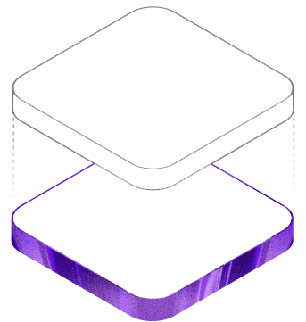
A sustainable marketplace
for pre-owned fashion.
RetroFit connects people who want to pass on quality clothing with shoppers looking for affordable style.
PROJECT PRESENTATION • 2026
Fashion with a future.

Slide 2


THE CHALLENGE
02
Good clothing should not become waste.
RetroFit is designed around a simple opportunity: make reuse visible, affordable, and easy.
Too many quality garments leave wardrobes without finding a new owner.
At the same time, students and budget-conscious shoppers need stylish options at accessible prices.
The gap
Quality garments → thoughtful shoppers
RETROFIT • FASHION WITH A FUTURE

Slide 3

OUR SOLUTION
03
RetroFit gives pre-loved fashion a clear next step.
A responsive marketplace experience that supports discovery, transparency, and circulation.
The marketplace brings together:
Affordable finds
Pre-owned styles across women, men, and kids.
Honest information
Price, size, material, condition, and use history.
A selling pathway
An easy request form to start rehoming an item.
DISCOVER
Curated categories and detailed products
RETROFIT • FASHION WITH A FUTURE

Slide 4
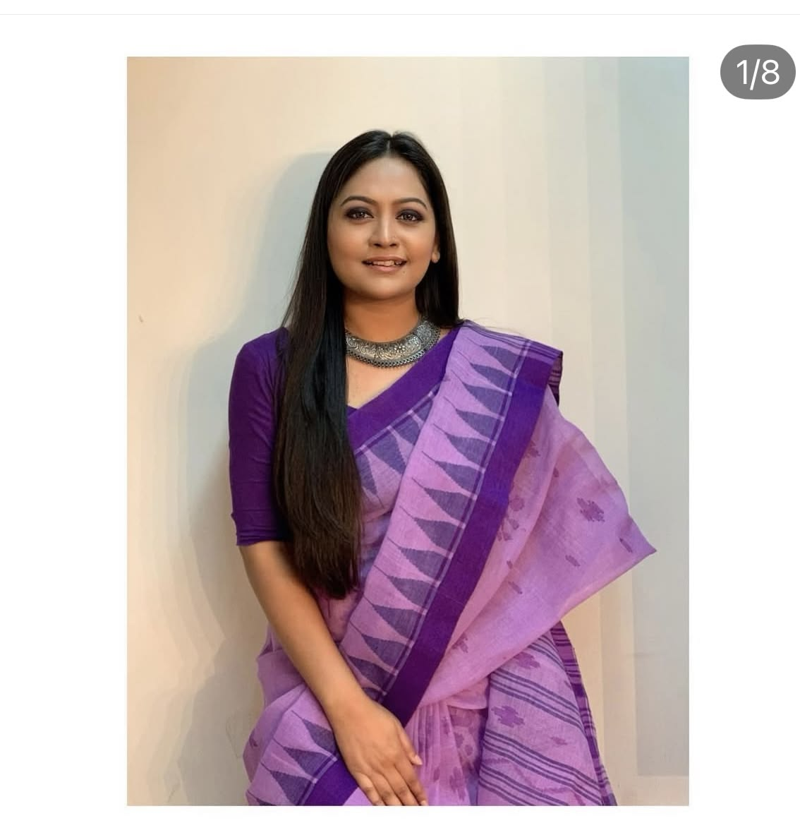
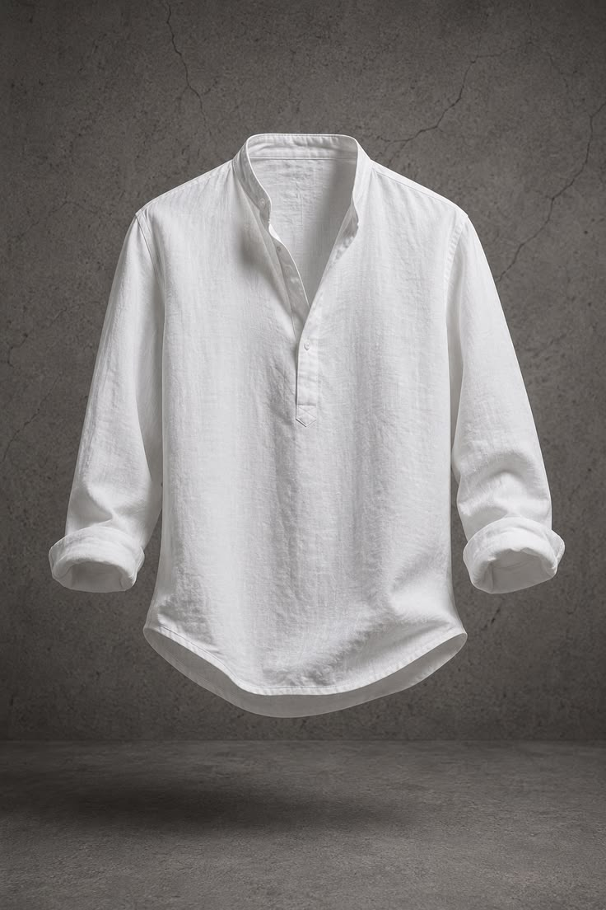
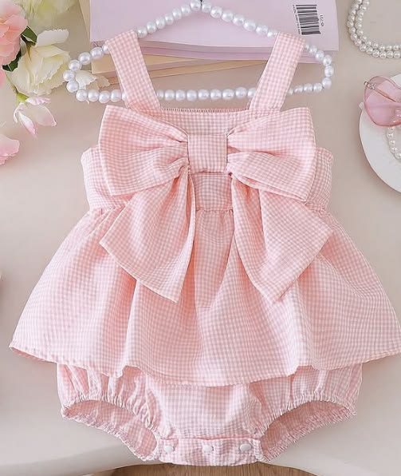
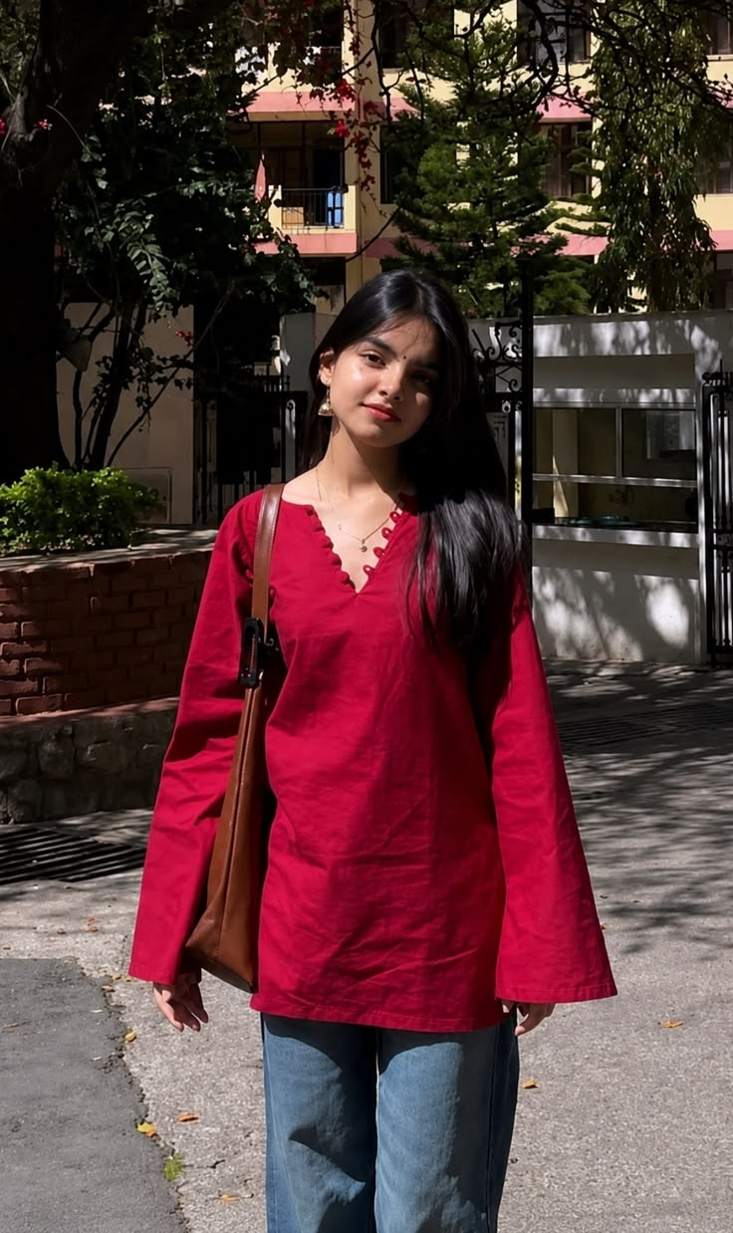
USER JOURNEY
04
The experience is simple for both sides of the marketplace.
Each interaction moves clothing closer to its next useful life.
01
02
03
04
Explore
Evaluate
Save or buy
Sell
Browse Women, Men, and Kids collections by category.
Open a product to check price, brand, size, material, and condition.
Add favourite finds to wishlist or place them in the cart.
Submit clothing details and a photo through the selling form.
RETROFIT • FASHION WITH A FUTURE

Slide 5

IMPLEMENTED EXPERIENCE
05
The current product already delivers a polished shopping flow.
The frontend focuses on product discovery and a clear, trust-building presentation.
—
Collection navigation
Women, Men, and Kids sections with category filters.
—
Product details
Modal view with image zoom and key garment attributes.
—
Shopping actions
Wishlist, cart, search, and newsletter interactions.
—
Responsive styling
Layouts adapt for desktop and mobile screens.
RETROFIT • FASHION WITH A FUTURE

Slide 6
TECHNOLOGY
06
A MERN foundation supports the marketplace.
The implemented backend exposes a focused product API while the React app powers the interface.
FRONTEND
BACKEND
DATA
React 19
Vite 8
Responsive CSS
Node.js
Express 4
CORS + dotenv
MongoDB
Mongoose
Product schema
IMPLEMENTED PRODUCT ENDPOINTS
GET /api/products GET /api/products/:id POST /api/products
RETROFIT • FASHION WITH A FUTURE

Slide 7
ARCHITECTURE
07
The system separates the customer experience from product data.
A simple client–API–database path keeps responsibilities clear as the product grows.
React + Vite
Express API
MongoDB
Product browsing
Cart & wishlist UI
Sell request flow
Route handlers
Controllers
Product validation
Product records
Price & condition
Image URL fields
Future deployment target: Vercel for the frontend • Render for the backend
RETROFIT • FASHION WITH A FUTURE

Slide 8

FRONTEND
08
Frontend: a branded, responsive shopping experience.
The React single-page interface manages navigation and interaction state without leaving the marketplace.
What the React frontend manages
Page state
Home, collection, category, search, and How It Works views.
Interaction state
Active products, image zoom, cart, wishlist, and modals.
Product rendering
Reusable product cards backed by catalog data and filters.
Responsive layout
CSS media queries keep the experience usable on mobile.
RETROFIT • FASHION WITH A FUTURE

Slide 9
BACKEND
09
Backend: Express routes organise product operations.
The current API focuses on product retrieval and listing creation, with a clean controller–model separation.
ROUTES
CONTROLLERS
MODELS
productRoutes.js
productController.js
Product.js
Defines GET and POST endpoints.
Handles requests, responses, and errors.
Enforces MongoDB product fields.
Middleware: express.json() parses incoming request data • CORS supports frontend access • dotenv loads environment configuration
RETROFIT • FASHION WITH A FUTURE

Slide 10
DATA MODEL
010
Database: the product model captures the information shoppers need.
MongoDB stores a flexible product document, while Mongoose validates key listing fields.
Validation rules protect the listing quality.
PRODUCT DOCUMENT
Product
Required
name, description, price, category, size, and condition
name
description
price
discount
category
size
brand
condition
imageUrl
createdAt / updatedAt
Controlled values
category: Men / Women / Kids / Accessories
Condition options
New / Like New / Good / Fair
Timestamps
Mongoose records creation and update time automatically
RETROFIT • FASHION WITH A FUTURE

Slide 11
INTEGRATION
011
Full-stack flow: a product request moves cleanly through the system.
This pattern connects the visual website to persistent product records.
Shopper action
React request
Express controller
MongoDB response
1
2
3
4
Open a collection or submit a new listing.
The client calls the API endpoint.
The server validates and processes the request.
The database returns saved product data.
GET /api/products → browse catalog • GET /api/products/:id → open details • POST /api/products → create listing
RETROFIT • FASHION WITH A FUTURE

Slide 12
BUILD STATUS
012
The project has a working product experience and a clear path to full marketplace operations.
Separating today’s implementation from the next release keeps the presentation honest and actionable.
IMPLEMENTED NOW
NEXT FULL-STACK MILESTONE
Responsive React marketplace UI
JWT authentication and user profiles
Product catalog browsing & filtering
Live product creation from the seller dashboard
Search, wishlist, cart, and modal details
Orders, payments, and purchase history
Sell-request and newsletter forms
Admin listing review and user management
Express + MongoDB product API
Cloud image storage and production deployment
RETROFIT • FASHION WITH A FUTURE

Slide 13
ROADMAP
013
Next, RetroFit can become a complete trusted marketplace.
The current product experience is the base for secure transactions, seller tools, and moderation.
BUILD NEXT
EXPAND AFTER
01
User accounts
01
Marketplace trust
Registration, login, and role-based access.
Listing approval, reviews, and order history.
02
Product operations
02
Growth features
Connect listings to the live API and add seller controls.
Payments, messaging, recommendations, and analytics.
RetroFit turns a smaller wardrobe decision into a more sustainable fashion habit.
RETROFIT • FASHION WITH A FUTURE

Slide 14

A better next chapter
for every good garment.
RetroFit combines an engaging React marketplace with a scalable Express and MongoDB foundation—making sustainable fashion easier to discover, share, and grow.
THANK YOU
Fashion with a future.

