Slide 1
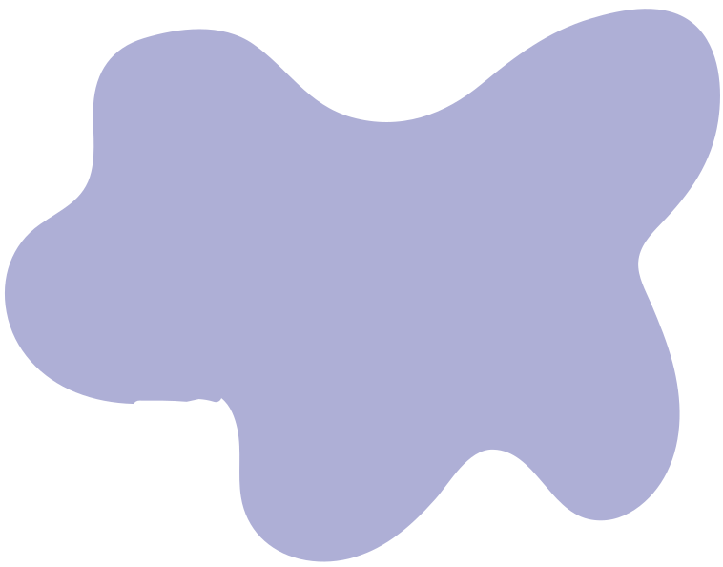

POLYGON RENDERING AND TRANSFORMATION USING OPENGL & PYTHON
BY GROUP 23

Slide 2
GROUP MEMBERS
Hilda Mwangi
Neema Ogao
Kiarie Zawadi Muthoni
Njoroge Kanyagia

Slide 3
INTRODUCTION
OpenGL is a widely used graphics API that provides developers with tools to draw and transform 2D and 3D objects efficiently.
Understanding basic shape rendering and transformations helps build foundational skills for more advanced tasks like animation, modeling, and user interaction in graphical applications.

Slide 4
QUESTION
Using OpenGL draw a filled polygon with the following dimensions (8,4;2,4;0,8;3,12;7,12;10,8) hint (GL POLYGON function ) might be useful
a. Write a function to fill the polygon above in Red
(#FF0000.)
b. write program to scale up (scaling) the polygon by a
factor of 2
c. Write a procedure to fill the interior of a given
polygon with shades of asterisks

Slide 5
PROBLEM STATEMENT
In this project, the task is to implement a polygon rendering and transformation system using OpenGL and Python. Specifically:
Draw a custom 6-sided polygon defined by given coordinates.
Fill the polygon with a red color using OpenGL.
Apply a scaling transformation to enlarge the polygon by a factor of 2.
Implement a method to symbolically fill the polygon using asterisks to simulate a visual fill effect.

Slide 6
PROBLEM DISCUSSION
This project focuses on two key ideas: filling and scaling a polygon.
We are given a polygon defined by six (x, y) points. The task is to fill it, scale it by a factor of 2, and then fill the larger version using asterisks.
The main challenge is identifying which points fall inside the polygon after it has been scaled. This is important because accurate filling depends on correctly detecting interior points.
Understanding this helps us learn how basic shape transformations and interior point detection work in graphics — using both OpenGL (C++) and Python (Matplotlib).

Slide 7
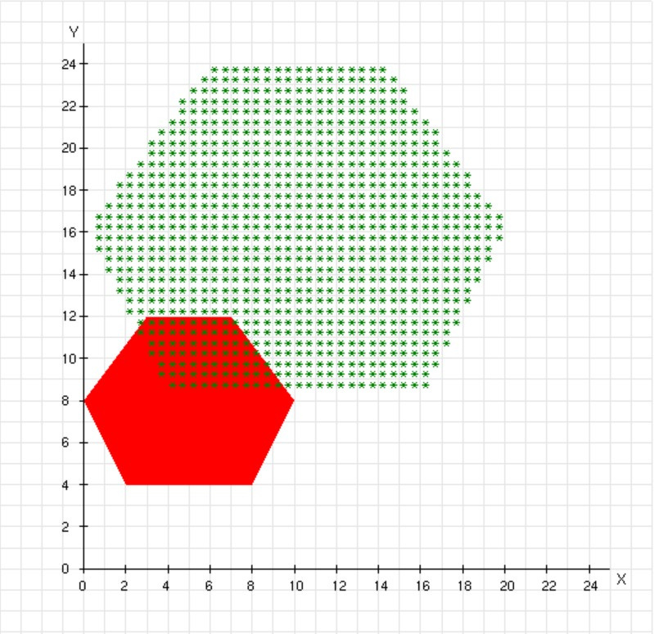
OPENGL OUTPUT
The output of this program is a graphical window displaying:
- A red polygon rendered using OpenGL, based on the given coordinates.
- A coordinate grid with labeled X and Y axes for reference.
- A scaled version of the polygon (enlarged by a factor of 2), filled with green asterisks (*).

Slide 8
OPENGL CODE
#include <GL/glut.h>
#include <cmath>
#include <cstdlib>
#include <cstdio>
// Polygon vertices
GLfloat vertices[][2] = {
{8, 4},
{2, 4},
{0, 8},
{3, 12},
{7, 12},
{10, 8}
};
const int numVertices = 6;
Polygon vertex definition
This section defines the polygon to be drawn by listing its six corner coordinates.
Each pair represents an (x, y) vertex of the polygon.
The variable numVertices stores the number of points, which will be used when drawing or transforming the shape.

Slide 9
OPENGL CODE
// Function to draw the grid
void drawGrid() {
glColor3f(0.9, 0.9, 0.9);
for (int i = -5; i <= 27; i++) {
// Horizontal
glBegin(GL_LINES);
glVertex2f(-5, i);
glVertex2f(27, i);
glEnd();
// Vertical
glBegin(GL_LINES);
glVertex2f(i, -5);
glVertex2f(i, 27);
glEnd();
}
}
Grid drawing function
This function draws a light gray background grid.
It uses two loops to create horizontal and vertical lines between -5 and 25 on the axes

Slide 10
OPENGL CODE
// Function to draw the axes and labels
void drawAxes() {
glColor3f(0.0, 0.0, 0.0); // Black for axes
// Drawing X and Y axes
glBegin(GL_LINES);
glVertex2f(0, 0); glVertex2f(25, 0); // X-axis start and end points
glVertex2f(0, 0);
glVertex2f(0, 25); // Y-axis start and end points
glEnd();
Axes drawing function
This function starts drawing the coordinate axes.
It sets the color to black, then draws a horizontal line for the X-axis and a vertical line for the Y-axis, both starting from the origin (0,0).

Slide 11
OPENGL CODE
// Labeling points on the X-axis
for (int i = 0; i <= 25; i+=2) {
// Tick marks
glBegin(GL_LINES);
glVertex2f(i, -0.2f);
glVertex2f(i, 0.2f);
glEnd();
// Numbering labels
glRasterPos2f(i - 0.2f, -1.0f);
char label[5];
sprintf(label, "%d", i);
for (char* c = label; *c != '\0'; c++) { glutBitmapCharacter(GLUT_BITMAP_HELVETICA_10, *c);} }
X-axis ticks and labels
This section adds tick marks and numeric labels to the X-axis.
It places short vertical lines every 2 units and labels them with their corresponding coordinate values using bitmap text.

Slide 12
OPENGL CODE
// Labeling points on the Y-axis
for (int i = 0; i <= 25; i+=2) {
// Tick marks
glBegin(GL_LINES);
glVertex2f(-0.2f, i);
glVertex2f(0.2f, i);
glEnd();
// Numbering labels
glRasterPos2f(-1.0f, i - 0.2f);
char label[5];
sprintf(label, "%d", i);
for (char* c = label; *c != '\0'; c++) {
glutBitmapCharacter(GLUT_BITMAP_HELVETICA_10, *c);} }
Y-axis ticks and labels
This part does the same as the previous section but for the Y-axis. It places horizontal tick marks and labels every 2 units from 0 to 25,

Slide 13
OPENGL CODE
// Axis labels
glRasterPos2f(25.3f, -0.7f); glutBitmapCharacter(GLUT_BITMAP_HELVETICA_12, 'X');
glRasterPos2f(-0.7f, 25.3f);
glutBitmapCharacter(GLUT_BITMAP_HELVETICA_12, 'Y');
// Function to draw the initial polygon in red
void drawPolygon(GLfloat vertexArray[][2], int numVertices) {
glColor3f(1.0, 0.0, 0.0); // Red
glBegin(GL_POLYGON);
Axis Labels and Start of Polygon Drawing
This section adds the axis labels 'X' and 'Y' to the ends of their respective axes. It also begins the function that will draw a red polygon using the vertex array passed to it.

Slide 14
OPENGL CODE
for (int i = 0; i < numVertices; i++) {
glVertex2f(vertexArray[i][0], vertexArray[i][1]);
}
glEnd();
}
// Function to fill the polygon with asterisks
void fillWithAsterisks(GLfloat vertexArray[][2], int numVertices) {
glColor3f(0.0, 0.5, 0.0); // Darker green
// Determine bounds
GLfloat minX = vertexArray[0][0], maxX = vertexArray[0][0];
Drawing the Red Polygon and Starting Asterisk Fill Function
This completes the drawPolygon function by adding all vertices and finalizing the shape with glEnd().
It then starts the fillWithAsterisks function, setting the color and initializing bounding values for filling the polygon.

Slide 15
OPENGL CODE
GLfloat minY = vertexArray[0][1], maxY = vertexArray[0][1];
for (int i = 1; i < numVertices; i++) {
if (vertexArray[i][0] < minX) minX = vertexArray[i][0];
if (vertexArray[i][0] > maxX) maxX = vertexArray[i][0];
if (vertexArray[i][1] < minY) minY = vertexArray[i][1];
if (vertexArray[i][1] > maxY) maxY = vertexArray[i][1];
}
for (float x = minX + 0.5; x < maxX; x += 0.5) {
for (float y = minY + 0.5; y < maxY; y += 0.5) {
int count = 0;
Bounding Box Calculation
This section finishes calculating the polygon’s bounding box by finding its min and max Y values.
It then starts scanning the interior using two nested loops that test points inside the bounding area in 0.5 unit steps.

Slide 16
OPENGL CODE
int count = 0;
for (int i = 0, j = numVertices - 1; i < numVertices; j = i++) {
if (((vertexArray[i][1] > y) != (vertexArray[j][1] > y)) && (x < (vertexArray[j][0] - vertexArray[i][0]) * (y - vertexArray[i][1]) / (vertexArray[j][1] - vertexArray[i][1]) + vertexArray[i][0])) {
count++;
}
}
if (count % 2 == 1) {
glRasterPos2f(x, y); glutBitmapCharacter(GLUT_BITMAP_8_BY_13, '*');
}} }}
Asterisk Filling using Ray Casting
This section applies the ray casting algorithm: for each scanned point, it counts how many times a horizontal ray intersects the polygon edges.
If the count is odd, the point is inside the polygon, and an asterisk is drawn at that location.

Slide 17
OPENGL CODE
// Display function
void display() {
glClear(GL_COLOR_BUFFER_BIT);
drawGrid(); // Grid
drawAxes(); // Axes and labels
drawPolygon(vertices, numVertices); // Original polygon
// Scale polygon by factor of 2
GLfloat scaledVertices[numVertices][2];
for (int i = 0; i < numVertices; i++) {
}
Display Function Setup
This is the main display function. It clears the screen, draws the background grid, axes, and the original polygon.
It then begins scaling the polygon by initializing a new vertex array and preparing a loop to store the scaled points.

Slide 18
OPENGL CODE
scaledVertices[i][0] = vertices[i][0] * 2;
scaledVertices[i][1] = vertices[i][1] * 2;
}
// Fill scaled polygon with asterisks
fillWithAsterisks(scaledVertices, numVertices);
glFlush();
}
// Initialization
void init() {
glClearColor(1.0, 1.0, 1.0, 1.0); // White background
glMatrixMode(GL_PROJECTION);
gluOrtho2D(-5, 30, -5, 30); // Adjusted to fit labels }
Polygon scaling & Initialization function
This section completes the scaling by multiplying each vertex's x and y values by 2.
It then calls the fill function to fill the scaled polygon with asterisks and flushes the graphics buffer to render everything on the screen.
It then defines the background color as white and sets up the 2D orthographic projection.

Slide 19
OPENGL CODE
// Main function
int main(int argc, char **argv) {
glutInit(&argc, argv);
glutInitDisplayMode(GLUT_SINGLE | GLUT_RGB);
glutInitWindowSize(600, 600);
glutCreateWindow("Group 23: Transformation and Shapes");
init();
glutDisplayFunc(display);
glutMainLoop();
return 0;
}
Main Function
This is the program's entry point.
It initializes GLUT, sets the display mode and window size, creates the window, runs the initialization and display functions, and starts the event loop to keep the window open and responsive.

Slide 20
PYTHON SOLUTION
Using Python, we try to replicate the previous OpenGL implementation.
It reproduces the same output by:
Drawing the original polygon using matplotlib.
Scaling the polygon by a factor of 2.
Filling the scaled polygon with green asterisks (*) using a point-in-polygon test.
It visually demonstrates transformation and symbolic fill using Python’s plotting libraries.

Slide 21
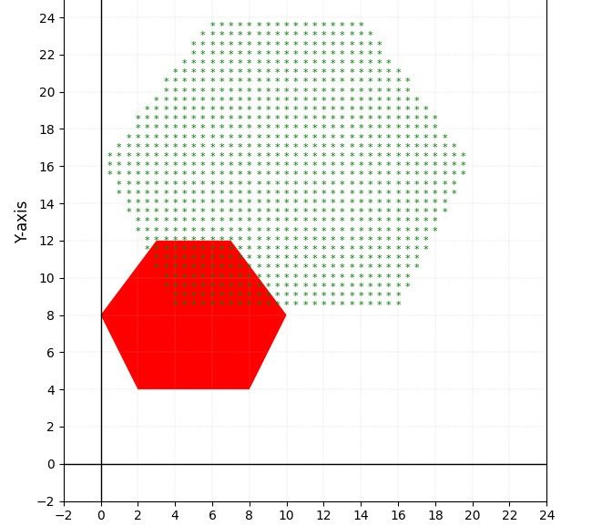
PYTHON OUTPUT
The output of this program is a plotted figure displaying:
A red polygon filled using the original coordinates.
A coordinate grid with labeled X and Y axes for reference.
A scaled version of the polygon (enlarged by a factor of 2), filled with green asterisks (*) using point-in-polygon logic.

Slide 22
PYTHON CODE
import matplotlib.pyplot as plt
from matplotlib.patches import Polygon as MplPolygon
from matplotlib.path import Path
import numpy as np
# Define the original polygon vertices
original_vertices = [
(8, 4),
(2, 4),
(0, 8),
(3, 12),
(7, 12),
(10, 8)
]
Import Libraries & Define Original Polygon
This section imports required Python libraries for plotting (matplotlib) and numerical calculations (numpy).
It also defines the 6 original vertices of the polygon as coordinate pairs.

Slide 23
PYTHON CODE
# Function to scale a polygon by a factor
def scale_polygon(vertices, factor):
"""
Scales each vertex of the polygon by a given factor.
vertices: list of (x, y) tuples
factor: scale factor (float)
:return: list of scaled (x, y) tuples
"""
return [(x * factor, y * factor) for x, y in vertices]
Scale Polygon Function
Defines a function that takes in a list of polygon vertices and a scale factor, returning a new list where each vertex coordinate is multiplied by the scale factor.

Slide 24
PYTHON CODE
# Function to draw and fill a polygon with a color
def draw_filled_polygon(ax, vertices, color):
"""
Draws a filled polygon on the given axes.
ax: matplotlib axes
vertices: list of (x, y) tuples
color: fill color
"""
polygon = MplPolygon(vertices, closed=True, facecolor=color, linewidth=1.5)
ax.add_patch(polygon)
Draw Filled Polygon Function
This function takes an axis, a list of polygon vertices, and a color, and draws the filled polygon on the canvas using Matplotlib’s patch functionality.

Slide 25
PYTHON CODE
# Function to fill a polygon with asterisks
def fill_with_asterisks(ax, vertices, color='green'):
"""
Fills the interior of a polygon with asterisks (*).
ax: matplotlib axes
vertices: list of (x, y) tuples
color: color of the asterisks
"""
# Create a Path from the polygon vertices to test point inclusion
path = Path(vertices)
Begin Asterisk Fill Function
Starts the function that will fill a polygon with asterisks.
It creates a Path object from the polygon, which will be used to check whether grid points fall inside the polygon.

Slide 26
PYTHON CODE
# Get bounding box of the polygon
min_x = min(x for x, y in vertices)
max_x = max(x for x, y in vertices)
min_y = min(y for x, y in vertices)
max_y = max(y for x, y in vertices)
# Loop through grid of points and check if inside the polygon
for x in np.arange(min_x, max_x, 0.5):
for y in np.arange(min_y, max_y, 0.5):
Loop Through Grid Inside Bounding Box
This part calculates the polygon’s bounding box and loops through points spaced by 0.5 units within this box.
These points will be checked for inclusion within the polygon to determine where asterisks should be placed.

Slide 27
PYTHON CODE
if path.contains_point((x, y)):
ax.text(x, y, '*', fontsize=8, color=color, ha='center', va='center')
# Main plot setup
fig, ax = plt.subplots(figsize=(10, 8))
ax.set_title("Original and Scaled Polygon with Asterisk Fill", fontsize=14)
ax.set_facecolor('white') # Set background to white
ax.set_aspect('equal') # Keep aspect ratio equal for X and Y
Draw Asterisks Inside Polygon & Set Up Plot
If a point lies inside the polygon path, an asterisk is drawn there in the specified color.
Then, the main plotting window is initialized, titled, and styled with a white background and equal axis scaling.

Slide 28
PYTHON CODE
# Set the coordinate space to show both polygons
ax.set_xlim(-2, 24)
ax.set_ylim(-2, 28)
# (a) Draw and fill the original polygon in Red
draw_filled_polygon(ax, original_vertices, '#FF0000') # Red fill
# (b) Scale up the polygon by factor of 2
scaled_vertices = scale_polygon(original_vertices, 2)
Draw Original Polygon & Scale It
This section sets the view limits of the canvas and draws the original polygon in red.
It then scales the polygon by a factor of 2 using the previously defined scale_polygon function.

Slide 29
PYTHON CODE
# (c) Fill the scaled polygon with green asterisks
fill_with_asterisks(ax, scaled_vertices, color='green')
# Draw x and y axes using black lines
ax.axhline(0, color='black', linewidth=1) # X-axis
ax.axvline(0, color='black', linewidth=1) # Y-axis
# Add axis labels
ax.set_xlabel("X-axis", fontsize=12)
ax.set_ylabel("Y-axis", fontsize=12)
Fill Scaled Polygon & Draw Axes
Fills the scaled polygon with green asterisks.
Then it draws the X and Y axes as black lines and labels them for orientation.

Slide 30
PYTHON CODE
# Add numerical tick marks for axes
ax.set_xticks(np.arange(-2, 25, 2))
ax.set_yticks(np.arange(-2, 29, 2))
# Show the result
plt.grid(True, which='both', linestyle='--', linewidth=0.3, alpha=0.5) # Optional: light grid
plt.show()
Add Ticks, Grid, and Display Output
Adds tick marks on both axes at 2-unit intervals and overlays a light dotted grid.
Finally, the plot is displayed showing both the original and scaled polygons with all labels, fills, and styles applied.

Slide 31
CONCLUSION
This project helped us understand key concepts in computer graphics by solving a practical problem in both OpenGL and Python.
We learned how to:
Handle vertices and draw custom shapes in OpenGL.
Work with coordinate systems and align shapes on a grid.
Apply scaling transformations to change shape size.
Use visualization to debug and interpret shape behavior clearly.

Slide 32
THANK YOU

