Slide 1
SOFTWARE DEVELOPMENT PROJECT – II
FINAL PRESENTATION

Slide 2
TEAM MEMBERS
NAME | ID
AKM ZAWADUR RAFID | 202314002
ASHFIA TABASSUM | 202314019
NANJIBA IBNAT FARAZI | 202314023
SAVERA MOMTAJ BHUIYAN | 202314066

Slide 3
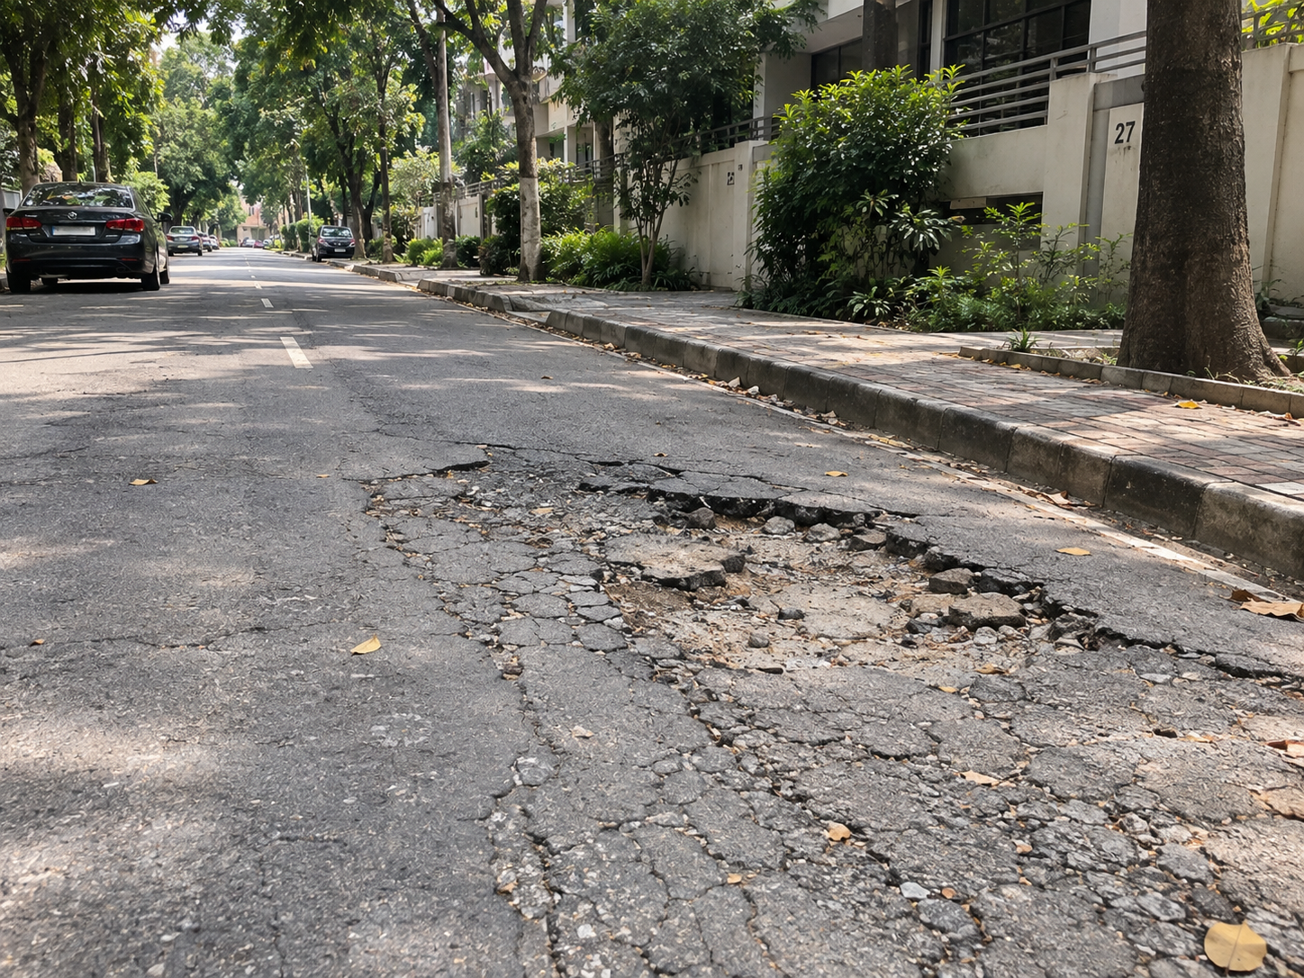
INTRODUCTION · WHY THIS PLATFORM
Overview
Problem Statement
Community maintenance complaints remain fragmented and difficult to track
1
Residents rely on phone calls, social media groups, and informal messages.
2
Reports often arrive without structured evidence or accurate location details.
3
Duplicate reports and disconnected channels delay verification and assignment.
4
Residents have limited visibility into progress, reducing trust and accountability.
NogorShomadhan provides one verified workflow from reporting to resolution.
THE EVERYDAY REALITY
Visible to everyone, yet no record of who reported it or what happens next.
1 / 27

Slide 4
INTRODUCTION · WHO USES THE PLATFORM
Stakeholders and Responsibilities
Three roles
Resident
Admin
Community Authority
Reports community problems with location and optional photographic evidence.
Tracks complaint status and receives important notifications.
Participates through urgency votes, forum discussions, and feedback.
Verifies resident accounts and newly submitted complaints.
Reviews possible duplicates identified by the system.
Approves valid records and maintains platform integrity.
Reviews verified complaints and begins the required work.
Manages deadlines, budgets, contractors, notes, and evidence.
Resolves complaints and responds to resident feedback.
System and AI: categorization, duplicate screening, status tracking, and notifications
2 / 27

Slide 5
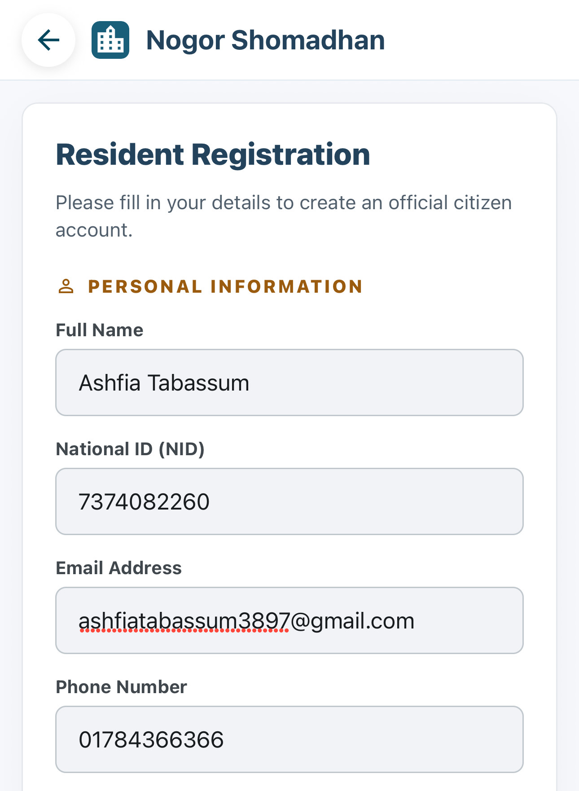
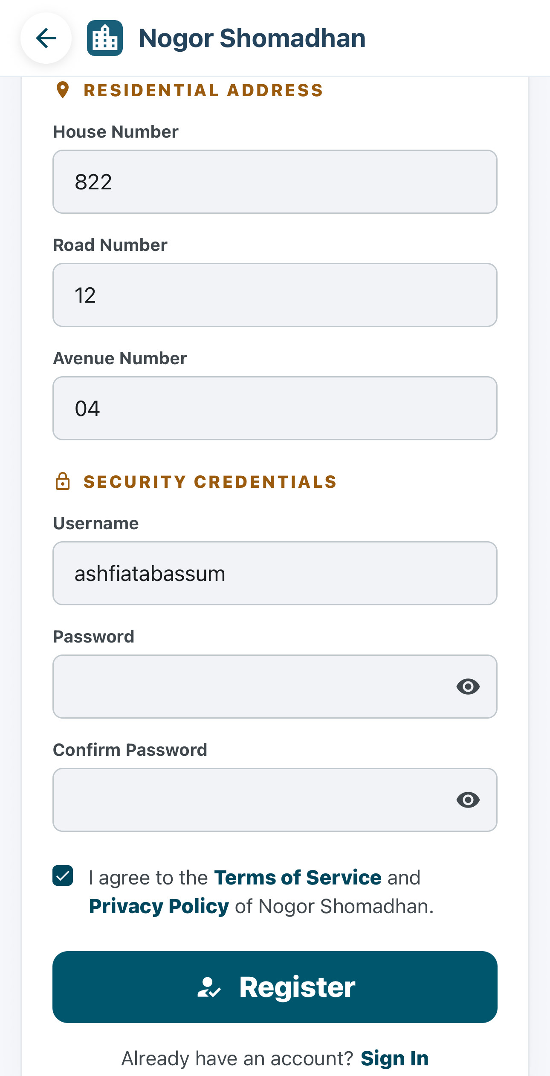
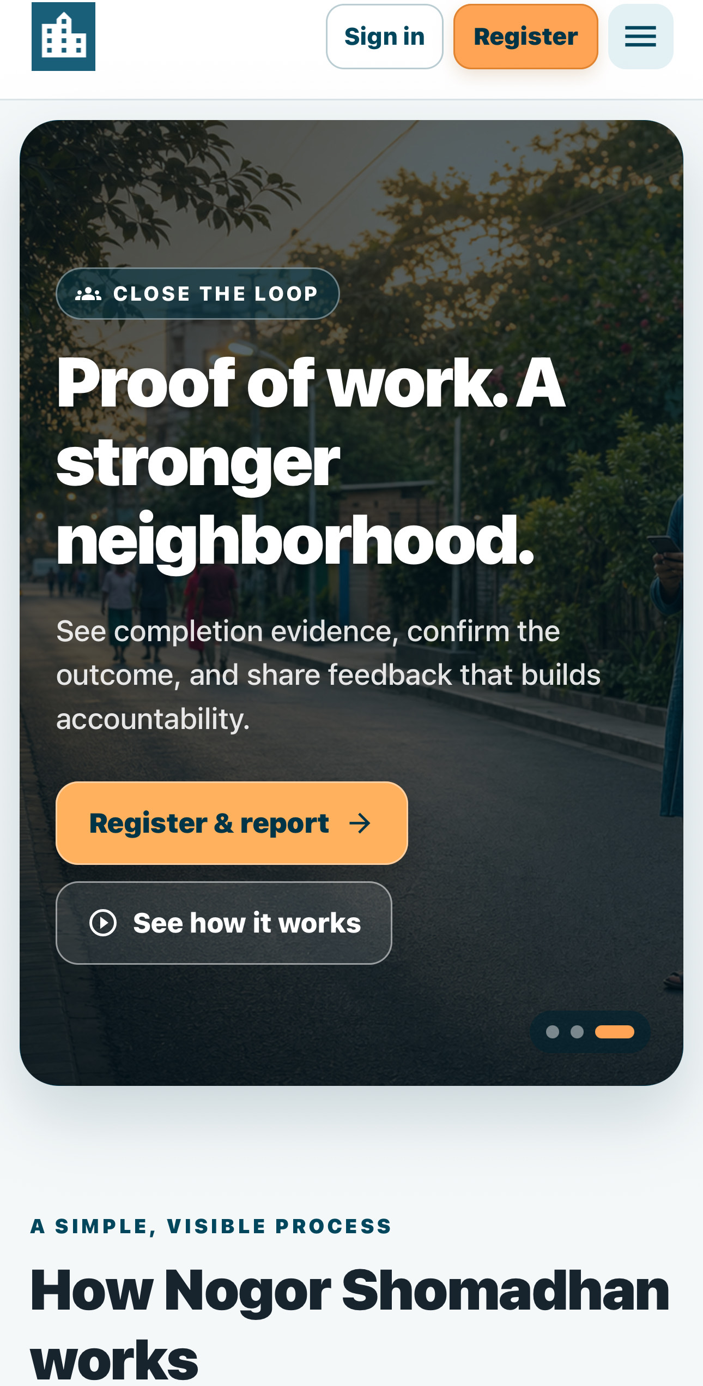
PHASE 1 · ACCOUNT REGISTRATION AND VERIFICATION
Resident
Resident Account Registration
1
Open Register from the public home page.
3
2
1
2
Enter identity and contact information.
3
Add the residential address and secure login credentials.
4
Review the information before registration.
4
Public home page
Personal information
Address and credentials
3 / 27

Slide 6
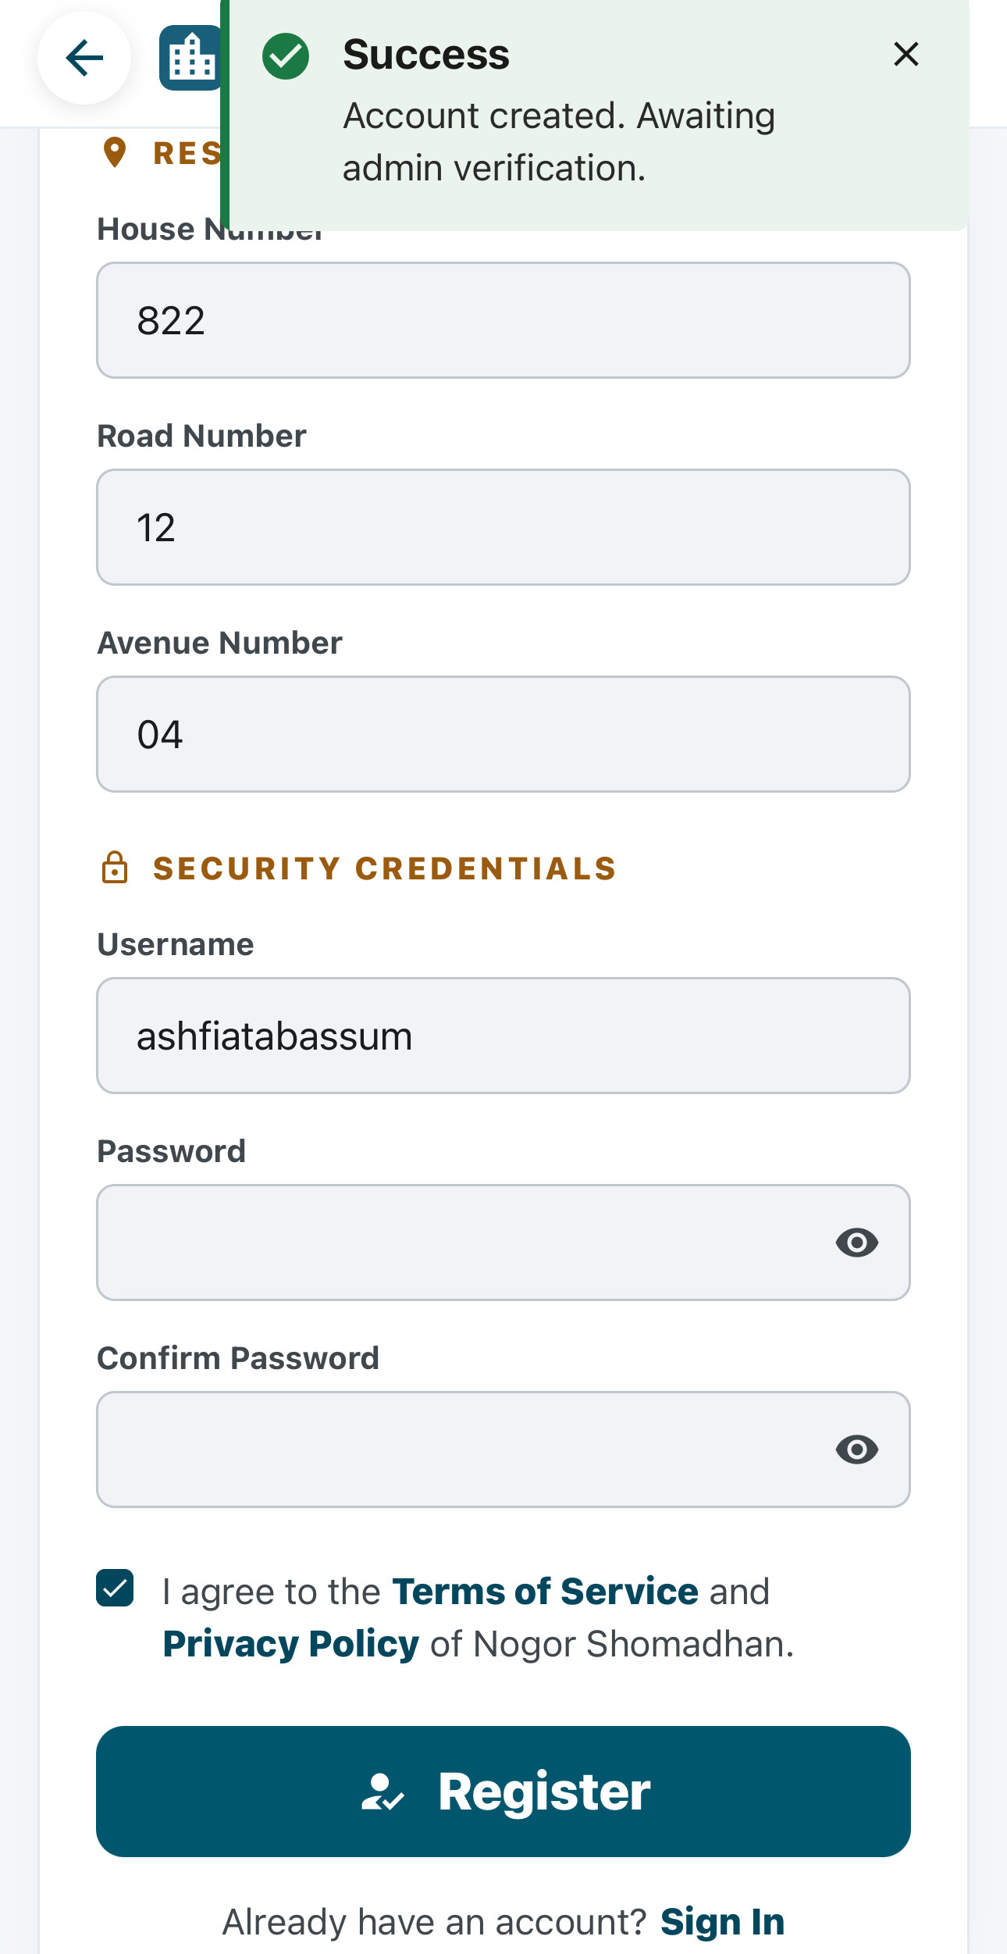
4
PHASE 1 · ACCOUNT REGISTRATION AND VERIFICATION
Registration Request Submitted
Resident
3
ON SCREEN
1
The resident submits the completed registration form.
“Account created. Awaiting admin verification.”
2
The system creates the account with an unverified status.
ACCOUNT STATUS
UNVERIFIED
3
The resident sees an awaiting-verification confirmation.
WHAT HAPPENS NEXT
The request now waits for an admin to review the account and approve it.
Nogor Shomadhan · User Manual
4 / 27

Slide 7
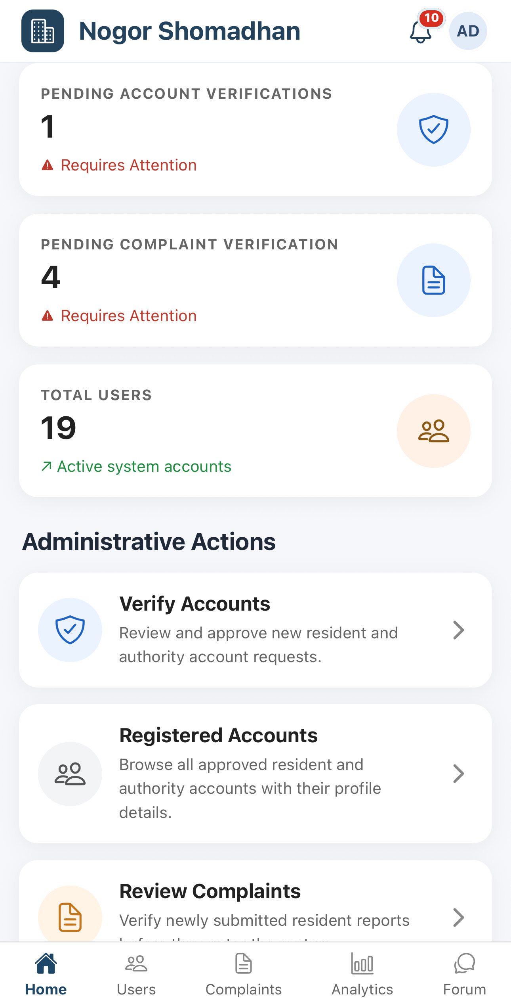
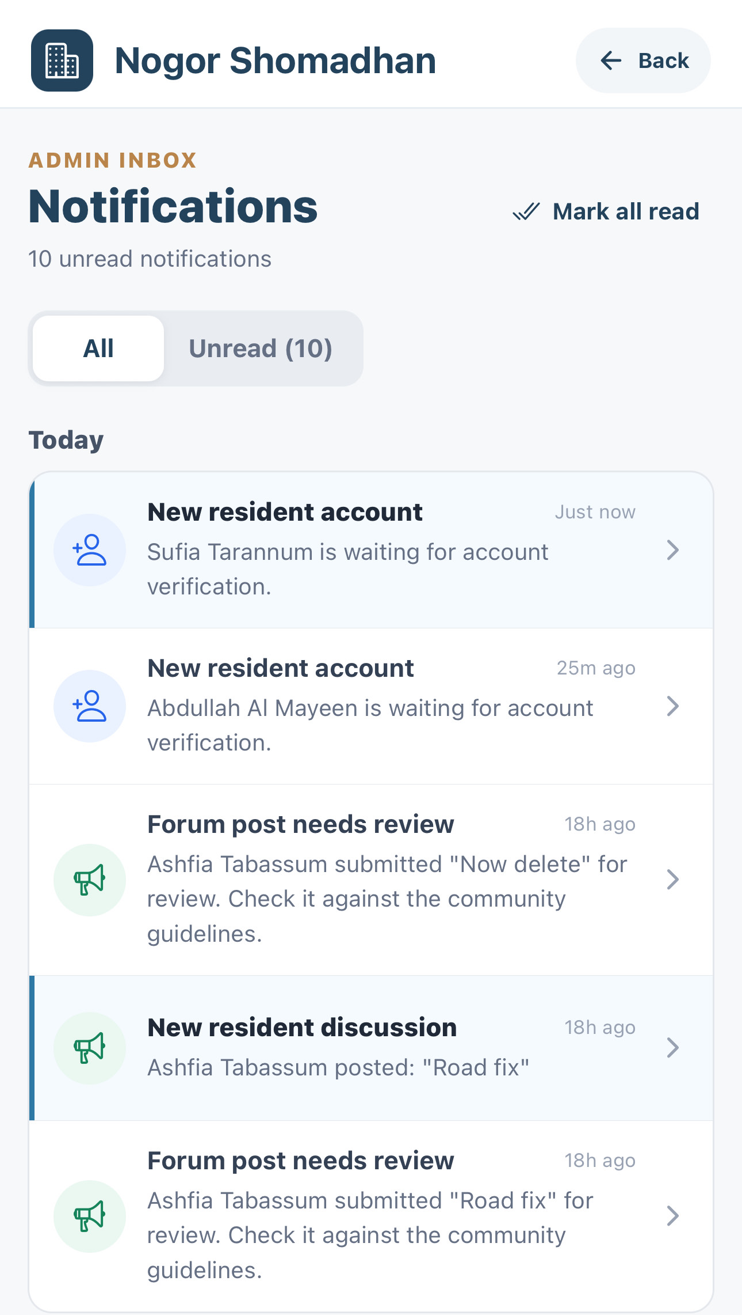
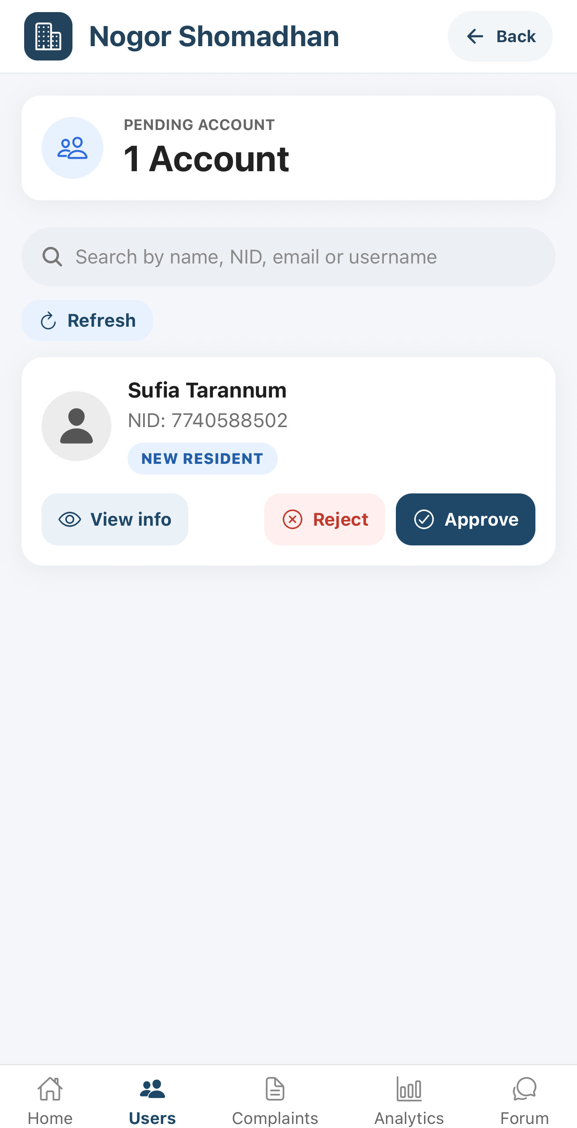
5
PHASE 1 · ACCOUNT REGISTRATION AND VERIFICATION
Admin Receives the Verification Request
Admin
1
1
The dashboard shows a pending account verification and a notification badge.
4
2
2
The bell opens the admin inbox listing the new resident account.
3
3
Verify Accounts on the dashboard opens the same pending queue.
4
The pending account offers View info, Reject, and Approve.
Verify Accounts opens the same pending queue
Nogor Shomadhan · User Manual
5 / 27

Slide 8
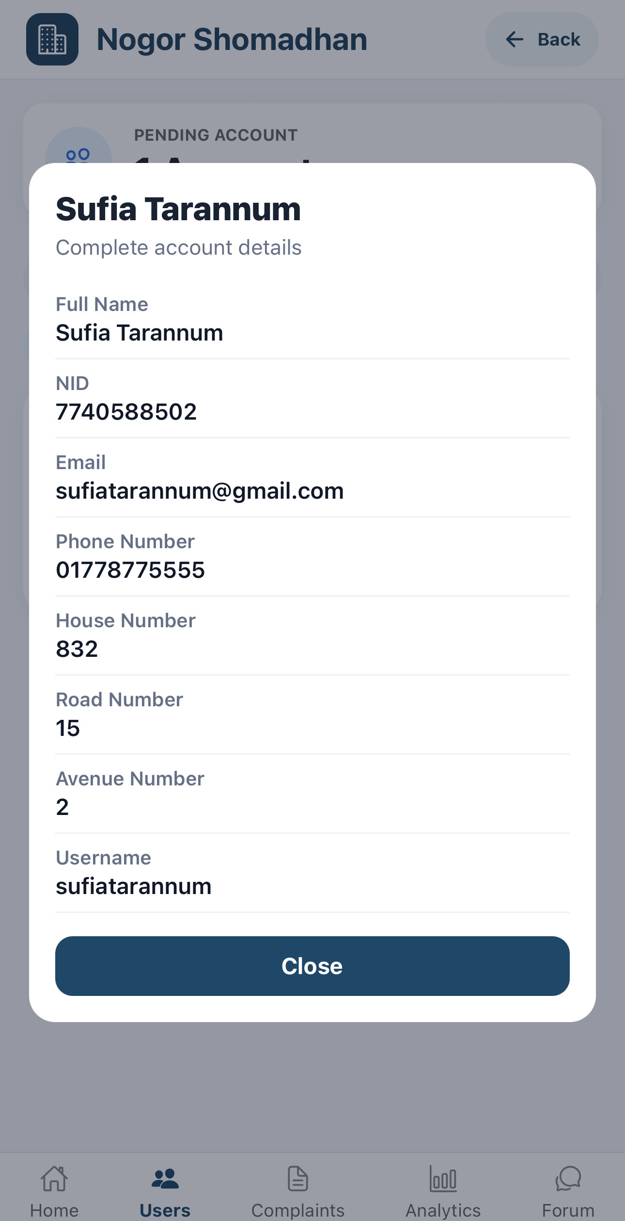
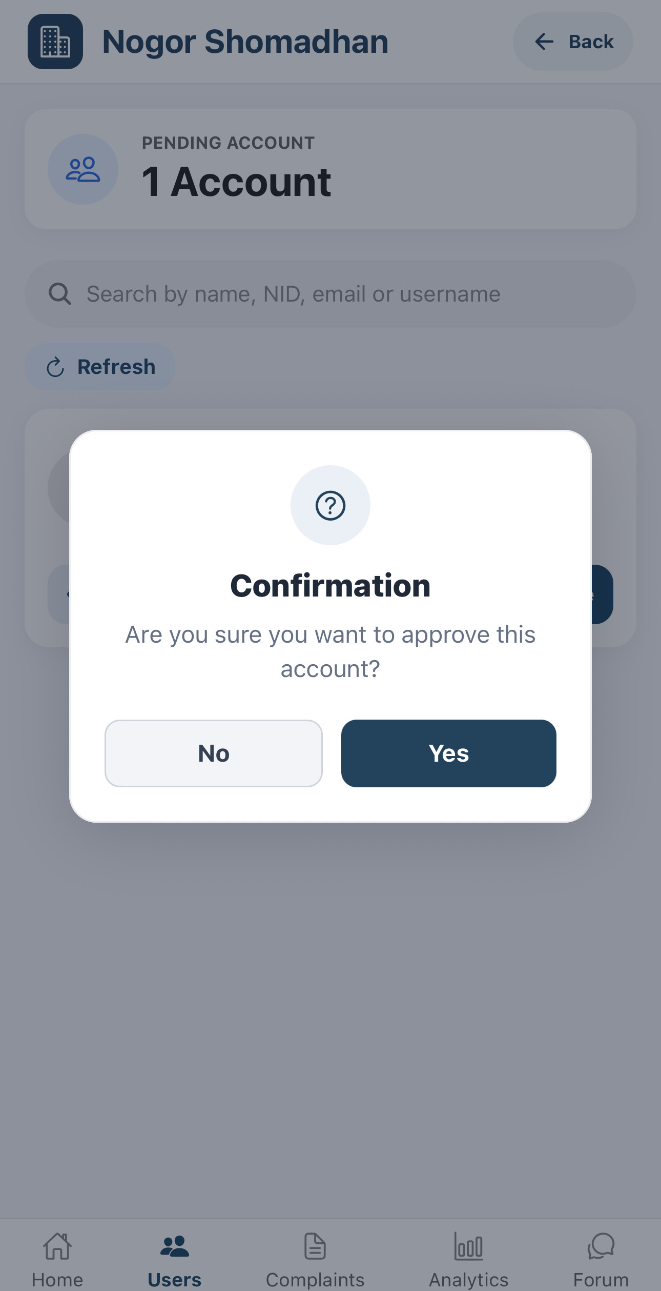
6
PHASE 1 · ACCOUNT REGISTRATION AND VERIFICATION
Admin Reviews and Approves the Account
Admin
1
Open View info to see the complete account details.
1
2
Check that the identity and address details are valid.
2
3
3
Approve the account and confirm the action.
Personal details masked for this presentation.
Complete account details
Approval confirmation
Nogor Shomadhan · User Manual
6 / 27

Slide 9
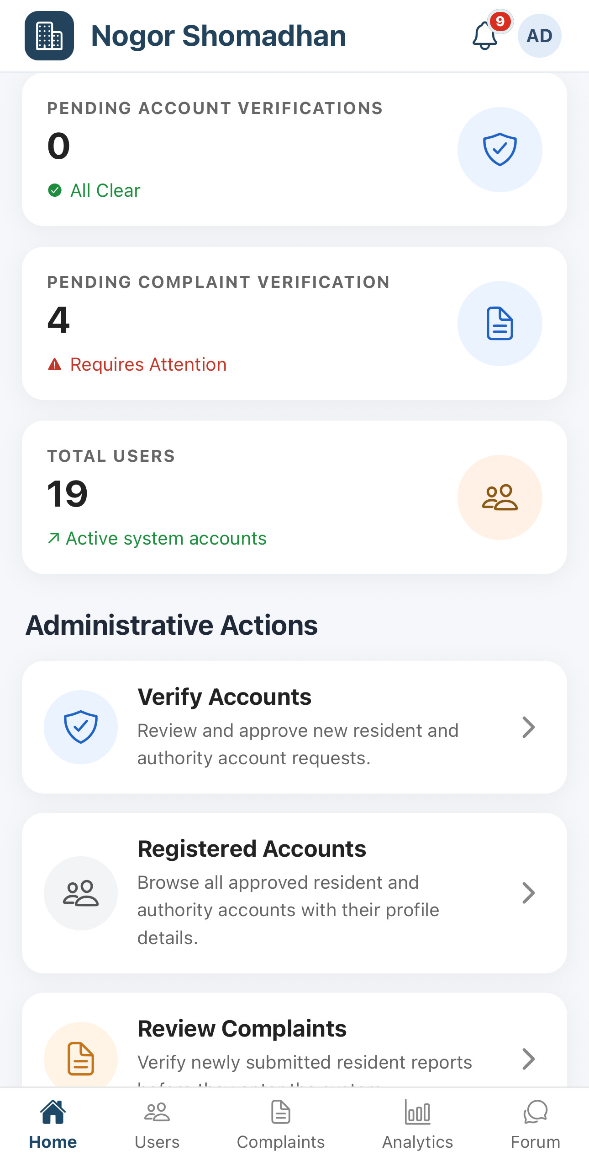
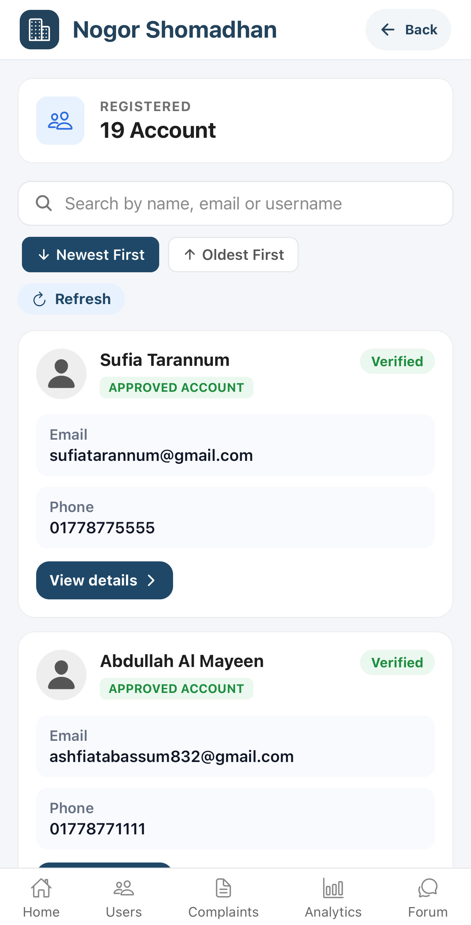
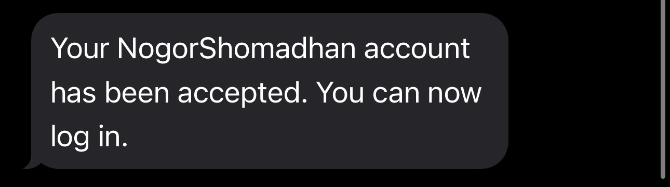
7
PHASE 1 · ACCOUNT REGISTRATION AND VERIFICATION
Account Verification Completed
Resident
Admin
The resident receives an SMS confirming account approval.
Admin dashboard
Registered accounts
1
2
Select Registered Accounts to view all approved profiles.
3
The account appears in the Registered Accounts list.
3
4
4
The account status changes to Verified.
2
SMS TO THE RESIDENT
1
The resident can now sign in and begin reporting community problems.
Nogor Shomadhan · User Manual
7 / 27

Slide 10
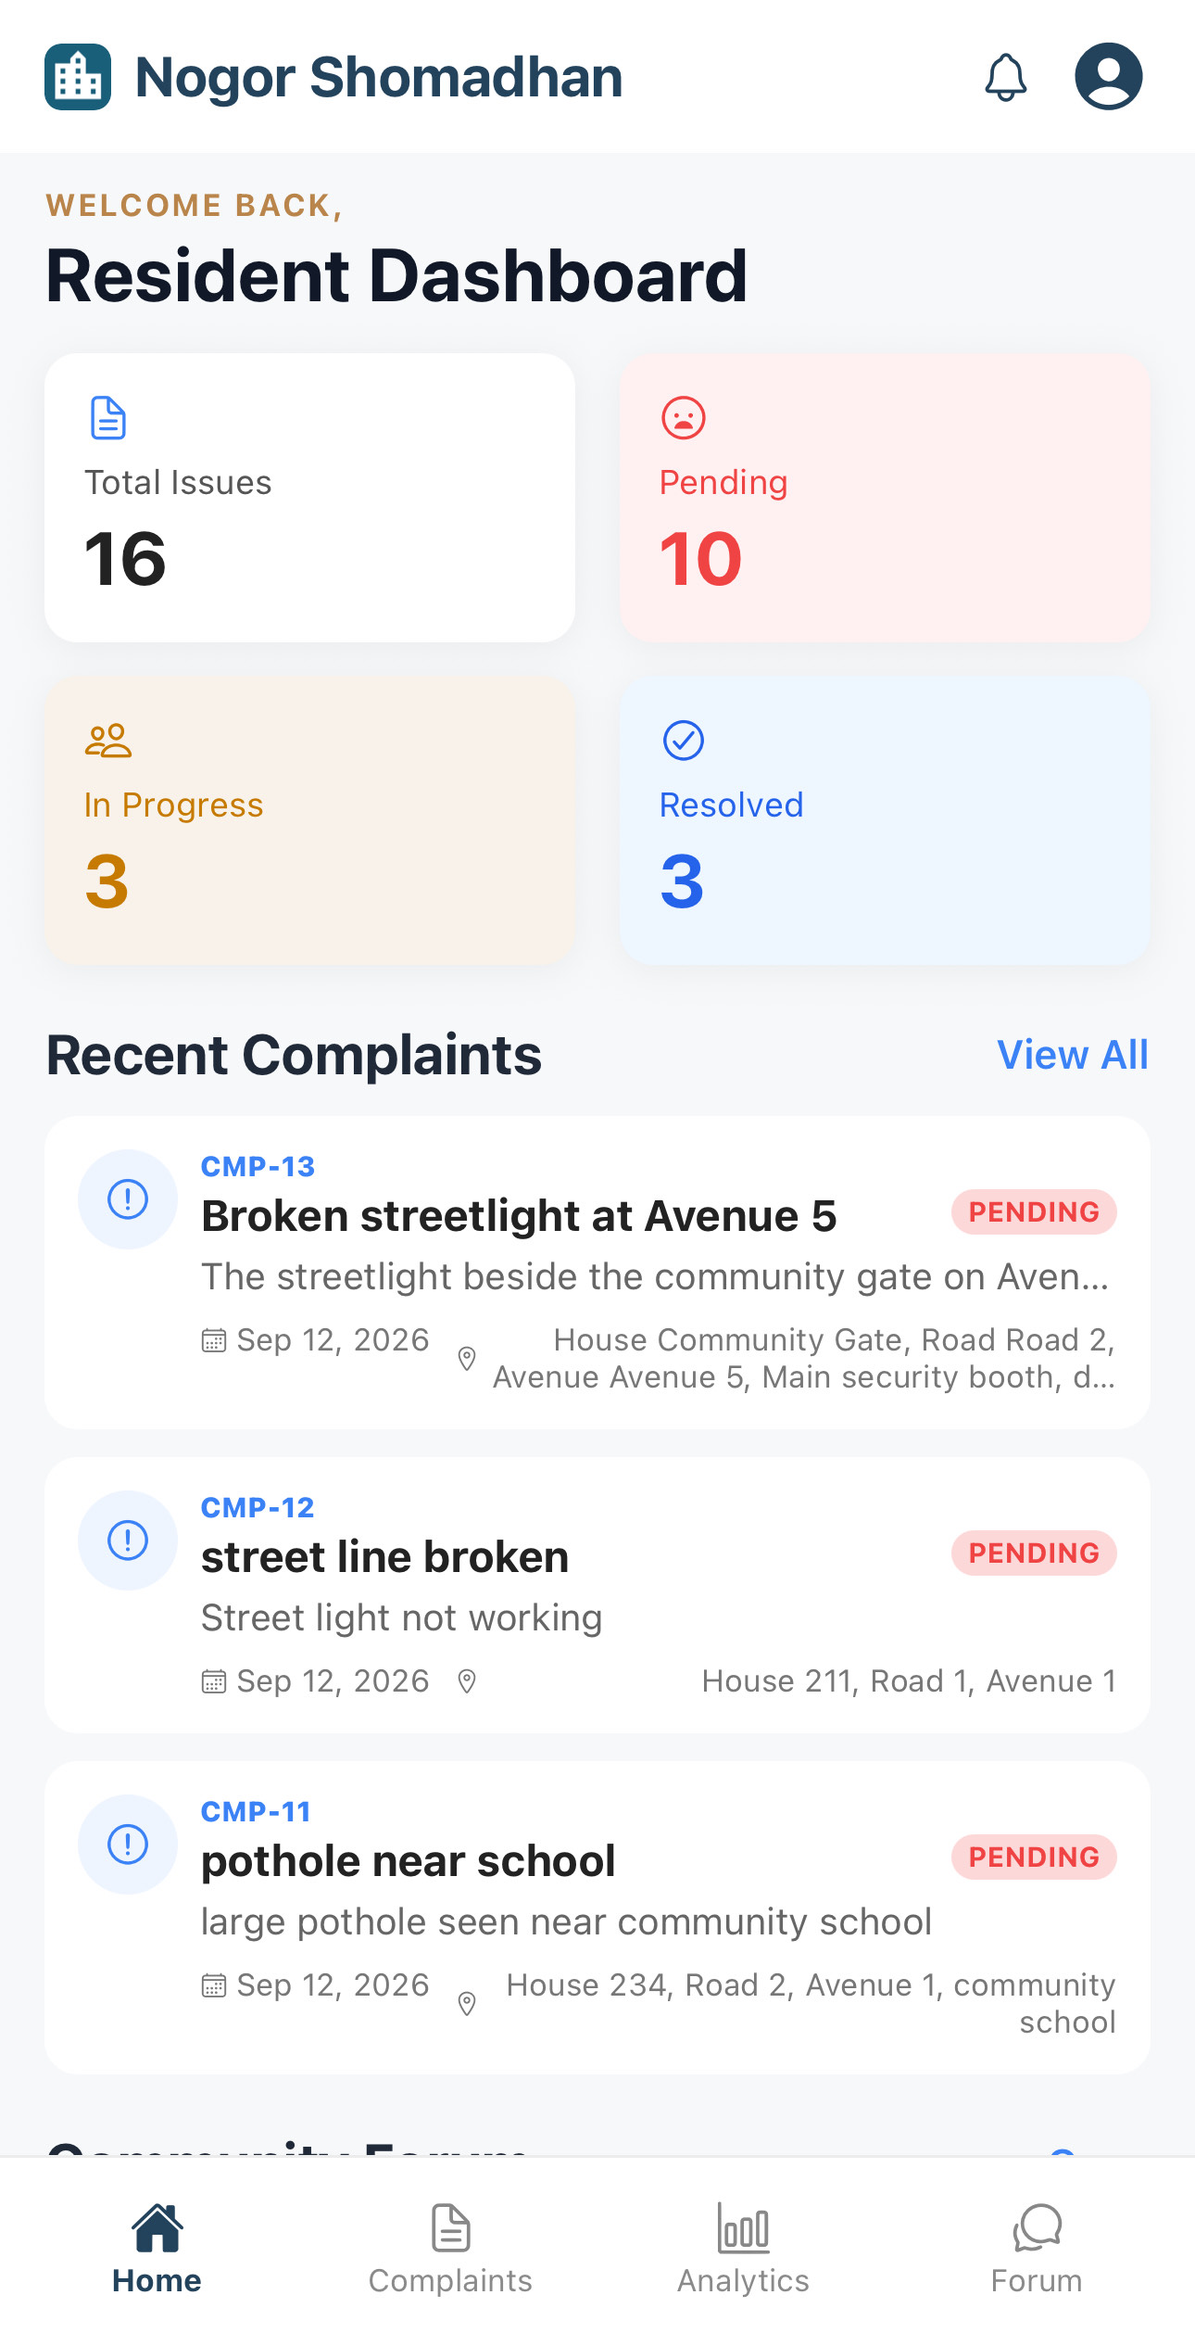
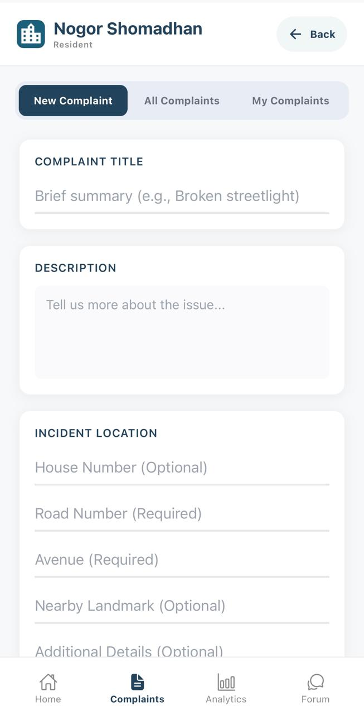
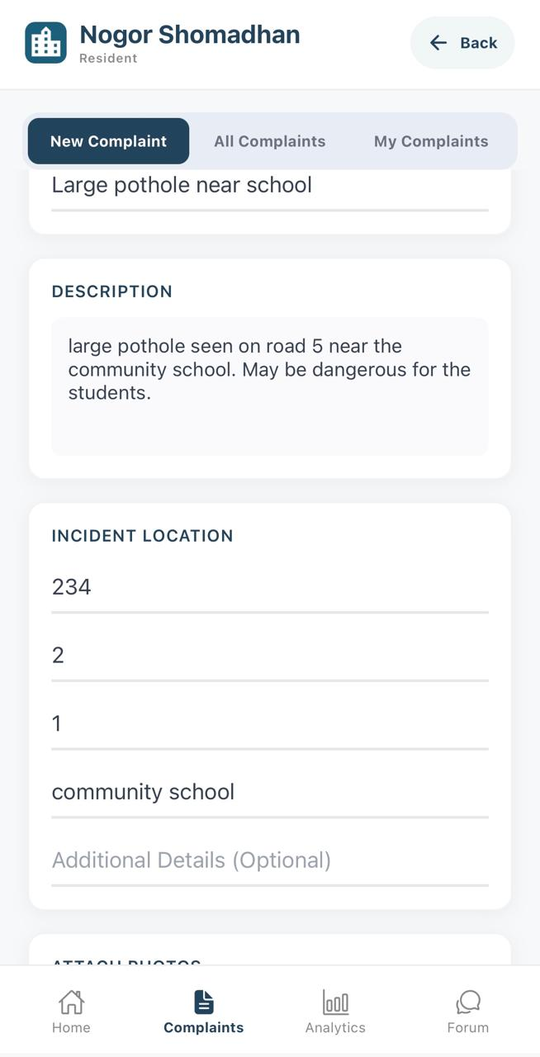
PHASE 2 · RESIDENT SUBMITS A COMPLAINT
Create a New Complaint
Resident
1
Select Complaints from the Resident Dashboard.
2
2
Open the New Complaint tab.
3
Enter the complaint title, description, incident address, nearby landmark, and additional location details.
3
1
8 / 27

Slide 11
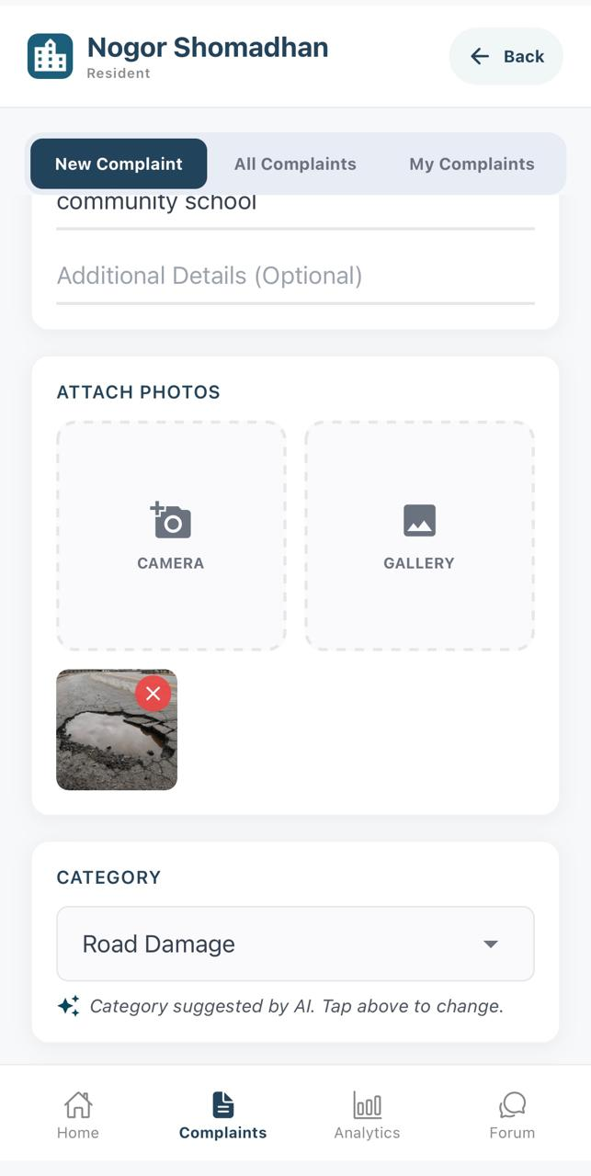
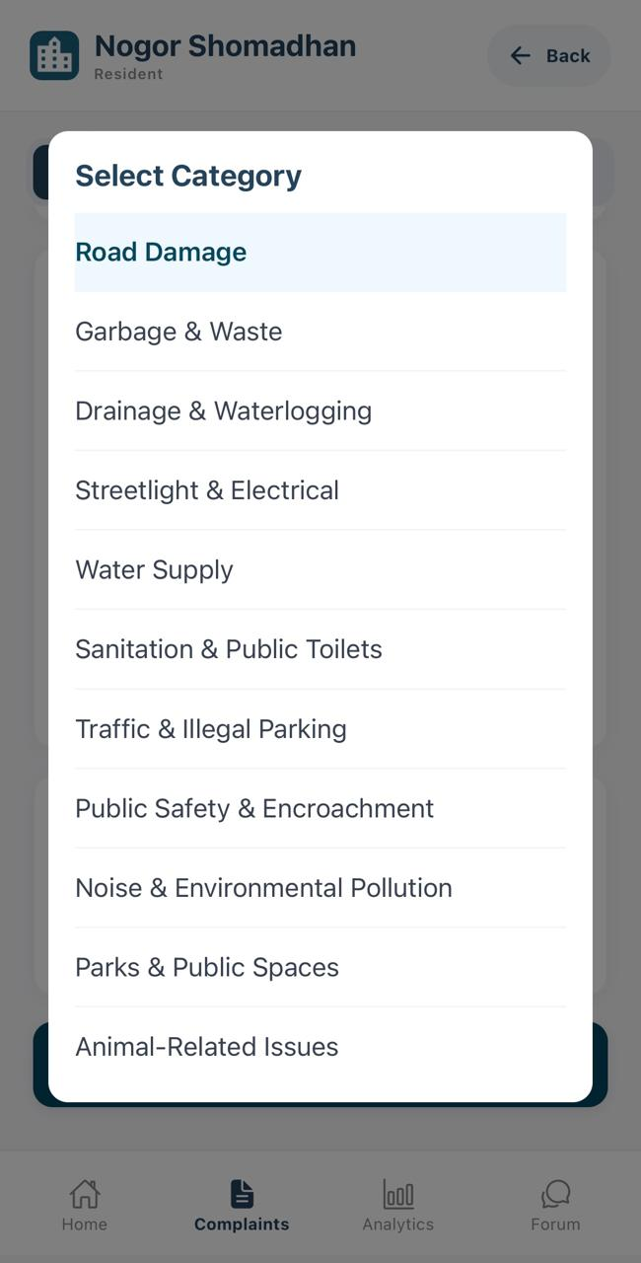
PHASE 2 · RESIDENT SUBMITS A COMPLAINT
Resident
Add Evidence and Review the Category
1
Optionally attach photo evidence using the camera or gallery.
3
1
2
Review the category automatically suggested by the AI.
opens
3
If necessary, open the category menu and select a more appropriate category manually.
2
9 / 27

Slide 12
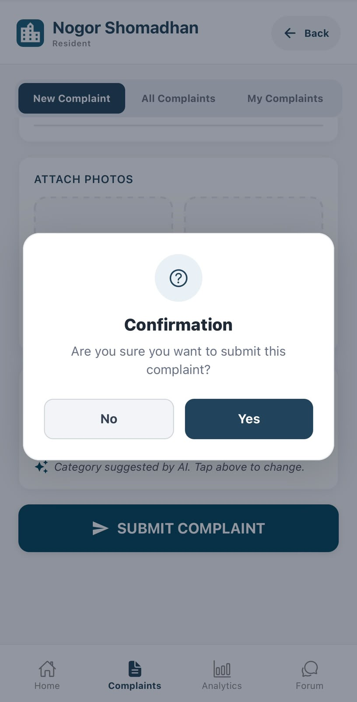
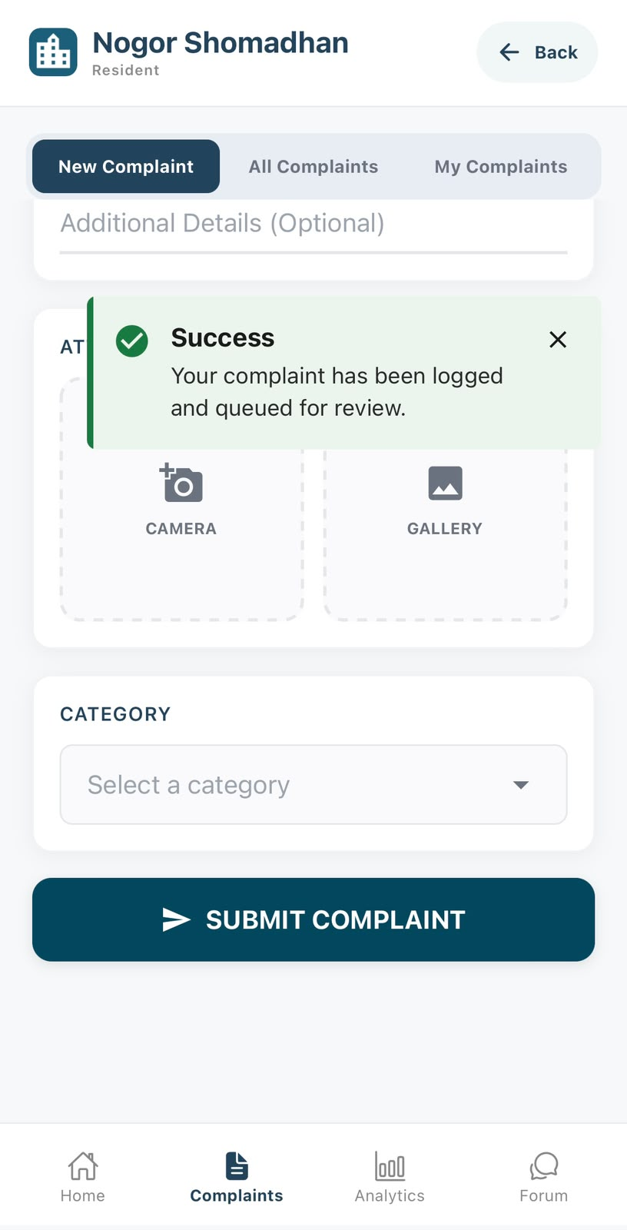
PHASE 2 · RESIDENT SUBMITS A COMPLAINT
Resident
Confirm the Complaint Submission
1
Tap Submit Complaint.
2
Review the confirmation prompt and select Yes.
3
3
The success message confirms the complaint was logged and queued for review.
2
1
10 / 27

Slide 13
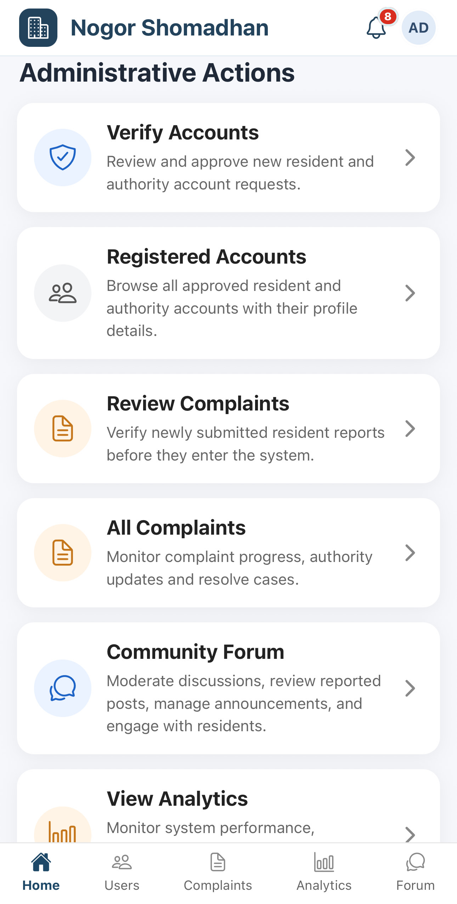
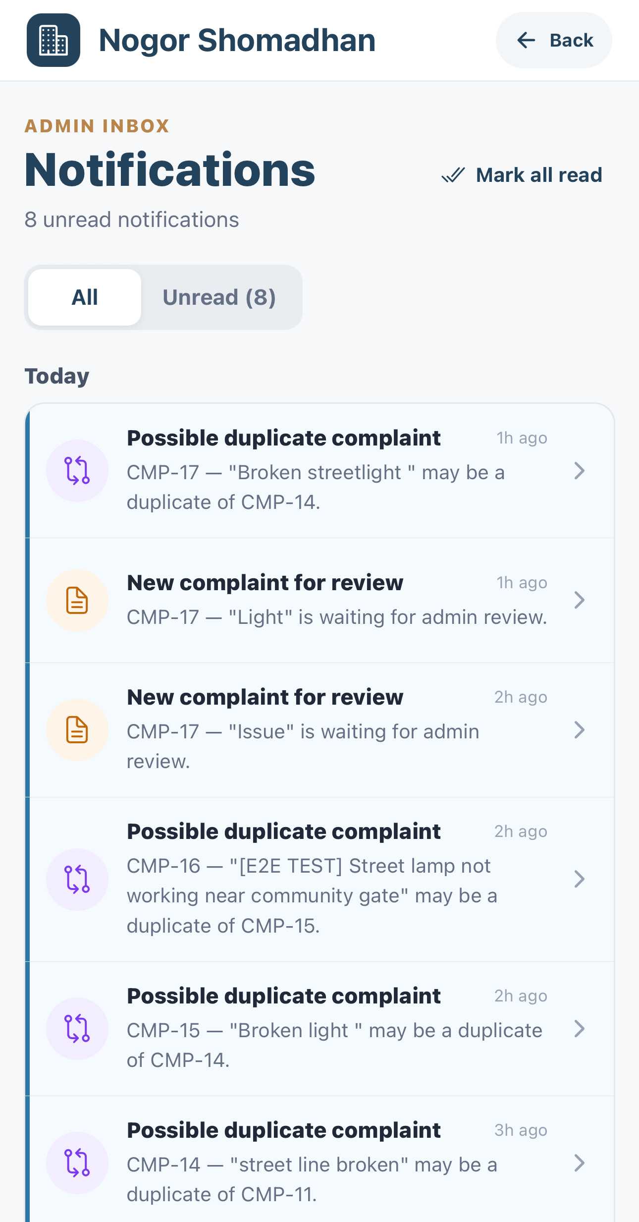
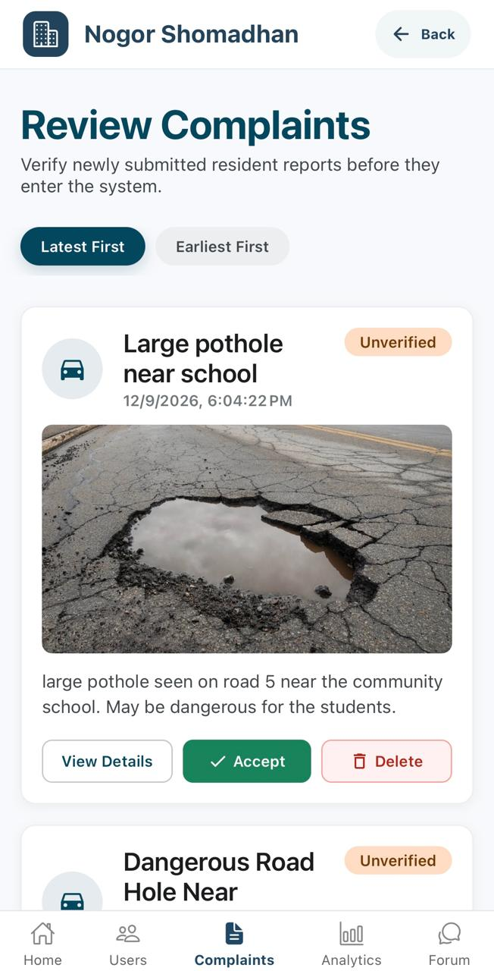
PHASE 3 · ADMIN COMPLAINT VERIFICATION
Admin Reviews a Standard New Complaint
Admin
1
Dashboard — the admin opens Review Complaints from Administrative Actions.
3
2
Select New Complaint — the admin chooses a new submission that has not been flagged as a duplicate.
1
2
3
Verify Complaint — the complaint remains “Unverified” until the admin reviews and accepts it.
Admin dashboard
Admin notifications
Review queue for new complaint
11 / 27

Slide 14
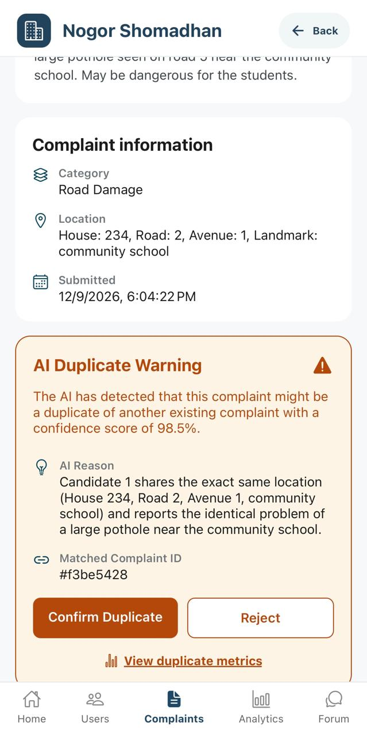
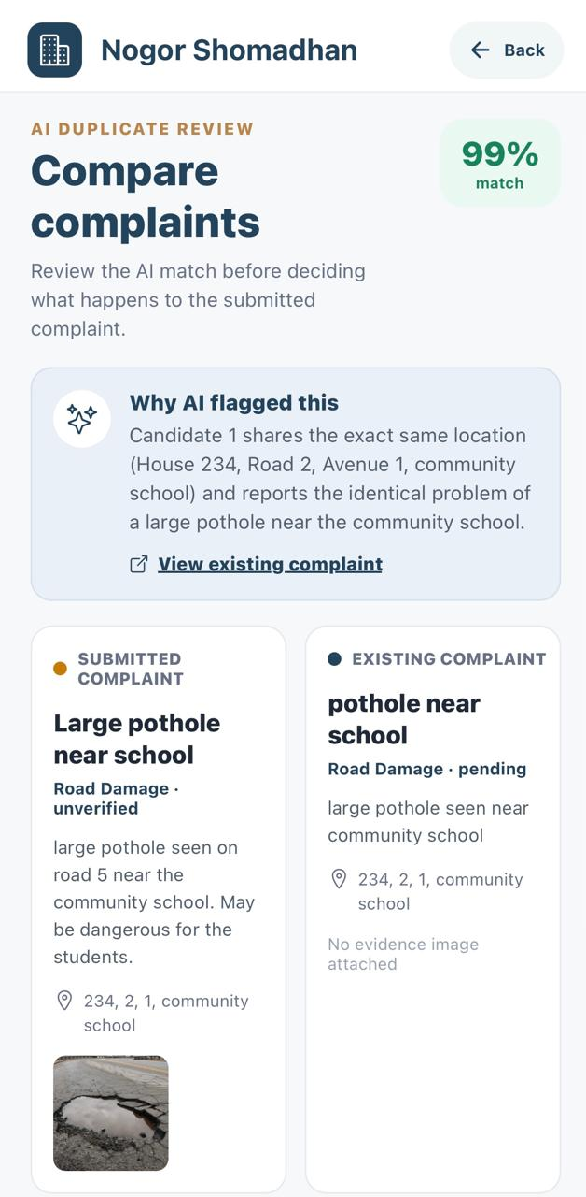
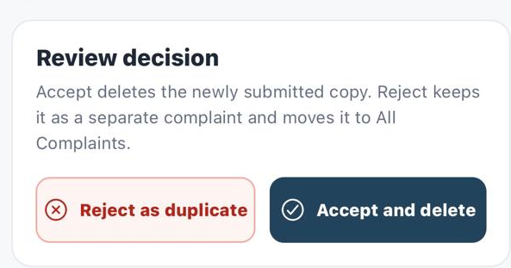
PHASE 3 · ADMIN COMPLAINT VERIFICATION
Admin Reviews a Possible Duplicate Complaint
Admin
4
Review New Submission — the admin checks the category, location, submission time, and evidence.
4
5
Check AI Duplicate Warning — the AI shows a possible matching complaint, its reason, and confidence score.
6
Compare and Decide — the admin compares the new submission with the existing complaint and confirms or rejects rejects the duplicate match.
5
6
12 / 27

Slide 15
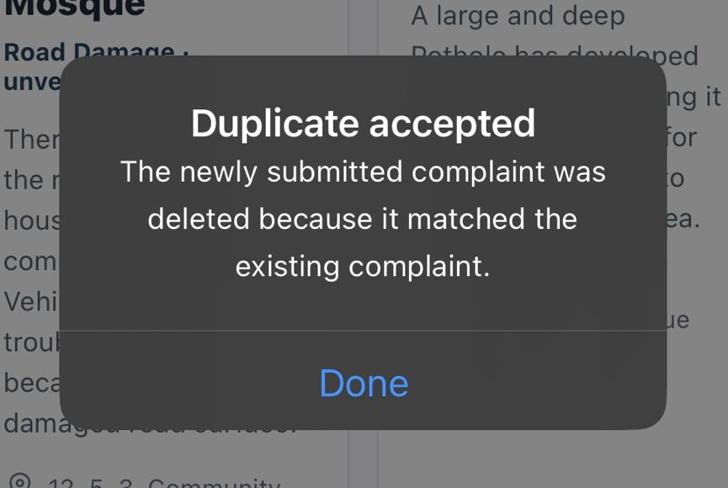
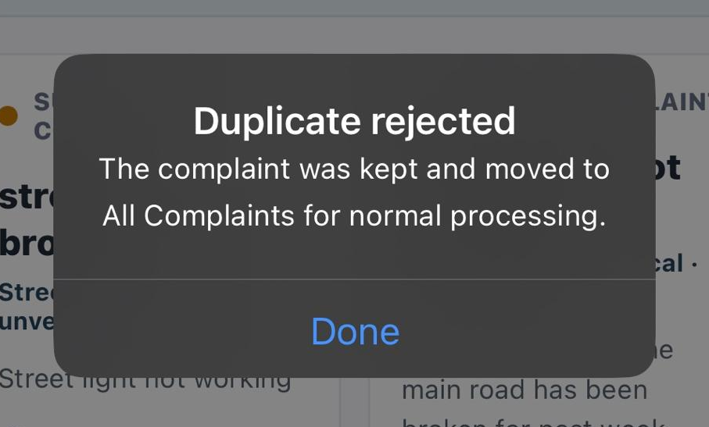
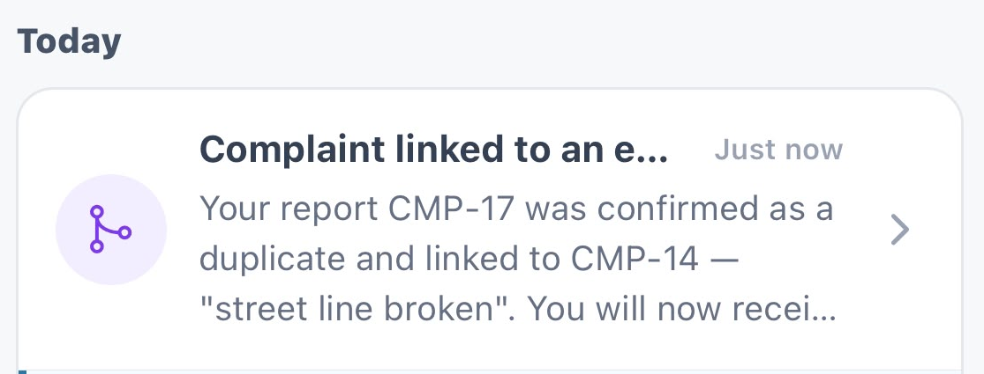
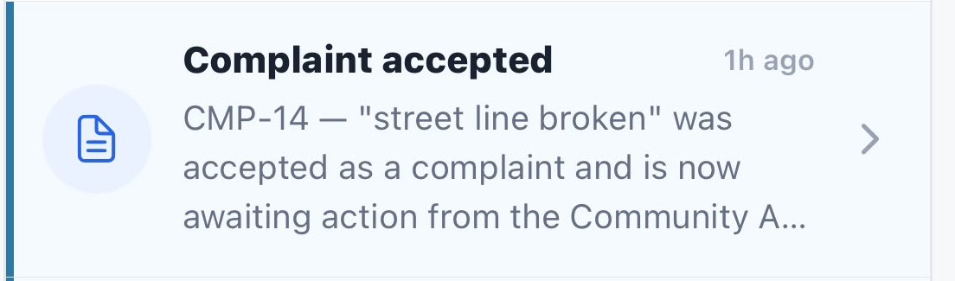
PHASE 3 · ADMIN COMPLAINT VERIFICATION
Duplicate Review Outcomes
Admin
Resident
DUPLICATE CONFIRMED
NOT A DUPLICATE
ADMIN DECISION
ADMIN DECISION
The admin confirms the match. The submitted copy is deleted and linked to the base complaint.
The admin rejects the duplicate suggestion, not the complaint. It is kept and set to Pending.
RESIDENT OUTCOME
RESIDENT OUTCOME
The resident is notified and follows the base complaint.
The resident is notified that the complaint was accepted and tracks it as Pending.
13 / 27

Slide 16
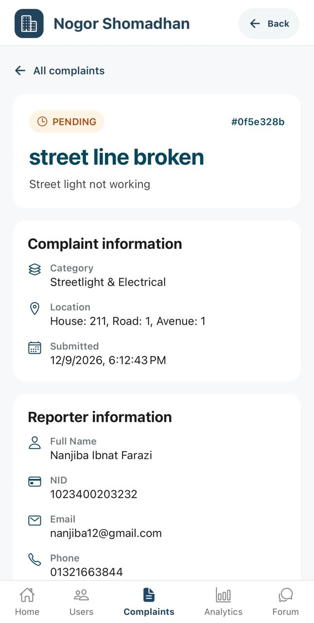
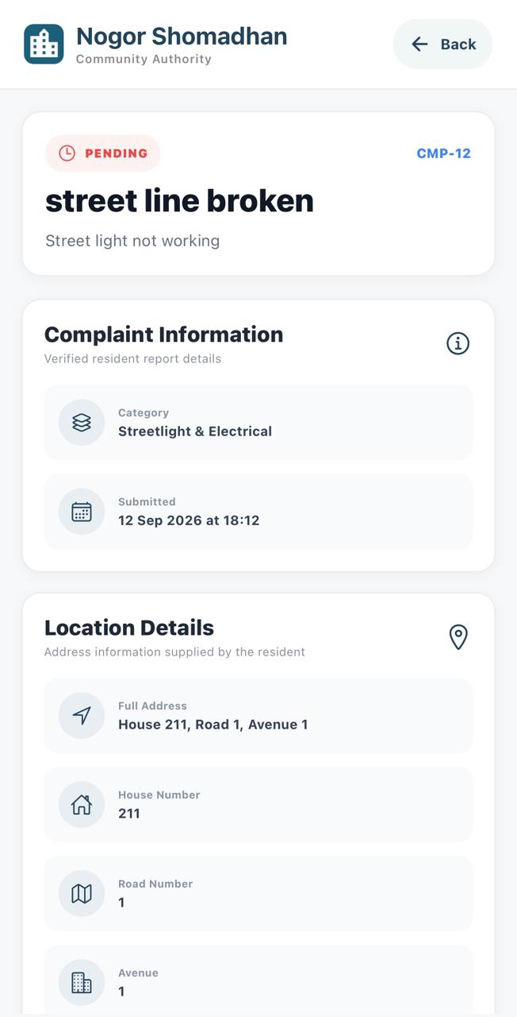
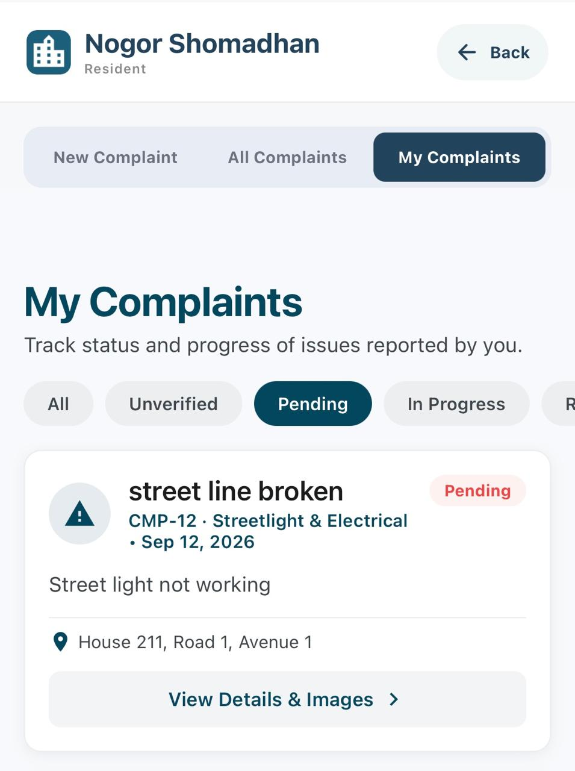
PHASE 3 · ADMIN COMPLAINT VERIFICATION
Not a duplicate
Pending Complaint Visibility
ADMIN
COMMUNITY AUTHORITY
RESIDENT
Appears in All Complaints with Pending status.
Available to the assigned authority for mitigation.
Visible in My Complaints with status and progress.
A complaint that is not a duplicate continues as a separate Pending complaint and becomes visible to every relevant role.
14 / 27

Slide 17
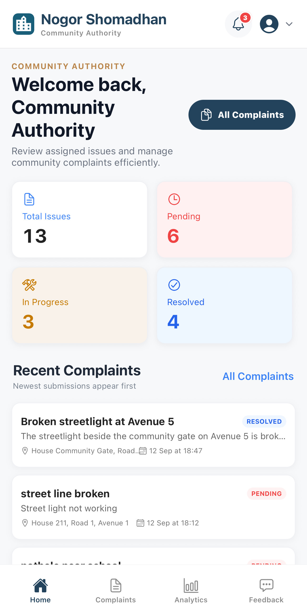
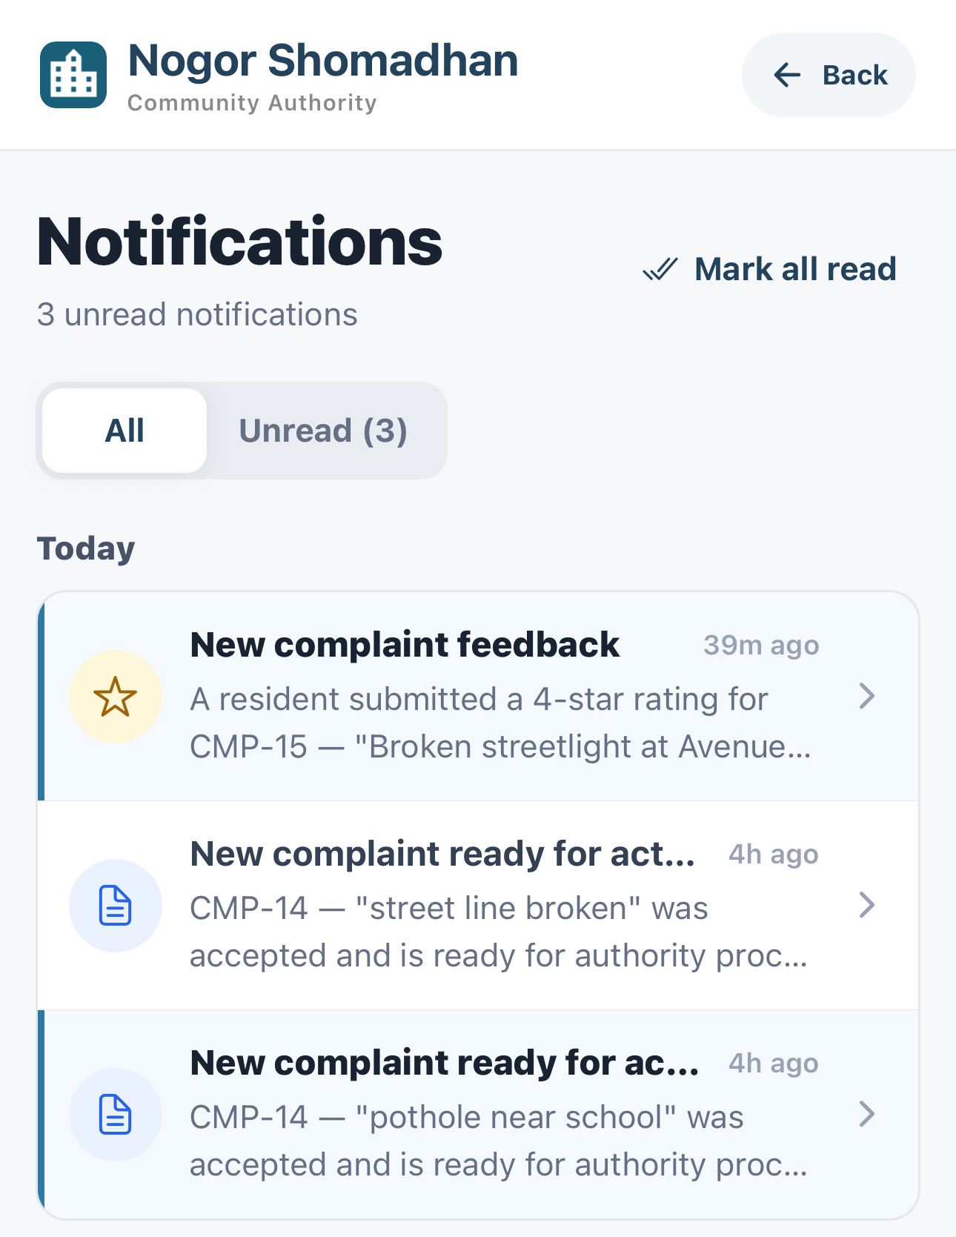
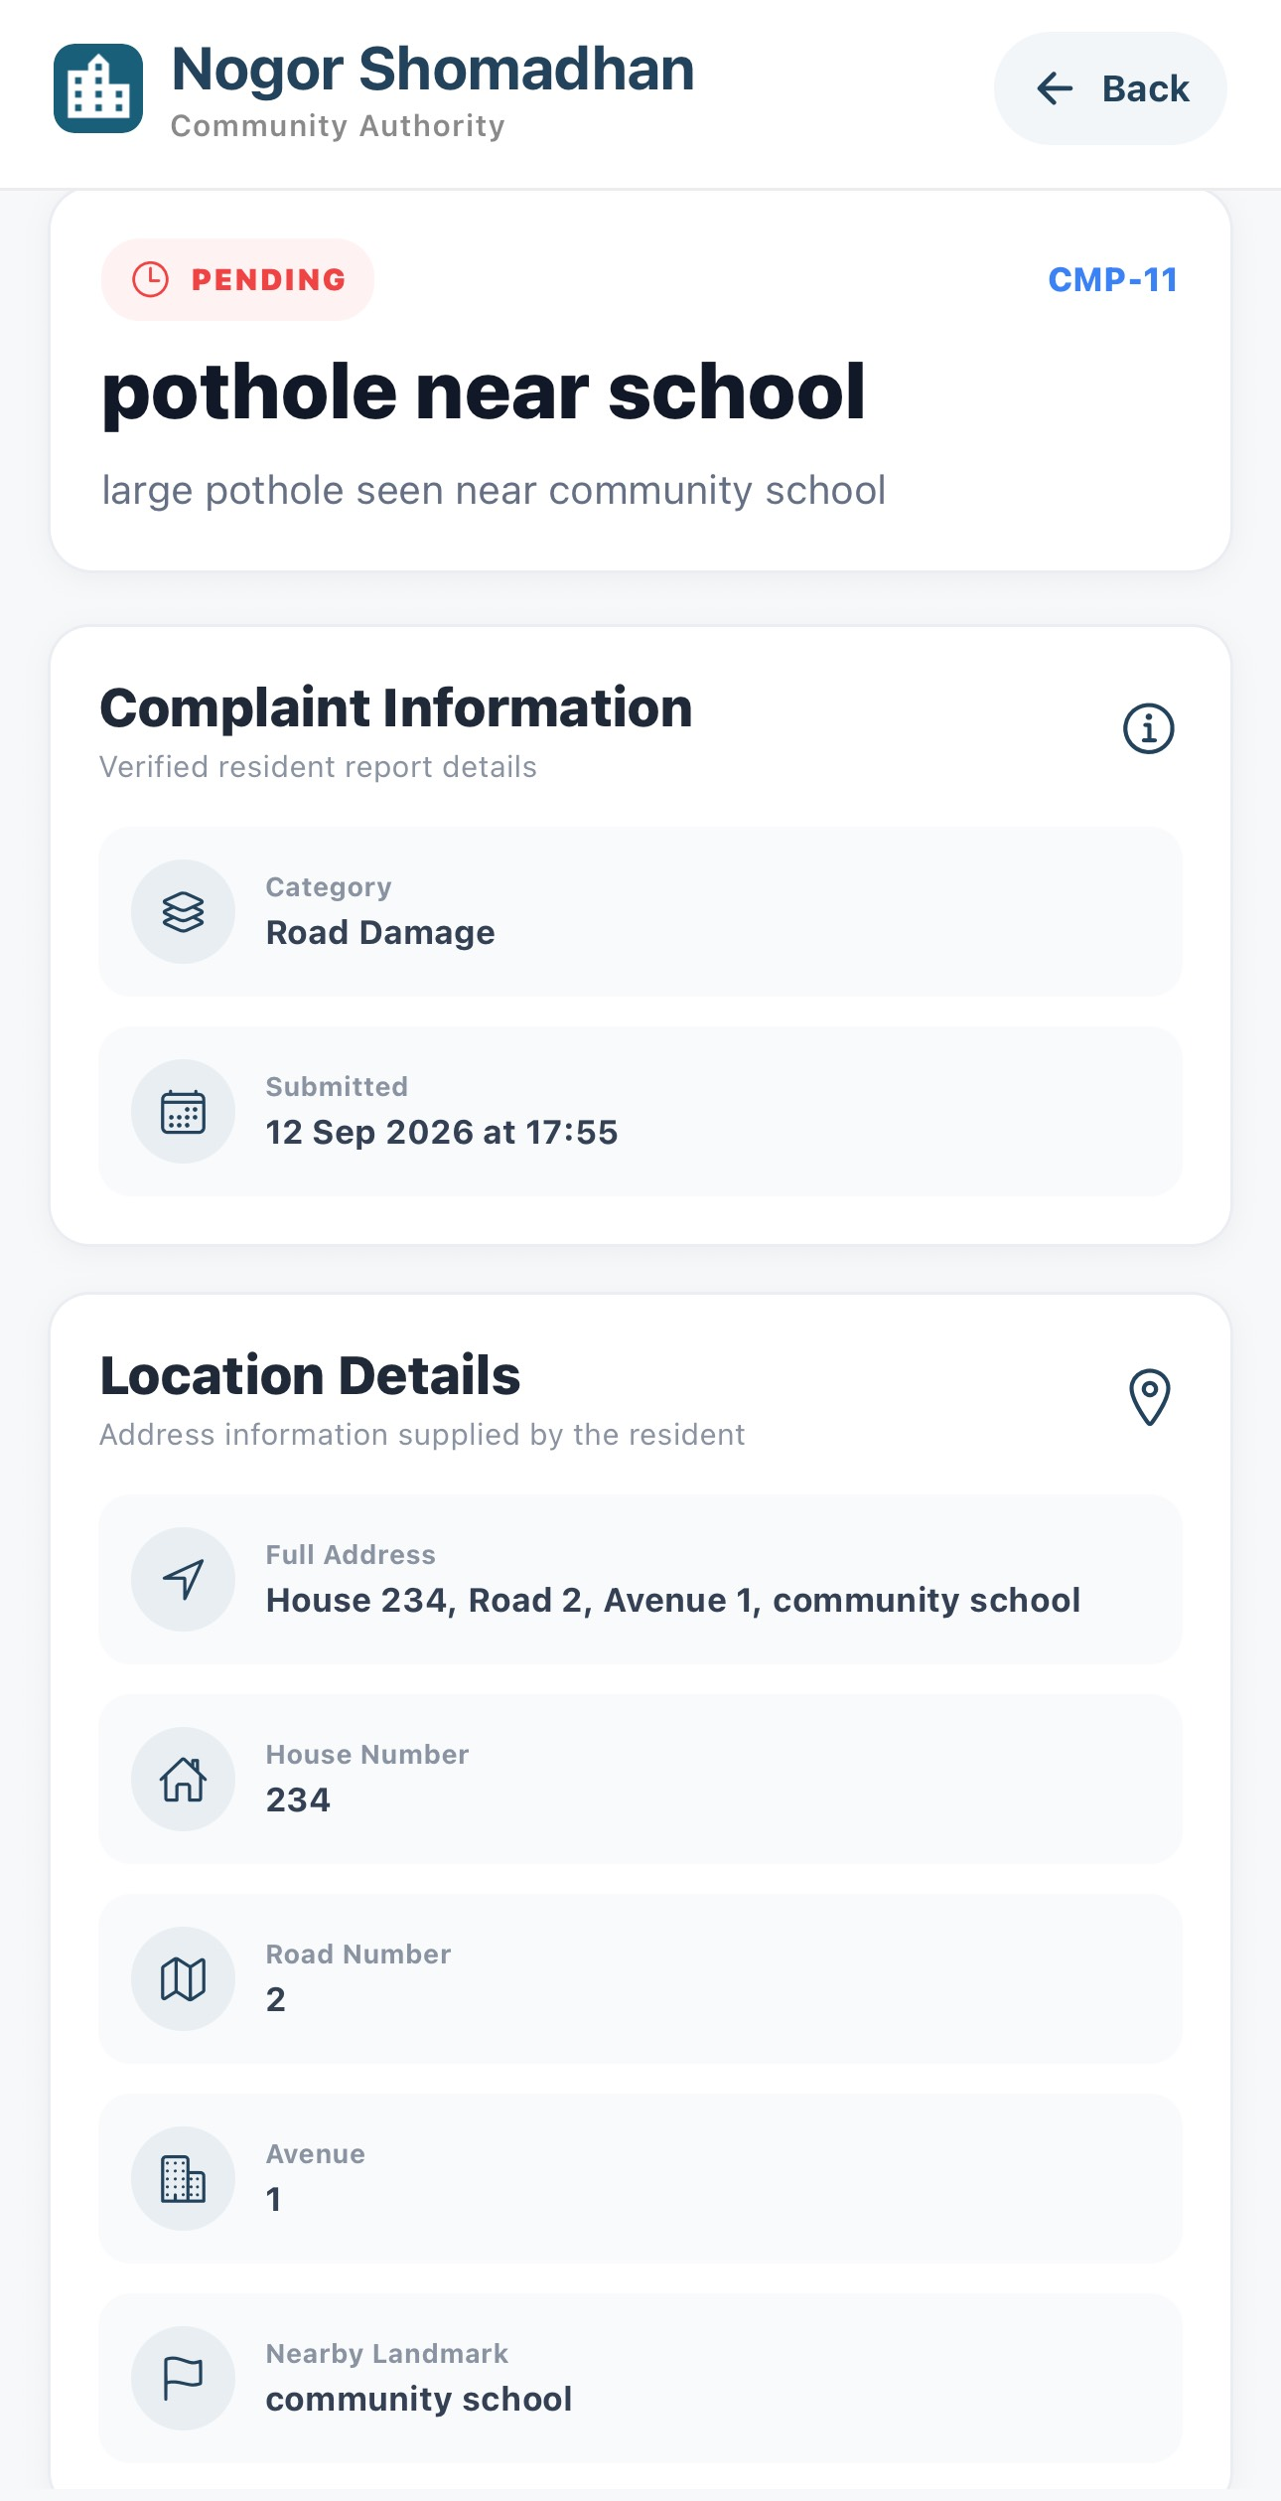
PHASE 4 · AUTHORITY STARTS THE WORK
Authority
Authority Opens the Complaint
2
1
The dashboard shows complaint counts and a notification badge.
The notification names the complaint that is ready for authority action.
Open the complaint to check its category, submission time, and location.
15 / 27

Slide 18
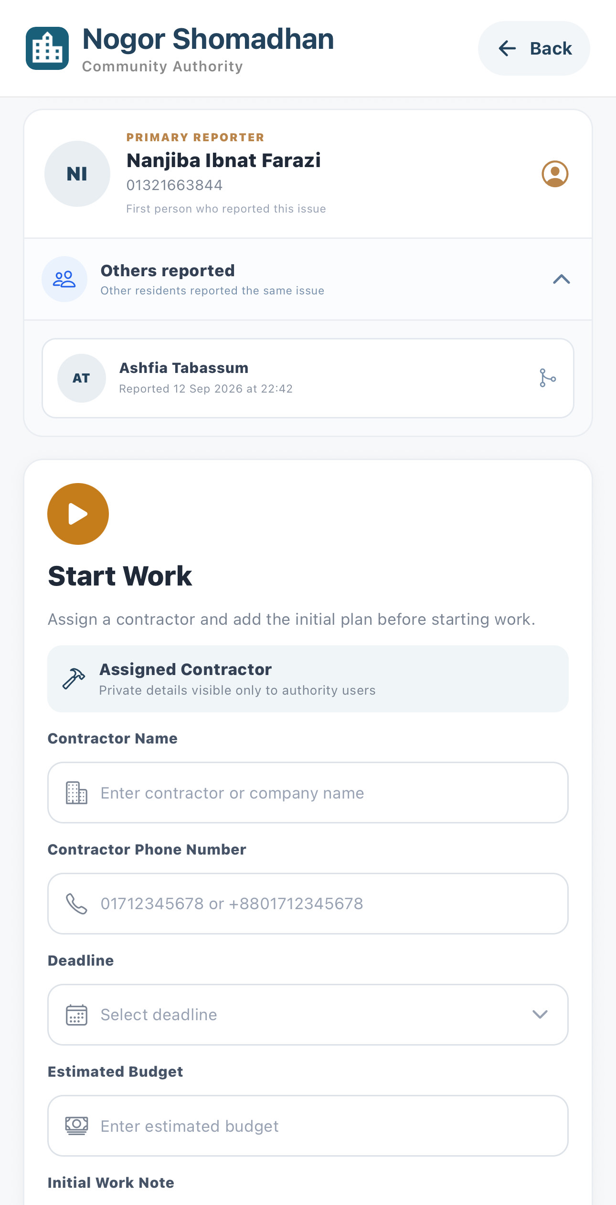
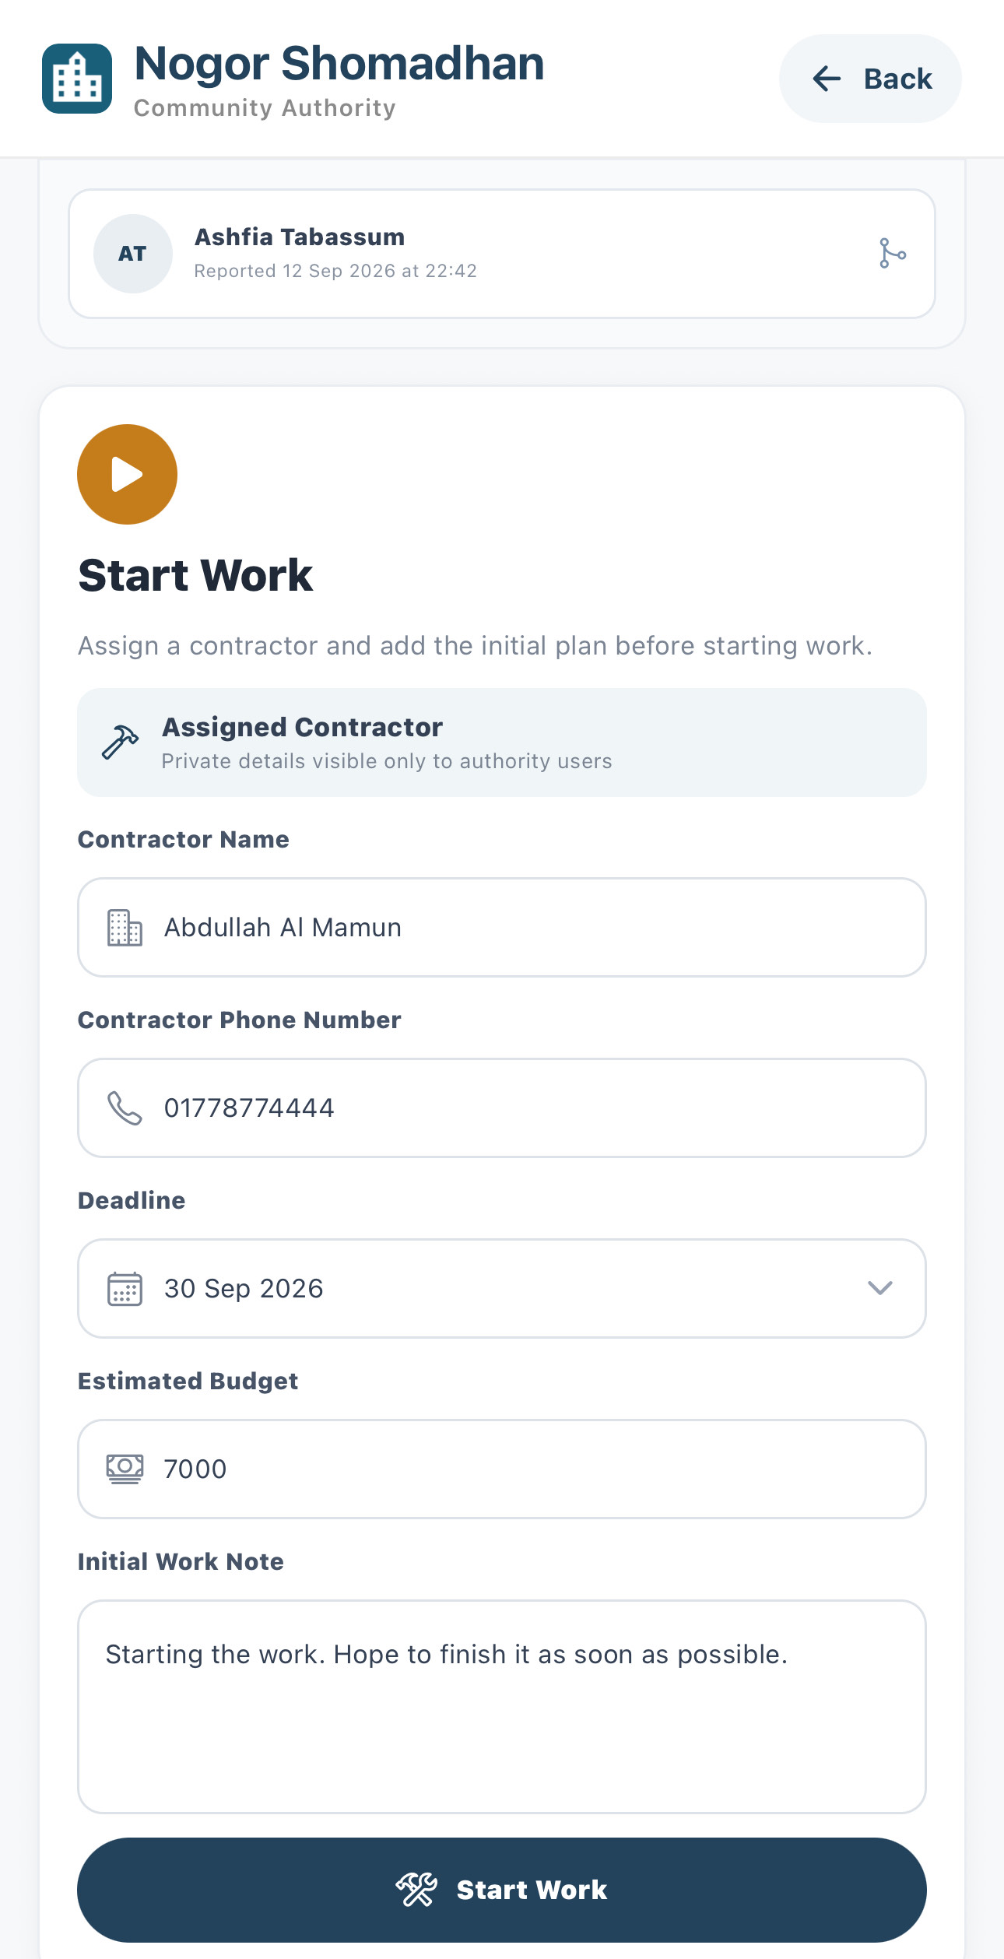
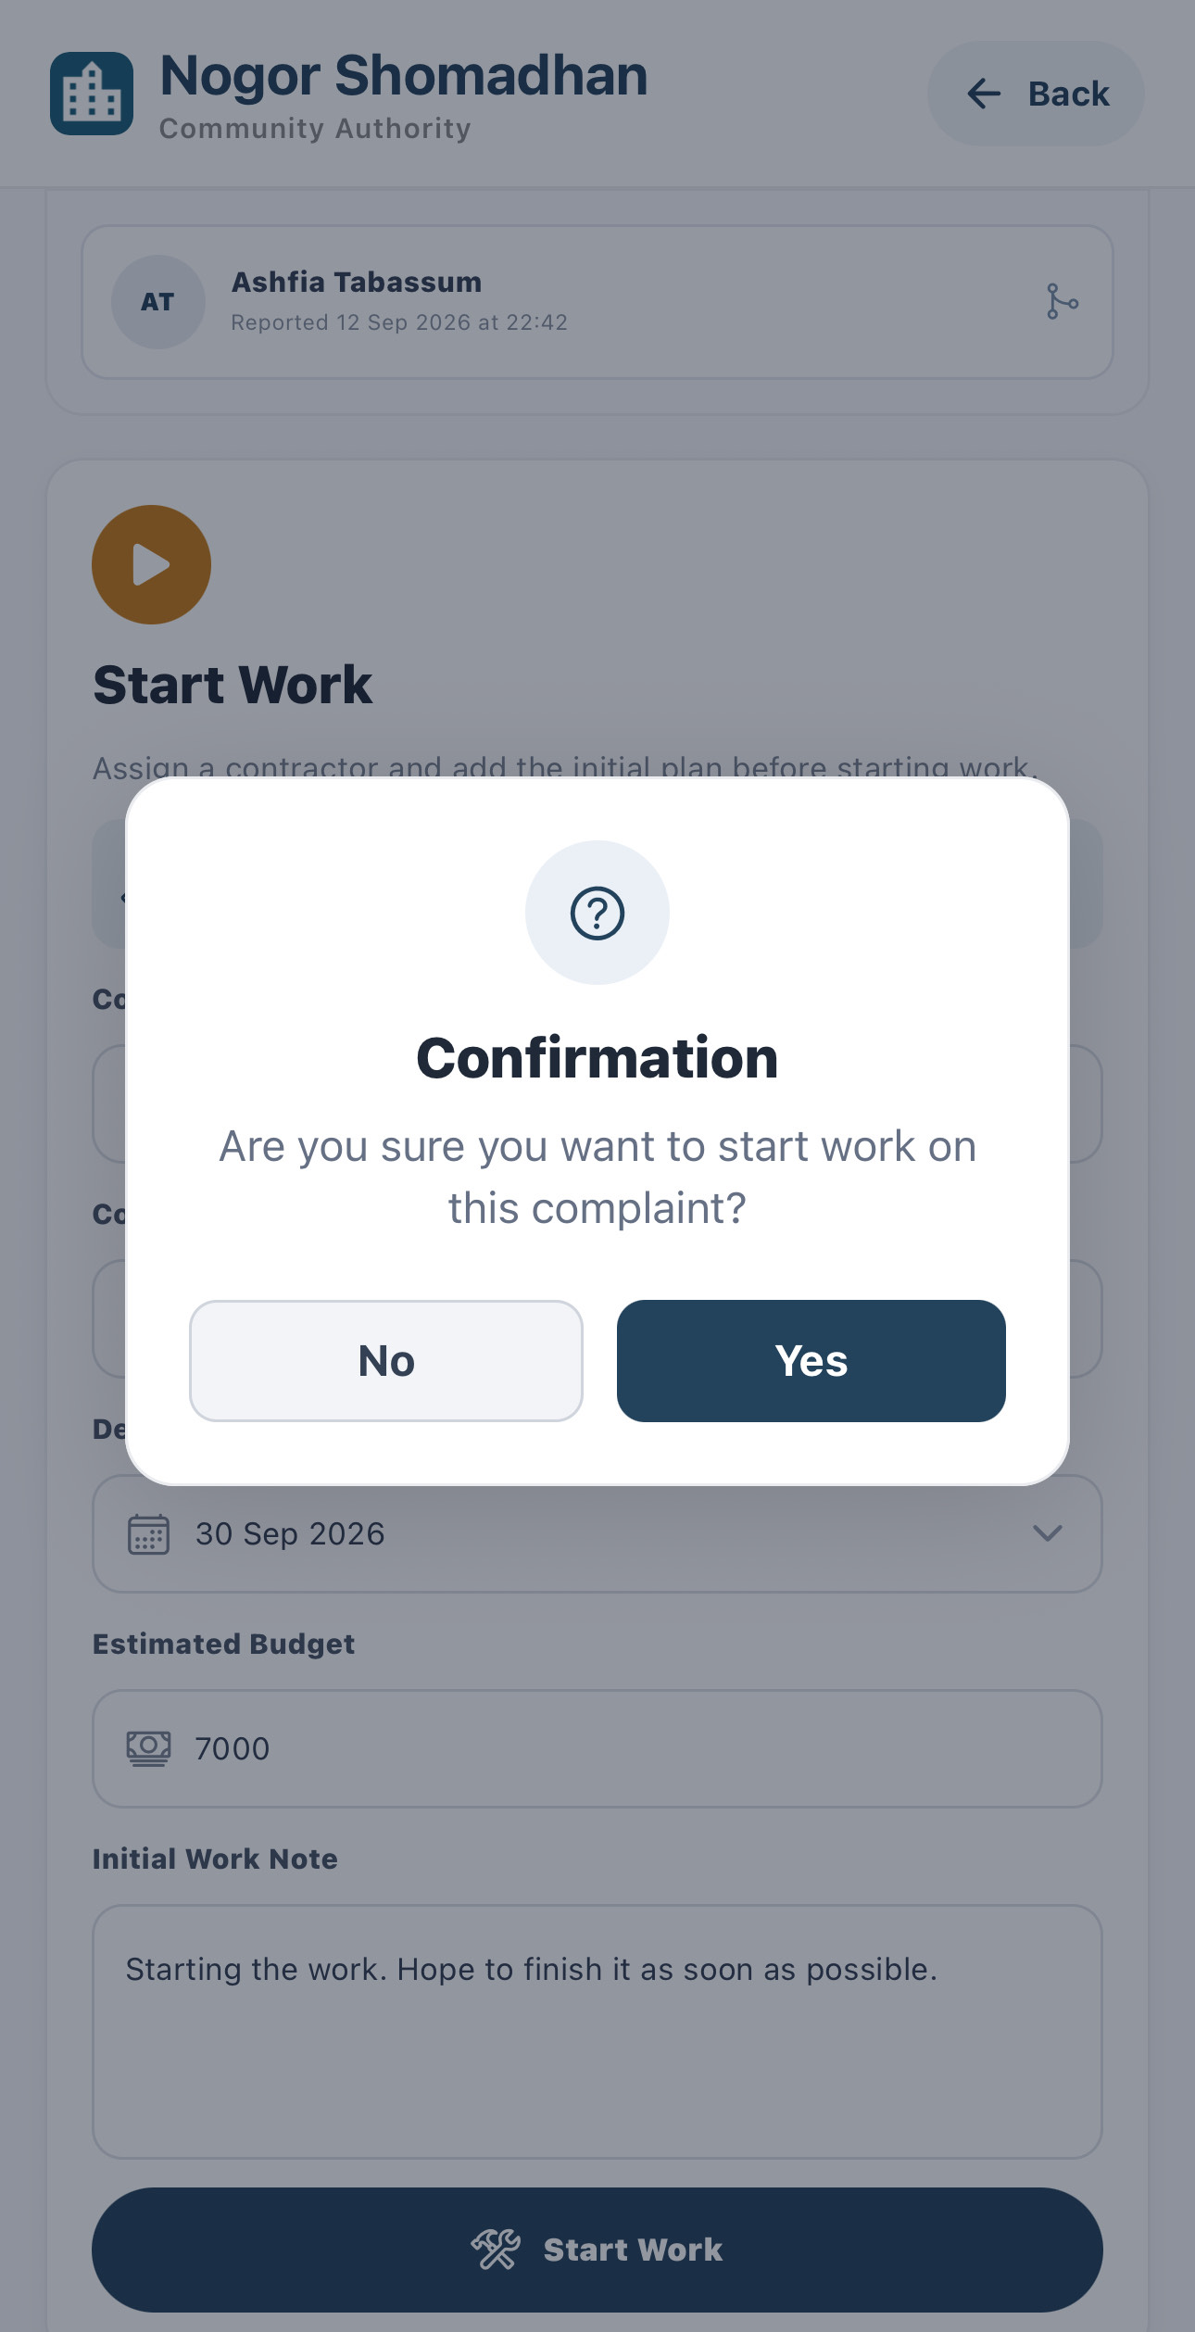
PHASE 4 · AUTHORITY STARTS THE WORK
Authority
Assign a Contractor and Start Work
3
4
5
See the primary reporter and the other residents who reported the same issue.
Enter the contractor, phone, deadline, budget, and an initial work note.
Confirm the prompt to start work on this complaint.
16 / 27

Slide 19
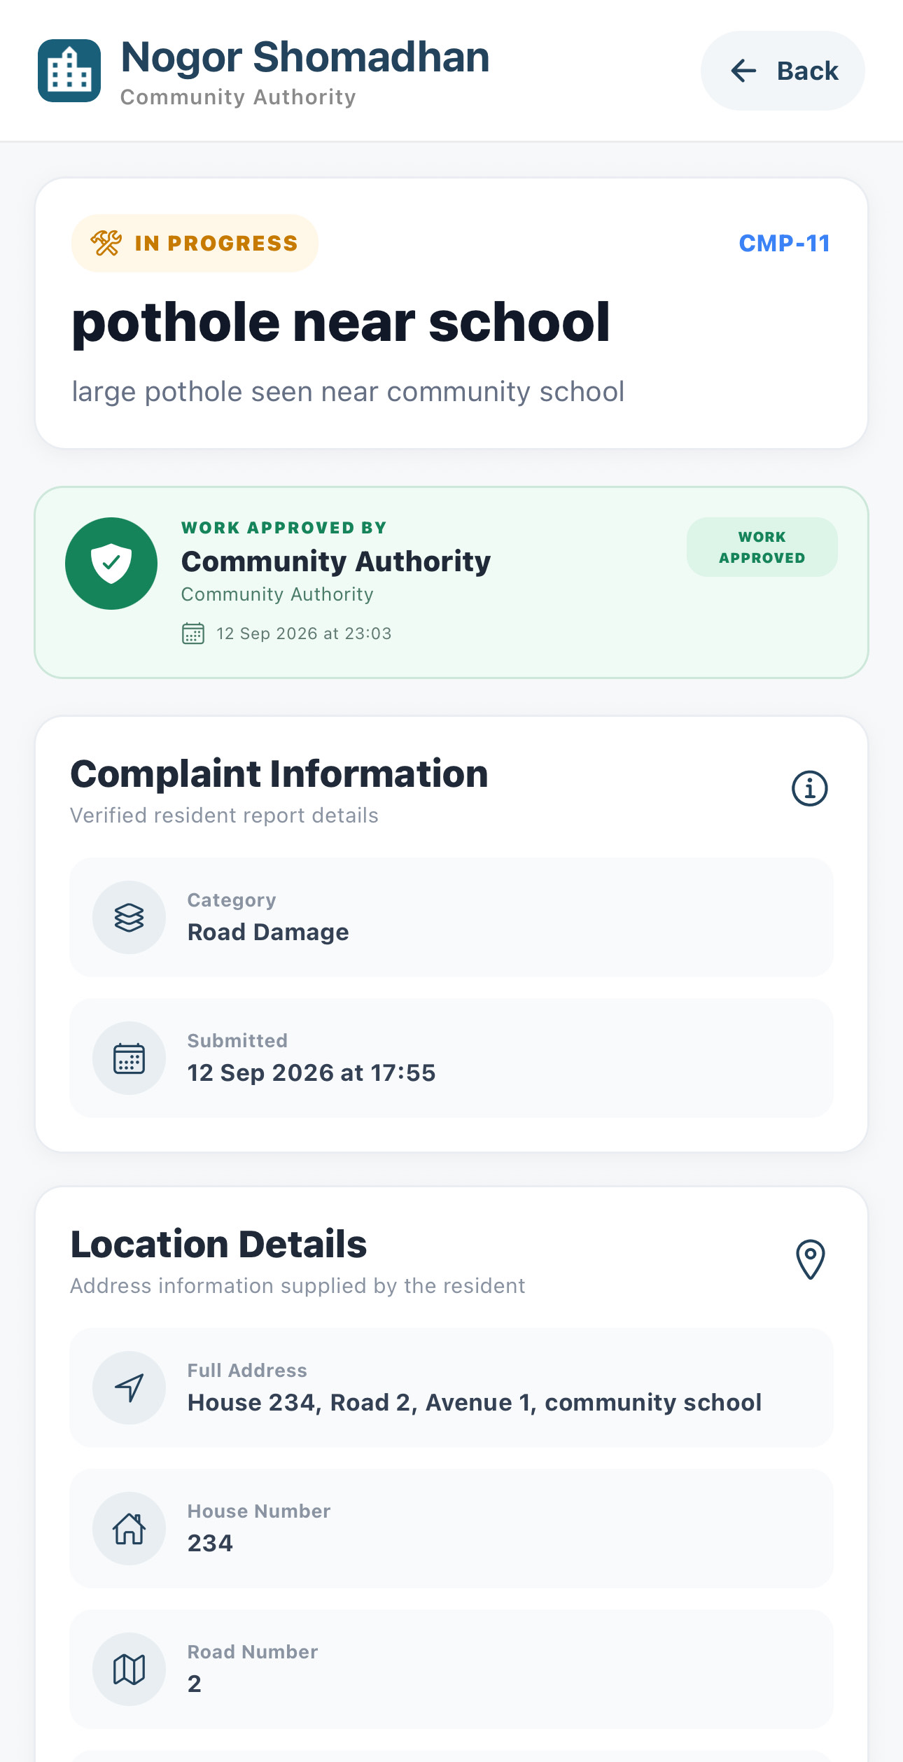
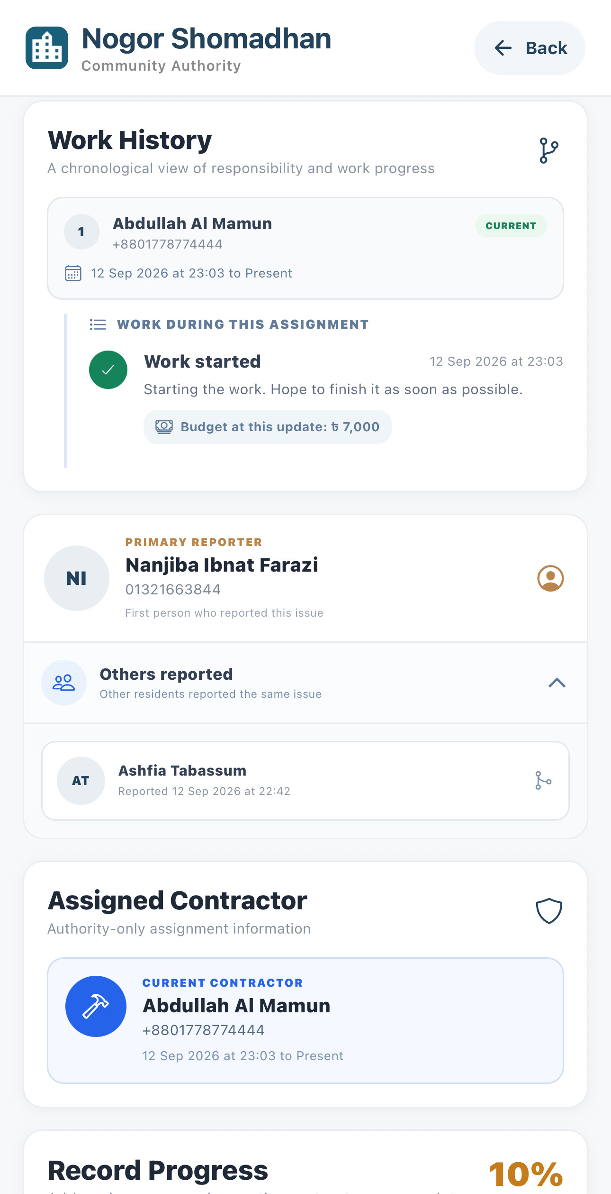
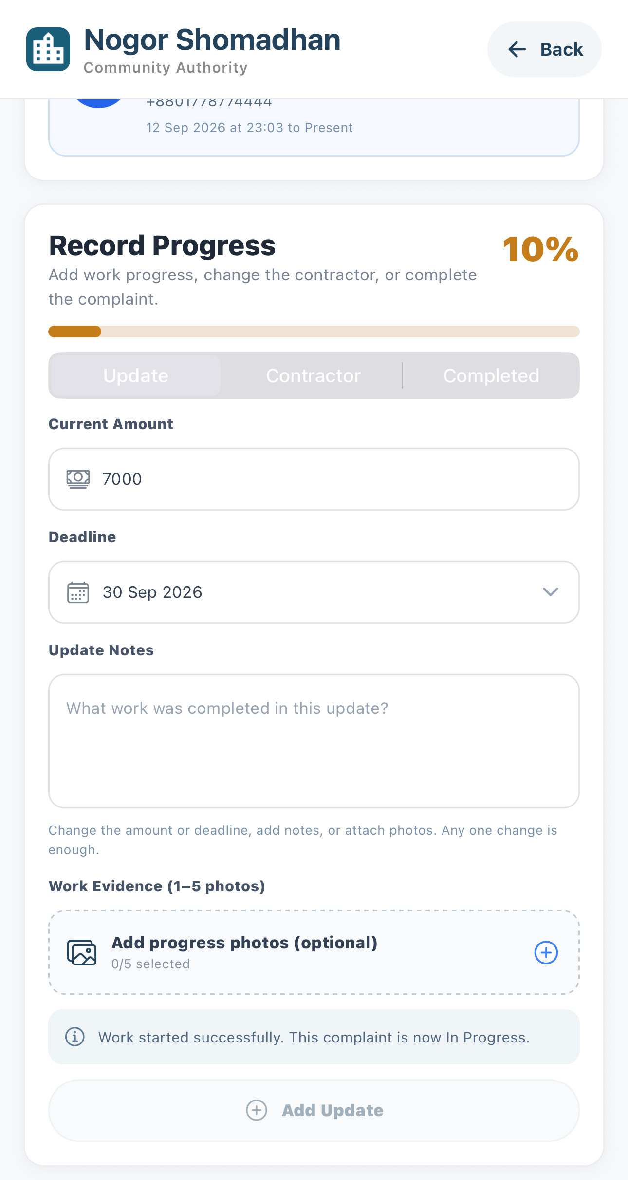
PHASE 4 · AUTHORITY STARTS THE WORK
The Complaint Moves to In Progress
Authority
7
8
6
The progress panel confirms the complaint is now In Progress and authority can change amount, deadline, contractor later if needed.
The status changes from Pending to In Progress and approval is recorded.
Work history records the assignment, the first note, and the budget.
17 / 27

Slide 20
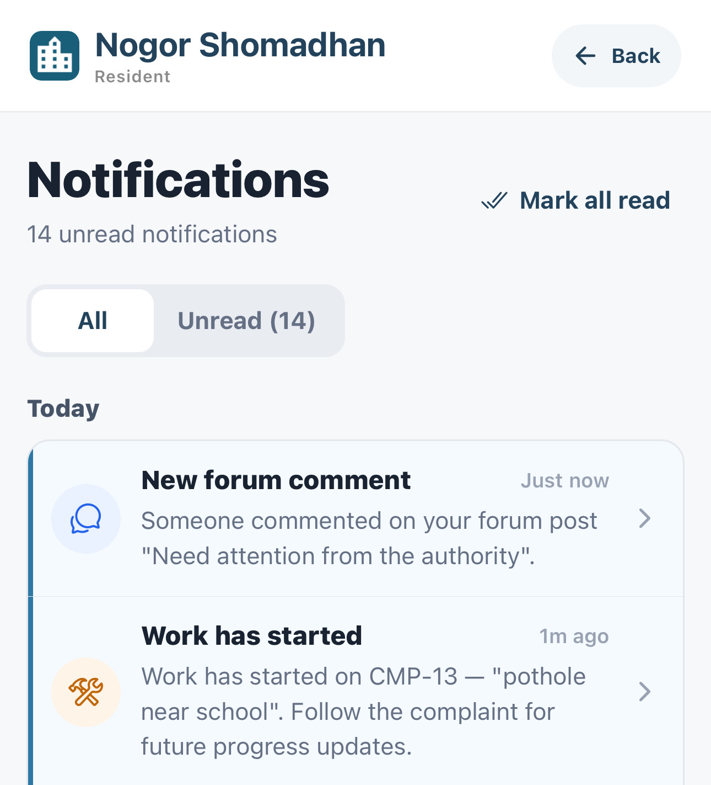
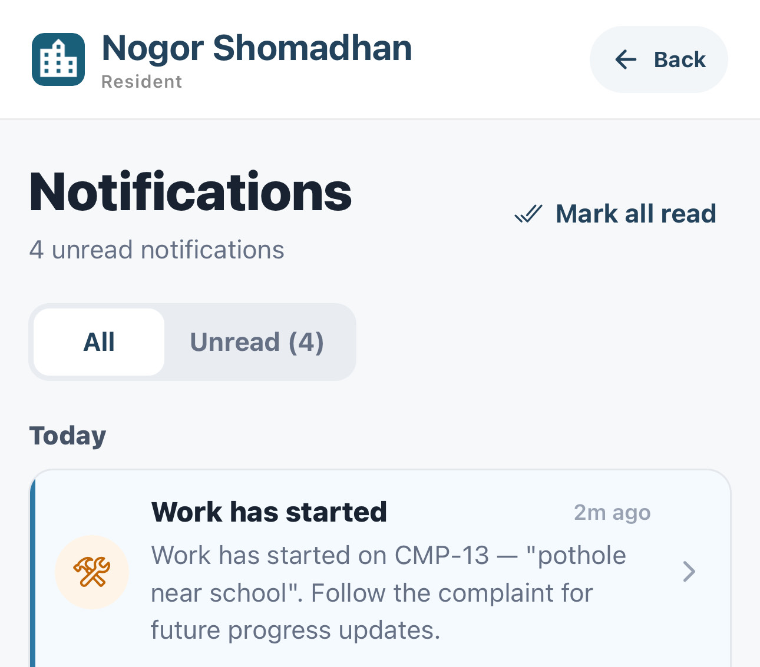
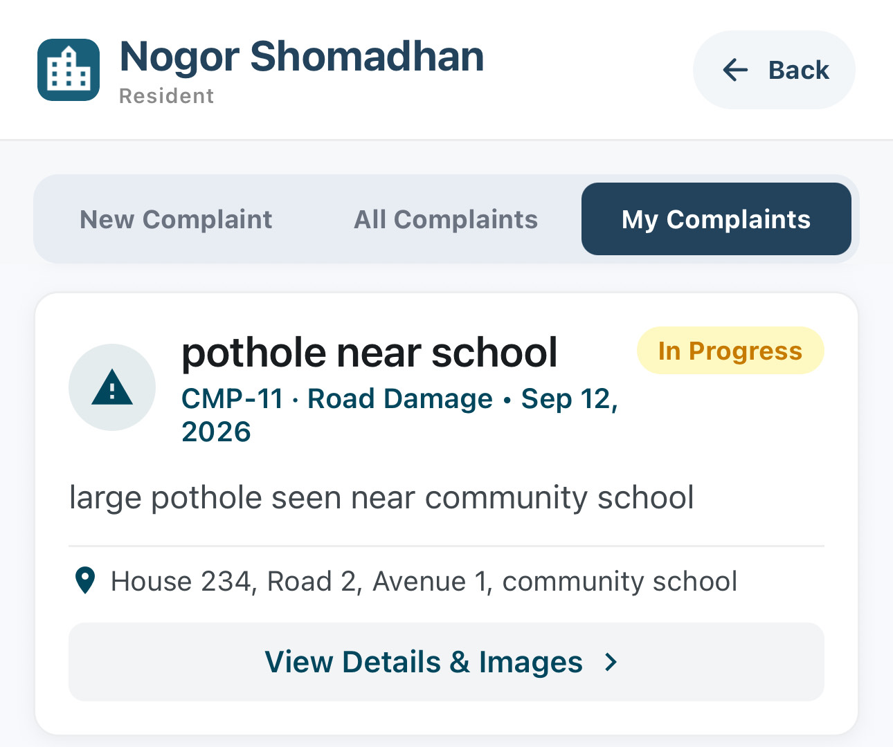
PHASE 4 · AUTHORITY STARTS THE WORK
Resident
Residents See the Progress Update
ORIGINAL REPORTER
DUPLICATE REPORTER
IN MY COMPLAINTS
10
11
9
The resident who reported the issue is notified that work has started.
The resident whose duplicate was linked receives the same update.
My Complaints shows the complaint as In Progress.
18 / 27

Slide 21
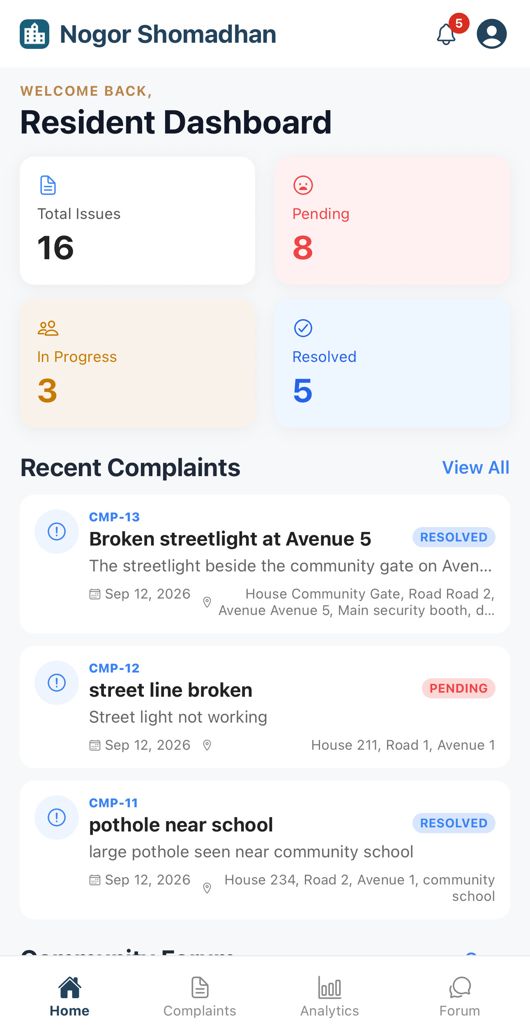
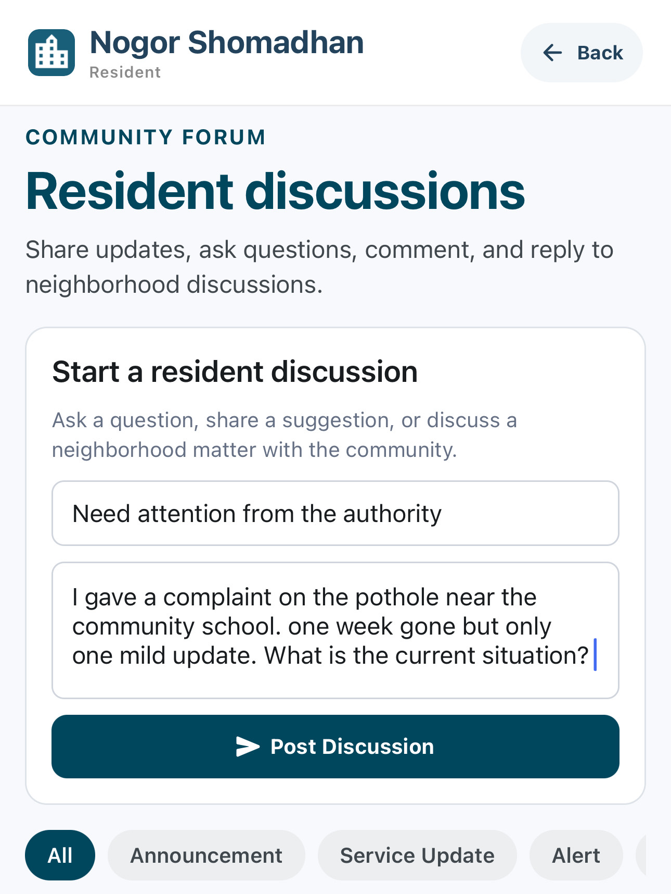
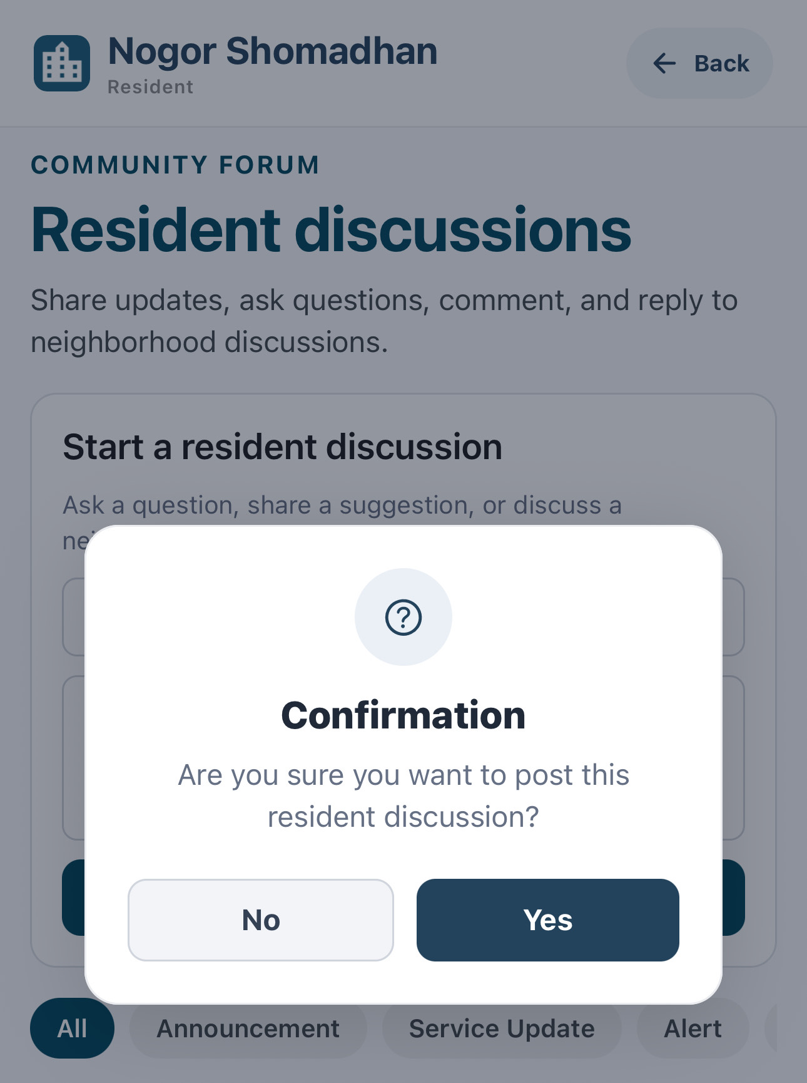
PHASE 5 · COMMUNITY FORUM DISCUSSION
Resident Starts a Forum Discussion
Resident
1
2
3
Open Forum from the resident dashboard.
Write a title, describe the issue, and post the discussion.
Confirm the prompt to publish the post to the community.
19 / 27

Slide 22
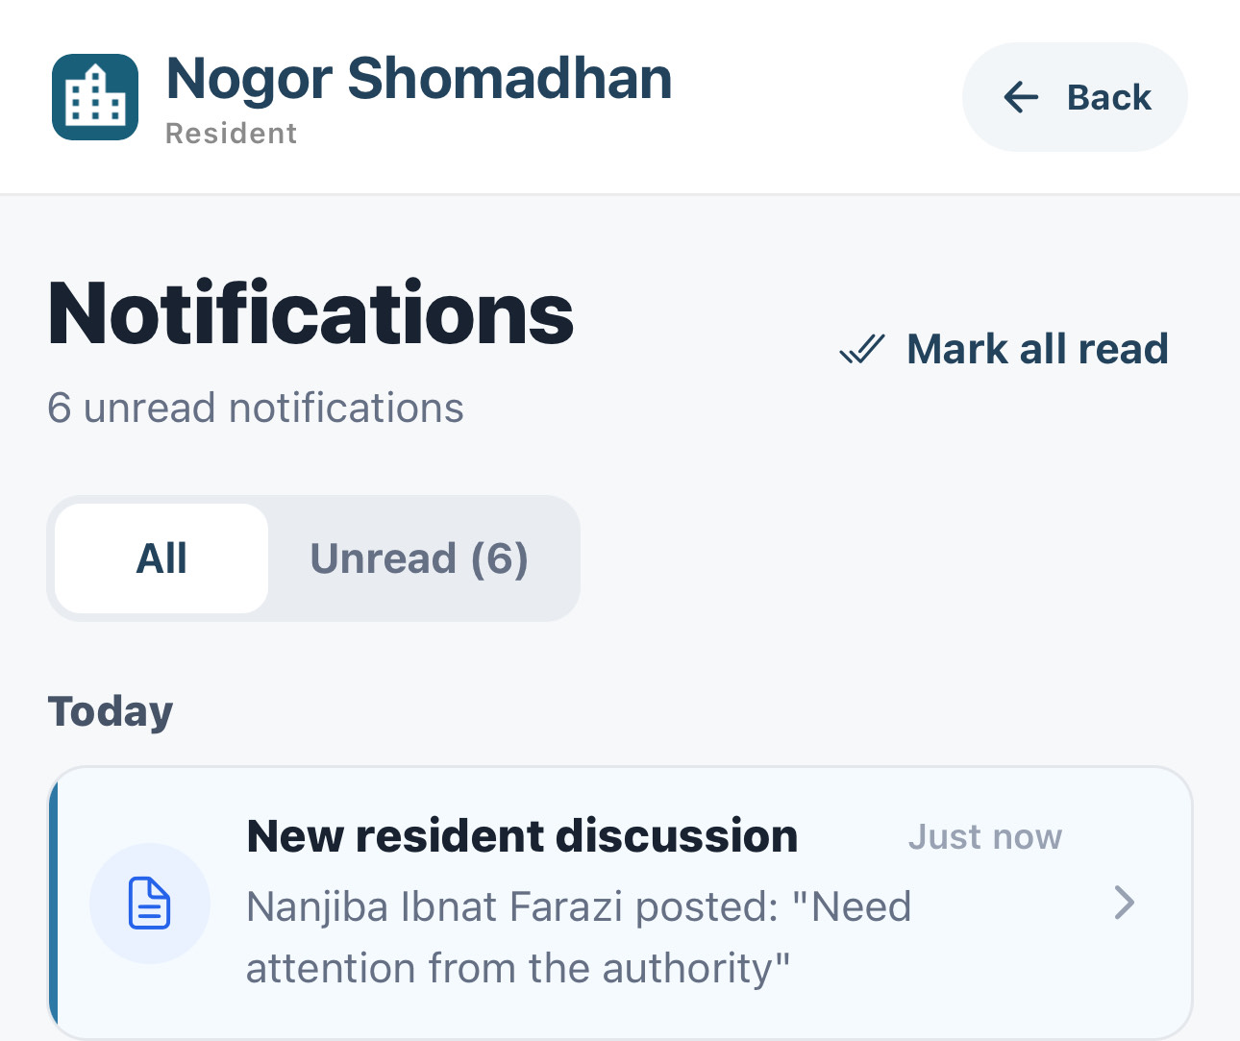
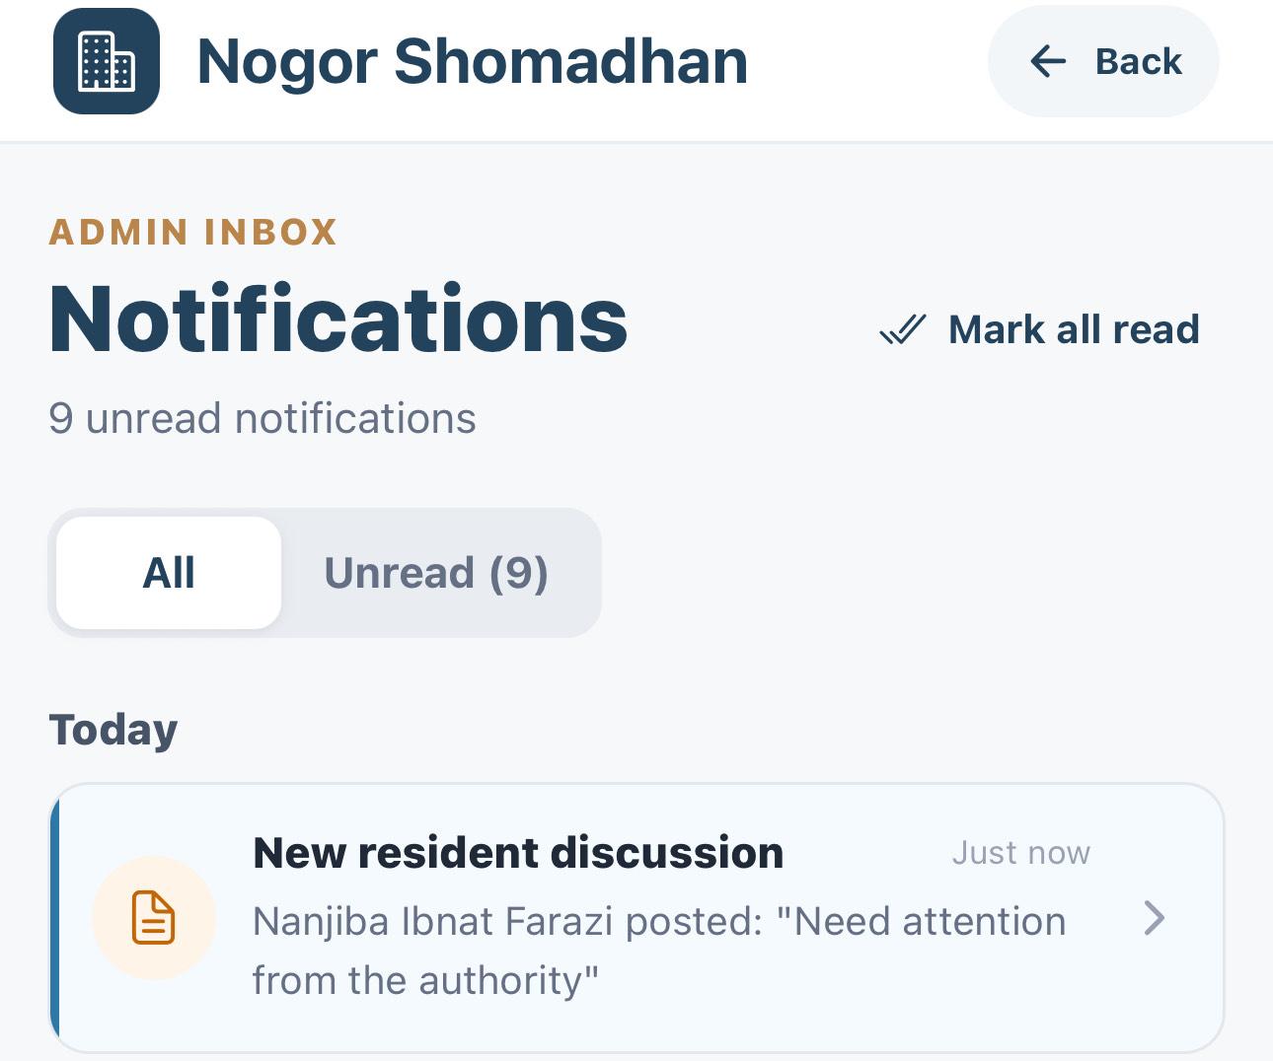

PHASE 5 · COMMUNITY FORUM DISCUSSION
Everyone Is Notified
Resident
Admin
Authority
RESIDENT
ADMIN
COMMUNITY AUTHORITY
4
5
6
Other residents are notified that a new discussion was posted.
The admin inbox receives the same discussion notification.
The community authority receives the same discussion notification.
20 / 27

Slide 23


PHASE 5 · COMMUNITY FORUM DISCUSSION
Open the Post and Discuss
Authority
Resident
AUTHORITY OPENS THE POST
RESIDENT
7
EVERYONE REPLIES IN ONE THREAD
Residents, the admin, and the community authority all answer in the same discussion. Official replies are badged so residents can tell them apart.
8
WHO TOOK PART
Residents — follow-up questions
Admin — progress replies
Authority — work updates
Selecting the notification opens the discussion directly, ready to reply.
Each new comment is sent to the other participants as a notification.
21 / 27

Slide 24



PHASE 6 · RESOLUTION AND RESIDENT FEEDBACK
Authority Updates the Work
Authority
Resident
1
2
3
Open Record Progress to change the amount, deadline, or contractor.
Work history records the contractor change and the new deadline.
The resident is notified that the deadline and progress changed.
22 / 27

Slide 25



PHASE 6 · RESOLUTION AND RESIDENT FEEDBACK
Authority Resolves the Complaint
Authority
6
4
5
Upload the final completion photo and the completion note.
Confirm the prompt to resolve the complaint.
The status changes to Resolved and the approval is recorded.
23 / 27

Slide 26



PHASE 6 · RESOLUTION AND RESIDENT FEEDBACK
Residents Give Feedback
Resident
8
7
9
The resident is notified that the complaint is resolved and can rate it.
Choose a star rating and write a short comment.
Confirm the prompt to submit the feedback.
24 / 27

Slide 27



PHASE 6 · RESOLUTION AND RESIDENT FEEDBACK
Feedback Is Public and Answered
Resident
Authority
12
11
10
The rating and comment appear on the complaint for everyone to see.
The authority is notified that a resident left a rating.
The authority replies to the feedback in the community discussion.
25 / 27

Slide 28



ADDITIONAL FEATURES · ANALYTICS AND FORUM TOOLS
Analytics and Reporting
Resident
Admin
Authority
2
3
1
Complaint volume, status, resolution rate, and response time at a glance.
Breakdowns by category and area, plus deadline and response performance.
Download Report PDF exports the selected period as a shareable file.
26 / 27

Slide 29


ADDITIONAL FEATURES · ANALYTICS AND FORUM TOOLS
Forum Announcements and Events
Authority
OFFICIAL POST TYPES
4
ANNOUNCEMENT
5
Planned notices, schedules, and community events
SERVICE UPDATE
Progress or changes to community services
ALERT
Urgent, time-sensitive information
Residents can filter the forum by type.
Create an event, mark the dates, and post it to the community.
Write an official post and choose its message type before publishing.
27 / 27

Slide 30
THANK YOU

