Slide 1


Nogor Shomadhan
Application demonstration and user manual
Resident report / AI review / Authority resolution
FINAL PRESENTATION · WEEK 13
12-minute group presentation
Notes:
Timing: 30 seconds. Introduce Nogor Shomadhan as a civic complaint platform connecting residents, administrators, and community authorities. State that the demonstration follows one complaint through its complete life cycle.

Slide 2
1
Complete complaint workflow
Both roles
1
2
3
4
5
Resident
System
Admin
Authority
Resident
Report issue
Classify and compare
Review and verify
Work and document
Confirm outcome
Photo, location, description
AI category and duplicate check
Approve, reject, or merge
Budget, updates, evidence
Track, rate, and comment
Status sequence
Unverified
›
Pending
›
In progress
›
Resolved
Notifications keep the resident and authority informed at each material status change.
Nogor Shomadhan • Final user manual
2
Notes:
Timing: 50 seconds. Explain the handoff between roles. Emphasize that AI assists classification and duplicate detection, while the admin makes the final review decision. The authority owns execution and evidence. The resident sees the full history and submits feedback.

Slide 3
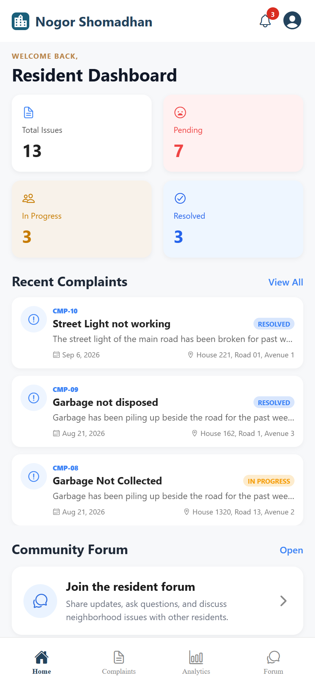
2
Resident dashboard and navigation
Resident
1
Sign in with a verified resident account.
Demo focus
2
Open a complaint or start a new report. Skip profile editing during the live presentation.
2
Review total, pending, in-progress, and resolved counts.
3
Tap a recent complaint to open its details.
Resident can also browse all verified community complaints, raise urgency, comment, and follow progress.
3
4
Use the bottom tabs for Complaints, Analytics, and Forum.
4
Nogor Shomadhan • Final user manual
Resident dashboard
3
Notes:
Timing: 45 seconds. Show the four status cards and recent complaints. Mention the navigation tabs once, then move directly to the complaint form. Authentication is demonstrated only if the evaluator asks.

Slide 4
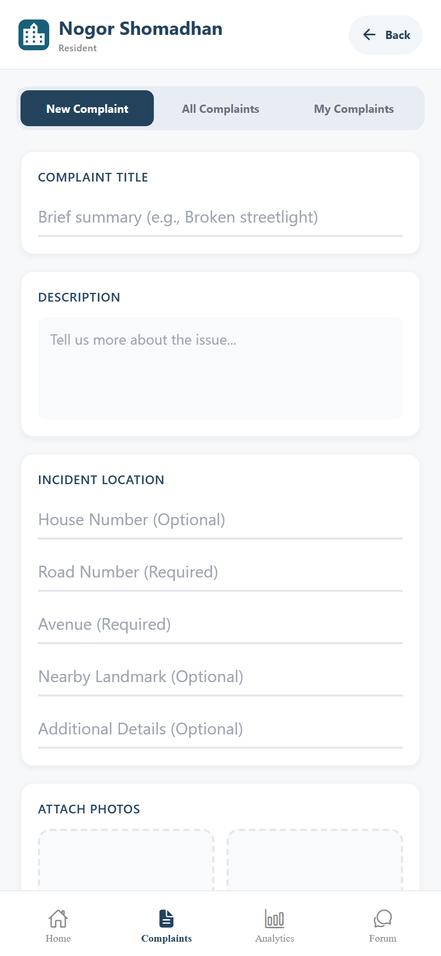
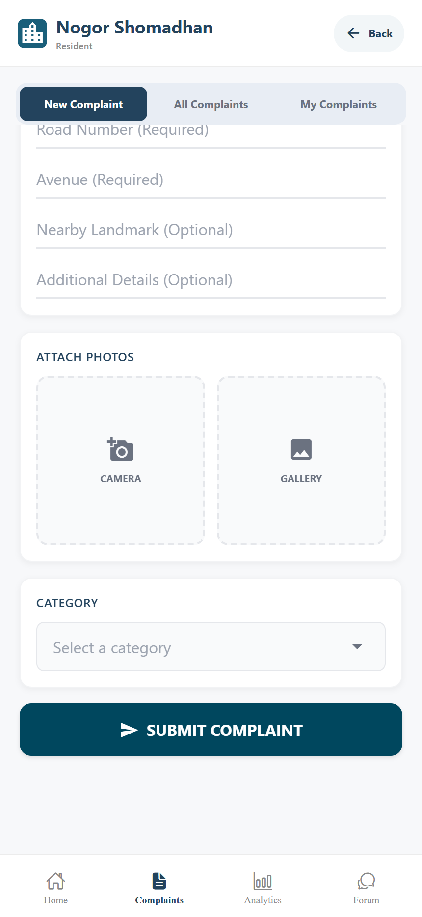
3
Submitting a new community issue
Resident
1
Open Complaints and select New Complaint.
Automatic after submission
2
Enter a clear title and description.
2
The system assigns a category, stores the report as Unverified, and starts duplicate screening.
3
Provide road and avenue; add a landmark when useful.
4
3
4
Attach photo evidence from the camera or gallery.
5
Review the entries and tap Submit Complaint.
5
Issue details
Evidence and submission
Nogor Shomadhan • Final user manual
4
Notes:
Timing: 70 seconds. Enter only enough data to demonstrate the required fields. Use a prepared photo to avoid camera delay. After submission, explain that classification and duplicate checking run automatically.

Slide 5
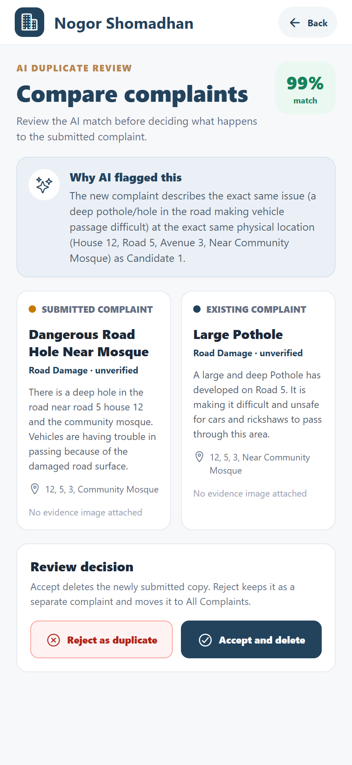
4
AI categorization and duplicate review
System + Admin
1
AI selects one complaint category from the system list.
4
Decision meaning
Accept as duplicate removes the newly submitted copy. Reject as duplicate keeps it as a separate complaint.
2
It compares recent reports in the same category.
3
Location and the real-world issue carry more weight than wording.
4
A score of 80% or higher creates an admin warning.
Stored confidence: 98.5%. The screen rounds it to 99%.
5
Admin compares both reports and makes the final decision.
5
Nogor Shomadhan • Final user manual
Admin duplicate comparison
5
Notes:
Timing: 60 seconds. Explain that the AI does not delete complaints. It produces a confidence score and reason. The admin retains control. In the live dataset, the road-hole reports show a 98.5 percent match.

Slide 6
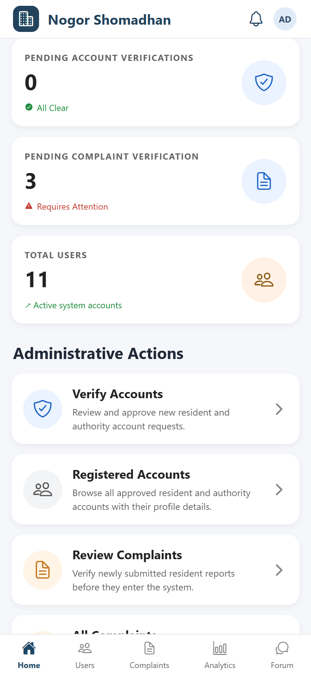
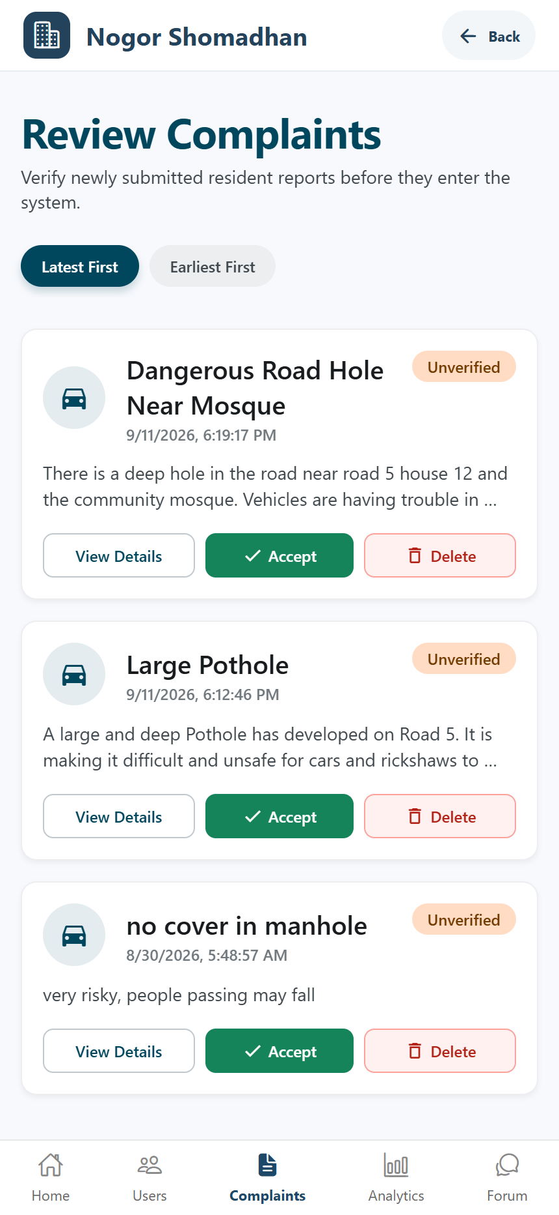
5
Admin verification and routing
Admin
1
Open Review Complaints from the admin dashboard.
2
Inspect the report title, location, category, and submitted evidence.
Result
3
The review step protects the authority queue from unverified or duplicate reports.
3
Open any possible-duplicate warning before deciding.
4
Verify a valid report or reject an invalid submission.
5
Verified complaints enter the authority workflow.
4
1
Admin dashboard
Review queue
Nogor Shomadhan • Final user manual
6
Notes:
Timing: 55 seconds. Open the review queue, select one complaint, and point to the evidence and decision controls. Do not spend time on account verification unless the evaluator asks about onboarding governance.

Slide 7
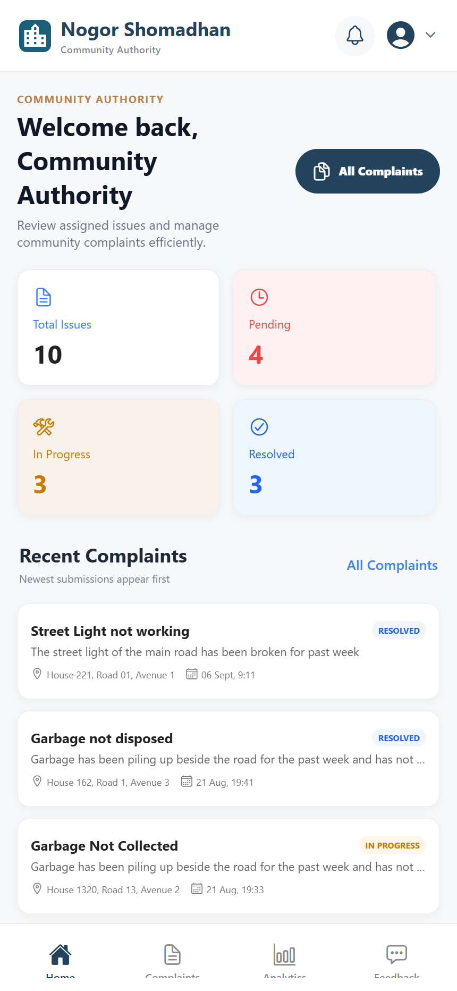
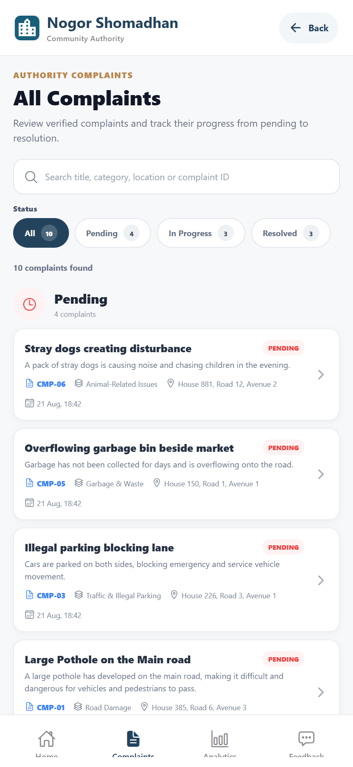
6
Authority dashboard and complaint queue
Authority
3
1
Sign in with a verified authority account.
Recommended live demo
2
Open one In Progress complaint with evidence already loaded.
2
Review workload counts by current status.
4
3
Open All Complaints or use the Complaints tab.
4
Filter the queue and select the next issue to handle.
Authority dashboard
Complaint queue
Nogor Shomadhan • Final user manual
7
Notes:
Timing: 45 seconds. Use the workload cards to explain prioritization, then open the complaint queue. Choose an existing in-progress complaint so progress history and evidence are immediately visible.

Slide 8
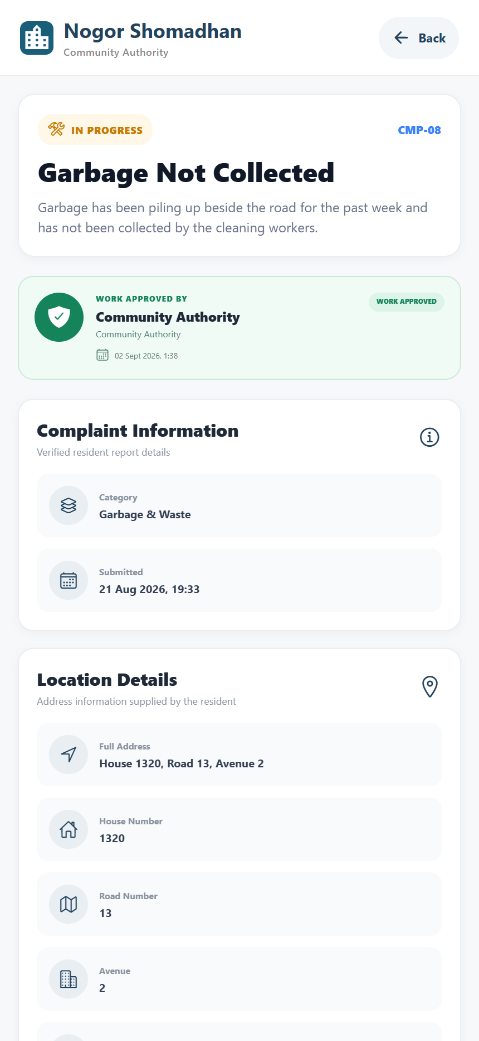
7
Reviewing an assigned complaint
Authority
1
Confirm the status, category, and complaint description.
1
Before updating status
2
Check the address and nearby location details.
Confirm that the report and location describe the same issue shown in the evidence photo.
3
Review the resident’s original evidence.
2
4
Verify assignment, estimated budget, and deadline.
5
Use the work history to understand earlier actions.
3
Nogor Shomadhan • Final user manual
Complaint overview
8
Notes:
Timing: 55 seconds. Point out the status badge, complaint metadata, location, and resident evidence. Explain that these checks reduce mistaken assignments before work starts.

Slide 9
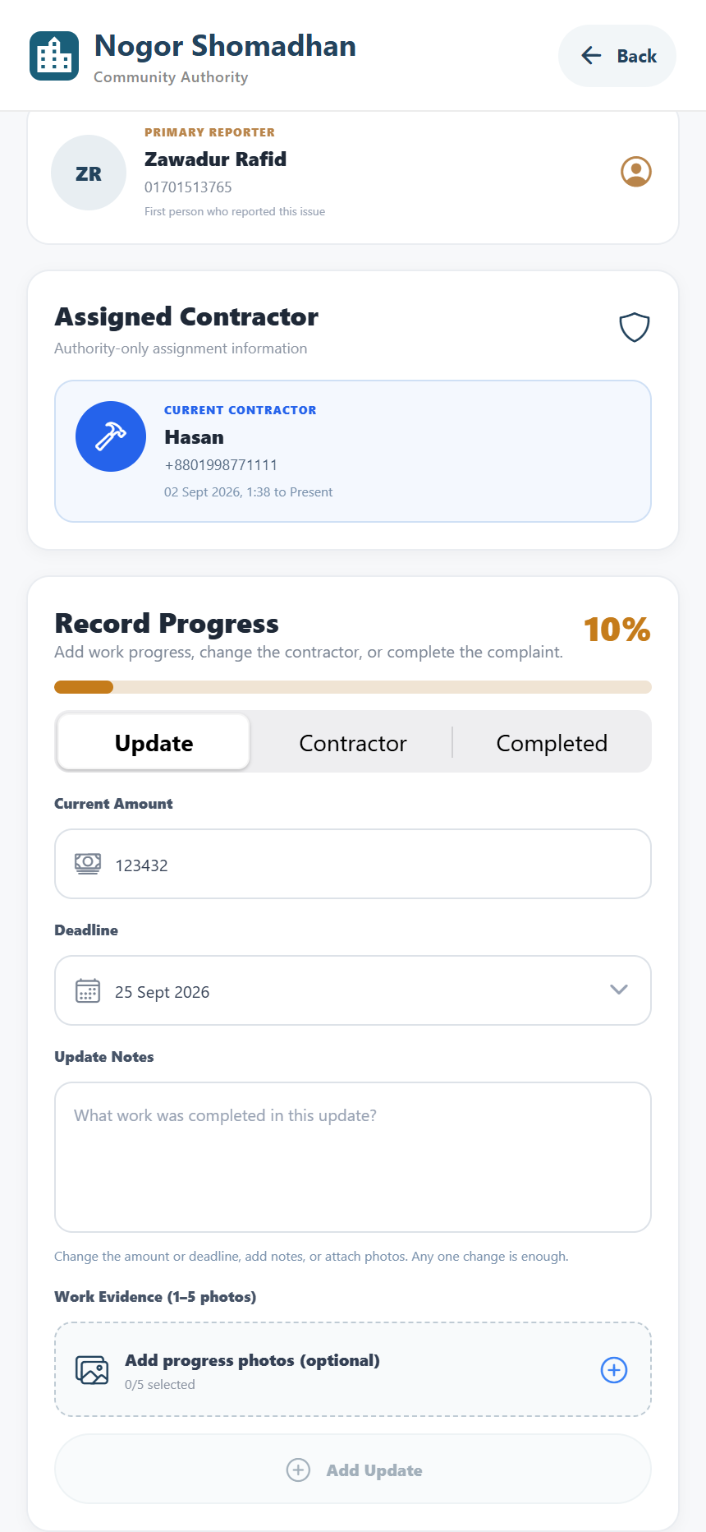
8
Recording work progress
Authority
1
Open the action area for the in-progress complaint.
Transparency rule
2
Select Update, Contractor, or Completed.
Budget, deadline, notes, and evidence changes remain visible in the complaint history.
3
Enter a new amount or deadline when either changes.
2
3
4
Add a concise work note and attach progress photos.
4
5
Save the update; it becomes part of the visible history.
Progress controls
Update details
Nogor Shomadhan • Final user manual
9
Notes:
Timing: 70 seconds. Demonstrate one progress update. Add either a note, a photo, or a changed amount or deadline. Mention that any one change is enough to save an update, and the resident can see it afterward.

Slide 10
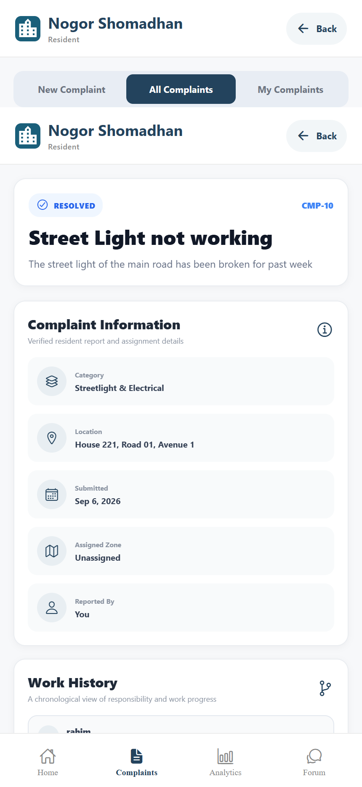
9
Completing and documenting the resolution
Both roles
1
Select Completed in the authority action area.
Resolved record
4
Residents can review the resolved status, complaint details, final proof, and every recorded work update.
2
Enter the final resolution note.
3
Confirm the final budget and attach completion evidence.
5
4
Submit the resolution to close the complaint.
This closes the operational loop before feedback begins.
5
The record becomes read-only and the resident receives an update.
5
Nogor Shomadhan • Final user manual
Resolved complaint and work history
10
Notes:
Timing: 55 seconds. Show the final evidence and work history. Explain that the closed record is read-only for the authority and remains visible to residents for accountability.

Slide 11
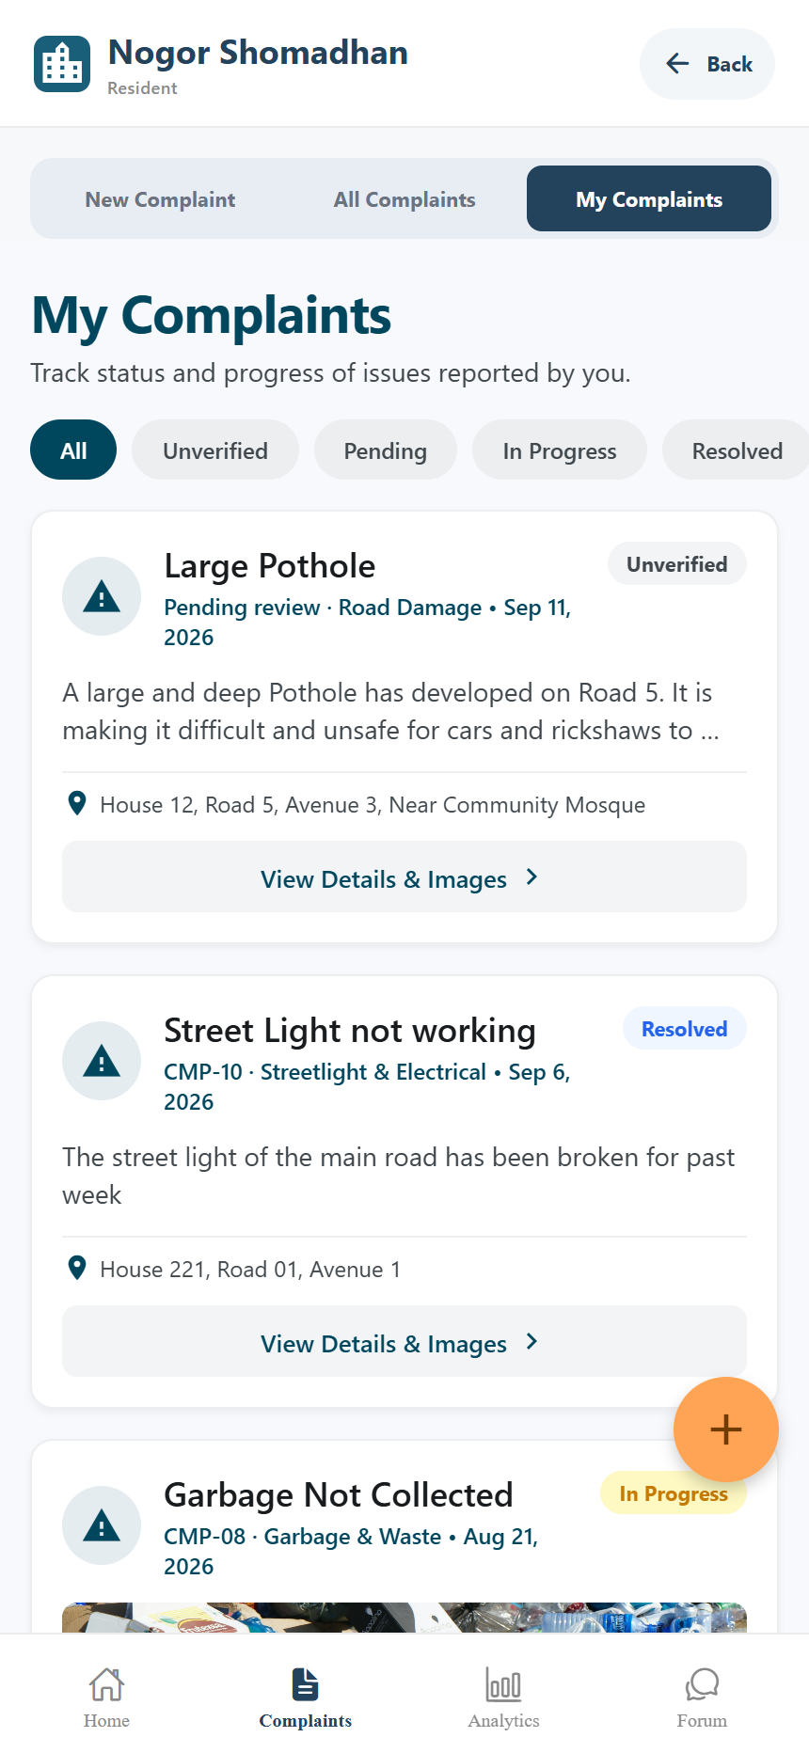
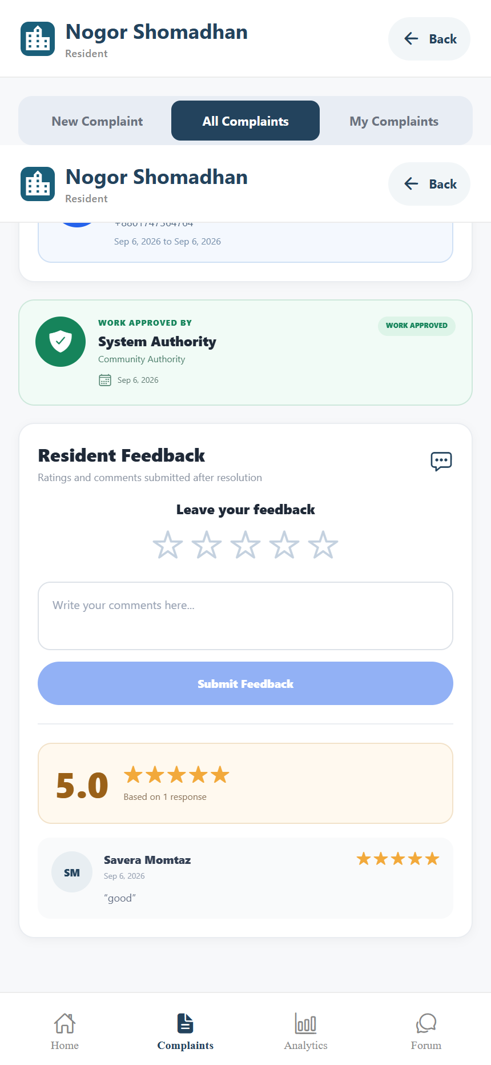
10
Resident confirmation and feedback
Resident
1
Open My Complaints and choose a resolved report.
2
Review the resolution evidence and work history.
Outcome
Feedback gives authorities a visible quality signal after the technical work is complete.
1
3
Scroll to Resident Feedback.
3
4
Choose a rating from one to five stars.
4
5
Write a short comment and submit feedback.
5
My complaints
Feedback section
Nogor Shomadhan • Final user manual
11
Notes:
Timing: 50 seconds. Open My Complaints, select a resolved item, and jump to the feedback section. If time is tight, show the rating controls without submitting a new review.

Slide 12
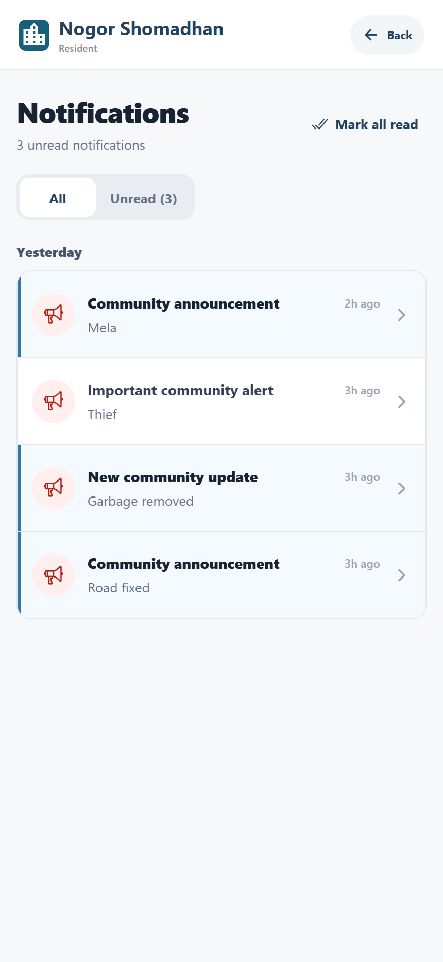
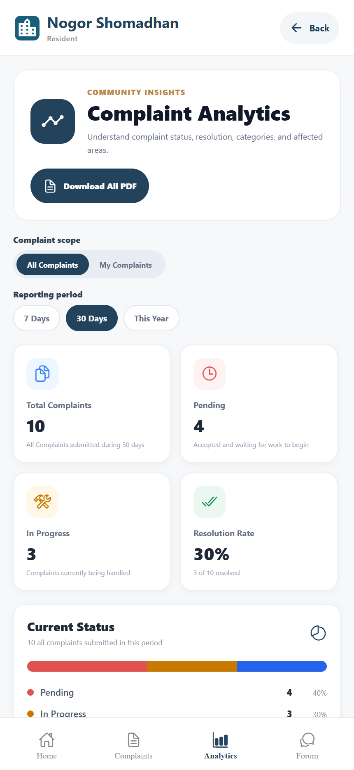
11
Notifications, analytics, and PDF reports
Resident
1
Open Notifications to review status and community updates.
5
3
2
Tap an actionable alert to return to its complaint.
Use in the demo
Show one notification and one analytics filter. Mention PDF export without waiting for the share sheet.
2
4
3
Open Analytics and choose All Complaints or My Complaints.
4
Select a reporting period to refresh the metrics.
5
Download a PDF report when a shareable summary is needed.
Notifications
Complaint analytics
Nogor Shomadhan • Final user manual
12
Notes:
Timing: 50 seconds. Open one actionable notification, then show the analytics scope and period controls. Mention that the app generates resident, authority, and admin PDF summaries. Avoid waiting for the operating system share dialog during the presentation.

Slide 13
12
12-minute demonstration runbook
Both roles
Live sequence
Q&A code map
0:00–1:00
Problem and workflow
Slides 1–2
Report form
src/app/(resident)/complaints/create.tsx
1:00–3:20
Resident dashboard and report
Slides 3–4
AI categorization
3:20–5:10
AI check and admin decision
Slides 5–6
src/services/ai.service.ts
Duplicate detection
5:10–8:30
Authority triage, update, and resolution
Slides 7–10
src/services/duplicate.service.ts
Authority workflow
8:30–10:10
Resident feedback
Slide 11
src/components/authority/authority-complaint-detail-screen.tsx
10:10–11:10
Notifications and analytics
Slide 12
Notifications
src/store/notification-store.ts
11:10–12:00
Summary and transition to Q&A
Close
PDF analytics
src/services/*-analytics-report.service.ts
Prepare the app on the resident and authority screens before the timer starts.
Nogor Shomadhan • Final user manual
13
Notes:
Use this slide during rehearsal, not necessarily during the live demonstration. Keep two devices or browser sessions ready: one resident and one authority. Keep the admin duplicate review open in a third tab. During Q&A, use the code map to jump directly to the relevant implementation.

