Slide 1
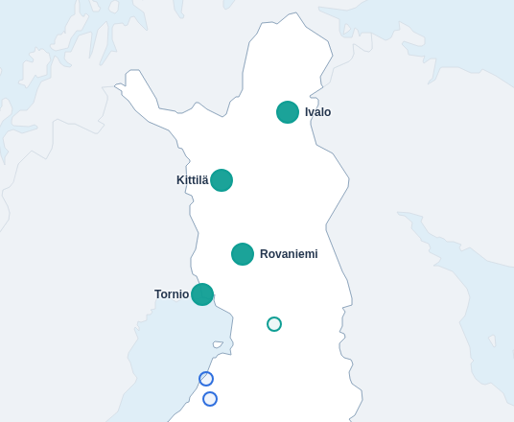
Tulva spring-flood risk, priced jointly
In May 2005, Kittilä and Ivalo flooded together.
The snow had warned us two months earlier.
1 March snow flagged 2005 in advance. Kittilä and Ivalo then passed their flood levels in the same spring.
Tulva app, year replay: spring 2005
Source: SYKE discharge 1961–2025 and 1 March snow (SWE); Tulva back-test (out/backtest.json)
Tulva 1
Notes:
[Hook (0:00–0:12)]
In May 2005, Kittilä and Ivalo flooded together. The snow had warned us two months earlier. Nobody priced that warning. Tulva does.

Slide 2
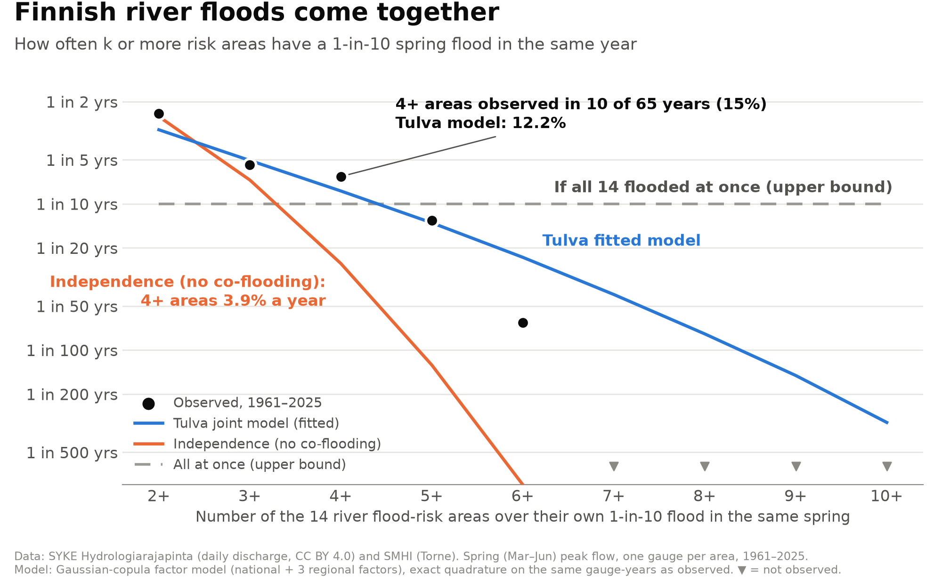
THE GAP
Finland's rivers flood together, not one at a time
Springs when ≥4 of the 14 river areas flooded (own 1-in-10 level)
15.4 %
observed, 1961–2025 (10 of 65 years)
12.2 %
Tulva joint model
3.9 %
if areas were independent
Home insurance pays only for floods rarer than 1-in-50.
Reinsurance renews 1 January, before the snow signal.
Source: SYKE 1961–2025 (+ SMHI Torne), Tulva model (exact); vesi.fi / OP (1-in-50 rule)
Tulva 2
Notes:
[The gap (0:12–0:32)]
Finnish rivers share one snowpack, so they flood together. In 65 years of SYKE data, four or more of fourteen river areas flooded in the same spring 15 percent of the time. Independence says 3.9. And reinsurance renews on 1 January, before the snow arrives.

Slide 3
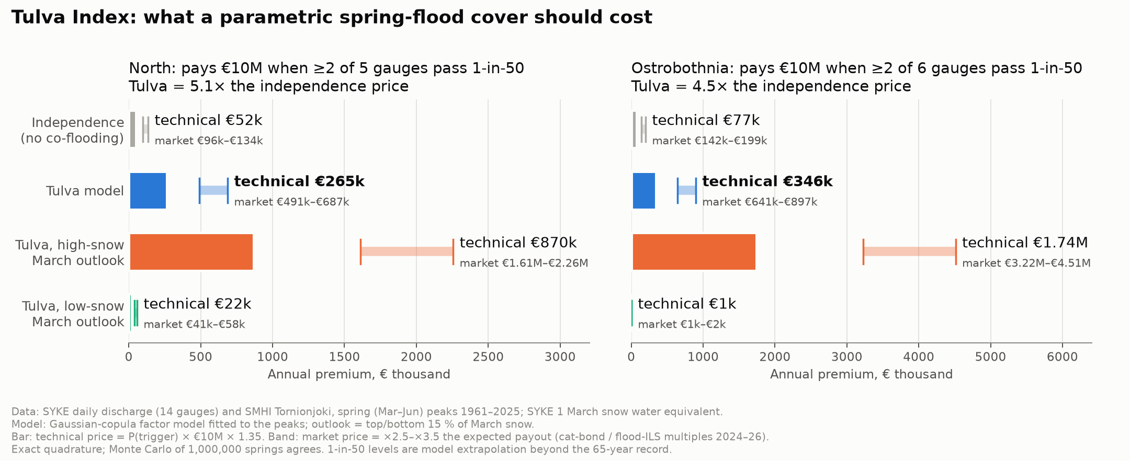
WHAT IT COSTS
Priced as independent, a joint flood cover is ~5× too cheap
North cluster: pays €10M if ≥2 of 5 gauges pass their 1-in-50 level. Market price per year:
€96k–134k
→
€491k–687k
5.1×
if areas were independent
Tulva joint risk (technical €265k)
Tulva vs independence
Source: SYKE 1961–2025, Tulva model (exact; MC 1M agrees). Market = 2.5–3.5× expected payout (AM Best cat bonds, flood ILS)
Tulva 3
Notes:
[What it costs (0:32–0:45)]
That gap has a price. A cover paying when two of five northern gauges pass their 1-in-50 level: about 100 thousand euros a year if you assume independence. On the joint risk, 500 to 700 thousand. Five times more.

Slide 4
THE PRODUCT
Tulva Index: bought in winter, pays in spring
TULVA INDEX · NORTH CLUSTER
Pays €10M if ≥2 of 5 northern gauges pass their 1-in-50 level this spring
Independence
Tulva
After a snowy March
€96k–134k
€491k–687k
€1.61M–2.26M
market price per year
market price per year
market price per year
Bought in winter
before the snow signal exists
Staged option
50 % paid at 2 gauges, 100 % at 3
Explainable trigger
public SYKE gauges anyone can check
11 of 19 payout years flagged in advance by the 1 March snow, 2005 included
Source: Tulva model, exact; market 2.5–3.5× expected payout. Back-test 1961–2025, all clusters, ≥2 gauges over 1-in-10, in-sample
Tulva 4
Notes:
[Tulva Index (0:45–1:05)]
The Tulva Index pays ten million euros if two of those gauges pass 1-in-50 this spring. Bought in winter, triggered by a public gauge anyone can check. Back-tested, the March snow flag caught 11 of 19 payout years, 2005 included.

Slide 5
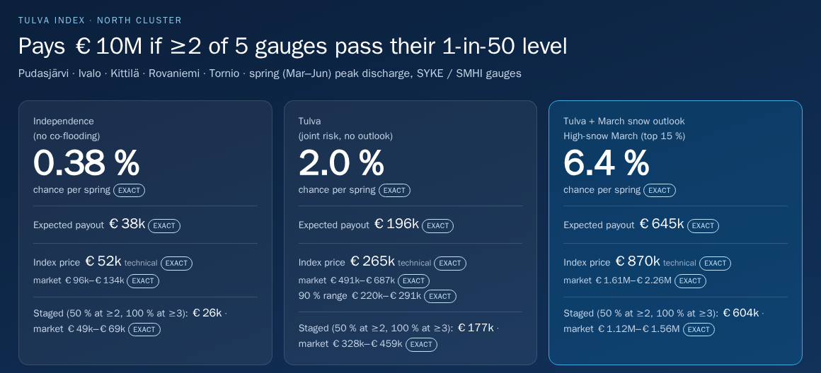
DEMO VIDEO (≈60 s) — insert recording here
Live app: the joint-flood map → March snow outlook → index price → real quantum runs → 2005 replay
Tulva 5
Notes:
[Demo video (1:05–2:05)]
This is Tulva, built this weekend on 65 years of SYKE river data. The map shows Finland's fourteen river flood-risk areas in three clusters; lines join areas whose spring peaks move together. Now set the March snow outlook to high snow. In the North, the chance that two gauges pass their 1-in-50 level jumps, and the index price follows: from 265 thousand to 870 thousand euros, technical. The product card shows the same cover three ways: independence, Tulva, and Tulva after a snowy March. Under the hood, the same joint model runs on real quantum chips, IBM Marrakesh and IQM Garnet and Emerald, next to the exact answer and classical Monte Carlo. Finally, replay 2005: the Lapland cluster lights up, Kittilä and Ivalo together.

Slide 6
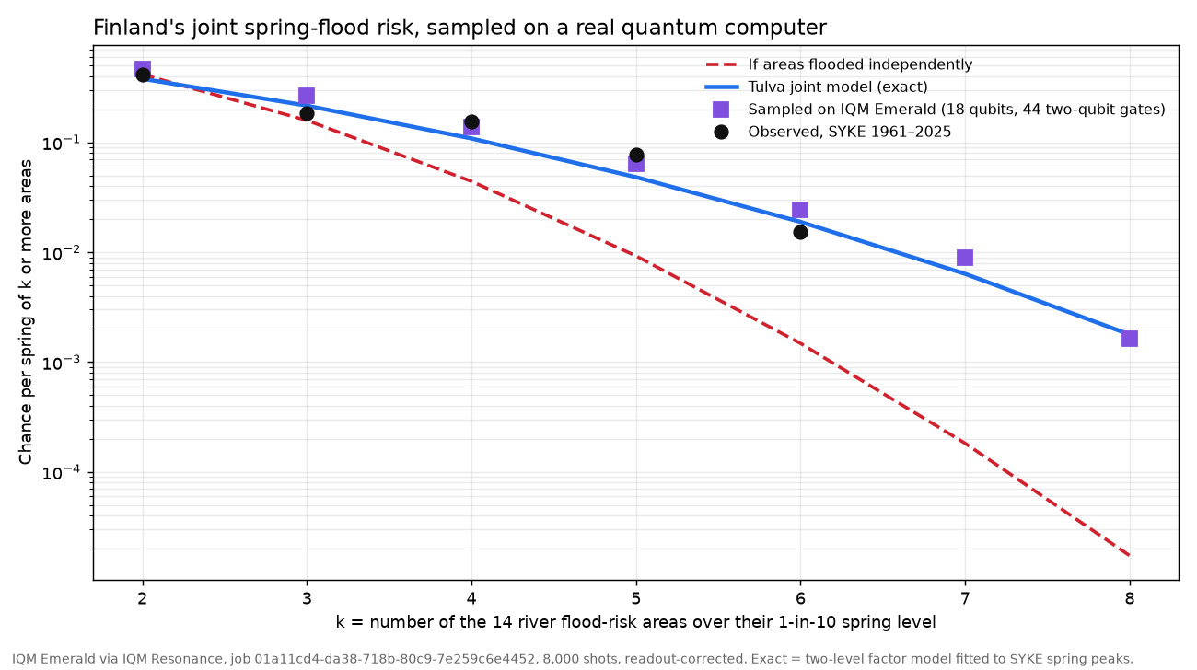
QUANTUM, IN PRACTICE
Pricing = a joint-flood probability → quantum amplitude estimation
ALL 14 AREAS ON IQM EMERALD
18
44
qubits
two-qubit gates
AMPLITUDE ESTIMATION, IBM & IQM
P(Kittilä and Ivalo both pass 1-in-50)
Exact
0.125 %
IBM Marrakesh
0.262 →
0.148 %
IQM Garnet
0.368 →
0.163 %
raw → calibrated
The chip reproduces the joint tail that independence misses.
Also native Qrisp on IQM Garnet; 20–25 side-by-side copies on IBM.
IQM Emerald job 01a11cd4…, 8,000 shots; IBM ibm_marrakesh (best-qubit run, 20 copies); IQM Garnet 4 copies, 120k shots
Tulva 6
Notes:
[Quantum, in practice (2:05–2:25)]
Pricing this cover means estimating one rare joint probability: a job for quantum amplitude estimation. We loaded all fourteen areas onto IQM Emerald, 18 qubits, 44 two-qubit gates, and it reproduced the joint tail. On IBM and IQM, calibrated amplitude estimation landed within 0.04 points of the exact answer.

Slide 7
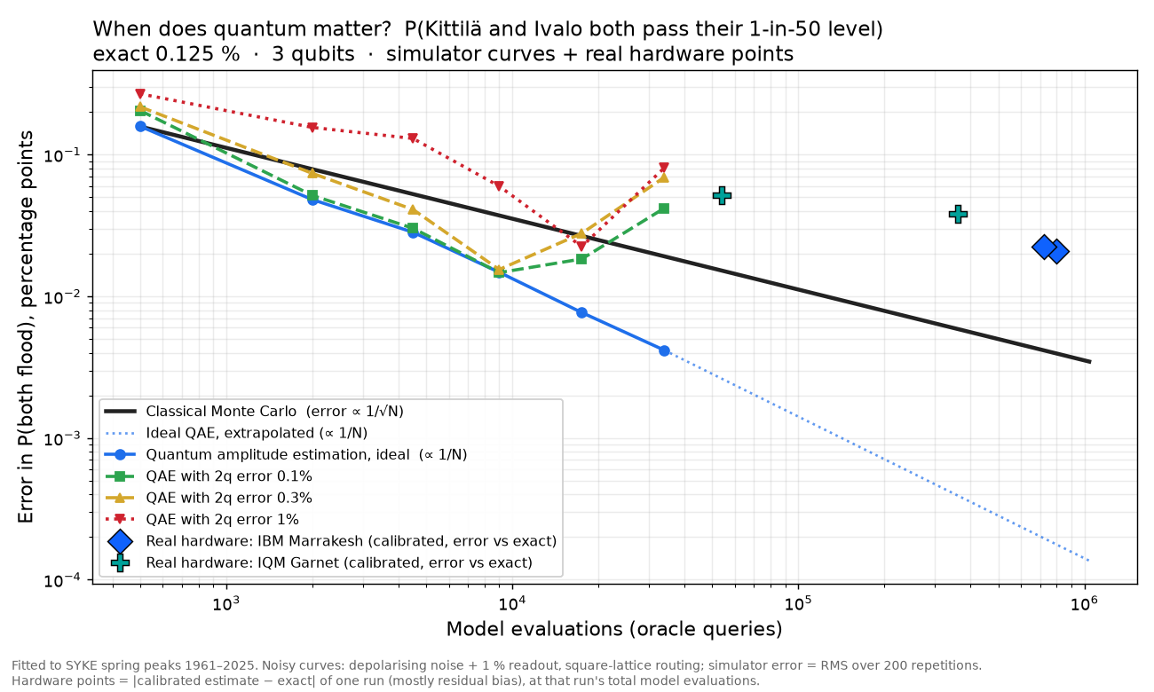
QUANTUM, HONESTLY
Classical Monte Carlo still wins today
Quantum wins at scale, with:
Fault-tolerant hardware
~8k logical qubits for comparable pricing (Chakrabarti et al. 2021)
Expensive models
full hydrological simulation per scenario
More work per price
multi-peril, daily repricing
Ideal QAE error falls like 1/N, Monte Carlo like 1/√N.
Source: Tulva simulations (qae-sim) + IBM Marrakesh / IQM Garnet runs; Chakrabarti et al., Quantum 5, 463 (2021)
Tulva 7
Notes:
[Quantum, honestly (2:25–2:39)]
Honestly: classical Monte Carlo still wins today. Quantum wins at scale, with fault-tolerant hardware and expensive models: a full hydrological simulation per scenario, many perils, daily repricing.

Slide 8
BUSINESS
Who buys, why, and why now
WHO BUYS
HOW WE EARN
WHY NOW
SCALE
Finnish non-life insurers
Engine licence
30 Jan 2027
Finland → Nordics → Central Europe
For the flood they keep under reinsurance. Four groups write 91 % of the market. Then reinsurers and ILS investors.
Pricing and trigger engine, licensed per insurer or reinsurer. Structuring fee on placed covers.
Solvency II flood factor for Finland: 0 % correlation with SE/NO/DK (25 % for snowmelt rejected). ORSA needs climate scenarios.
Same engine, any snowmelt or river region. Gävle 2021: SEK 1.9bn claims. Storm Boris 2024: €2.15bn insured.
First step: a paid pilot with one insurer in autumn, ahead of the 1 January renewals.
Sources: Finance Finland 2024; Del. Reg. (EU) 2026/269; EIOPA-BoS-24/462 §4.70; Finansinspektionen 2023 (Gävle); PERILS 2025 (Boris)
Tulva 8
Notes:
[Business (2:39–2:54)]
Who buys? Finland's non-life insurers, for the flood risk they keep, and the reinsurers behind them. We license the pricing and trigger engine. Why now? From 2027, Solvency II gives Finland a flood factor with zero correlation to its neighbours. Finland first, then the Nordics and Central Europe.

Slide 9
Tulva
Tulva prices Finland's spring floods as a joint risk, and runs it on real quantum hardware.
BUILT THIS WEEKEND
SYKE data pipeline
Joint flood model
Index pricing
QAE on IBM & IQM
Toivo Kallio · Vaishnav Rane
Team 21 STUHI · Quantum x Finance 2026, Hanken × Ultrahack
Tulva 9
Notes:
[Close (2:54–3:00)]
Tulva prices Finland's spring floods as a joint risk, and runs it on real quantum hardware.

