Slide 1
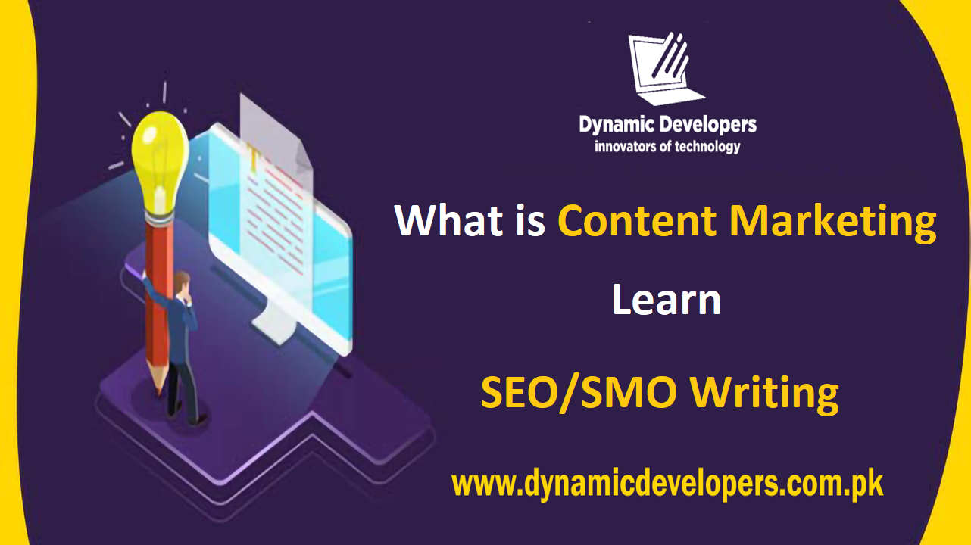

Slide 2

A SOFTWARE COMPANY IN PAKISTAN PROVIDING SERVICES IN FIELD OF IT AND SOFTWARE DEVELOPMENT

Slide 3
WELCOME
To all the students of,
“Digital Marketing Certified Program"

Slide 4

C O U R S E I N S T R U C T O R
Hafiz Arslan Ramzan
Digital Marketing & SEO Expert
Founder & CEO, Dynamic Developers

Slide 5
CLASS BASIC RULES
▪︎Attendance 80%
▪︎Discipline
▪︎Active Participation
▪︎Presentation, Quiz, Assignments, Assessments are mandatory

Slide 6
Search Marketing
S E A R C H M A R K E T I N G
What is a Search Marketing ?

Slide 7
What is a Search Marketing ?
S E A R C H M A R K E T I N G
Search marketing is a form of Internet marketing that involves the promotion of websites by increasing their visibility in search engine results pages primarily.

Slide 8
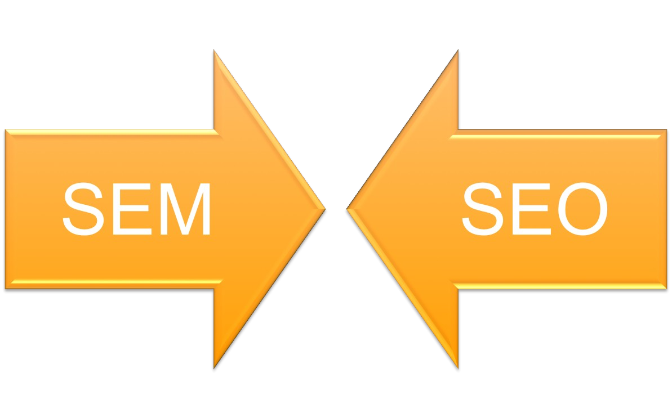
Two types of search marketing
S E A R C H M A R K E T I N G

Slide 9
Search Engine Marketing (SEM)
S E A R C H M A R K E T I N G
Search Engine Marketing (SEM) is a form of internet advertising utilizing search engine results to promote brands and websites.
It is a paid media where advertisers bid of specific search keywords that when typed in, their ads are shown.

Slide 10
Search Engine Optimization (SEO)
S E A R C H M A R K E T I N G
Search engine optimization (SEO) is the process of improving your website and content so that it is visible to search engines.
Website SEO aims to make the information & services that your organization provide deemed most relevant (by the search engine) to match the keywords that their users are searching for.

Slide 11
S E A R C H M A R K E T I N G
SEM terminologies;
what does it mean ? -
PPC
CPC
Creative/ Adtext
SERP
CTR%
Impressions
Google Content Network
Rank/ Position
Quality score

Slide 12
S E A R C H M A R K E T I N G
SEM terminologies;
PPC – Pay Per Click
CPC – Cost per Click
Creative – Heading and description of search ad
SERP – Search Engine Results Page
CTR% - Click through Rate (as a percentage)
Impressions – The number of times your ad is shown
Google Content Network – Display banner ads outside of Google
Rank/ Position – The position your ad is shown when a keyword is searched (1 through 8 for page 1)
Quality score – A ranking Google gives your ad based on its CTR, relevance to the keyword & the landing page’s relevance & other factors.

Slide 13
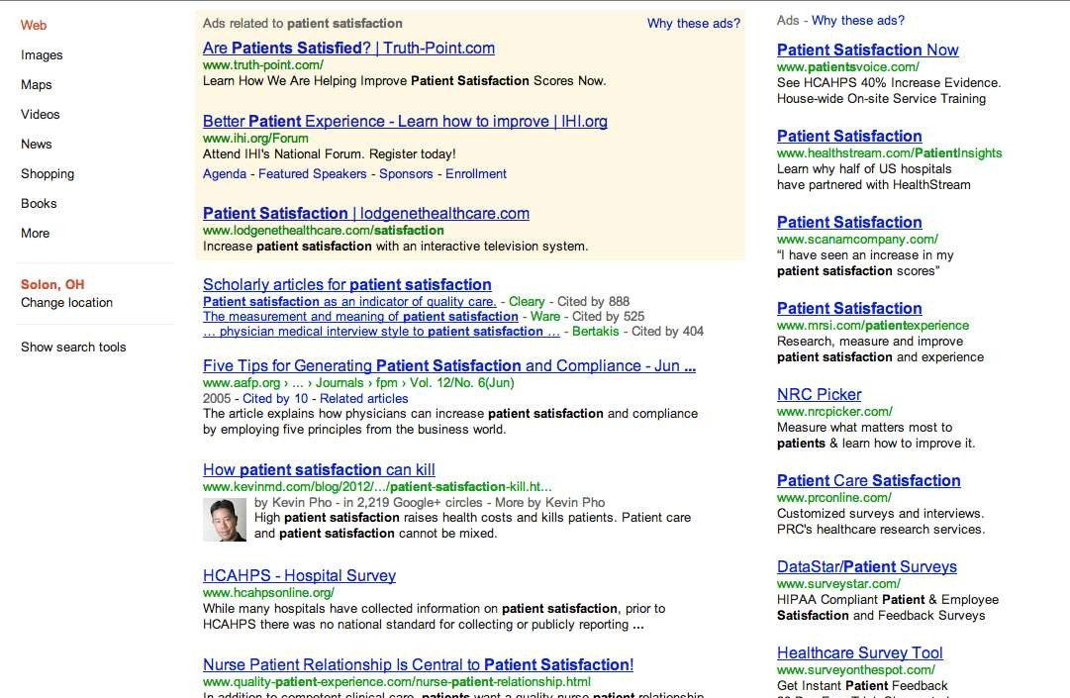
The Anatomy of search engine results page
S E A R C H M A R K E T I N G
Paid
Paid
Organic

Slide 14
The Anatomy of search engine results page
S E A R C H M A R K E T I N G
Paid
Paid
~25% of Clicks on a SERP Goes to Paid
Organic
~75% of Clicks on a SERP Goes to Organic

Slide 15
The Anatomy of search engine results page
S E A R C H M A R K E T I N G
Paid
Paid
Immediate Traffic
Organic
Sustainable Traffic

Slide 16
The Anatomy of search engine results page
S E A R C H M A R K E T I N G
Of the 75% of organic traffic, the click through rate greatly diminishes the further you move down the page
Paid
18%
10%
7.2%
4.8%
Organic

Slide 17


The Anatomy of search engine results page
S E A R C H M A R K E T I N G
Paid Search: Depending on the level of competition, this includes three ads above and seven to the right of the organic traffic. These ads can sometimes include products, phone, or site link information.
Organic Search: By default, this includes ten organic listings. Then, depending on the personalization or targeting, this could include local results, news, scholarly articles and maps.

Slide 18
Search Marketing
S E A R C H M A R K E T I N G
What is Content Marketing ?

Slide 19
What is Content Marketing ?
S E A R C H M A R K E T I N G
Content marketing is a strategic marketing approach focused on creating and distributing valuable, relevant, and consistent content to attract and retain a clearly defined audience — and, ultimately, to drive profitable customer action.

Slide 20
Content Marketing
S E A R C H M A R K E T I N G
Marketing is impossible without great content
Regardless of what type of marketing tactics you use, content marketing should be part of your process, not something separate. Quality content is part of all forms of marketing.

Slide 21
S E A R C H M A R K E T I N G
Forms of Marketing;
Social media marketing: Content marketing strategy comes before your social media strategy.
SEO: Search engines reward businesses that publish quality, consistent content.
PR: Successful PR strategies address issues readers care about, not their business.
PPC: For PPC to work, you need great content behind it.
Inbound marketing: Content is key to driving inbound traffic and leads.
Content strategy: Content strategy is part of most content marketing strategies.

Slide 22
Discussion Session !

Slide 23
Practical Work
Prepare Presentation for Next Lecture

Slide 24
THANKYOU!
DYNAMIC DEVELOPERS
INNOVATORS OF TECHNOLOGY

