Slide 1


Slide 2

A SOFTWARE COMPANY IN PAKISTAN PROVIDING SERVICES IN FIELD OF IT AND SOFTWARE DEVELOPMENT

Slide 3
WELCOME
To all the students of,
“Content Writing Certified Program"

Slide 4

C O U R S E I N S T R U C T O R
Hafiz M. Arslan
Web Content Writer & Freelancer
Founder & CEO, Dynamic Developers

Slide 5
CLASS BASIC RULES
▪︎Attendance 80%
▪︎Discipline
▪︎Active Participation
▪︎Presentation, Quiz, Assignments, Assessments are mandatory

Slide 6
C O U R S E O U T L I N E
Concepts of content writing
SMO Writing
4
2
Content Writing Theory
Blog Writing
1
3

Slide 7
C O U R S E O U T L I N E
Overview of course
How to write an effective content
8
6
Role of SEO in
content writing
Creativity in Writing
5
7

Slide 8
SMO
S M O W R I T I N G
What is SMO ?

Slide 9
What is a Social Media Optimization (SMO) ?
S M O W R I T I N G
The distribution of social media posting and their ability to rise to the top of any related search query.

Slide 10
S M O W R I T I N G
Advantages of SMO
Brand building: Internet is a very good place for advertising and SMO can effectively create awareness about brand, product and services swiftly through social networking sites.
Low cost: SMO is more effective, both in terms of money and as a method compared to traditional marketing.
Search engine ranking: SMO can provide you with a good collection of back links to enable your ranking to be among the top searches.
Instant turnaround: Through SMO, your brand will get visibility in the popular social sites in no time. Indeed the most profitable way of advertising.
Targeting specific audience: SMO strives to reach specific customer groups based on their age, interests, location, gender etc. and finally proving beneficial for your business.

Slide 11
SMO Writing
S M O W R I T I N G
How to Write an effective SMO Content ?

Slide 12
Social Media Optimization (SMO) Writing
S M O W R I T I N G
Write search engine friendly Taglines in Content. Include 1-2 keywords related to your topic. ...
Optimize your abstract. Place essential findings and keywords in the first two sentences of your abstract. ...
Use keywords throughout your Content. ...
Be consistent. ...
Insert links/emails/contact details in content.
Use Hashtags at the end of content.

Slide 13
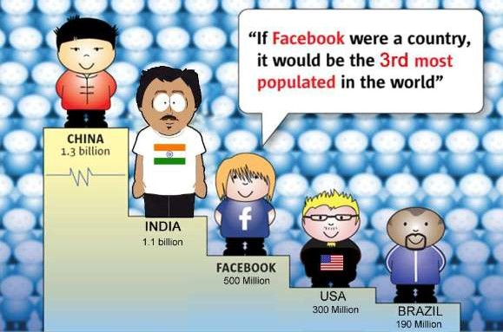

S M O W R I T I N G

Slide 14
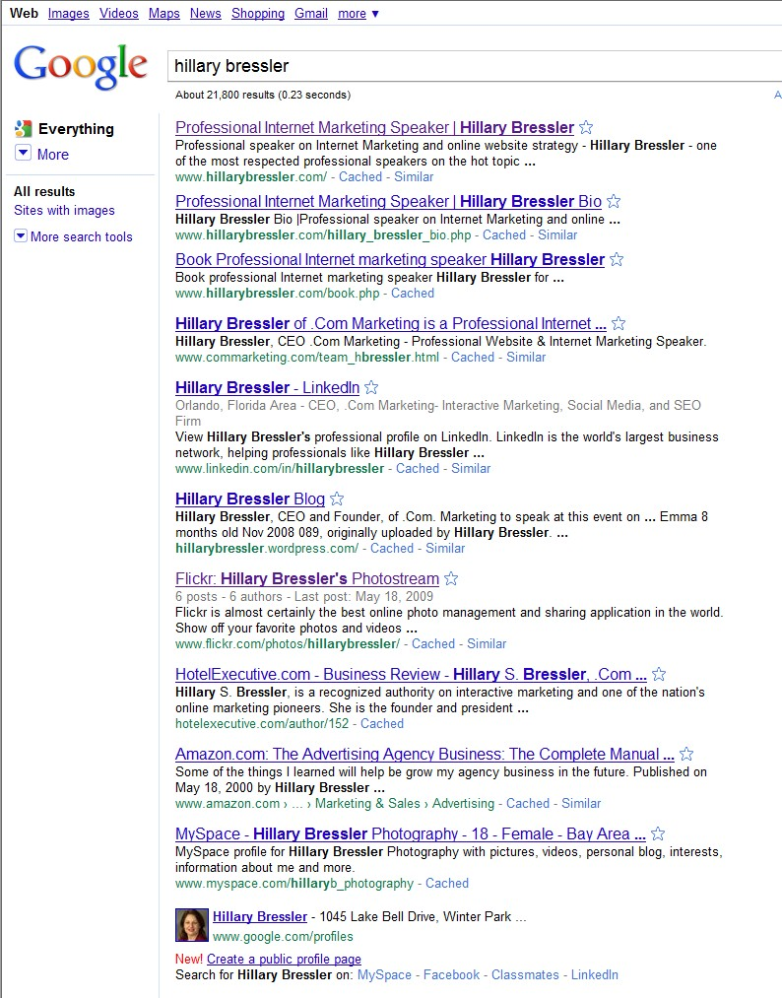
S M O W R I T I N G
Dominating your brand and having control of each posting
is the true
SEO + SMO = Amplified
Rankings
SEO
Dominating your brand and having
control of each posting is the true
SEO + SMO = Amplified
Rankings
SEO
SEO
SMO
SMO
SMO
I dominate and control my
“Personal brand”
that is easy, as there are only 3
“Hillary Bressler’s in the USA.

Slide 15
Discussion Session !

Slide 16
Practical Work
Write a SMO based content for post related to any product’s
Send it to the given email address.
hmarslan@dynamicdevelopers.com.pk

Slide 17
THANKYOU!
DYNAMIC DEVELOPERS
INNOVATORS OF TECHNOLOGY

