Slide 1
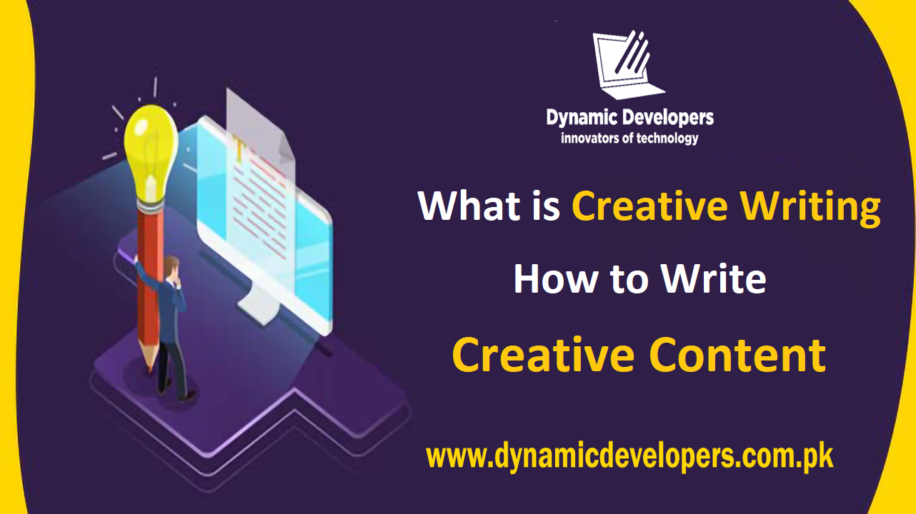

Slide 2

A SOFTWARE COMPANY IN PAKISTAN PROVIDING SERVICES IN FIELD OF IT AND SOFTWARE DEVELOPMENT

Slide 3
WELCOME
To all the students of,
“Content Writing Certified Program"

Slide 4

C O U R S E I N S T R U C T O R
Hafiz M. Arslan
Web Content Writer
Founder & CEO, Dynamic Developers

Slide 5
CLASS BASIC RULES
▪︎Attendance 80%
▪︎Discipline
▪︎Active Participation
▪︎Presentation, Quiz, Assignments, Assessments are mandatory

Slide 6
C O U R S E O U T L I N E
Concepts of content writing
SMO Writing
4
2
Content Writing Theory
Blog Writing
1
3

Slide 7
C O U R S E O U T L I N E
Overview of course
How to write an effective content
8
6
Role of SEO in
content writing
Creativity in Writing
5
7

Slide 8
Creativity
C R E A T I V E W R I T I N G
What is Creativity ?

Slide 9

What is Creativity ?
C R E A T I V E W R I T I N G
Ability to produce original ideas.
The result of a complex of cognitive skills, abilities, personality factors, motivation and strategies.

Slide 10

Elements of Creativity
C R E A T I V E W R I T I N G
Fluency
Flexibility
Originality
Elaboration
Visualization
Lateral Thinking
Define Problems

Slide 11
Creative Writing
C R E A T I V E W R I T I N G
What is creative writing?

Slide 12

What is Creative writing ?
C R E A T I V E W R I T I N G
Creative Writing expresses the writers thoughts and feeling in an imaginative often unique and poetic way.
Creative writing is guided more by the writers need to express feelings and ideas than by the restrictive demands of factual and logical progression of expository writing.

Slide 13
C R E A T I V E W R I T I N G
Conducive Environment for developing learners creativity:
Provide challenges
Appreciate individuality
Encourage open discussion
Absence of conflicts
Allow time to think
Encourage confidence and willingness to take risk
Appreciate and support ideas
Respect the novel and unusual

Slide 14

Activity Time ! (1)
C R E A T I V E W R I T I N G
Three Minute Fast Write:
Write anything that you can remember from the Hare and the Tortoise.
1,2,3 ……...go !!!!!!!

Slide 15
The Tortoise and the Hare
C R E A T I V E W R I T I N G
hare tortoise slow grass white lazy stupid clever Sunny un competition sleep hot tired sad cry surprised happy cry wake-up sunny unhappy sleep
r
Setting .
Who when where
Event
Problems
Resolutions
Green tortoise White rabbit Grass hot sunny
Running competition
Slow fast lazy
Wake-up win lose happy unhappy Surprised cry
Stupid clever
sleep hot tired
work hard a long time
Swimming competition
Cant swim clever Jump easy proud find a bridge enjoying.
Arrive first rest laugh silly proud

Slide 16

Thematic Tree:
C R E A T I V E W R I T I N G
Start with a theme
Reflect on the theme
Develop sub themes
Brainstorm relevant themes

Slide 17
Thematic Tree
C R E A T I V E W R I T I N G
Theme : My House
Rooms in my house
Things to put in each room
Things to do in each room

Slide 18
Now write about the dream house:
C R E A T I V E W R I T I N G
How many rooms do you want.
Besides the living room, bedroom, washroom, drawing room dining room do you want any other rooms.
What do you want to put in those rooms.
What do you want to do in those rooms.
Who do want to live with.

Slide 19
Why Use Thematic Tree ?
C R E A T I V E W R I T I N G
Encourages yourself to think of different perspectives
build thinking flexibility
Generates more idea
Helps to structure your writing

Slide 20

Multi-dimensional writing:
C R E A T I V E W R I T I N G
A car accident has occurred injuring several people.
You have to discuss how it could have been averted.
Imagine that you are one of the following characters and write an account
Driver
Passenger
Pedestrian

Slide 21
Activity Time ! (2)
C R E A T I V E W R I T I N G
Three Minute Fast Write:
Imagine you are the:
Principal/Headmistress
Librarian
Head Girl/ Boy
Teachers.
Write about any one particular day.
1,2,3 ……...go !!!!!!!

Slide 22
Why Use Multi-dimensional writing ?
C R E A T I V E W R I T I N G
Enables Students to view things from different angles.
Helps students to remain focused when they write.

Slide 23
Brainstorming and Mind Mapping:
C R E A T I V E W R I T I N G
Put the word ‘Future’ on the board.
Brainstorm words related to your future.
Now focus on your education, family and career.
Group all the words under these three sub themes and write a composition.

Slide 24
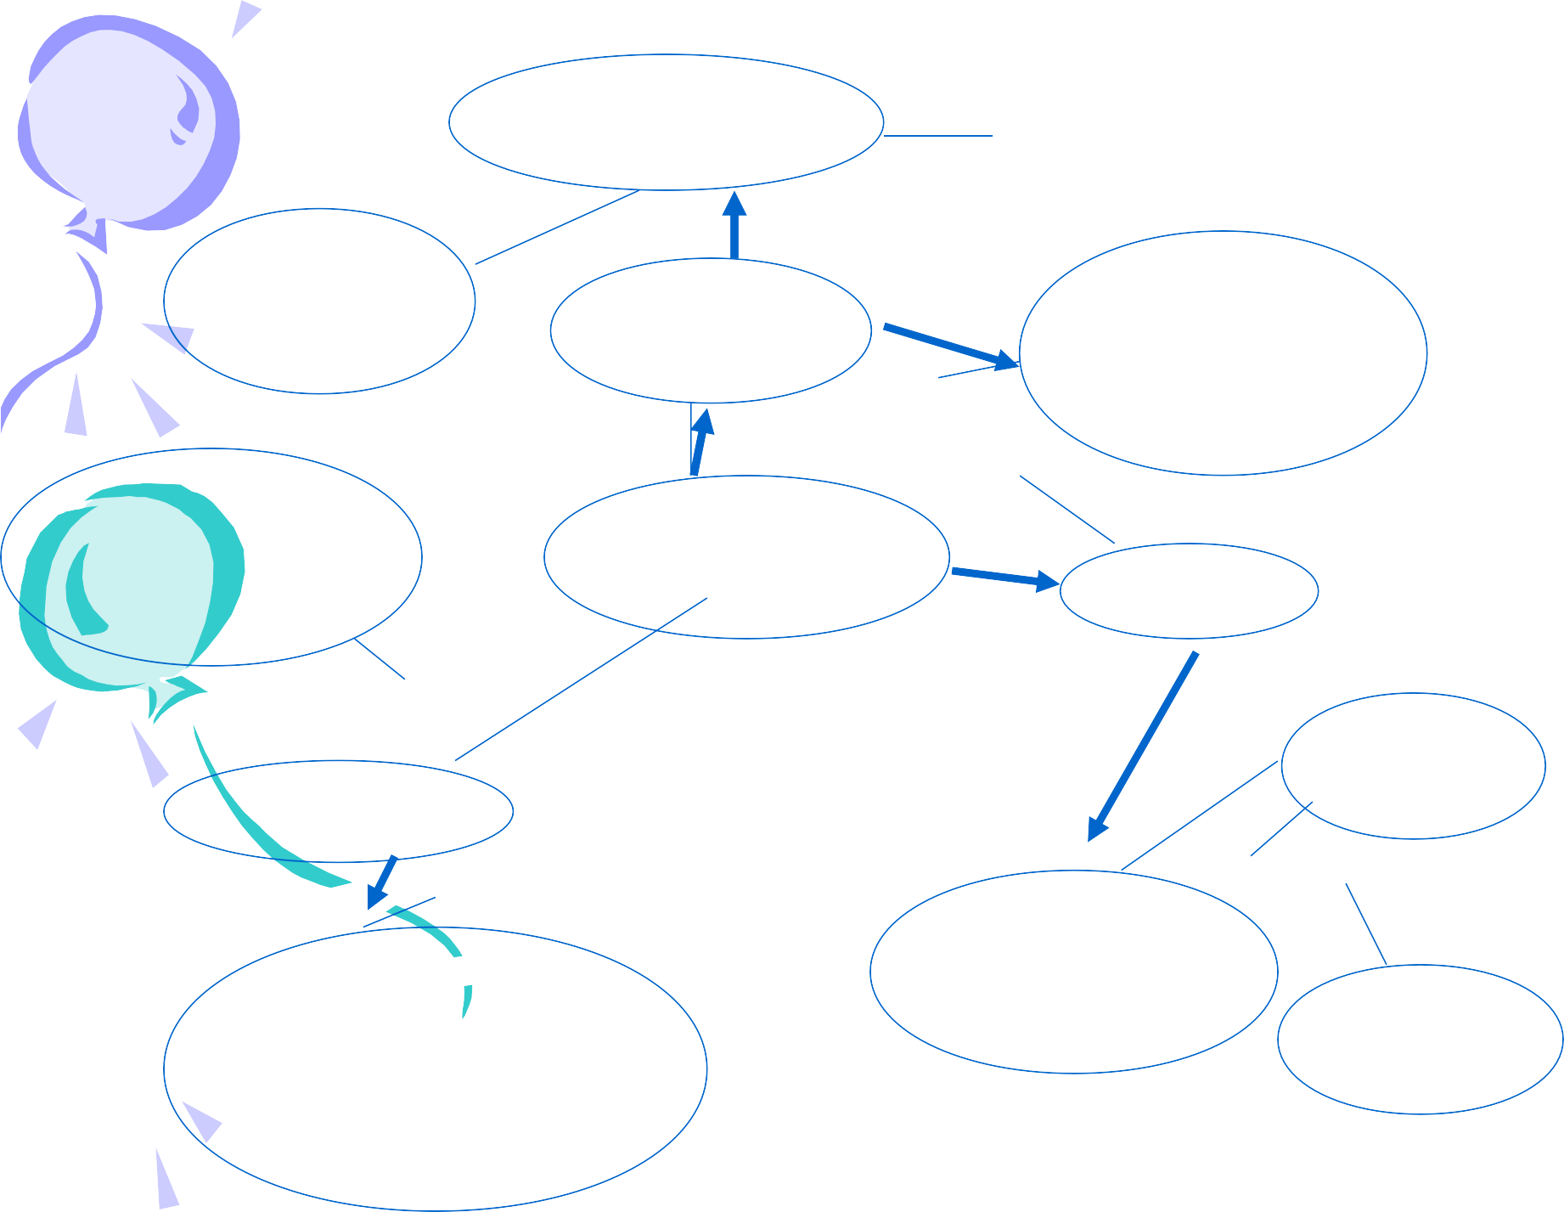

Example Map
Never stop learning
Eventually get a PhD
Instill a love of education in my children
Education
Learn to love whatever work I am doing
My future
family
Make them a priority
work
Stay at home while raising children
Raise healthy, happy children
Use the skills I have learned in as many ways as possible
Stay close to my family

Slide 25
Why Use Brainstorming and Mind Mapping ?
C R E A T I V E W R I T I N G
Brainstorming: Excellent way of creating many new ideas.
Helps to break thinking patterns into new ways of looking at things.
Mind Map: Used for arranging and developing ideas.
A good format for reviewing ideas.

Slide 26
Discussion Session !

Slide 27
Practical Work
Write a ?????????????????????????????

Slide 28
THANKYOU!
DYNAMIC DEVELOPERS
INNOVATORS OF TECHNOLOGY

