Slide 1
Going out with a Bang
Zach Sadler (zps6)
Andrew Beers (acb75)

Slide 2
Final Video

Slide 3
Individual Fireworks

Slide 4
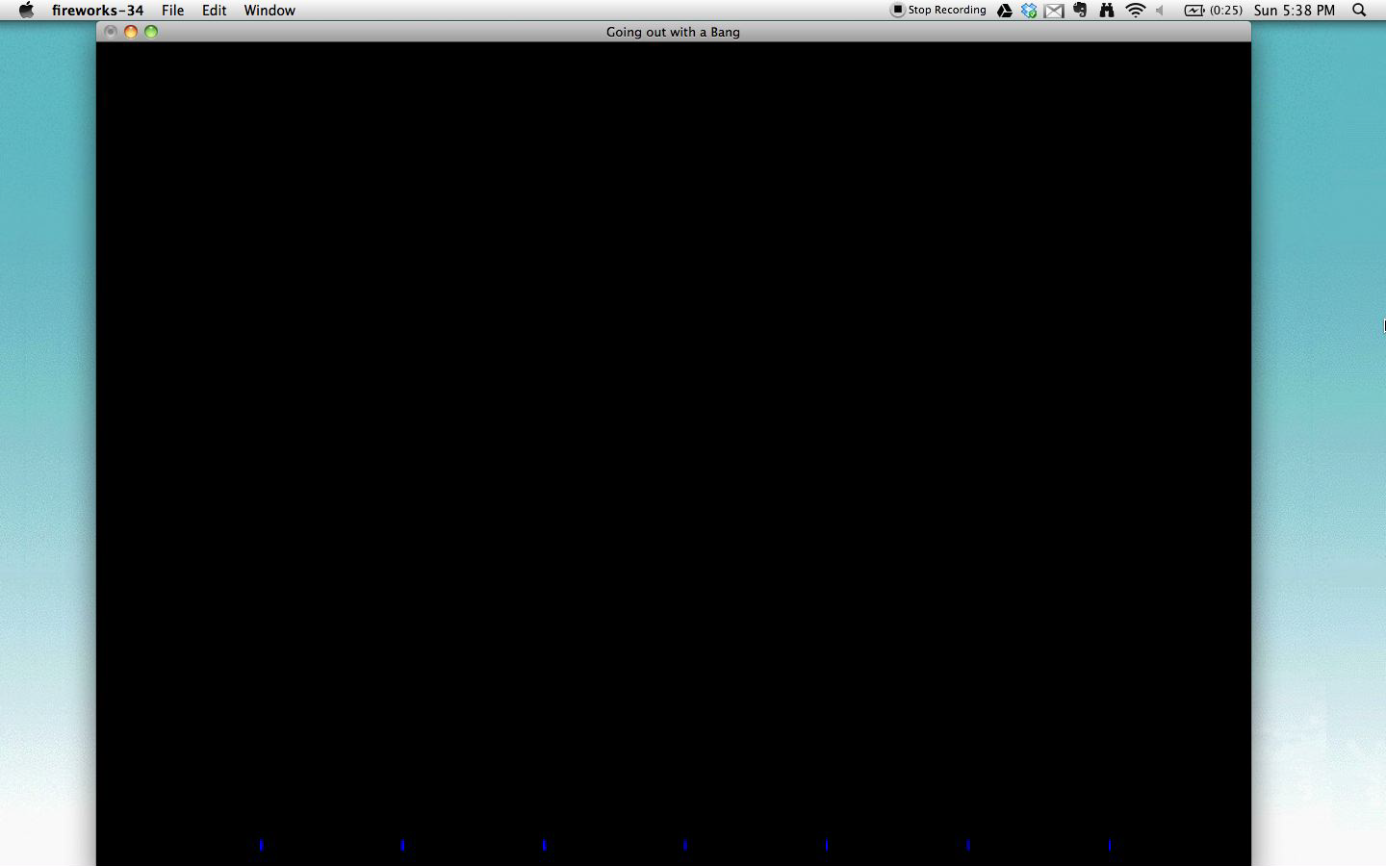
boom

Slide 5

bang

Slide 6

sparklers

Slide 7

Nozzle sparklers

Slide 8

recursive

Slide 9

heart

Slide 10

Triforce

Slide 11

Mushroom

Slide 12

1-up

Slide 13
Inspiration
Final Project by Lukas Hoffman ‘09

Slide 14
Progression

