Slide 1

When Should Students Take Paid Tutoring
By: Alex Liu

Slide 2
The Problem:
Students struggling with certain subjects
Students not meeting certain grade thresholds early on throughout the semester
Would seeking out paid tutoring help?
What do other students in similar situations end up choosing?

Slide 3
Dataset Information
Dataset on 395 students from two secondary schools Portugal
Main two subjects of focus are Math and Portuguese
Features include students’ demographic, social, and school-related data
(https://www.kaggle.com/dipam7/student-grade-prediction)

Slide 4

Exploratory Data Analysis

Slide 5
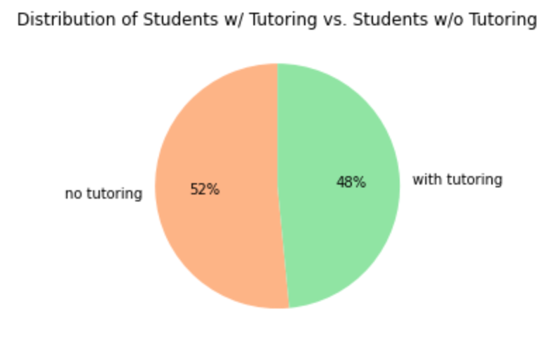
Approximately an equal distribution of students among both sides!

Slide 6
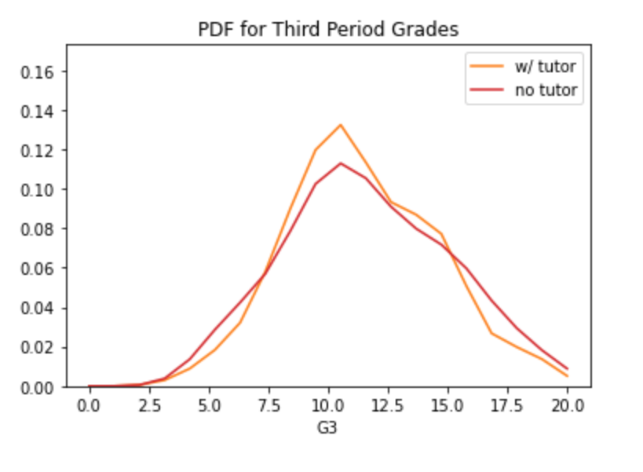
Students are more likely to perform better with paid tutoring than those without it!

Slide 7
Modelling

Slide 8
Model Selection
Random Forest Classifier
K-Nearest Neighbors Classifier
Gradient Boosting Classifier

Slide 9
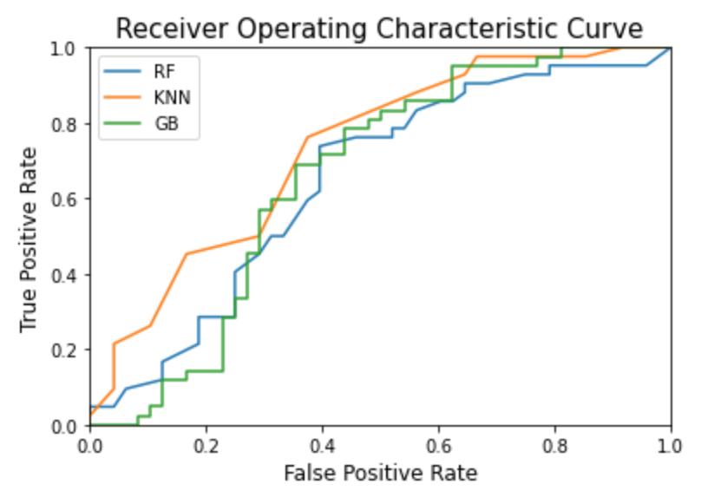
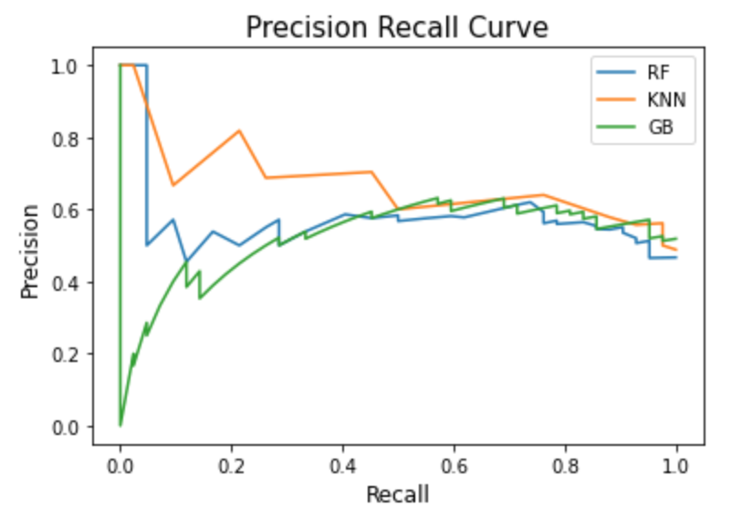
Model Comparisons
KNN produces the best ROC curve!
KNN also produces the best precision-recall curve!

Slide 10
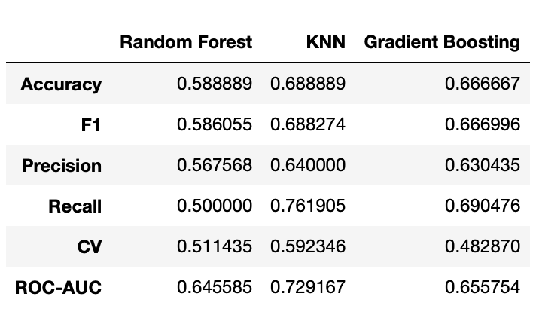
Score Comparisons

Slide 11
KNN Performs the Best Overall!

Slide 12
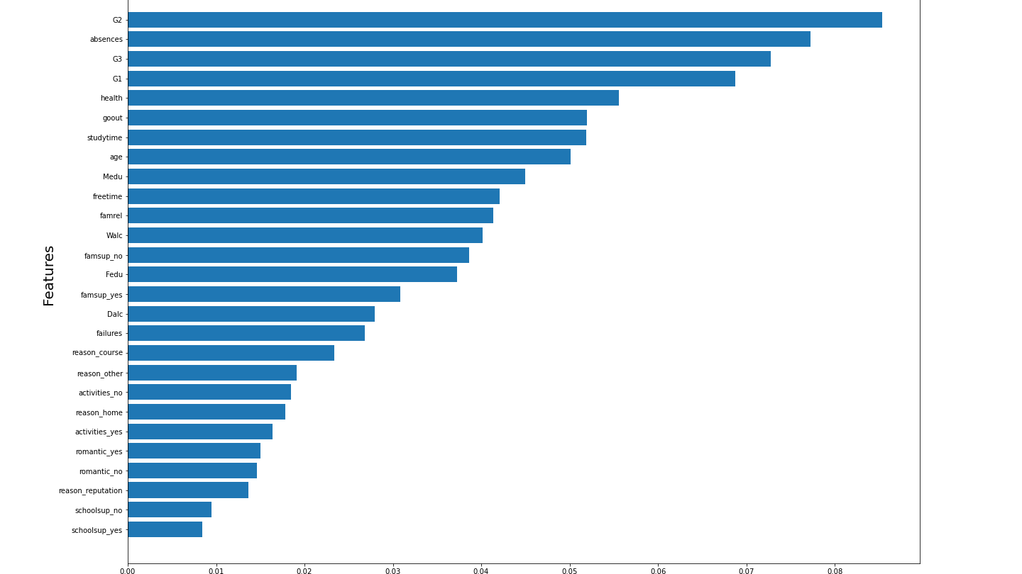
Most Important Features

Slide 13
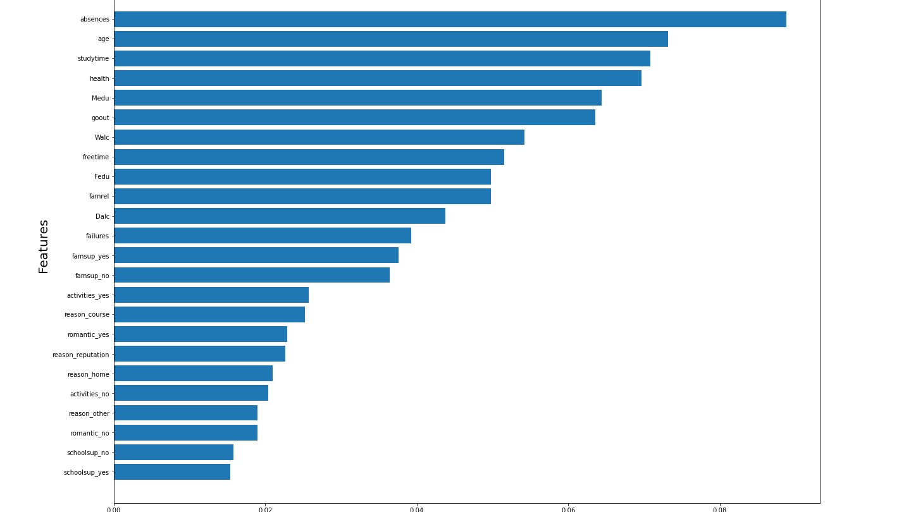
Most Important Features Excluding Grades

Slide 14
Main Takeaways
KNN is the best performing model
Many demographic features were not important
Out of 33 features, 21 were used in the final model
Predictive power of model can be improved by a lot more
The best accuracy score from the model is 0.688
Highest scores in all areas
Approximately 40-45% more accurate than random guessing

Slide 15
Future Improvements to Model
Expand sample size of students, schools, and subjects
Collect more detailed data to create more in-depth features (i.e. exact time period students started taking tutoring)
Try to incorporate individuality of students to the model

Slide 16
Thank You

