Slide 1

Big Mountain Resort: Findings and Recommendations

Slide 2
Problem Identification
How can Big Mountain Resort increase its revenue within one year to offset the incurred operating costs of $1,540,000 from the new chair lift through either increasing ticket prices or removing facilities in the resort

Slide 3
Recommendations and Key Findings
Summarizing the findings, Big Mountain is essentially undervaluing its ticket price compared to its competitors
Main recommendation is for Big Mountain to look into increasing their ticket price

Slide 4
Modeling Results and Analysis
The modeling results given by the random forest regression model show that the best eight features in terms of correlation with ticket price are the following:
Vertical_drop
Snow Making_ac
Total_chairs
fastQuads
Runs
LongestRun_mi
Trams
SkiableTerrain_ac

Slide 5
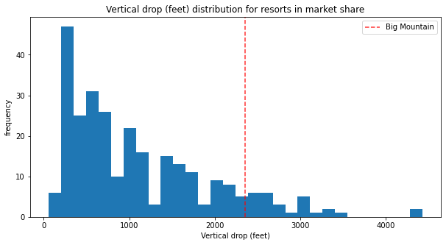
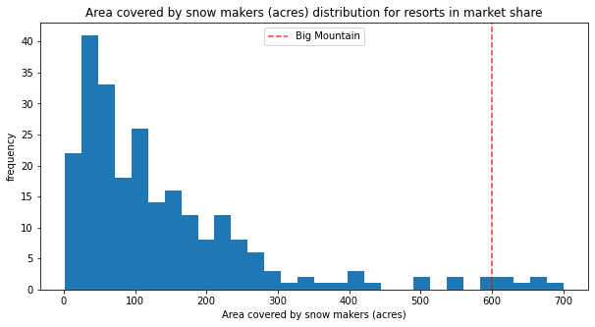
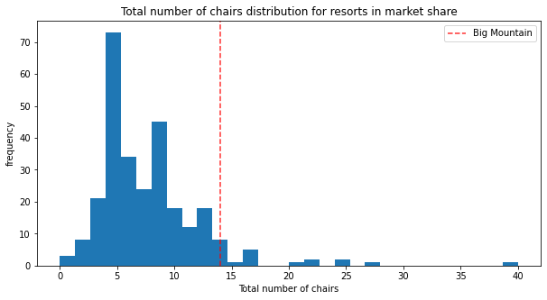
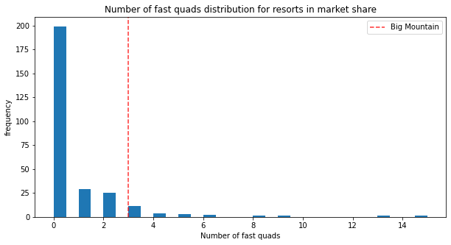
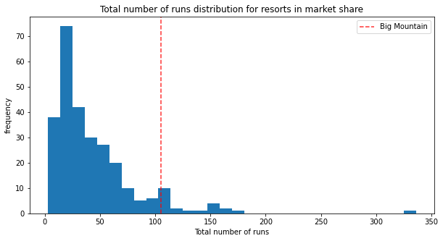
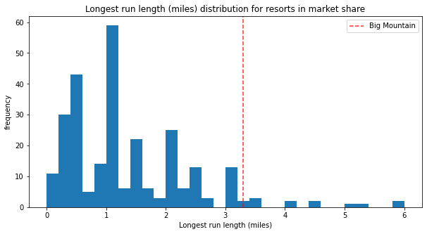
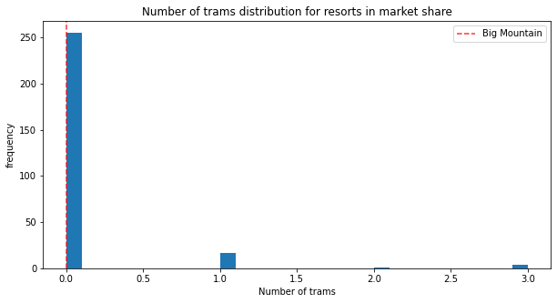
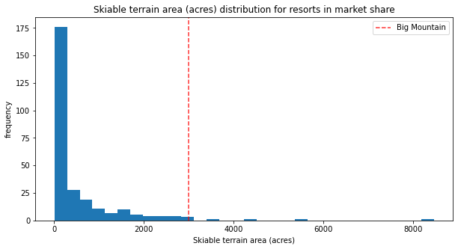
Modeling Results and Analysis (cont’d)
These graphs show that Big Mountain is mainly in the top percentile of the distribution of each graph relative to its competitors.

Slide 6
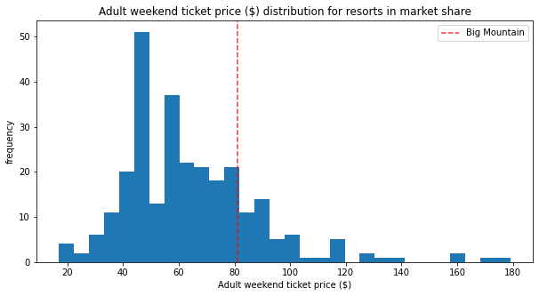
Modeling Results and Analysis (cont’d)
Big Mountain’s ticket price is around the higher end in the middle of the distribution, which does not mirror Big Mountain’s top percentile placements in the eight best features graph listed prior.

Slide 7
Summary and Conclusion
To summarize, the modeling supports the idea that Big Mountain has been undercharging its ticket price and undervaluing their facilities compared to its competitors
In conclusion, it is recommended that Big Mountain seeks to increase its current ticket price

