Slide 1
Ethics in Information Technology
Chapter 1
An Overview of Ethics

Slide 2
Objectives
  What is ethics, and why is it important to act according to a code of ethics?
  Why is business ethics becoming increasingly important?
  What are organizations doing to improve their business ethics?

Slide 3
Objectives (cont’d)
  Why are organizations interested in fostering good business ethics?
  What approach can you take to ensure ethical decision making?
  What trends have increased the risk of using information technology in an unethical manner?

Slide 4
What is Ethics?
Ethics is a set of beliefs about right and wrong behavior within a society.
Moral code
  Set of rules
  Establishes boundaries of generally accepted behaviour
  Different rules often have contradictions
Morality
  Social conventions about right and wrong
  Widely shared
  Form basis for an established consensus

Slide 5
What is Ethics? (cont’d)
Morality may vary by:
  Age
  Cultural group
  Ethnic background
  Religion
  Life experiences
  Education
  Gender

Slide 6
Definition of Ethics
Ethics
  Set of beliefs about right and wrong behavior
Virtues
  Habits that incline people to do what is acceptable
Vices
  Habits of unacceptable behavior
Virtues and vices define a personal value system
  Scheme of moral values

Slide 7
The Importance of Integrity
Integrity is a cornerstone of ethical behaviour
People with integrity:
  Act in accordance with a personal code of principles
  Extend to all the same respect and consideration
  Apply the same moral standards in all situations
Lack of integrity emerges if you apply moral standards differently according to situation or people involved
Many ethical dilemmas are not as simple as right versus wrong

Slide 8
The Difference Between Morals,
Ethics, and Laws
Morals: are one’s personal beliefs about right and wrong.
Ethics: standards or codes of behavior expected of an individual by a group (nation, organization, profession) to which an individual belongs.
Law: is a system of rules that tells us what we can and cannot do.
  Laws are enforced by a set of institutions
  Legal acts conform to the law
  Moral acts conform to what an individual believes is the right belief of right and wrong

Slide 9
Ethics in the Business World
Both the likelihood and the negative impact of inappropriate behaviour have increased
Several trends have increased the likelihood of unethical behaviour:
  Globalization creating complex work environments
  Organizations challenged to maintain profits / revenue
  Heightened vigilance by:
    Employees
    Shareholders
    Regulatory agencies

Slide 10
Ethics in the Business World (cont’d)
Recent scandals in IT companies
  Satyam Computer Services (India)
  Hewlett Packard
  Computer Associates International
  IBM
Not just executives, but even lower-level employees, can find themselves in the middle of an ethical dilemma

Slide 11
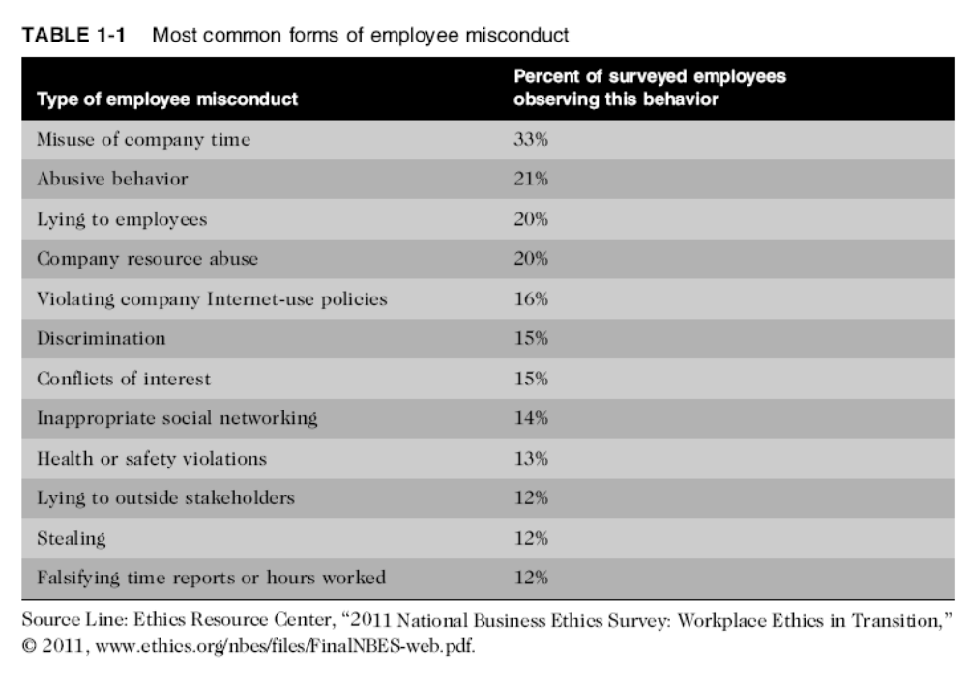
Ethics in the Business World (cont’d)

Slide 12
Corporate Social Responsibility (CSR)
Organization taking responsibility for the impact of its actions on the:
  Environment
  Community
  Welfare of its employees
Supply chain sustainability: Developing and maintaining a supply chain that meets the needs of the present without compromising the ability of future generations to meet their needs

Slide 13
Why Fostering Good Business Ethics
Is Important
To gain the good will of the community
To create an organization that operates consistently
To foster good business practices
To protect organization/employees from legal action
To avoid unfavorable publicity

Slide 14
Gaining the Good Will of the Community
Organizations have fundamental responsibilities to society
  Declared in formal statement of company’s principles or beliefs
  Include:
    Making contributions to charitable organizations and nonprofit institutions
    Providing benefits for employees in excess of legal requirements
    Choosing economic opportunities that might be more socially desirable than profitable

Slide 15
Gaining the Good Will of the Community (cont’d)
Socially responsible activities create good will
Good will makes it easier for corporations to conduct business

Slide 16
Creating an Organization That Operates Consistently
Consistency ensures that employees:
  Know what is expected of them
  Can employ the organization’s values to help them in decision making
Consistency also means that shareholders, customers, suppliers, and community know what they can expect of the organization

Slide 17
Creating an Organization That Operates Consistently (cont’d)
Many companies share the following values:
  Operate with honesty and integrity, staying true to organizational principles
  Operate according to standards of ethical conduct, in words and action
  Treat colleagues, customers, and consumers with respect
  Strive to be the best at what matters to the company
  Value diversity
  Make decisions based on facts and principles

Slide 18
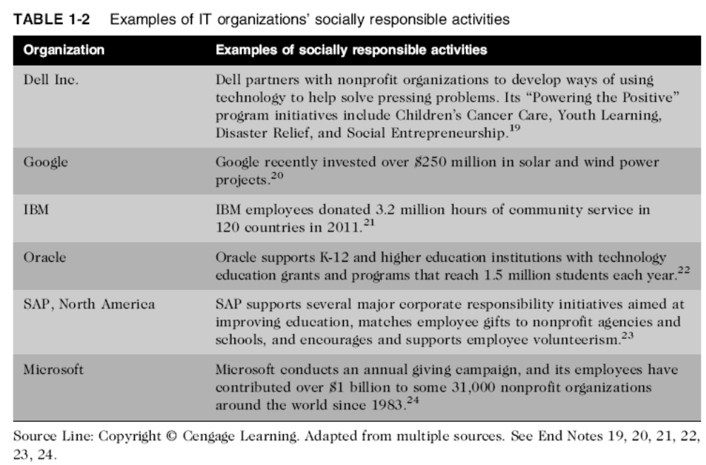
Creating an Organization That Operates Consistently (cont’d)

Slide 19
Fostering Good Business Practices
Good ethics means good business/improved profits
Companies that:
  Produce safe and effective products
    Avoid costly recalls and lawsuits
  Provide excellent service that retains customers
  Develop and maintain strong employee relations
    Suffer lower turnover rates
    Enjoy better employee morale

Slide 20
Fostering Good Business Practices (cont’d)
Suppliers/business partners place priority on working with companies that operate in a fair and ethical manner
Bad ethics means bad business/waning profits
  Bad ethics can lead to bad business results
  Bad ethics can have a negative impact on employees

Slide 21
Protecting the Organization and Its Employees from Legal Actions
U.S. Supreme Court established that an employer can be held responsible for the acts of its employees
This principle is called respondent superior
Coalition of several legal organizations argues establishment of ethics and compliance programs should reduce criminal liability of organization
Others argue company officers should not be given light sentences if their ethics programs are ineffective

Slide 22
Avoiding Unfavourable Publicity
Public reputation of company strongly influences:
  Value of its stock
  How consumers regard products and services
  Degree of oversight received from government
  Amount of support and cooperation received
Organizations are motivated to build strong ethics programs to avoid negative publicity

Slide 23
Improving Corporate Ethics
Characteristics of a successful ethics program
  Employees willing to seek advice about ethical issues
  Employees feel prepared to handle situations that could lead to misconduct
  Employees are rewarded for ethical behavior
  Employees are not rewarded for success obtained through questionable means
  Employees feel positive about their company

Slide 24
Appointing a Corporate Ethics Officer
Corporate ethics officer
  Provides vision and leadership in business conduct
  Should be well-respected, senior-level manager who reports directly to the CEO
  Ensures ethical procedures are put in place
  Creates and maintains ethics culture
  Is responsible for key knowledge/contact person for ethical issues

Slide 25
Ethical Standards Set by Board of Directors
Board oversees the organization’s business activities and management
Board members of company are expected to:
  Conduct themselves according to the highest standards of personal and professional integrity
  Set standard for company-wide ethical conduct
  Ensure compliance with laws and regulations
  Create environment in which employees can seek advice about business conduct, raise issues, and report misconduct

Slide 26
Establishing a Corporate Code of Ethics
Code of ethics
  Highlights an organization’s key ethical issues
  Identifies overarching values and important principles
  Focuses employees on areas of ethical risk
  Offers guidance for employees to recognize and deal with ethical issues
  Provides mechanisms to report unethical conduct
  Help employees abide by the law, follow necessary regulations, and behave in an ethical manner

Slide 27
Establishing a Corporate
Code of Ethics (cont’d)
Sarbanes-Oxley Act of 2002
  Enacted in response to public outrage over several major accounting scandals
  Section 404 requires that the CEO and CFO sign any SEC filing to attest to its accuracy
  Section 406 requires public companies to disclose whether or not they have a code of ethics and if any waivers to that code have been granted

Slide 28
Establishing a Corporate
Code of Ethics (cont’d)
  Cannot gain company-wide acceptance unless it is:
    Developed with employee participation
    Fully endorsed by organization’s leadership
  Must continually be applied to company’s decision making and emphasized as part of its culture
  Breaches in the code of ethics must be identified and dealt with appropriately

Slide 29
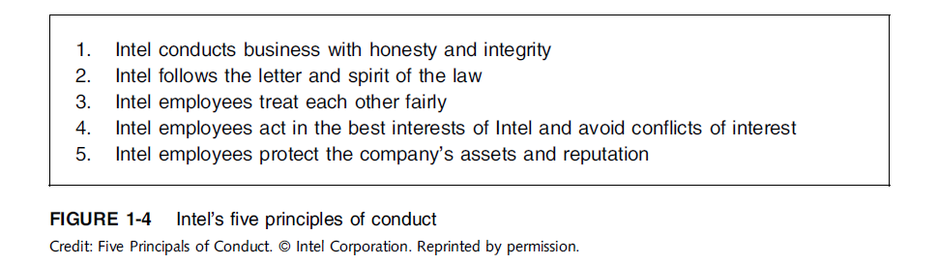
Establishing a Corporate
Code of Ethics (cont’d)

Slide 30
Conducting Social Audits
Social audit
  Reviews how well organization is meeting ethical and social responsibility goals
  Communicates new goals for upcoming year
  Shared broadly with employees, shareholders, investors, market analysts, customers, suppliers, government agencies, and local communities

Slide 31
Requiring Employees to
Take Ethics Training
Personal convictions improved through education
Comprehensive ethics education program encourages employees to act responsibly and ethically
  Often presented in small workshop formats
  Employees apply code of ethics to hypothetical but realistic case studies
  Demonstration of recent company decisions based on principles from the code of ethics

Slide 32
Requiring Employees to
Take Ethics Training (cont’d)
Critical that training increase the percentage of employees who report incidents of misconduct
Employees must:
  Learn effective ways of reporting incidents
  Be reassured their feedback will be acted on without retaliation

Slide 33
Including Ethical Criteria in
Employee Appraisals
Only 43% of companies include ethical conduct in employee’s performance appraisal
Ethical criteria include:
  Treating others fairly and with respect
  Operating effectively in a multicultural environment
  Accepting personal accountability
  Continually developing themselves and others
  Operating openly and honestly with all

Slide 34
Creating an Ethical Work Environment
Good employees may make bad ethical choices
May be encouraged to do “whatever it takes” to get the job done
Employees need a knowledgeable resource to discuss perceived unethical practices
  A manager
  Legal or Internal Audit Department
  Business Unit’s legal counsel
  Anonymously through internal Web site

Slide 35
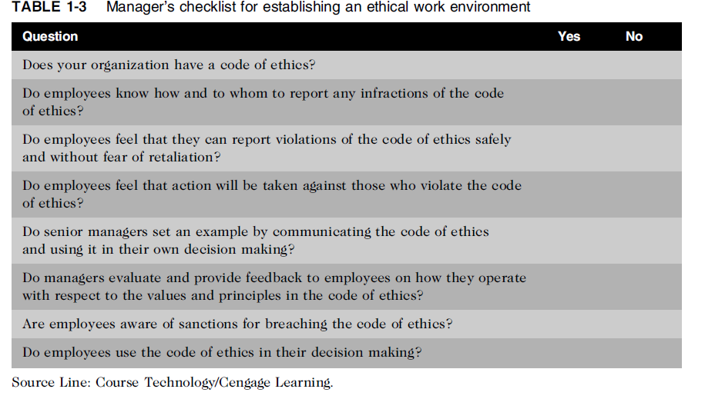
Creating an Ethical Work Environment (cont’d)

Slide 36
Including Ethical Considerations in Decision Making
Steps in a decision-making process
  Develop problem statement
  Identify alternatives
  Evaluate and choose alternative
  Implement decision
  Evaluate results
  Success

Slide 37
Develop a Problem Statement
Clear, concise description of the issue
Answers these questions:
  What causes people to think there is a problem?
  Who is directly affected by the problem?
  Is there anyone else affected?
  How often does it occur?
  What is the impact of the problem?
  How serious is the problem?
Most critical step in decision-making process

Slide 38
Develop a Problem Statement (cont’d)
Example of a good problem statement:
  “Our product supply organization is continually running out of stock of finished products, creating an out-of-stock situation on over 15 percent of our customer orders, resulting in over $300,000 in lost sales per month.”
Examples of poor problem statements:
  “We need to implement a new inventory control system.” (possible solution, not a problem statement)
  “We have a problem with finished product inventory.” (not specific enough)

Slide 39
Identify, Evaluate, and Choose an Alternative
Enlist help to brainstorm alternative solutions
Evaluate by weighing laws, guidelines, and principles
Consider likely consequences of each alternative
Alternative selected must:
  Be ethically and legally defensible
  Be consistent with policies and code of ethics
  Take into account impact on others
  Provide a good solution to problem

Slide 40
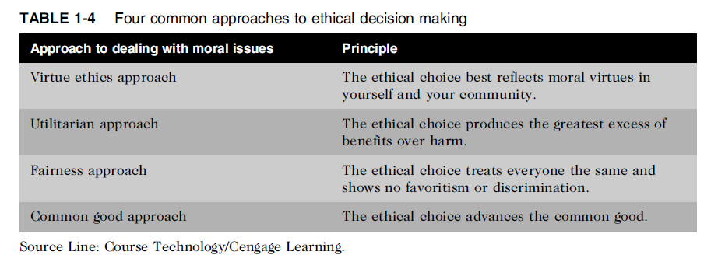
Common Approaches to Ethical Decision Making
Table 1-5 Four common approaches to ethical decision making

Slide 41
Virtue Ethics Approach
Virtue ethics approach
  Focuses on concern with daily life in a community
  People guided by virtues to reach “right” decision
  More effective than following set of principles/rules
Problems
  Does not provide guide for action
  Virtue cannot be worked out objectively; depends on circumstances

Slide 42
Utilitarian Approach
Utilitarian approach
  Chooses action that has best overall consequences
  Finds the greatest good by balancing all interests
  Fits concept of value in economics and the use of cost-benefit analysis
Problems
  Measuring and comparing values is often difficult
  Predicting resulting benefits and harm is difficult

Slide 43
Fairness Approach
Fairness approach
  Focuses on fair distribution of benefits/burdens
  Guiding principle is to treat all people the same
Problems
  Decisions can be influenced by personal bias
  Others may consider the decision unfair

Slide 44
Common Good Approach
Common good approach
  Work together for common set of values and goals
  Implement systems that benefit all people
Problems
  Consensus is difficult
  Some required to bear greater costs than others

Slide 45
Implement the Decision and
Evaluate the Results
Implement the decision
  Efficient, effective, timely implementation
  Communication is key for people to accept change
  Transition plan made easy and pain-free
Evaluate the results
  Monitor results for desired effect
  Observe impact on organization and stakeholders
  Return to “Develop problem statement” step if further refinements may be needed

Slide 46
Ethics in Information Technology
Public concern about the ethical use of information technology includes:
  E-mail and Internet access monitoring
  Downloading in violation of copyright laws
  Unsolicited e-mail (spam)
  Hackers and identify theft
  Students and plagiarism
  Cookies and spyware

Slide 47
Ethics in Information Technology (cont’d)
The general public does not understand the critical importance of ethics as applied to IT
Important decisions are often left to technical experts
General business managers must assume greater responsibility for these decisions by:
  Making decisions based on technical savvy, business know-how, and a sense of ethics
  Creating an environment where ethical dilemmas can be discussed openly, objectively, and constructively

Slide 48
Ethics in Information Technology (cont’d)
Goals of this text
  To educate people about the tremendous impact of ethical issues in the successful and secure use of information technology
  To motivate people to recognize these issues when making business decisions
  To provide tools, approaches, and useful insights for making ethical decisions

Slide 49
Summary
Ethics is important because the risks associated with inappropriate behavior have increased
Organizations have at least five good reasons for encouraging employees to act ethically
  To gain the good will of the community
  To create an organization that operates consistently
  To foster good business practices
  To protect the organization and its employees against legal action
  To avoid unfavorable publicity

Slide 50
Summary (cont’d)
Organizations require successful ethics programs
The corporate ethics officer ensures that ethical procedures are installed and followed
Managers’ behaviors and expectations can strongly influence employees’ ethical behavior
Most of us have developed a simple decision-making model that includes five steps
Ethical considerations must be incorporated into decision making

Slide 51
Summary (cont’d)
Four common approaches to ethical decision making
  Virtue ethics approach
  Utilitarian approach
  Fairness approach
  Common good approach

Slide 52
Reference
Ethics in Information Technology, George W. Reynolds, Fifth Edition

Slide 53
Quiz (Chapter 1)

