Slide 1
Ethics in Information Technology
Chapter 2
Ethics for IT Workers and IT Users

Slide 2
Objectives
  What key characteristics distinguish a professional from other kinds of workers, and is an IT worker considered a professional?
  What factors are transforming the professional services industry?
  What relationships must an IT worker manage, and what key ethical issues can arise in each?

Slide 3
Objectives (cont’d)
  How do codes of ethics, professional organizations, certification, and licensing affect the ethical behavior of IT professionals?
  What is meant by compliance, and how does it help promote the right behaviors and discourage undesirable ones?

Slide 4
IT Professionals
Profession is a calling that requires:
  Specialized knowledge
  Long and intensive academic preparation
Professionals:
  Require advanced training and experience
  Must exercise discretion and judgment in their work
  Their work cannot be standardized
  Contribute to society, participate in lifelong training, assist other professionals
  Carry special rights and responsibilities

Slide 5
Are IT Workers Professionals?
Partial list of IT specialists
  Programmers
  Systems analysts
  Software engineers
  Database administrators
  Local area network (LAN) administrators
  Chief information officers (CIOs)

Slide 6
Are IT Workers Professionals?
(cont’d)
Legal perspective
  IT workers do not meet legal definition of professional
    Not licensed by state or federal government
    Not liable for malpractice

Slide 7
The Changing Professional Services Industry
IT workers are considered part of the professional services industry
Seven forces are changing professional services
  Client sophistication (able to drive hard bargains)
  Governance (due to major scandals)
  Connectivity (instant communications)
  Transparency (view work-in-progress in real-time)
  Modularization (able to outsource modules)
  Globalization (worldwide sourcing)
  Commoditization (for low-end services)

Slide 8
Professional Relationships That Must Be Managed
IT workers involved in relationships with:
  Employers
  Clients
  Suppliers
  Other professionals
  IT users
  Society at large

Slide 9
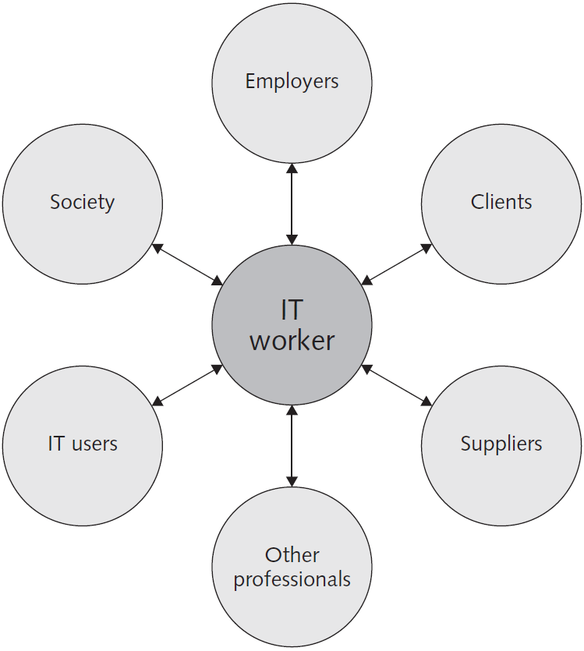
Figure 2.1 - Professional Relationships IT Workers Must Manage
Credit: Course Technology/Cengage Learning.

Slide 10
Relationships Between
IT Workers and Employers
IT workers agree on many aspects of work relationship before workers accept job offer
Other aspects of work relationship defined in company’s policy and procedure manual or code of conduct
Some aspects develop over time
As steward of organization’s IT resources, IT workers must set an example and enforce policies regarding the ethical use of IT in:

Slide 11
Relationships Between
IT Workers and Employers (cont’d)
  Software piracy
  Act of illegally making copies of software or enabling access to software to which they are not entitled
  Area in which IT workers can be tempted to violate laws and policies
  The Business Software Alliance (BSA) is a trade group representing the world’s largest software and hardware manufacturers; mission is to stop the unauthorized copying of software
  Thousands of cases prosecuted each year

Slide 12
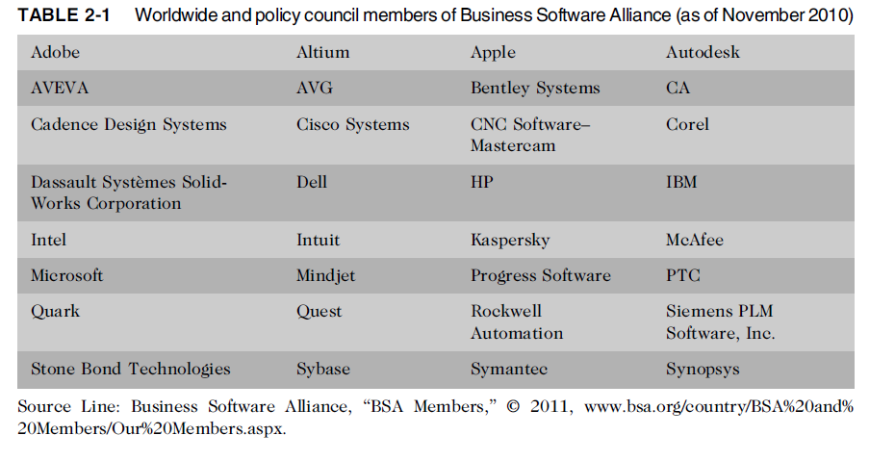
Relationships Between
IT Workers and Employers (cont’d)

Slide 13
Relationships Between
IT Workers and Employers (cont’d)
IT workers must set an example and enforce policies regarding the ethical use of IT in:
  Trade secrets
    Business information generally unknown to public
    Company takes actions to keep confidential
    Require cost or effort to develop
    Have some degree of uniqueness or novelty
  Whistle-blowing
    Employee attracts attention to a negligent, illegal, unethical, abusive, or dangerous act that threatens the public interest

Slide 14
Relationships Between
IT Workers and Clients
IT worker provides:
  Hardware, software, or services at a certain cost and within a given time frame
Client provides:
  Compensation
  Access to key contacts
  Work space
Relationship is usually documented in contractual terms

Slide 15
Relationships Between
IT Workers and Clients (cont’d)
Client makes decisions about a project based on information, alternatives, and recommendations provided by the IT worker
Client trusts IT worker to act in client’s best interests
IT worker trusts that client will provide relevant information, listen to and understand what the IT worker says, ask questions to understand impact of key decisions, and use the information to make wise choices

Slide 16
Relationships Between
IT Workers and Clients (cont’d)
Ethical problems arise if a company recommends its own products and services to remedy problems they have detected
  Creates a conflict of interest
Problems arise during a project if IT workers are unable to provide full and accurate reporting of a project’s status
  Finger pointing and heated discussions can ensue

Slide 17
Relationships Between
IT Workers and Clients (cont’d)
Fraud
  Crime of obtaining goods, services, or property through deception or trickery
Misrepresentation
  Misstatement or incomplete statement of material fact
  If misrepresentation causes a party to enter into a contract, that party may have the right to cancel contract or seek reimbursement for damages

Slide 18
Relationships Between
IT Workers and Clients (cont’d)
Breach of contract
  One party fails to meet the terms of a contract
  When there is material breach of contract:
    The non-breaching party may rescind the contract, seek restitution of any compensation paid to the breaching party, and be discharged from any further performance under the contract
IT projects are joint efforts in which vendors and customers work together
  When there are problems, it is difficult to assign who is at fault

Slide 19
Relationships Between
IT Workers and Suppliers
Develop good working relationships with suppliers:
  To encourage flow of useful information and ideas to develop innovative and cost-effective ways of using the supplier in ways that the IT worker may not have considered
  By dealing fairly with them
  By not making unreasonable demands

Slide 20
Relationships Between
IT Workers and Suppliers (cont’d)
Bribery
  Providing money, property, or favours to obtain a business advantage
  U.S. Foreign Corrupt Practices Act (FCPA): crime to bribe a foreign official, a foreign political party official, or a candidate for foreign political office
  At what point does a gift become a bribe?
  No gift should be hidden
  Perceptions of donor and recipient can differ
  United Nations Convention Against Corruption is a global treaty to fight bribery and corruption

Slide 21
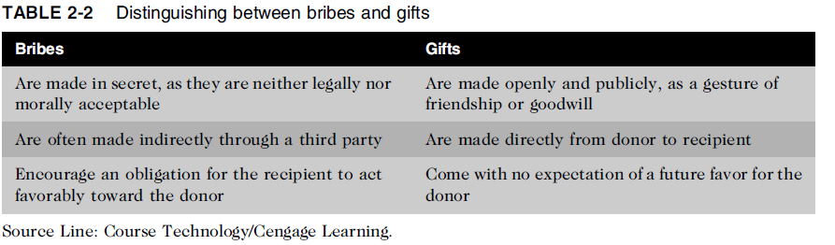
Relationships Between
IT Workers and Suppliers (cont’d)

Slide 22
Relationships Between
IT Workers and Other Professionals
Professionals feel a degree of loyalty to other members of their profession
Professionals owe each other adherence to their profession’s code of conduct
Ethical problems among the IT profession
  Résumé inflation on 30% of U.S. job applications
  Inappropriate sharing of corporate information
    Information might be sold intentionally or shared informally with those who have no need to know

Slide 23
Relationships Between
IT Workers and IT Users
IT user: person using a hardware or software product
IT workers’ duties
  Understand users’ needs and capabilities
  Deliver products and services that meet those needs
  Establish environment that supports ethical behaviour:
    To discourages software piracy
    To minimize inappropriate use of corporate computing resources
    To avoid inappropriate sharing of information

Slide 24
Relationships Between
IT Workers and Society
Society expects members of a profession:
  To provide significant benefits
  To not cause harm through their actions
Actions of an IT worker can affect society
Professional organizations provide codes of ethics to guide IT workers’ actions

Slide 25
Professional Codes of Ethics
State the principles and core values that are essential to the work of an occupational group
Most codes of ethics include:
  What the organization aspires to become
  Rules and principles by which members of the organization are expected to abide
Many codes also include commitment to continuing education for those who practice the profession

Slide 26
Professional Codes of Ethics
(cont’d)
Following a professional code of ethics can produce benefits for the individual, the profession, and society as a whole
  Ethical decision making
  High standards of practice and ethical behavior
  Trust and respect from general public
  Evaluation benchmark for self-assessment

Slide 27
Professional Organizations
No universal code of ethics for IT professionals
No single, formal organization of IT professionals has emerged as preeminent
Five of the most prominent organizations include:
  Association for Computing Machinery (ACM)
  Institute of Electrical and Electronics Engineers Computer Society (IEEE-CS)
  Association of IT Professionals (AITP)
  SysAdmin, Audit, Network, Security (SANS) Institute

Slide 28
Certification
Indicates that a professional possesses a particular set of skills, knowledge, or abilities in the opinion of the certifying organization
Can also apply to products
Generally voluntary
May or may not require adherence to a code of ethics
Employers view as benchmark of knowledge
Opinions are divided on value of certification

Slide 29
Certification (cont’d)
Vendor certifications
  Some certifications substantially improve IT workers’ salaries and career prospects
  Relevant for narrowly defined roles or certain aspects of broader roles
  Require passing a written exam, or in some cases, a hands-on lab to demonstrate skills and knowledge
  Can take years to obtain necessary experience
  Training can be expensive

Slide 30
Certification (cont’d)
Industry association certifications
  Require a higher level of experience and a broader perspective than vendor certifications
  Must sit for and pass written exam
  May need to pay annual renewal fee, earn continuing education credits, and/or pass renewal test
  Lag in developing tests that cover new technologies
  Are moving from purely technical content to a broader mix of technical, business, and behavioral competencies

Slide 31
Government Licensing
License is a government-issued permission to engage in an activity or operate a business
Generally administered at the state level in the United States
Often requires that recipient pass a test
Some professionals must be licensed – doctors, lawyers, CPAs, medical and day care providers, engineers
One goal: protect public safety

Slide 32
Government Licensing (cont’d)
Case for licensing IT workers
  Encourages following highest standards of profession
  Encourages practicing a code of ethics
  Violators would be punished
Without licensing, there are no requirements for heightened care and no concept of professional malpractice

Slide 33
Government Licensing (cont’d)
Issues associated with government licensing of IT workers
  There are few licensing programs for IT professionals
    No universally accepted core body of knowledge
    Unclear who should manage content and administration of licensing exams
    No administrative body to accredit professional education programs
    No administrative body to assess and ensure competence of individual workers

Slide 34
IT Professional Malpractice
Negligence: not doing something that a reasonable person would do, or doing something that a reasonable person would not do
Duty of care: obligation to protect people against any unreasonable harm or risk
  Reasonable person standard
  Reasonable professional standard
Professional malpractice: professionals who breach the duty of care are liable for injuries that their negligence causes

Slide 35
IT Users
Employees’ ethical use of IT is an area of growing concern because of increased access to:
  Personal computers
  Corporate information systems and data
  The Internet

Slide 36
Common Ethical Issues for IT Users
Software piracy
  Popularity of the Android smartphone operating system has contributed to the software piracy problem
Inappropriate use of computing resources
  Erodes productivity and wastes time
  Could lead to lawsuits
Inappropriate sharing of information, including:
  Every organization stores vast amounts of private or confidential data
    Private data (employees and customers)
    Confidential information (company and operations)

Slide 37
Supporting the Ethical Practices of
IT Users
Policies that protect against abuses:
  Set forth general rights and responsibilities of users
  Create boundaries of acceptable behaviour
  Enable management to punish violators
Policy components include:
  Establishing guidelines for use of company software
  Defining appropriate use of IT resources
  Structuring information systems to protect data and information
  Installing and maintaining a corporate firewall

Slide 38
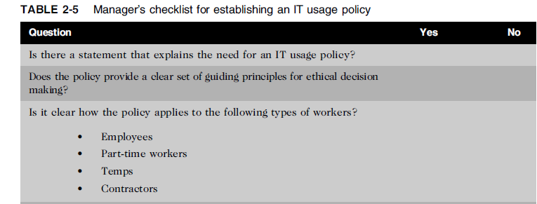
Supporting the Ethical Practices of
IT Users (cont’d)

Slide 39
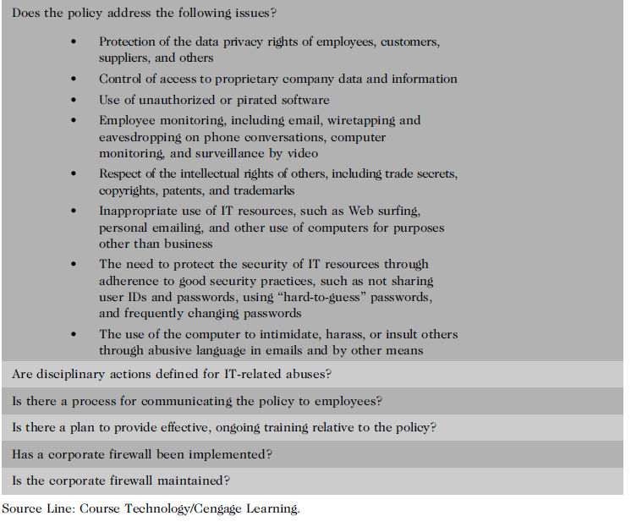

Slide 40
Compliance
To be in accordance with established policies, guidelines, specifications, and legislation
  Sarbanes-Oxley – established requirements for internal controls
  HIPAA – ensures security and privacy of employee healthcare data
  Failure to be in conformance can lead to criminal or civil penalties and also lawsuits

Slide 41
Compliance (cont’d)
Major challenge to comply with multiple government and industry regulations that are sometimes in conflict
To meet this challenge:
  Implement software to track and record compliance actions
  Hire management consultants for advice and training
  Create Chief Compliance Officer position

Slide 42
Compliance (cont’d)
Audit committee is subset of the board of directors, with oversight for the following activities:
  Quality and integrity of accounting and reporting practices and controls
  Compliance with legal and regulatory requirements
  Qualifications, independence, and performance of organization’s independent auditor
  Performance of company’s internal audit team

Slide 43
Compliance (cont’d)
Internal audit committee responsibilities:
  Determine that internal systems and controls are adequate and effective
  Verify existence of company assets and maintain proper safeguards over their protection
  Measure the organization’s compliance with its own policies and procedures
  Insure that institutional policies and procedures, appropriate laws, and good practices are followed
  Evaluate adequacy and reliability of information available for management decision making

Slide 44
Summary
Professionals
  Require advanced training and experience
  Must exercise discretion and judgment in their work
  Their work cannot be standardized
From a legal standpoint, a professional:
  Has passed the state licensing requirements
  Has earned the right to practice in a state(s)
IT professionals have many different relationships
  Each with its own ethical issues and potential problems

Slide 45
Summary (cont’d)
Professional code of ethics
  States the principles and core values essential to the work of an occupational group
  Serves as a guideline for ethical decision making
  Promotes high standards of practice and behavior
  Enhances trust and respect from the general public
  Provides an evaluation benchmark
Licensing and certification of IT professionals
  Would increase the reliability and effectiveness of information systems
  Raises many issues

Slide 46
Summary (cont’d)
IT-related professional organizations have developed their code of ethics that:
  Outlines what the organization aspires to become
  Lists rules and principles for members
  Includes a commitment to continuing education for those who practice the profession
Audit committee and internal audit team have a major role in ensuring that both the IT organization and IT users are in compliance with guidelines and various legal and regulatory practices.

Slide 47
Reference
Ethics in Information Technology, George W. Reynolds, Fifth Edition

Slide 48
Quiz (Chapter 2)

