Slide 1

Ethics in Information Technology
Chapter 3
Computer and Internet Crime

Slide 2
Objectives
  What key trade-offs and ethical issues are associated with the safeguarding of data and information systems?
  Why has there been a dramatic increase in the number of computer-related security incidents in recent years?
  What are the most common types of computer security attacks?

Slide 3
Objectives (cont’d)
  Who are the primary perpetrators of computer crime, and what are their objectives?
  What are the key elements of a multilayer process for managing security vulnerabilities based on the concept of reasonable assurance?
  What actions must be taken in response to a security incident?
  What is computer forensics, and what role does it play in responding to a computer incident?

Slide 4
IT Security Incidents: A Major Concern
Security of information technology is of utmost importance
  Safeguard:
    Confidential business data
    Private customer and employee data
  Protect against malicious acts of theft or disruption
  Balance against other business needs and issues
  Number of IT-related security incidents is increasing around the world

Slide 5
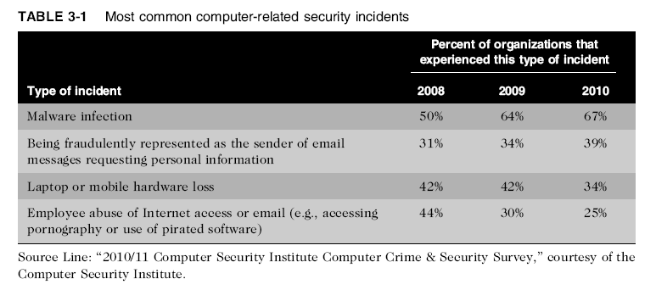
IT Security Incidents: A Major Concern
(cont’d)

Slide 6
Why Computer Incidents Are So Prevalent
Increasing complexity increases vulnerability
Higher computer user expectations
Expanding/changing systems equal new risks
Increased reliance on commercial software with known vulnerabilities

Slide 7
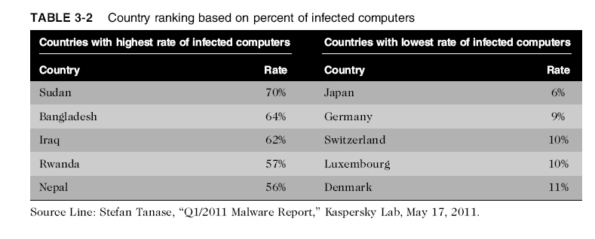

Why Computer Incidents Are So Prevalent (cont’d)

Slide 8
Why Computer Incidents Are So Prevalent (cont’d)
Increasing complexity increases vulnerability
    Computing environment is enormously complex
    Number of entry points expands continuously
    Workers in many organizations operate in a cloud computing environment in which software and data storage are services provided via the Internet.
    Virtualization software emulates computer hardware by enabling multiple operating systems to run on one computer host.

Slide 9
Why Computer Incidents Are So Prevalent (cont’d)
Higher computer user expectations
    Forget to verify users’ IDs or check authorizations
    Computer users share login IDs and passwords

Slide 10
Why Computer Incidents Are So Prevalent (cont’d)
Expanding/changing systems equal new risks
  Network era
    Personal computers connect to networks with millions of other computers
    All capable of sharing information
  Information technology
    Ubiquitous
    Necessary tool for organizations to achieve goals
    Increasingly difficult to match pace of technological change

Slide 11
Why Computer Incidents Are So Prevalent (cont’d)
Increased reliance on commercial software with known vulnerabilities
  Exploit
    Attack on information system that takes advantage of system vulnerability
    Due to poor system design or implementation
  Patch
    “Fix” or “ Patch” to eliminate the problem
    Users are responsible for obtaining and installing
    Delays expose users to security breaches

Slide 12
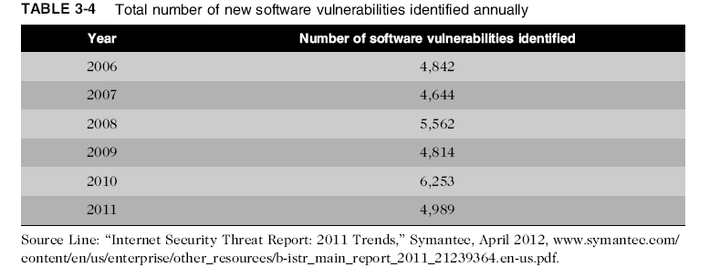
Why Computer Incidents Are So Prevalent (cont’d)

Slide 13
Why Computer Incidents Are So Prevalent (cont’d)
Zero-day attack
  Before a vulnerability is discovered or fixed
U.S. companies rely on commercial software with known vulnerabilities

Slide 14
Types of Exploits
Computers as well as smartphones can be target
Types of attacks
  Virus
  Worm
  Trojan horse
  Distributed denial of service
  Rootkit
  Spam
  Phishing (spear-phishing, smishing, and vishing)

Slide 15
Types of Exploits (cont’d)
Virus
  Virus: Piece of programming code, disguised as something else, that causes a computer to behave in an unexpected and undesirable manner.
  A virus is attached to a file, so that when the infected file is opened, the virus executes.
  Most viruses deliver a “payload,”
  A virus is spread to other machines when a computer user opens an infected email attachment, downloads an infected program, or visits infected Web sites.

Slide 16
Types of Exploits (cont’d)
Worm
  Worms: Harmful program that resides in the active memory of the computer and duplicates itself.
  Worms differ from viruses in that they can propagate without human intervention, often sending copies of themselves to other computers by email.
  The negative impact of a worm attack on an organization’s computers
  Lost data and programs
    Lost productivity
    Additional effort for IT workers
    The cost to repair the damage done by each of the Code Red, SirCam, and Melissa worms was estimated to exceed $1 billion, with that of the Conficker, Storm, and ILOVEYOU worms totaling well over $5 billion.

Slide 17
Types of Exploits (cont’d)
Trojan Horse
  Trojan Horse: Program in which malicious code is hidden inside a seemingly harmless program.
  Users are tricked into installing them
  Delivered via email attachment, downloaded from a Web site, or contracted via a removable media device
  Logic bomb: Executes when it is triggered by a specific event
  For example, logic bombs can be triggered by a change in a particular file, by typing a specific series of keystrokes, or by a specific time or date.

Slide 18
Types of Exploits (cont’d)
Distributed Denial-of-Service (DDoS) Attacks
DDoS Attacks : Malicious hacker takes over computers via the Internet and causes them to flood a target site with demands for data and other small tasks.
Does not involve infiltration of the targeted system.
DDoS Attacks :Target machine is busy responding to a stream of automated requests Legitimate users cannot access target machine.
Botnet is used to describe a large group of such computers, which are controlled from one or more remote locations by hackers, without the knowledge or consent of their owners.
Based on a command by the attacker or at a preset time, the botnet computers (called zombies) go into action, each sending a simple request for access to the target site again and again.

Slide 19
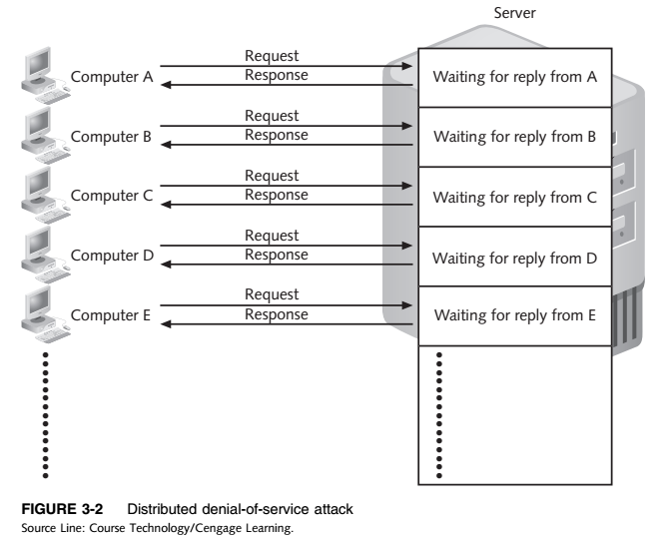
Types of Exploits (cont’d)
Distributed Denial-of-Service (DDoS) Attacks

Slide 20
Types of Exploits (cont’d)
Rootkits
Rootkits: Set of programs that enables its user to gain administrator-level access to a computer without the end user’s consent or knowledge.
Attacker can gain full control of the system and even obscure the presence of the rootkit.
Attackers can use the rootkit to execute files, access logs, monitor user activity, and change the computer’s configuration.
Fundamental problem in detecting a rootkit is that the operating system currently running cannot be trusted to provide valid test results.
Dropper code gets a rootkit installation started and can be easily activated by clicking on a link to a malicious Web site in an email or opening an infected PDF file.

Slide 21
Types of Exploits (cont’d)
Spam
  Spam: Abuse of email systems to send unsolicited email to large numbers of people
  Most spam is a form of low-cost commercial advertising, sometimes for questionable products
  Method of marketing also used by many legitimate organizations
  Spam detracts recipients from the ability of recipients to communicate effectively due to full mailboxes and relevant emails being hidden among many unsolicited messages.

Slide 22
Types of Exploits (cont’d)
Spam
  The Controlling the Assault of Non-Solicited Pornography and Marketing (CAN-SPAM) Act went into effect in 2004 and states that it is legal to spam, provided the messages meet a few basic requirements.
  Spammers cannot disguise their identity
  CAPTCHA (Completely Automated Public Turing Test to Tell Computers and Humans Apart)
  Spammers can defeat the registration process of free email services by launching a coordinated CAPTCHA attack that can sign up for thousands of untraceable email accounts.
  CAPTCHA Software generates tests that humans can pass but computer programs cannot.

Slide 23
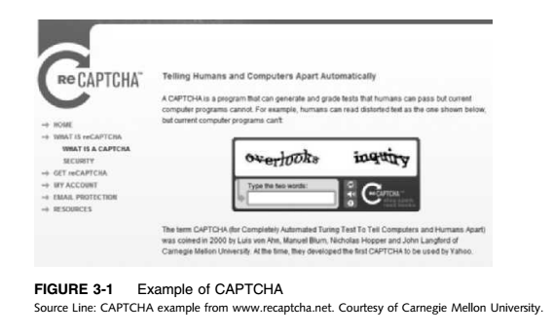
Types of Exploits (cont’d)
Spam

Slide 24
Types of Exploits (cont’d)
Phishing
Phishing: Act of using email fraudulently to try to get the recipient to reveal personal data
Legitimate-looking emails lead users to counterfeit Web sites

Slide 25
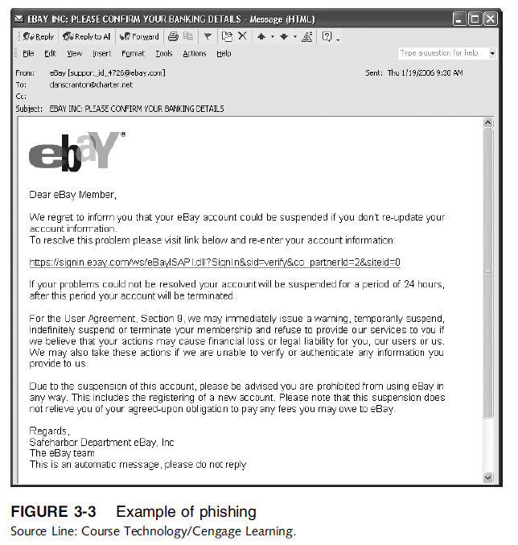
Types of Exploits (cont’d)
Phishing

Slide 26
Types of Exploits (cont’d)
Phishing
Spear-phishing : Fraudulent emails to an organization’s employees designed to look like they came from high­ level executives from within the organization.
  Emails are designed to look like they came from high-level executives within the organization.
Smishing : Phishing via text messages
Legitimate-looking text message sent to people, telling them to call a specific phone number or to log on to a Web site.
Vishing :Phishing via voice mail messages
  the victims receive a voice mail telling them to call a phone number or access a Web site.

Slide 27
Types of Perpetrators
Perpetrators
  Perpetrators include:
  Thrill seekers wanting a challenge
  Common criminals looking for financial gain
  Industrial spies trying to gain an advantage
  Terrorists seeking to cause destruction to further their cause
Different objectives and access to varying resources
Willing to take different levels of risk to accomplish his or her objective.

Slide 28
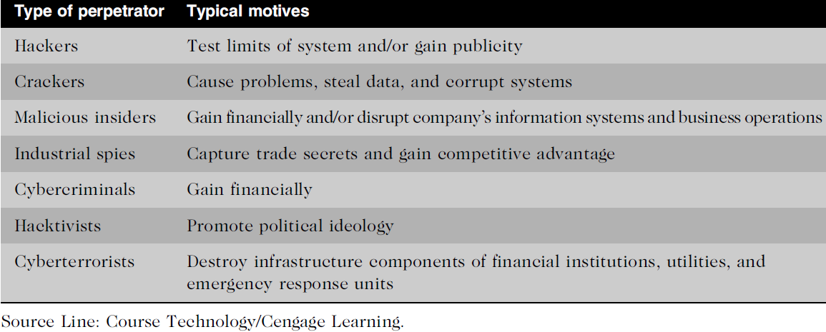
Table 3.5 - Classifying Perpetrators of Computer Crime
Types of Perpetrators (cont’d)

Slide 29
Types of Perpetrators (cont’d)
Hackers and Crackers
Hackers: Test the limitations of information systems out of intellectual curiosity
Some hackers are smart and talented
Lamers or script kiddies: Terms used to refer to technically inept hackers
Crackers: Cracking is a form of hacking
Clearly criminal activity

Slide 30
Types of Perpetrators (cont’d)
Malicious insiders
Malicious Insider: A major security concern for companies
An ever-present and extremely dangerous adversary
Fraud within an organization is usually due to weaknesses in internal control procedures
Collusion: Cooperation between an employee and an outsider
Insiders are not necessarily employees; they can also be consultants and contractors.
Extremely difficult to detect or stop because they are often authorized to access the very systems they abuse.
Negligent Insiders: Poorly trained and inadequately managed employees who cause damage accidently.

Slide 31
Types of Perpetrators (cont’d)
Industrial spies
  Industrial spies use illegal means to obtain trade secrets from competitors.
  Trade secrets are protected by the Economic Espionage Act of 1996.
  Trade secrets are most often stolen by insiders, such as disgruntled employees and exemployees.
  Competitive intelligence: Legally obtained data gathered using sources available to the public.
  Information is gathered from financial reports, trade journals, public filings, and printed interviews with company officials.
  Industrial espionage: Using illegal means to obtain information that is not available to the public.

Slide 32
Types of Perpetrators (cont’d)
Cybercriminals
  Cybercriminals: Hack into computers to steal and engage in computer fraud.
  Engage in all forms of computer fraud
  Chargebacks are disputed transactions
  Loss of customer trust has more impact than fraud
  To reduce potential for online credit card fraud:
  Use encryption technology
  Verify the address submitted online against the issuing bank
  Request a card verification value (CVV)
  Use transaction-risk scoring software
  Use smart cards

Slide 33
Types of Perpetrators (cont’d)
Cybercriminals
Smart cards: which contain a memory chip that is updated with encrypted data every time the card is used.
  Used widely in Europe, Not widely used in the U.S.
  Data breach: Unintended release of sensitive data or the access of sensitive data by unauthorized individuals

Slide 34
Types of Perpetrators (cont’d)
Hacktivists and Cyberterrorists
  Hacktivism: a combination of the words hacking and activism, is hacking to achieve a political or social goal.
  Cyberterrorists: launches computer-based attacks to intimidate or coerce an organization in order to advance certain political or social objectives.
  Seek to cause harm rather than gather information
  Use techniques that destroy or disrupt services.

Slide 35
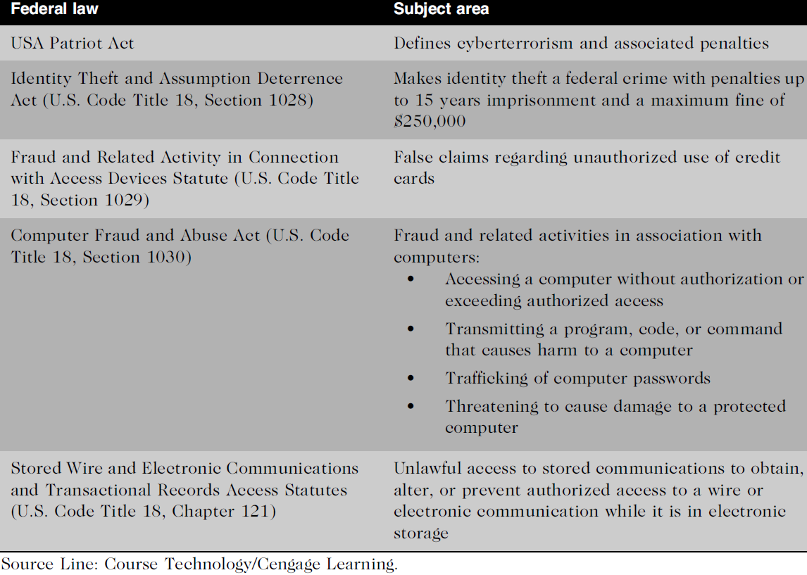
Table 3.6 - Federal Laws that Address Computer Crime
Federal Laws for Prosecuting Computer Attacks

Slide 36
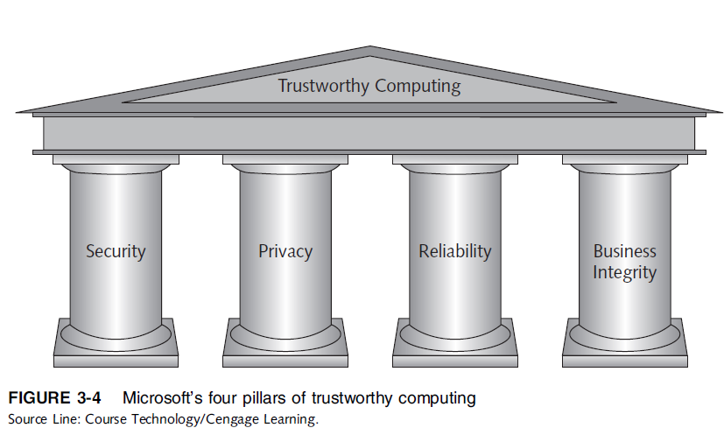
Implementing Trustworthy Computing
Trustworthy Computing
  Trustworthy computing is a method of computing that delivers secure, private, and reliable computing experiences based on sound business practices.

Slide 37
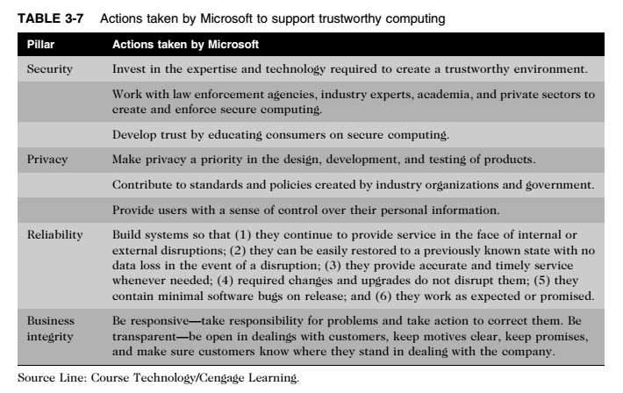
Implementing Trustworthy Computing (cont’d)

Slide 38
Implementing Trustworthy Computing (cont’d)
Trustworthy Computing
Trustworthy Computing : The security of any system or network is a combination of technology, policy, and people and requires a wide range of activities to be effective.
Systems must be monitored to detect possible intrusion
Clear reaction plan addresses:
  Notification, evidence protection, activity log maintenance, containment, eradication, and recovery

Slide 39
Risk Assessment
Risk Assessment
Risk assessment is the process of assessing security-related risks to an organization’s computers and networks from internal and external threats.
The goal of risk assessment is to identify which investments of time and resources will best protect the organization from its most likely and serious threats.
Asset (an IT risk assessment): Hardware, software, information system, network, or database used by an organization to achieve its business objectives.
Loss event : Any occurrence that has a negative impact on an asset such as a computer contracting a virus or a Web site undergoing a distributed denial-of-service attack.
Focus security efforts on the areas of highest payoff.

Slide 40
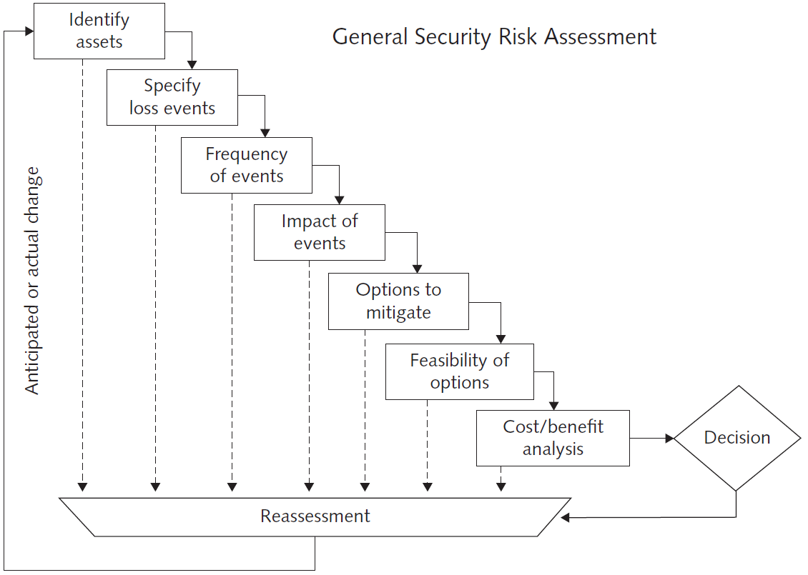
Risk Assessment (cont’d)
Source Line: General Security Risk Assessment Guidelines, ASIS International (2003). See the Standards and Guidelines page of the ASIS International website (www.asisonline.org) for revisions and/or updates. Reprinted by permission.

Slide 41
Risk Assessment (cont’d)
Eight-step risk assessment process
  #1 Identify assets of most concern
  #2 Identify loss events that could occur
  #3 Assess likelihood of each potential threat
  #4 Determine the impact of each threat
  #5 Determine how each threat could be mitigated
  #6 Assess feasibility of mitigation options
  #7 Perform cost-benefit analysis
  #8 Decide which countermeasures to implement

Slide 42
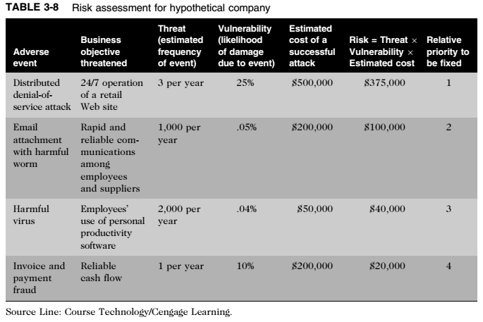
Risk Assessment (cont’d)

Slide 43
Establishing a Security Policy
Security Policy
Security Policy: defines an organization’s security requirements, as well as the controls and sanctions needed to meet those requirements.
A good security policy delineates responsibilities and the behavior expected of members of the organization.
A security policy outlines: what needs to be done but not how to do it.
  Automated system policies should mirror written policies
  When applying system security restrictions, there are some trade-offs between ease of use and increased security.

Slide 44
Establishing a Security Policy (cont’d)
Security Policy
Areas of concern
    Use of email attachments
    Use of wireless devices
Virtual private network (VPN): Works by using the Internet to relay communications; but it maintains privacy through security procedures and tunneling protocols.
Encrypt data at the sending end and decrypt it at the receiving end.

Slide 45
Educating Employees and Contract Workers
Motivates them to understand and follow the security policies
Users must help protect an organization’s information systems and data by:
  Guarding their passwords to protect against unauthorized access to their accounts
  Prohibiting others from using their passwords
  Applying strict access controls (file and directory permissions) to protect data from disclosure or destruction
  Reporting all unusual activity to the organization’s IT security group
  Taking care to ensure that portable computing and data storage devices are protected (hundreds of thousands of laptops are lost or stolen per year)

Slide 46
Prevention
The key is to implement a layered security solution to make computer break-ins so difficult that an attacker eventually gives up.
Install a corporate firewall
  Firewall stands guard between an organization’s internal network and the Internet,
  It limits network access based on the organization’s access policy.

Slide 47
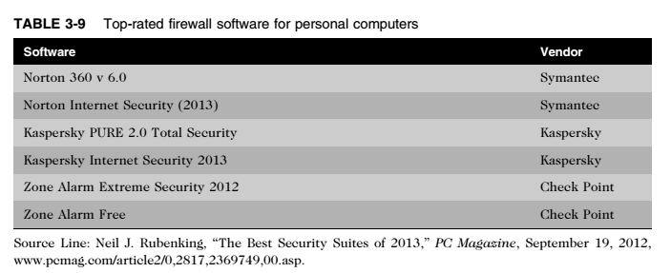
Prevention (cont’d)
Install a corporate firewall

Slide 48
Prevention (cont’d)
Intrusion detection system (IDS)
  IDS: Monitors system and network resources and activities,
  Notifies network security personnel when network traffic attempts to circumvent the security measures
  Knowledge-based approaches and behavior-based approaches are two fundamentally different approaches to intrusion detection.
Intrusion Prevention System (IPS)
  IPS: Controls system and block viruses, malformed packets, and other threats.

Slide 49
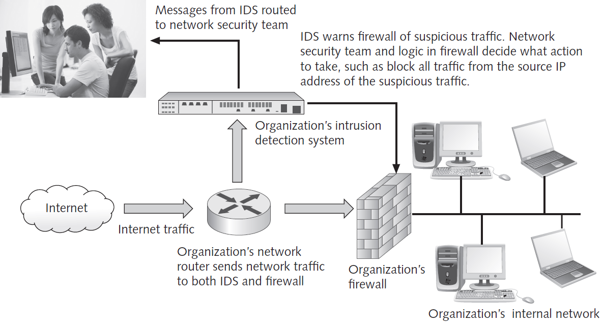
Figure 3.6 - Intrusion Detection System
Prevention (cont’d)
Credit: Monkey Business Images/Shutterstock.com.

Slide 50
Prevention (cont’d)
Installing Antivirus Software on Personal Computers
Antivirus software should be installed on each user’s personal computer to scan a computer’s memory and disk drives regularly for viruses.
  Scans for a specific sequence of bytes, known as a Virus signature: Indicates the presence of a specific virus
  Two of the most widely used antivirus software products are Norton AntiVirus from Symantec and Personal Firewall from McAfee.

Slide 51
Prevention (cont’d)
The United States Computer Emergency Readiness Team ( US-CERT) is a partnership between the Department of Homeland Security (DHS) and the public and private sectors— established in 2003.
Protect the nation’s Internet infrastructure against cyberattacks.
Serves as a clearinghouse for information on new viruses, worms, and other computer security topics.

Slide 52
Prevention (cont’d)
Implement safeguards against attacks by malicious insiders
  User accounts that remain active after employees leave a company are another potential security risk.
  To reduce the threat of attack by malicious insiders, IT staff must promptly delete the computer accounts, login IDs, and passwords of departing employees and contractors.
  Organizations also need to define employee roles carefully and separate key responsibilities properly.
  Another important safeguard is to create roles and user accounts so that users have the authority to perform their responsibilities and nothing more.

Slide 53
Prevention (cont’d)
Defend against cyberterrorism
  Department of Homeland Security (DHS): Aims to secure critical infrastructure and information systems
  The DHS leads the federal government’s efforts in “securing civilian government computer systems, and works with industry and state, local, tribal, and territorial governments to secure critical infrastructure and information systems.”
    Builds and maintains a national security cyberspace response system
    Implements a cyber-risk management program for protection of critical infrastructure, including banking and finance, water, government operations, and emergency services.

Slide 54
Prevention (cont’d)
Conducting periodic IT security audits
  Security audit: Evaluates whether an organization has a well considered security policy in place and if it is being followed.
  Review access and levels of authority
  Test system safeguards
  Information Protection Assessment kit is available from the Computer Security Institute.

Slide 55
Detection Systems
Catch Intruders in the Act
Minimize the Impact of Intruders

Slide 56
Response
Response plan
  Develop well in advance of any incident
  Approved by:
    Legal department
    Senior management
Primary goals
  Regain control and limit damage
  Not to monitor or catch an intruder
Only 56% have response plan

Slide 57
Response (cont’d)
Incident notification
  Define who to notify and who not to notify
  Security experts recommend against releasing specific information about a security compromise in public forums.
Protection of evidence and activity logs
  Document all details of a security incident as it works to resolve
  the incident.
  It is especially important to capture all system events, the specific actions taken (what, when, and who), and all external conversations (what, when, and who) in a logbook.

Slide 58
Response (cont’d)
Incident Containment
  Determine if an attack is dangerous enough to warrant shutting down the systems or disconnecting critical systems from the network.
Eradication
  Collect and log all criminal evidence from the system.
  Verify that all backups are current, complete, and free of any virus.
  After virus eradication, the group must create a new backup.

Slide 59
Response (cont’d)
Incident follow-up
  Determine how the security was compromised
  Review: should be conducted after an incident to determine exactly what happened and to evaluate how the organization responded.
Weigh carefully the amount of effort required to capture the perpetrator
Consider the potential for negative publicity
Legal precedent
  Hold organizations accountable for their own IT security weaknesses

Slide 60
Computer Forensics
Computer forensics is a discipline that combines elements of law and computer science to:
  Identify, collect, examine, and preserve data from computer systems and preserves the integrity of the data gathered so that it is admissible as evidence in a court of law
Computer forensics investigation requires extensive training and certification and knowledge of laws that apply to gathering of criminal evidence.

Slide 61
Summary
Ethical decisions in determining which information systems and data most need protection
Most common computer exploits
  Viruses and worms
  Trojan horses
  Distributed denial-of-service attacks
  Rootkits and spam
  Phishing and spear-fishing
  Smishing and vishing

Slide 62
Summary
Perpetrators include:
  Hackers
  Crackers
  Malicious insider
  Industrial spies
  Cybercriminals
  Hacktivist
  Cyberterrorists

Slide 63
Summary
Must implement multilayer process for managing security vulnerabilities, including:
  Assessment of threats
  Identifying actions to address vulnerabilities
  User education
IT must lead the effort to implement:
  Security policies and procedures
  Hardware and software to prevent security breaches
Computer forensics is key to fighting computer crime in a court of law

Slide 64
Reference
1. Ethics in information technology 5th Edition

Slide 65
Quiz (Chapter 3)

