Slide 1
Ethics in Information Technology
Chapter 4
Privacy

Slide 2
Objectives
  What is the right of privacy, and what is the basis for protecting personal privacy under the law?
  What are some of the laws that provide protection for the privacy of personal data, and what are some of the associated ethical issues?
  What is identity theft, and what techniques do identity thieves use?

Slide 3
Objectives (cont’d)
  What are the various strategies for consumer profiling, and what are the associated ethical issues?
  What must organizations do to treat consumer data responsibly?
  Why and how are employers increasingly using workplace monitoring?
  What are the capabilities of advanced surveillance technologies, and what ethical issues do they raise?

Slide 4
Privacy Protection and the Law
Systems collect and store key data from every interaction with customers to make better decisions
Many object to data collection policies of government and business
Privacy
  Key concern of Internet users
  Top reason why nonusers still avoid the Internet
Reasonable limits must be set
Historical perspective on the right to privacy
  Fourth Amendment reasonable expectation of privacy

Slide 5
Information Privacy
Definition of privacy
  “The right to be left alone—the most comprehensive of rights, and the right most valued by a free people”
Information privacy is a combination of:
  Communications privacy
    Ability to communicate with others without being monitored by other persons or organizations
  Data privacy
    Ability to limit access to one’s personal data by other individuals and organizations in order to exercise a substantial degree of control over that data and its use

Slide 6
Privacy Laws, Applications, and Court Rulings
Legislative acts passed over the past 40 years
  Most address invasion of privacy by the government
  No protection of data privacy abuses by corporations
  No single, overarching national data privacy policy

Slide 7
Privacy Laws, Applications, and Court Rulings (cont’d)
Financial data
  Fair Credit Reporting Act (1970)
      Regulates operations of credit-reporting bureaus
  Fair and Accurate Credit Transactions Act (2003)
      Allows consumers to request and obtain a free credit report once each year from each of the three primary consumer credit reporting companies
  Right to Financial Privacy Act (1978)
      Protects the financial records of financial institution customers from unauthorized scrutiny by the federal government

Slide 8
Privacy Laws, Applications, and Court Rulings (cont’d)
Financial data
  Gramm-Leach-Bliley Act (1999)
      Bank deregulation that enabled institutions to offer investment, commercial banking, and insurance services
    Three key rules affecting personal privacy
        Financial Privacy Rule
        Safeguards Rule
        Pretexting Rule

Slide 9
Privacy Laws, Applications, and Court Rulings (cont’d)
Opt-out policy
  Assumes that consumers approve of companies collecting and storing their personal information
  Requires consumers to actively opt out
  Favored by data collectors
Opt-in policy
  Must obtain specific permission from consumers before collecting any data
  Favored by consumers

Slide 10
Privacy Laws, Applications, and Court Rulings (cont’d)
Health information
  Health Insurance Portability and Accountability Act (1996)
      Improves the portability and continuity of health insurance coverage
      Reduces fraud, waste, and abuse
      Simplifies the administration of health insurance
  American Recovery and Reinvestment Act (2009)
      Included strong privacy provisions for electronic health records
      Offers protection for victims of data breaches

Slide 11
Privacy Laws, Applications, and Court Rulings (cont’d)
State laws related to security breach notification
  Over 40 states have enacted legislation requiring organizations to disclose security breaches
  For some states, these laws are quite stringent

Slide 12
Privacy Laws, Applications, and Court Rulings (cont’d)
Children’s personal data
  Children’s Online Privacy Protection Act (1998)
      Web sites catering to children must offer comprehensive privacy policies, notify parents or guardians about its data-collection practices, and receive parental consent before collecting personal information from children under 13
  Family Education Rights and Privacy Act (1974)
      Assigns rights to parents regarding their children’s education records
      Rights transfer to student once student becomes 18

Slide 13
Privacy Laws, Applications, and Court Rulings (cont’d)
Electronic surveillance
  Communications Act of 1934
      Established the Federal Communications Commission
      Regulates all non-federal-government use of radio and television plus all interstate communications
    Title III of the Omnibus Crime Control and Safe Streets Act (Wiretap Act)
      Regulates interception of telephone and oral communications
      Has been amended by new laws

Slide 14
Privacy Laws, Applications, and Court Rulings (cont’d)
Electronic surveillance
    Foreign Intelligence Surveillance Act (FISA) of 1978
    Describes procedures for electronic surveillance and collection of foreign intelligence information in communications between foreign powers and agents of foreign powers

Slide 15
Privacy Laws, Applications, and Court Rulings (cont’d)
Electronic surveillance
  Electronic Communications Privacy Act of 1986 (ECPA)
    Protects communications in transfer from sender to receiver
    Protects communications held in electronic storage
    Prohibits recording dialing, routing, addressing, and signaling information without a search warrant
      Pen register records electronic impulses to identify numbers dialed for outgoing calls
      Trap and trace records originating number of incoming calls

Slide 16
Privacy Laws, Applications, and Court Rulings (cont’d)
Electronic surveillance
  Communications Assistance for Law Enforcement Act (CALEA) 1994
    Amended both the Wiretap Act and ECPA
    Required the telecommunications industry to build tools into its products so federal investigators could eavesdrop and intercept electronic communications
    Covered emerging technologies, such as:
      Wireless modems
      Radio-based electronic mail
      Cellular data networks

Slide 17
Privacy Laws, Applications, and Court Rulings (cont’d)
Electronic surveillance
  USA PATRIOT Act (2001)
    Increased ability of law enforcement agencies to search telephone, email, medical, financial, and other records
    Critics argue law removed many checks and balances that ensured law enforcement did not abuse its powers
    Relaxed requirements for National Security Letters (NSLs)

Slide 18
Privacy Laws, Applications, and Court Rulings (cont’d)
Export of personal data
  Organization for Economic Co-operation and Development Fair Information Practices (1980)
    Fair Information Practices
      Set of eight principles
      Model of ethical treatment of consumer data

Slide 19
Privacy Laws, Applications, and Court Rulings (cont’d)
Export of personal data
European Union Data Protection Directive
    Requires companies doing business within the borders of 15 European nations to implement a set of privacy directives on the fair and appropriate use of information
    Goal to ensure data transferred to non-European countries is protected
    Based on set of seven principles for data privacy
    Concern that U.S. government can invoke USA PATRIOT Act to access data

Slide 20
Privacy Laws, Applications, and Court Rulings (cont’d)
BBBOnLine and TRUSTe
  Independent initiatives that favor an industry-regulated approach to data privacy
  BBBOnLine reliability seal or a TRUSTe data privacy seal demonstrates that Web site adheres to high level of data privacy
  Seals
    Increase consumer confidence in site
    Help users make more informed decisions about whether to release personal information

Slide 21
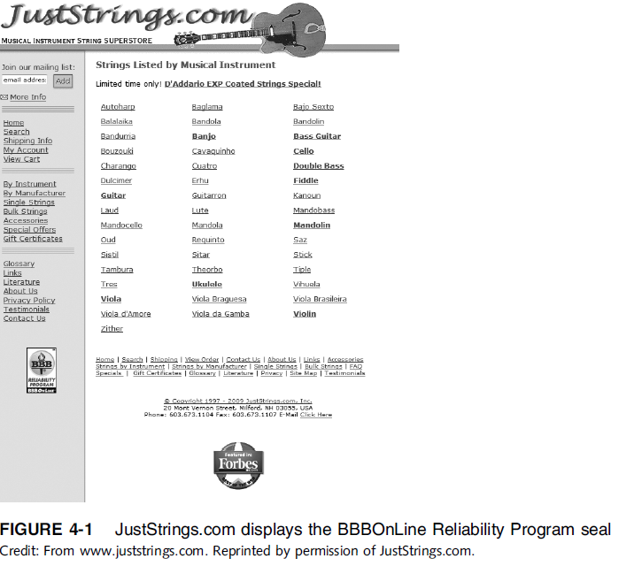

Slide 22
Privacy Laws, Applications, and Court Rulings (cont’d)
Access to government records
  Freedom of Information Act (1966 amended 1974)
    Grants citizens the right to access certain information and records of the federal government upon request
    Exemptions bar disclosure of information that could:
      Compromise national security
      Interfere with active law enforcement investigation
      Invade someone’s privacy

Slide 23
Privacy Laws, Applications, and Court Rulings (cont’d)
Access to government records
    The Privacy Act of 1974
      Prohibits government agencies from concealing the existence of any personal data record-keeping system
      Outlines 12 requirements that each record-keeping agency must meet
      CIA and law enforcement agencies are excluded from this act
      Does not cover actions of private industry

Slide 24
Key Privacy and Anonymity Issues
Identity theft
Electronic discovery
Consumer profiling
Treating customer data responsibly
Workplace monitoring
Advanced surveillance technology

Slide 25
Identity Theft
Theft of key pieces of personal information to impersonate a person, including:
  Name
  Address
  Date of birth
  Social Security number
  Passport number
  Driver’s license number
  Mother’s maiden name

Slide 26
Identity Theft (cont’d)
Fastest-growing form of fraud in the United States
Consumers and organizations are becoming more vigilant and proactive in fighting identity theft
Four approaches used by identity thieves
  Create a data breach
  Purchase personal data
  Use phishing to entice users to give up data
  Install spyware to capture keystrokes of victims

Slide 27
Identity Theft (cont’d)
Data breaches of large databases
  To gain personal identity information
  May be caused by:
    Hackers
    Failure to follow proper security procedures
Purchase of personal data
  Black market for:
    Credit card numbers in bulk—$.40 each
    Logon name and PIN for bank account—$10
    Identity information—including DOB, address, SSN, and telephone number—$1 to $15

Slide 28
Identity Theft (cont’d)
Phishing
  Stealing personal identity data by tricking users into entering information on a counterfeit Web site
Spyware
  Keystroke-logging software
  Enables the capture of:
    Account usernames
    Passwords
    Credit card numbers
    Other sensitive information
  Operates even if infected computer is not online

Slide 29
Identity Theft (cont’d)
Identity Theft and Assumption Deterrence Act of 1998 was passed to fight fraud
Identity Theft Monitoring Services
  Monitor the three major credit reporting agencies (TransUnion, Equifax, and Experian)
  Monitor additional databases (financial institutions, utilities, and DMV)

Slide 30
Electronic Discovery
Collection, preparation, review, and production of electronically stored information for use in criminal and civil actions
Quite likely that information of a private or personal nature will be disclosed during e-discovery
Federal Rules of Procedure define e-discovery processes
E-discovery is complicated and requires extensive time to collect, prepare, and review data

Slide 31
Electronic Discovery (cont’d)
Raises many ethical issues
  Should an organization attempt to destroy or conceal incriminating evidence?
  To what degree must an organization be proactive and thorough in providing evidence?
  Should an organization attempt to “bury” incriminating evidence in a mountain of trivial, routine data?

Slide 32
Consumer Profiling
Companies openly collect personal information about Internet users
Cookies
  Text files that a Web site can download to visitors’ hard drives so that it can identify visitors later
Tracking software analyzes browsing habits
Similar controversial methods are used outside the Web environment

Slide 33
Consumer Profiling (cont’d)
Aggregating consumer data
  Databases contain a huge amount of consumer behavioral data
  Affiliated Web sites are served by a single advertising network
Collecting data from Web site visits
  Goal: provide customized service for each consumer
  Types of data collected
    GET data
    POST data
    Click-stream data

Slide 34
Consumer Profiling (cont’d)
Four ways to limit or stop the deposit of cookies on hard drives
  Set the browser to limit or stop cookies
  Manually delete them from the hard drive
  Download and install a cookie-management program
  Use anonymous browsing programs that don’t accept cookies

Slide 35
Consumer Profiling (cont’d)
Personalization software
  Used by marketers to optimize the number, frequency, and mixture of their ad placements
    Rules-based
    Collaborative filtering
    Demographic filtering
    Contextual commerce
Consumer data privacy
  Platform for Privacy Preferences (P3P)
    Shields users from sites that don’t provide the level of privacy protection desired

Slide 36
Treating Consumer Data Responsibly
Strong measures are required to avoid customer relationship problems
Companies should adopt:
  Fair Information Practices
  1980 OECD privacy guidelines
Federal Trade Commission responsible for protecting privacy of U.S. consumers
Chief privacy officer (CPO)
  Executive to oversee data privacy policies and initiatives

Slide 37
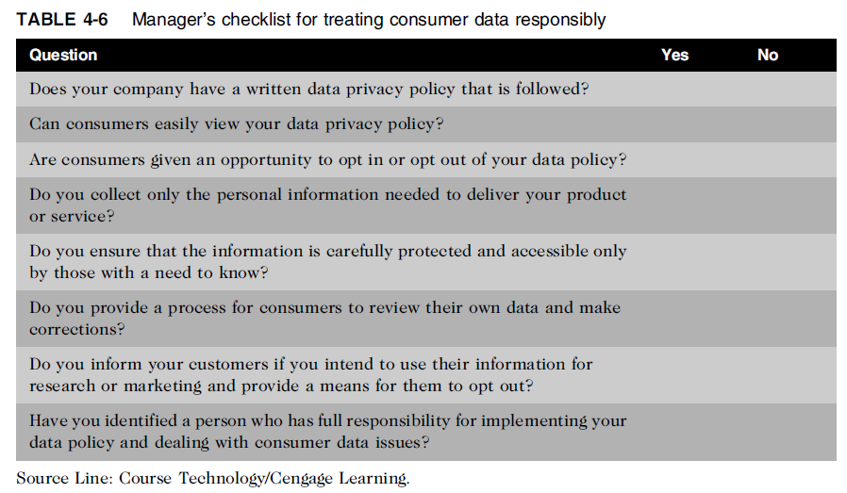
Treating Consumer Data Responsibly (cont’d)

Slide 38
Workplace Monitoring
Employers monitor workers
  Protect against employee abuses that reduce worker productivity or expose employer to harassment lawsuits
Fourth Amendment cannot be used to limit how a private employer treats its employees
  Public-sector employees have far greater privacy rights than in the private industry
Privacy advocates want federal legislation
  To keep employers from infringing upon privacy rights of employees

Slide 39
Advanced Surveillance Technology
Camera surveillance
  Many cities plan to expand surveillance systems
  Advocates argue people have no expectation of privacy in a public place
  Critics concerned about potential for abuse
Global positioning system (GPS) chips
  Placed in many devices
  Precisely locate users
  Banks, retailers, airlines eager to launch new services based on knowledge of consumer location

Slide 40
Summary
Laws, technical solutions, and privacy policies are required to balance needs of business against rights of consumers
A number of laws have been enacted that affect a person’s privacy particularly in the areas of financial and health records, protection following a security breach, children’s personal data, electronic surveillance, export of personal data, and access to government records

Slide 41
Summary (cont’d)
Identity theft is fastest-growing form of fraud
E-discovery can be expensive, can reveal data of a private or personal data, and raises many ethical issues
Web sites collect personal data about visitors
Consumer data privacy has become a major marketing issue
Code of Fair Information Practices and 1980 OECD privacy guidelines provide an approach to treating consumer data responsibly

Slide 42
Summary (cont’d)
Employers monitor employees to maintain employee productivity and limit exposure to harassment lawsuits
Advances in information technology provide new data-gathering capabilities but also diminish individual privacy
  Surveillance cameras
  GPS systems

Slide 43
Reference
Ethics in Information Technology, George W. Reynolds, Fifth Edition

Slide 44
Quiz (Chapter 4)

