Slide 1
Ethics in Information Technology
Chapter 6
Intellectual Property

Slide 2
Objectives
  What does the term intellectual property encompass, and why are organizations so concerned about protecting intellectual property?
  What are the strengths and limitations of using copyrights, patents, and trade secret laws to protect intellectual property?
  What is plagiarism, and what can be done to combat it?

Slide 3
Objectives (cont’d)
  What is reverse engineering, and what issues are associated with applying it to create a look-alike of a competitor’s software program?
  What is open source code, and what is the fundamental premise behind its use?
  What is the essential difference between competitive intelligence and industrial espionage, and how is competitive intelligence gathered?
  What is cybersquatting, and what strategy should be used to protect an organization from it?

Slide 4
What Is Intellectual Property?
Term used to describe works of the mind
  Distinct and “owned” or created by a person or group
Copyright law
  Protects authored works
Patent law
  Protects inventions
Trade secret law
  Helps safeguard information critical to an organization’s success

Slide 5
Copyrights
Established in the U.S. Constitution
  Article I, Section 8, Clause 8
Grants creators of original works the exclusive right to:
  Distribute
  Display
  Perform
  Reproduce work
  Prepare derivative works based upon the work
Author may grant exclusive right to others

Slide 6
Copyrights (cont’d)
Copyright term
  Copyright law guarantees developers the rights to their works for a certain amount of time
Sonny Bono Copyright Term Extension Act
  Created after 1/1/78, life of the author plus 70 years
  Created but not published or registered before 1/1/78, life of the author plus 70 years; no expiration before 12/31/2004
  Created before 1978 still in original or renewable term of copyright, 95 years from the date the copyright was originally secured

Slide 7
Copyrights (cont’d)
Types of work that can be copyrighted
  Architecture
  Art
  Audiovisual works
  Choreography
  Drama
  Graphics
  Literature
  Motion pictures

Slide 8
Copyrights (cont’d)
Types of work that can be copyrighted
  Music
  Pantomimes
  Pictures
  sculpture
  Sound recordings
  Other intellectual works:
    As described in Title 17 of U.S. Code

Slide 9
Copyrights (cont’d)
Must fall within one of the preceding categories
Must be original
  Evaluating originality can cause problems
Fair use doctrine
  Allows portions of copyrighted materials to be used without permission under certain circumstances
  Maintains balance between protecting an author’s rights and enabling public access to copyrighted works
  Factors to consider when evaluating the use of copyrighted material

Slide 10
Copyrights (cont’d)
Fair use doctrine factors include:
  Purpose and character of the use
  Nature of the copyrighted work
  Portion of the copyrighted work used
  Effect of the use upon the value of the copyrighted work
  Key concept: an idea cannot be copyrighted, but the expression of an idea can be

Slide 11
Copyrights (cont’d)
Copyright infringement
  Copy substantial and material part of another’s copyrighted work
  Without permission
Software copyright protection
  Raises many complicated issues of interpretation
  Copyright law should not be used to inhibit interoperability between the products of rival vendors

Slide 12
Copyrights (cont’d)
The Prioritizing Resources and Organization for Intellectual Property (PRO-IP) Act of 2008
  Increased enforcement and substantially increased penalties for infringement
General Agreement on Tariffs and Trade (GATT)
  Trade agreement between 117 countries
  Created World Trade Organization (WTO) to enforce
  Despite GATT, copyright protection varies greatly from country to country

Slide 13
Copyrights (cont’d)
The WTO and the WTO TRIPS Agreement (1994)
  Many nations recognize that intellectual property has become increasingly important in world trade
  Established minimum levels of protection that each government must provide to the intellectual property of members
  Covers copyright, patents, and trade secrets

Slide 14
Copyrights (cont’d)
World Intellectual Property Organization (WIPO)
  Agency of the United Nations
  Advocates for the interests of intellectual property owners
  WIPO Copyright Treaty provides additional copyright protections for electronic media

Slide 15
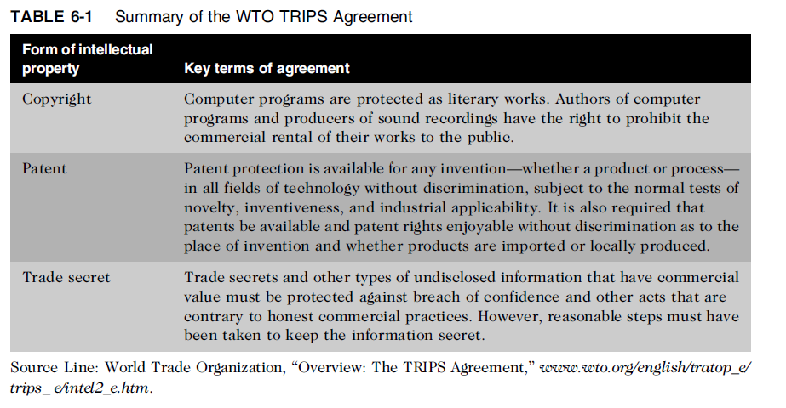
Copyrights (cont’d)

Slide 16
Copyrights (cont’d)
Digital Millennium Copyright Act (DMCA)
  Civil and criminal penalties included
  Governs distribution of tools and software that can be used to circumvent technological measures used to protect copyrighted works
  Provides safe harbors for ISPs whose customers/subscribers may be breaking copyright laws
    ISP must comply with “notice and takedown procedures” that grant copyright holders a process to halt access to alleged infringing content

Slide 17
Patents
Grant of property right to inventors
Issued by the U.S. Patent and Trademark Office (USPTO)
Permits an owner to exclude the public from making, using, or selling the protected invention
Allows legal action against violators
Prevents independent creation as well as copying
Extends only to the United States and its territories and possessions

Slide 18
Patents (cont’d)
Applicant must file with the USPTO
  USPTO searches prior art
  Takes an average of 35.3 months from filing an application until application is issued as a patent or abandoned
Prior art
  Existing body of knowledge
  Available to a person of ordinary skill in the art

Slide 19
Patents (cont’d)
An invention must pass four tests
  Must be in one of the five statutory classes of items
  Must be useful
  Must be novel
  Must not be obvious to a person having ordinary skill in the same field
Items cannot be patented if they are:
  Abstract ideas
  Laws of nature
  Natural phenomena

Slide 20
Patents (cont’d)
Patent infringement
  Making unauthorized use of another’s patent
  No specified limit to the monetary penalty
Software patent
  Protects feature, function, or process embodied in instructions executed on a computer
20,000 software-related patents per year have been issued since the early 1980s
Some experts think the number of software patents being granted inhibits new software development

Slide 21
Patents (cont’d)
Before obtaining a software patent, do a patent search
Software Patent Institute is building a database of information
Software cross-licensing agreements
  Large software companies agree not to sue each other over patent infringements
  Small businesses have no choice but to license patents if they use them
Average patent lawsuit costs $3 - $10 million

Slide 22
Patents (cont’d)
Defensive publishing
  Alternative to filing for patents
  Company publishes a description of the innovation
  Establishes the idea’s legal existence as prior art
  Costs mere hundreds of dollars
  No lawyers
  Fast
Patent troll firm
  Acquires patents with no intention of manufacturing anything; instead, licensing the patents to others

Slide 23
Patents (cont’d)
Standard is a definition or format
  Approved by recognized standards organization or accepted as a de facto standard by the industry
  Enables hardware and software from different manufacturers to work together
Submarine patent
  Patented process/invention hidden within a standard
  Does not surface until standard is broadly adopted

Slide 24
Patents (cont’d)
Patent farming involves:
  Influencing a standards organization to make use of a patented item without revealing the existence of the patent
  Demanding royalties from all parties that use the standard

Slide 25
Trade Secrets
Trade secret
  Business information
  Represents something of economic value
  Requires an effort or cost to develop
  Some degree of uniqueness or novelty
  Generally unknown to the public
  Kept confidential
Information is only considered a trade secret if the company takes steps to protect it

Slide 26
Trade Secrets (cont’d)
Trade secret law has a few key advantages over patents and copyrights
  No time limitations
  No need to file an application
  Patents can be ruled invalid by courts
  No filing or application fees
Law doesn’t prevent someone from using the same idea if it is developed independently
Trade secret law varies greatly from country to country

Slide 27
Trade Secret Laws
Uniform Trade Secrets Act (UTSA)
  Established uniformity across the states in area of trade secret law
  Computer hardware and software can qualify for trade secret protection
The Economic Espionage Act (EEA) of 1996
  Penalties of up to $10 million and 15 years in prison for the theft of trade secrets

Slide 28
Employees and Trade Secrets
Employees are the greatest threat to trade secrets
Unauthorized use of an employer’s customer list
  Customer list is not automatically considered a trade secret
  Educate workers about the confidentiality of lists
Nondisclosure clauses in employee’s contract
  Enforcement can be difficult
  Confidentiality issues are reviewed at the exit interview

Slide 29
Employees and Trade Secrets (cont’d)
Noncompete agreements
  Protect intellectual property from being used by competitors when key employees leave
  Require employees not to work for competitors for a period of time
  Wide range of treatment on noncompete agreements among the various states

Slide 30
Key Intellectual Property Issues
Issues that apply to intellectual property and information technology
  Plagiarism
  Reverse engineering
  Open source code
  Competitive intelligence
  Trademark infringement
  Cybersquatting

Slide 31
Plagiarism
Plagiarism : Stealing someone’s ideas or words and passing them off as one’s own
Many students:
  Do not understand what constitutes plagiarism
  Believe that all electronic content is in the public domain
Plagiarism is also common outside academia
Plagiarism detection systems
  Check submitted material against databases of electronic content

Slide 32
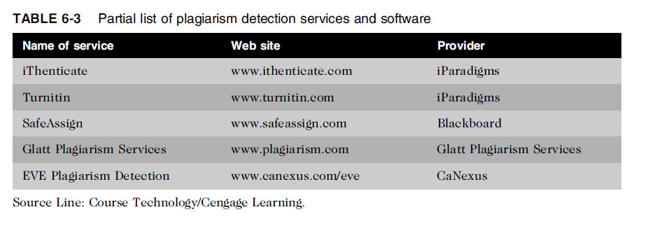
Plagiarism (cont’d)

Slide 33
Plagiarism (cont’d)
Steps to combat student plagiarism
  Help students understand what constitutes plagiarism and why they need to cite sources
  Show students how to document Web pages
  Schedule major writing assignments in portions due over the course of the term
  Tell students that instructors are aware of Internet paper mills and plagiarism detection services
  Incorporate detection into an antiplagiarism program

Slide 34
Reverse Engineering
Reverse Engineering
Process of taking something apart in order to:
  Understand it
  Build a copy of it
  Improve it
Applied to computer:
  Hardware
  Software
Convert a program code to a higher-level design
Convert an application that ran on one vendor’s database to run on another’s

Slide 35
Reverse Engineering (cont’d)
Compiler
  Language translator
  Converts computer program statements expressed in a source language to machine language
Software manufacturer
  Provides software in machine language form
Decompiler
  Reads machine language
  Produces source code

Slide 36
Reverse Engineering (cont’d)
Courts have ruled in favor of reverse engineering:
  To enable interoperability
Software license agreements forbid reverse engineering
Ethics of using reverse engineering are debated
  Fair use if it provides useful function/interoperability
  Can uncover designs that someone else has developed at great cost and taken care to protect

Slide 37
Open Source Code
Open Source Code
Program source code made available for use or modification:
  As users or other developers see fit
Basic premise
  Many programmers can help software improve
  Can be adapted to meet new needs
  Bugs rapidly identified and fixed
  High reliability
GNU General Public License (GPL) was a precursor to the Open Source Initiative (OSI)

Slide 38
Competitive Intelligence
Gathering of legally obtainable information
  To help a company gain an advantage over rivals
Often integrated into a company’s strategic plans and decision making
Not the same as industrial espionage, which uses illegal means to obtain business information not available to the general public
Without proper management safeguards, it can cross over to industrial espionage

Slide 39
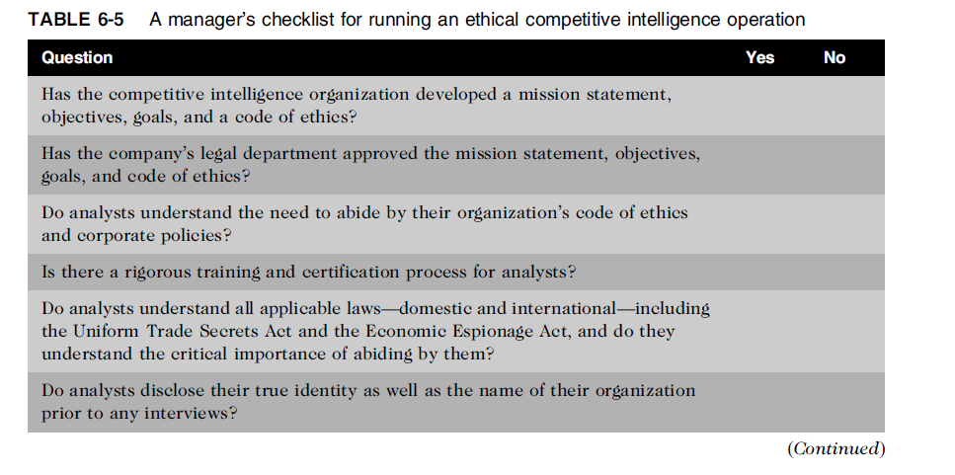
Competitive Intelligence (cont’d)

Slide 40
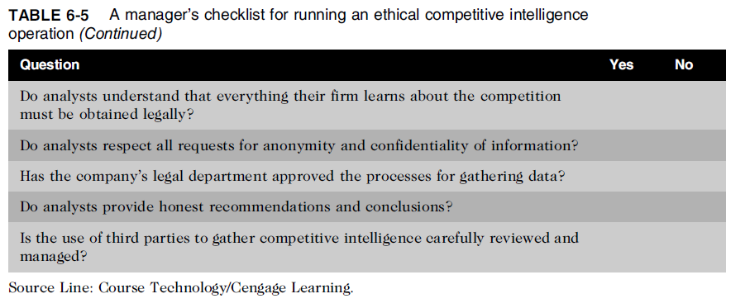
Competitive Intelligence (cont’d)

Slide 41
Trademark Infringement
Trademark is logo, package design, phrase, sound, or word that enables consumer to differentiate one company’s product from another’s
Trademark owner can prevent others from using the same mark or a confusingly similar mark on a product’s label
Organizations frequently sue one another over the use of a trademark in a Web site or domain name
Nominative fair use is defense often employed by defendant in trademark infringement case

Slide 42
Cybersquatting
Cybersquatters
  Register domain names for famous trademarks or company names
  Hope the trademark’s owner will buy the domain name for a large sum of money
To curb cybersquatting, register all possible domain names
  .org, .com, .info

Slide 43
Cybersquatting (cont’d)
Internet Corporation for Assigned Names and Numbers (ICANN)
  Several top-level domains (.com, .edu, edu., .gov, .int, .mil, .net, .org, aero, .biz, .coop, .info, .museum, .name, .pro, .asis, .cat, .mobi, .tel, and .travel)
  Current trademark holders are given time to assert their rights in the new top-level domains before registrations are opened to the general public
  Anticybersquatting Consumer Protection Act allows trademark owners to challenge foreign cybersquatters

Slide 44
Summary
Intellectual property is protected by laws for:
  Copyrights
  Patents
  Trademarks
  Trade secrets
Plagiarism is stealing and passing off the ideas and words of another as one’s own
Reverse engineering
  Process of breaking something down in order to understand, build a copy of, or improve it

Slide 45
Summary (cont’d)
Open source code
  Made available for use or modification as users or other developers see fit
Competitive intelligence
  Uses legal means and public information
Trademark infringement
  Use of other’s trademark in a Web site can lead to issues
Cybersquatting
  Registration of a domain name by an unaffiliated party

Slide 46
Reference
Ethics in Information Technology, George W. Reynolds, Fifth Edition

Slide 47
Quiz (Chapter 6)

