Slide 1
Who pays for school, and who can read, in rural Sindh?
PSLM 2019-20 | Weighted by household weight (hhweight)
1,440
Variant 2
Sindh rural
82 = 10 x 8 + 2 (prov_code 3, urban_rural 1)
students with education spending (Q2)
7,171
persons aged 10-64 with known literacy (Q3)
FA24-BEDS-082 | Section B | ECO346 Data Visualization Techniques for Economists
Notes:
Variant: 82 = 10 x 8 + 2, remainder 2 = Sindh rural. Students are persons with ed_total > 0; literacy sample is aged 10-64 with literate not missing.

Slide 2
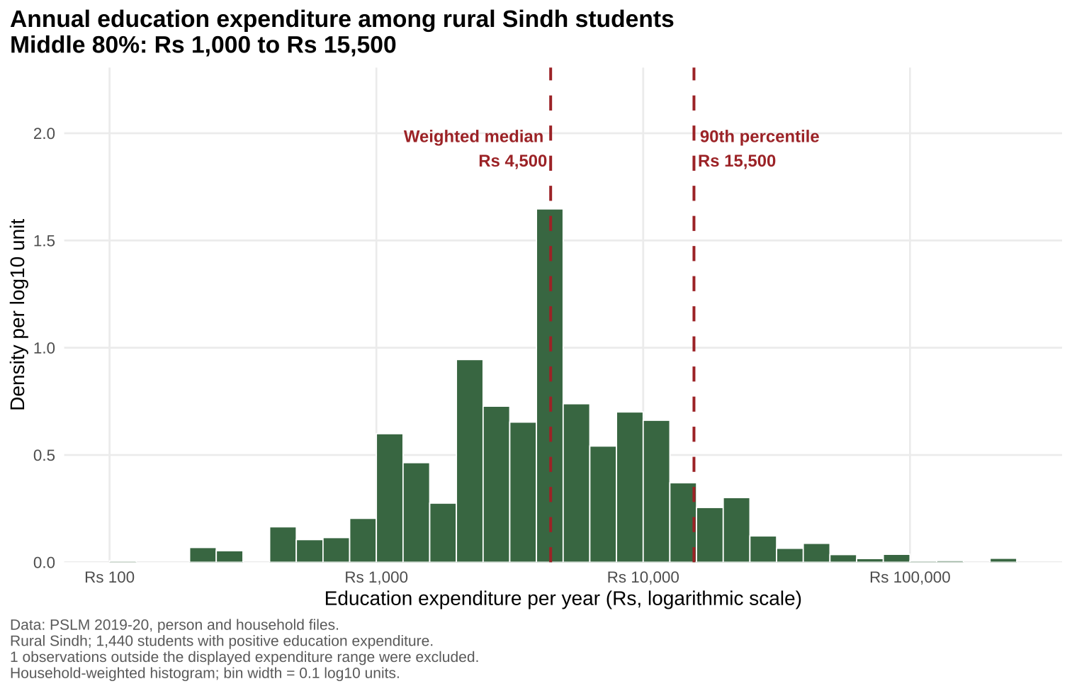
The middle 80% of students cost families Rs 1,000 to Rs 15,500 a year
Rs 4,500
weighted median (unweighted: Rs 4,295)
Rs 15,500
weighted 90th percentile; the 10th is Rs 1,000
15.50x
spread between the 90th and 10th percentile
Notes:
Weighted median Rs 4,500 vs unweighted Rs 4,295: weights give more influence to higher-weight households, which spend slightly more. One student outside Rs 100 to Rs 1,000,000 was excluded from the histogram.

Slide 3
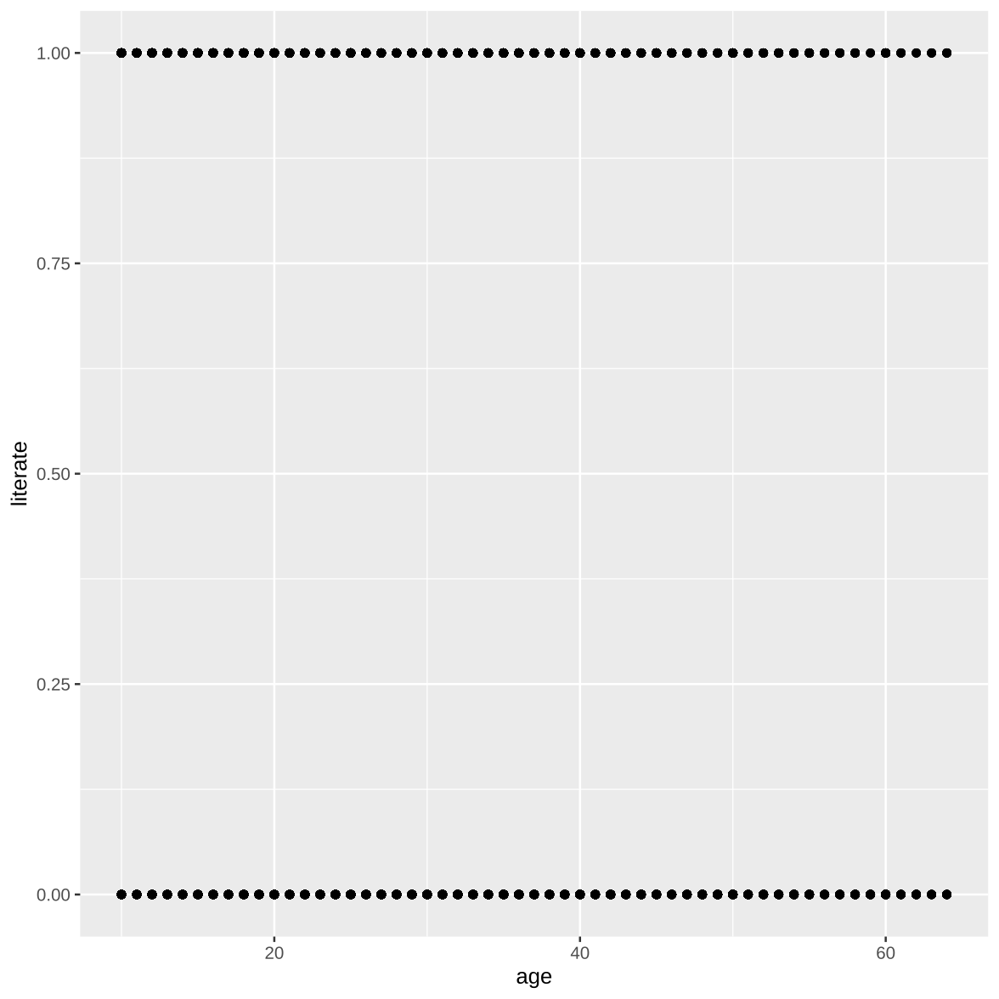
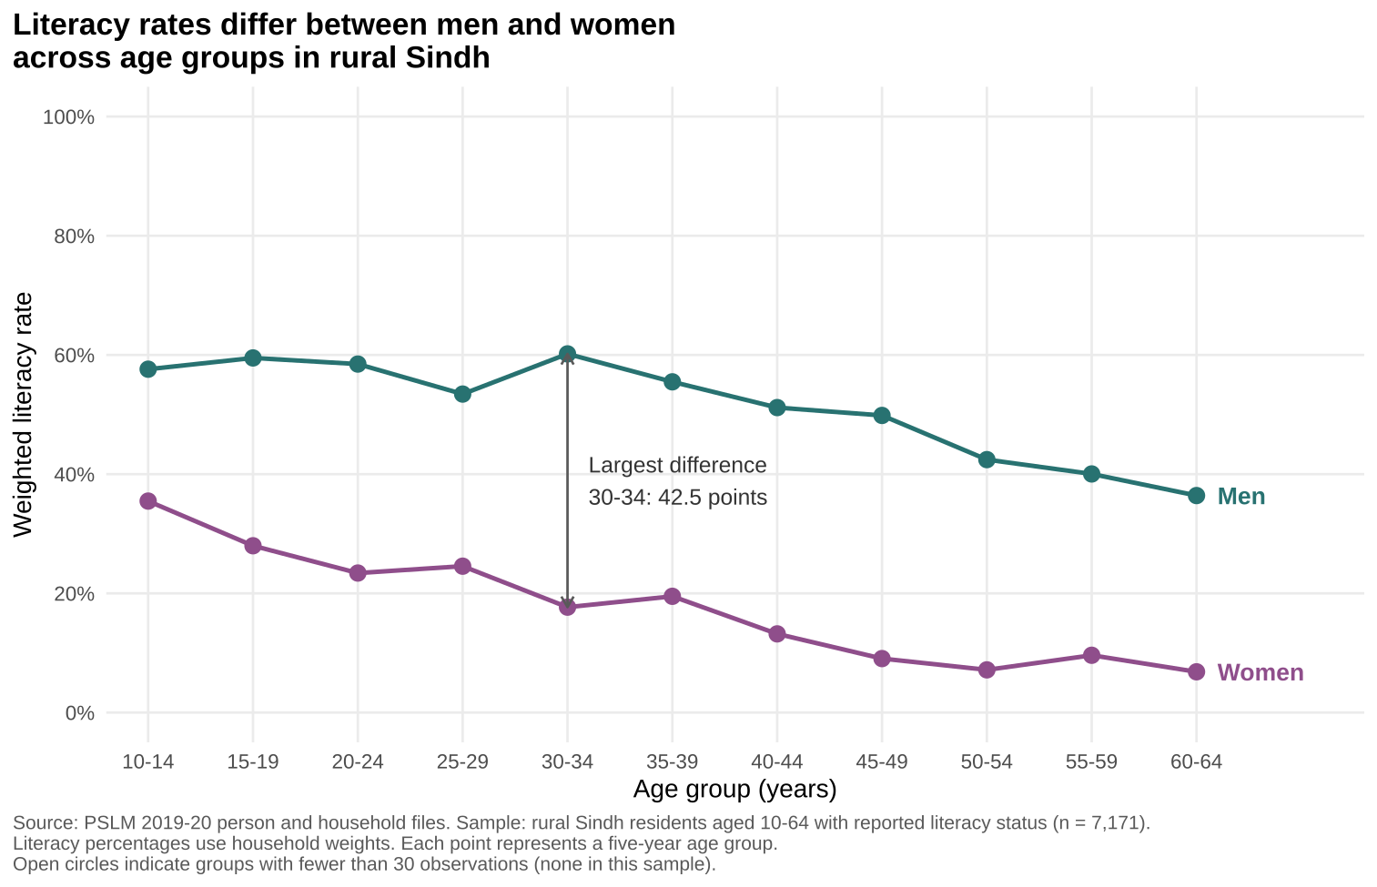
The makeover: from 7,171 overplotted dots to two readable trends
Default: ggplot + geom_point() only
Redesign: weighted means by band, labelled lines
Conditional means replace overplotted points; direct labels replace a legend; weights make it rural Sindh.
Notes:
Changes: (1) conditional means E[literate|age] instead of binary points that overplot; (2) direct labels, no legend, less ink; (3) weights, hollow markers for thin cells, 0-100% axis, caption. The default shows individual observations; the redesign hides the spread inside a band.

Slide 4
Most important finding: the gender gap in literacy has barely narrowed
31.5 pts
gap among those aged 15-19 (28.0% vs 59.5%)
30.4 pts
gap among those aged 55-59 (9.6% vs 40.0%)
42.5 pts
largest gap, at ages 30-34
One cross-section: it cannot say why (school supply or household demand).
Notes:
Women: 28.0% vs men 59.5% at 15-19; 9.6% vs 40.0% at 55-59. Largest gap 42.5 points at 30-34. Caution: older bands are older birth cohorts, so age and generation are mixed; one cross-section cannot separate supply from demand.

