Slide 1
Recognizing and Avoiding Phishing Attacks
To:
CodeAlpha
Submitted by:
Muhammad Zayan

Slide 2
Contents
What is Phishing
How Phishing Attacks Work?
Common Phishing Techniques
Avoiding Phishing Websites
Social Engineering Tactics
Best Practices to Avoid Phishing Attacks

Slide 3
What is Phishing
Phishing is the practice of sending fraudulent communications that appear to come from a legitimate and reputable source, usually through email and text messaging. The attacker's goal is to steal money, gain access to sensitive data and login information, or to install malware on the victim's device.

Slide 4
How Phishing Attack Works?
Phishing attacks typically involve sending deceptive emails or directing victims to fraudulent websites that mimic legitimate ones. The attackers often use social engineering techniques to manipulate victims into providing their personal information.

Slide 5
Common Phishing Techniques
Phishing attacks can take various forms, including:
Email Spoofing: Attackers send emails that appear to be from a trusted source, such as a bank or a well-known company, to trick victims into clicking on malicious links or providing sensitive information.
Spear Phishing: Attackers target specific individuals or organizations, using personalized information to make their phishing attempts more convincing and increase the likelihood of success.
Pharming: Attackers redirect victims to fraudulent websites by tampering with DNS settings or using malicious code, leading victims to unknowingly provide their personal information.

Slide 6
Recognizing Phishing Emails
Phishing emails are designed to deceive individuals into revealing sensitive information or downloading malicious software. By being aware of common red flags and signs of a phishing attempt, you can protect yourself and your organization from cyber threats.
Common Red Flags:
Sender's Email Address: Check for misspellings or unusual domain names.
Urgent or Threatening Language: Phishing emails often create a sense of urgency to prompt immediate action.
Unusual Requests for Information: Be cautious of emails asking for personal or financial information.
Poor Grammar and Spelling: Phishing emails often contain grammatical errors.

Slide 7
Signs of a Phishing Attempt
Generic Greetings: Phishing emails often use generic greetings instead of addressing you by name.
Suspicious Links: Hover over links to check the URL before clicking.
Attachments: Be cautious of unexpected attachments, especially from unknown senders.
Spoofed Websites: Phishing emails may direct you to fake websites that mimic legitimate ones.
By staying vigilant and following these tips, you can avoid falling victim to phishing attacks.

Slide 8
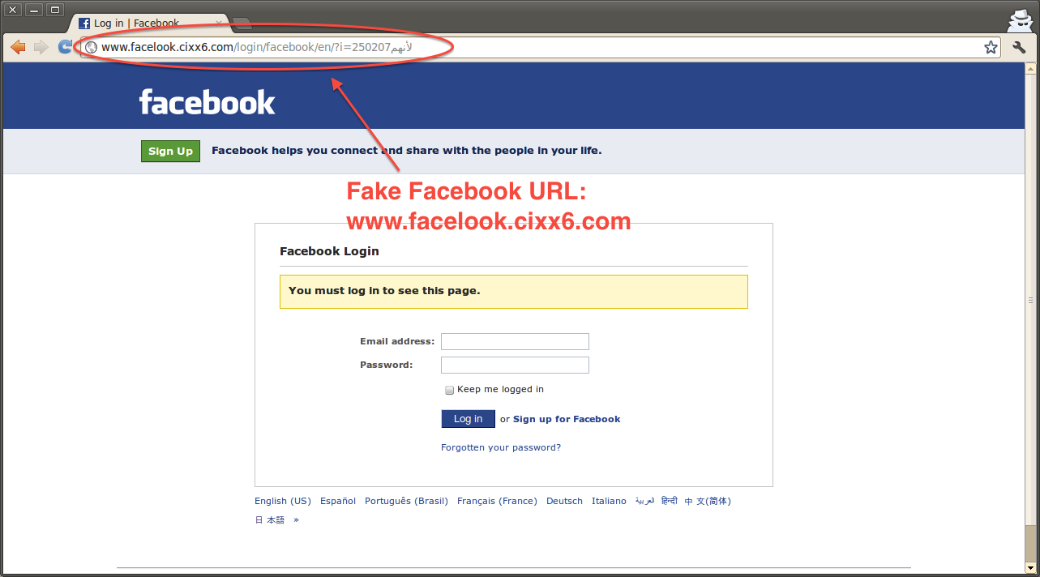
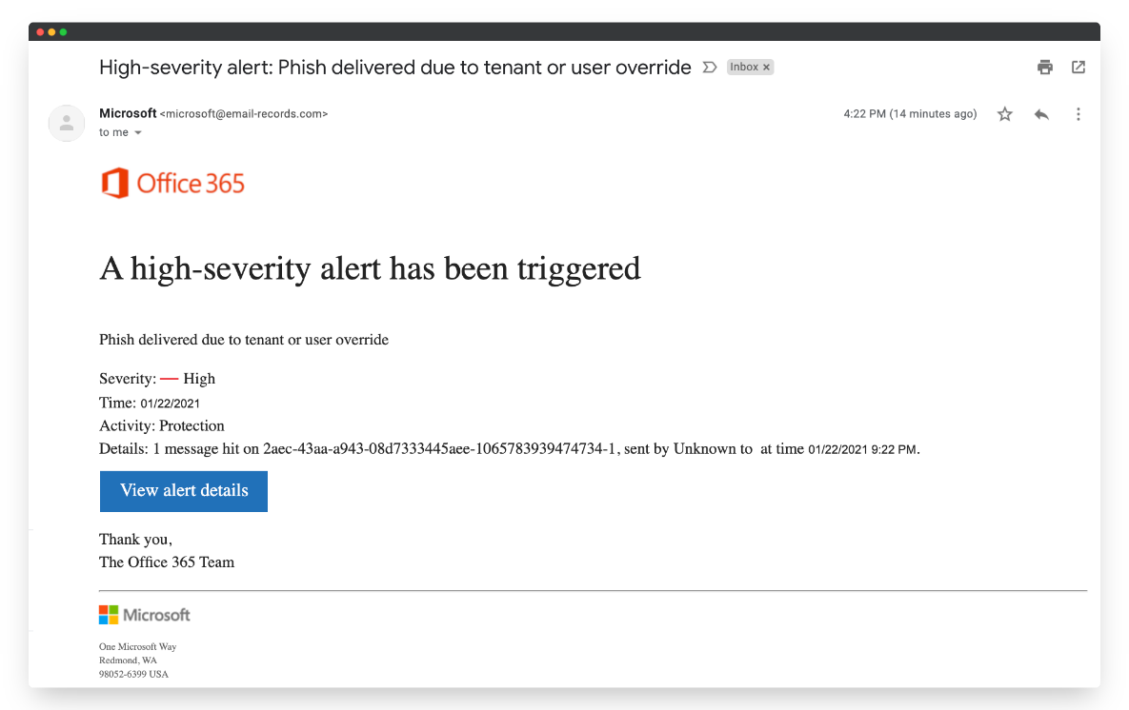
Examples

Slide 9
Avoiding Phishing Websites
Verify Website Authenticity
Check the website's URL for any misspellings or unusual characters.
Look for the padlock icon in the address bar to ensure the website is using a secure connection (HTTPS).
Be cautious of websites that ask for personal or financial information.
Safe Browsing Practices
Avoid clicking on suspicious links or downloading attachments from unknown sources.
Keep your web browser and security software up to date.
Be wary of emails or messages that create a sense of urgency or require immediate action.

Slide 10
Social Engineering Tactics
Spoofing and Impersonation: Attackers impersonate trusted entities, such as banks or government agencies, to gain the target's trust and convince them to disclose sensitive information.
Urgency and Fear: Attackers create a sense of urgency or fear to pressure individuals into taking immediate action, such as clicking on a malicious link or providing personal information.
Phishing Links and Attachments: Attackers include malicious links or attachments in emails or messages, tricking individuals into clicking on them and compromising their devices or accounts.

Slide 11
Identifying and Avoiding Social Engineering Attacks
Here are some tips to help you identify and avoid social engineering attacks:
Think Before Clicking: Be cautious of clicking on links or downloading attachments, especially if the message is unexpected or creates a sense of urgency.
Verify the Sender: Check the email address, phone number, or website URL to ensure they are legitimate and not spoofed or impersonated.
Be Wary of Requests for Personal Information: Avoid providing sensitive information, such as passwords or financial details, unless you are certain of the legitimacy of the request.

Slide 12
Best Practices for Avoiding Phishing Attacks
Secure Password Management
Enable Two-Factor Authentication
Stay Vigilant Online

Slide 13
Secure Password Management
Use strong, unique passwords for each of your accounts.
Avoid using personal information or common words in your passwords.
Consider using a password manager to securely store and generate passwords.

Slide 14
Enable Two-Factor Authentication
Enable two-factor authentication (2FA) whenever possible.
This adds an extra layer of security by requiring a second verification step, such as a code sent to your phone or email.

Slide 15
Stay Vigilant Online
Be cautious of unsolicited emails, messages, or phone calls asking for personal or financial information.
Verify the legitimacy of websites and links before clicking on them.
Keep your operating system, antivirus software, and web browser up to date.

Slide 16
Conclusion
No single technology will completely stop phishing.
However, a combination of good organization and practice, proper application of current technologies, and improvements in security technology has the potential to reduce the prevalence of phishing and the losses suffered from it.

