Slide 1
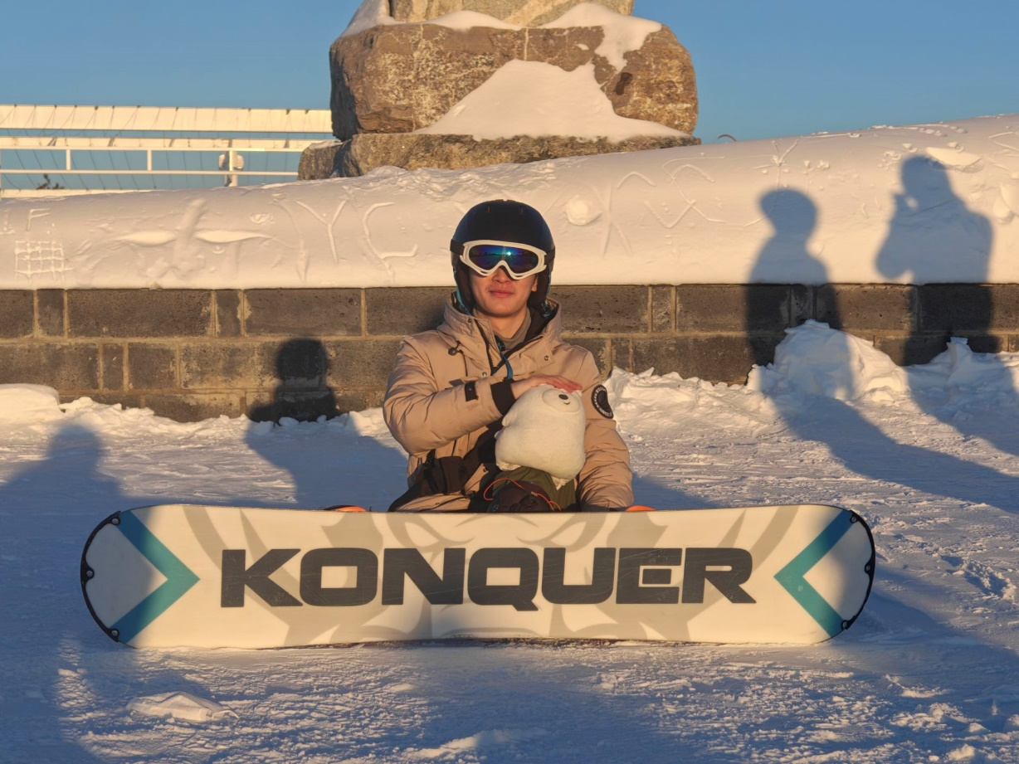
Self-Introduction
陈鸿远+吉林大学+大四
本科做过一段时间动态人体重建， 现在在做3D生成
下学期在西湖，欢迎大家来交流
爱好：羽毛球，学滑雪(刚发现)

Slide 2
Towards Compact and Efficient geometry representation with 3D native supervision

Slide 3
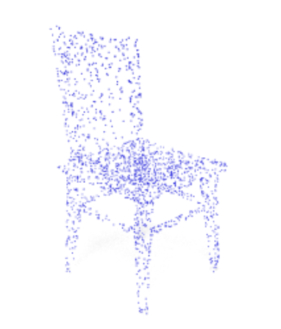
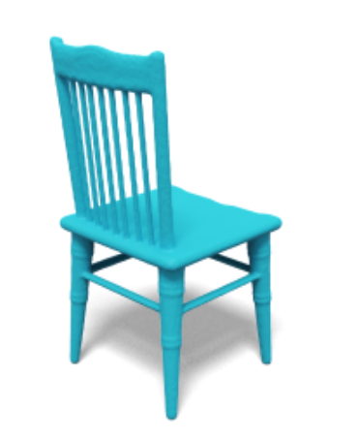
Task
Given conditions:
Point clouds:
Text:
chair
Image:
3D assets

Slide 4
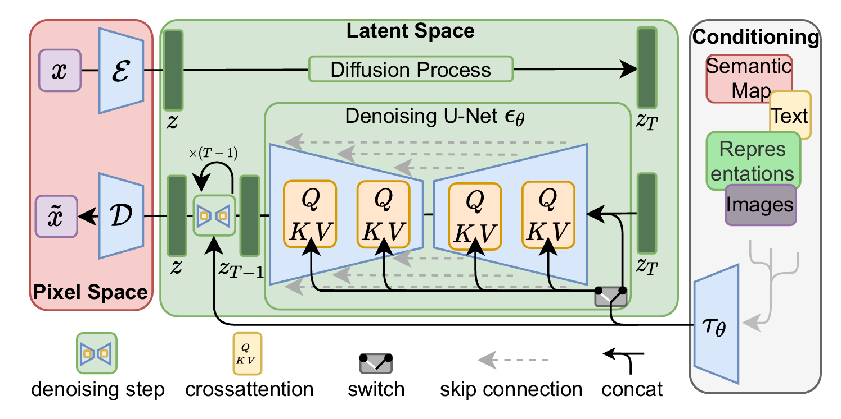
Task
Add conditions in latent space

Slide 5
Background
z
Encoder
Decoder
Desired z: compact, generalized and efficient
1D vector set (CLAY, 3Dshape2VecSet, CraftsMan)
z
Triplane latent (LRM, Direct3D)

Slide 6
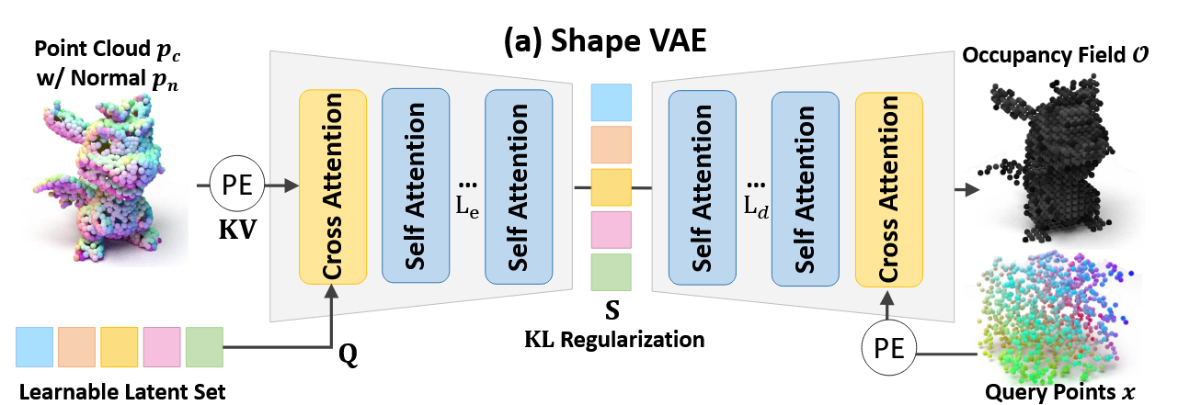
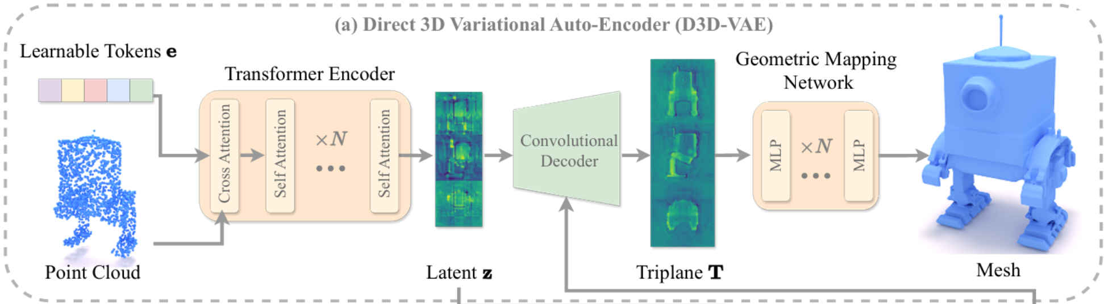
Background
1. 1D vector set
Weakness: Decoder heavy
Strength:
1D latent generalized
Craftsman
2. Triplane latent
Weakness: Triplane from sparse point
Strength:
Decoder interpolation efficient
Direct3D

Slide 7
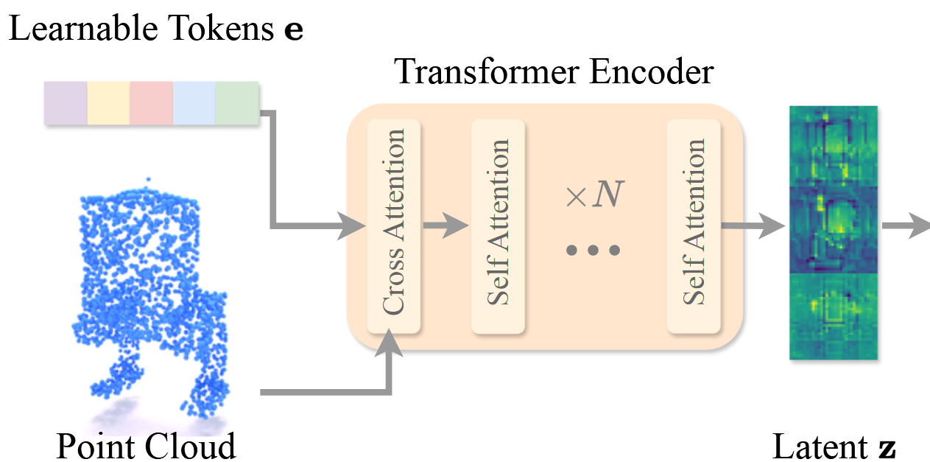
Motivation
1. Learnable tokens need high channels (768) to query information in sparse points clouds
Direct3D
Result in slow and expensive training (donzens of A100 for several days)
2. More compact latent

Slide 8
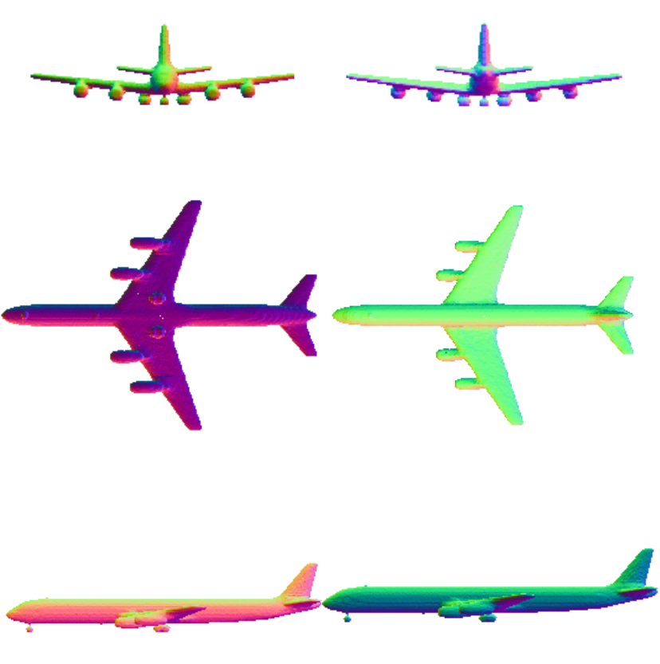
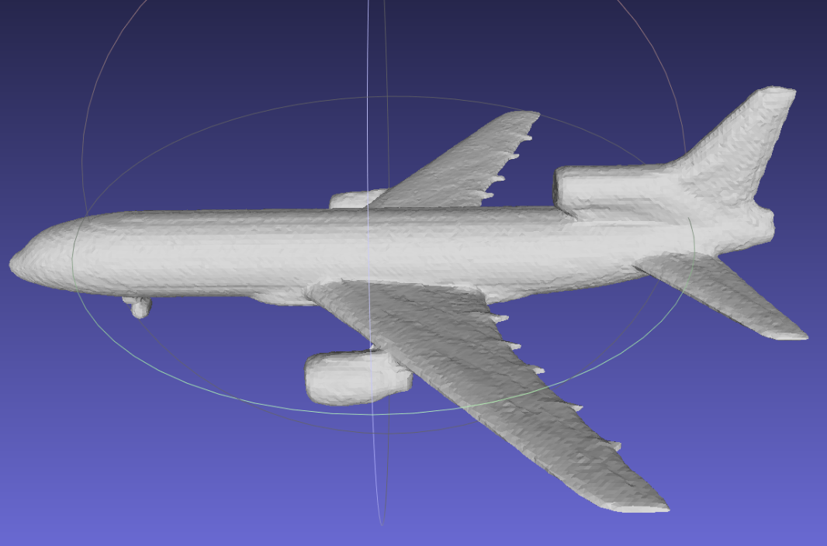
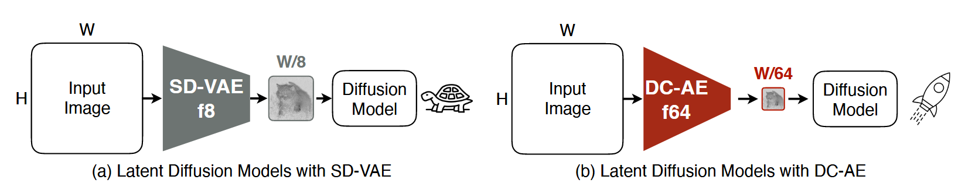
Motivation
1. Triplane from 2D normal images
z
Unet-VAE
2. Pretrain model for converge and compression
DC-AE

Slide 9
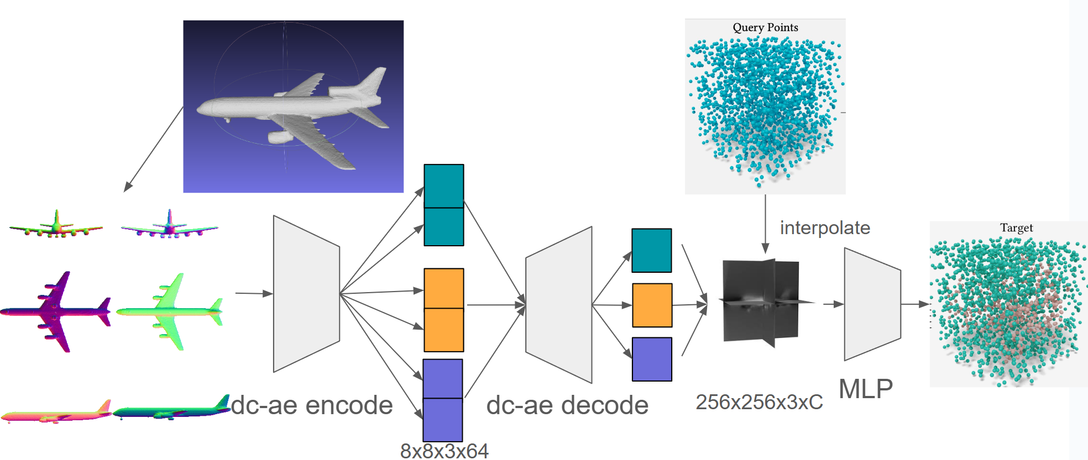
Methods
Pipeline
512-Byte latent with shape (8,8,3,64) i.e. 192 tokens 64 channels

Slide 10
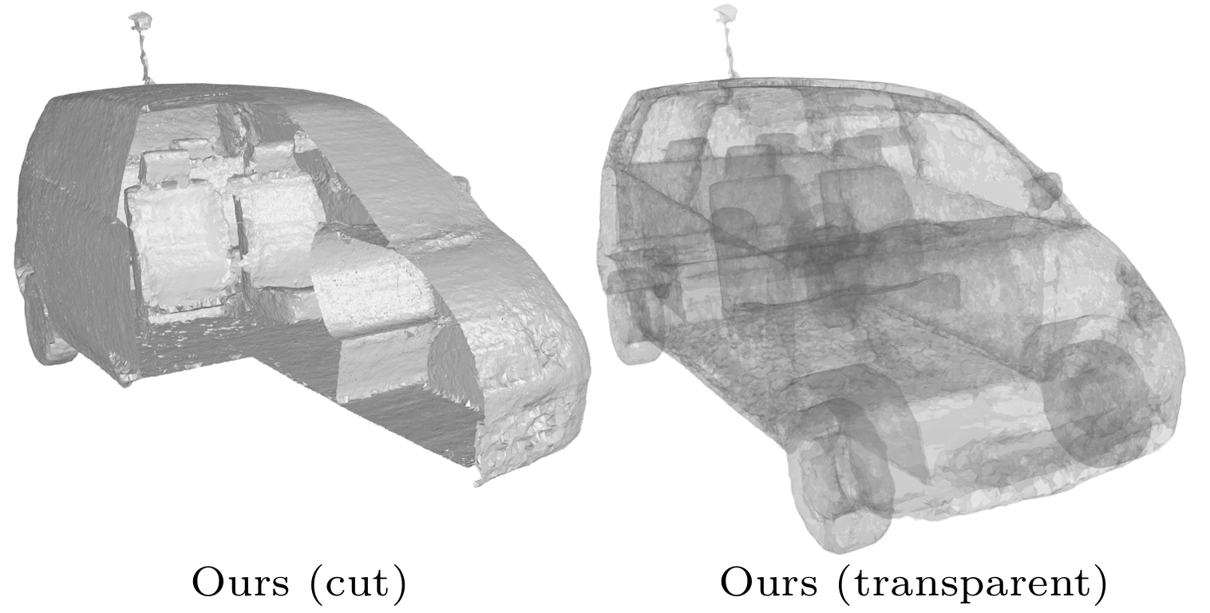
To be continue
Images potential (semi-transparent image for inner struture)
NDF

Slide 11
Q&A
Notes:
Why not color
Entangled
3D监督和2D监督不一样

