Slide 1
Prediction of Product Ad Campaign Performance
Internship Project • First Quadrant Labs • Mohammed Zayd Quadri
First Quadrant Labs Internship Project • Mohammed Zayd Quadri

Slide 2
Problem Statement
Objective: Develop a predictive model to forecast KPI performance (orders & sales) of future product ad campaigns, enabling data-driven marketing decisions and ROI improvement.
First Quadrant Labs Internship Project • Mohammed Zayd Quadri

Slide 3
Dataset Overview
Records: 731 • Original Features: 11
Source: First Quadrant Labs (confidential)
Includes campaign budget, discount, email rates, product level, etc.
Only 2 missing values in price column – handled successfully.
First Quadrant Labs Internship Project • Mohammed Zayd Quadri

Slide 4
Data Preprocessing
Missing values filled (price) using median
Categorical variables encoded (campaign_type, campaign_level, product_level)
No missing values post-cleaning
Clean dataset ready for modelling
First Quadrant Labs Internship Project • Mohammed Zayd Quadri

Slide 5
Feature Engineering
Created 6 new business-relevant features:
Effective Price = price × (1 − discount_rate).
ROI = orders ÷ campaign_fee.
Cost per Order = campaign_fee ÷ orders.
Budget per Hour = resource_amount ÷ hour_resources.
Discount Impact = discount_rate × email_rate.
Revenue Estimate = orders × effective_price.
These enhance model’s ability to capture efficiency and profitability.
First Quadrant Labs Internship Project • Mohammed Zayd Quadri

Slide 6
Model Comparison
Models evaluated: Linear Regression, Random Forest, Gradient Boosting, XGBoost (Base & Tuned)
| Model | R² | MAE | RMSE |
| Linear Regression | 0.99919 | 27.75 | 55.26 |
| Gradient Boosting | 0.99730 | 77.62 | 100.83
| Random Forest | 0.99674 | 72.79 | 110.70 |
| XGBoost (Base) | 0.99631 | 87.38 | 117.93 |
| XGBoost (Tuned) | 0.99560 | 74.70 | 128.68|
Conclusion: Linear Regression outperforms others and is selected as final model.
First Quadrant Labs Internship Project • Mohammed Zayd Quadri

Slide 7
Overfitting Check
Training R²: 0.999674 • Testing R²: 0.999190
Difference ~0.000484 → negligible.
Model shows excellent generalisation, no significant overfitting.
First Quadrant Labs Internship Project • Mohammed Zayd Quadri

Slide 8
Regularisation Validation
Tested advanced models (Ridge & Lasso) to confirm stability:
Ridge: R² = 0.9912, MAE = 44.84, RMSE = 181.76 → performance drop.
Lasso: R² = 0.999185, MAE = 27.78, RMSE = 55.42 → nearly same as Linear.
Therefore: regularisation offered no material benefit → Linear Regression remains best.
First Quadrant Labs Internship Project • Mohammed Zayd Quadri

Slide 9
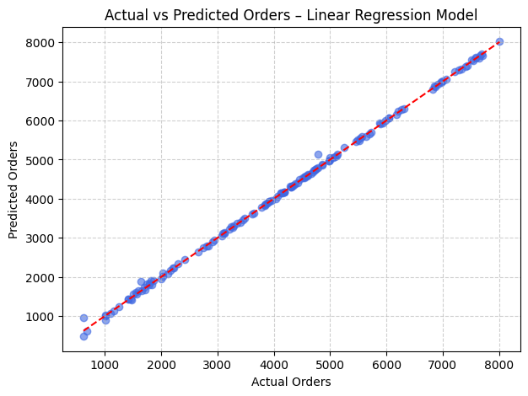
Visualization: Actual vs Predicted
Most points lie along the diagonal → model predictions almost perfectly match actuals, confirming high accuracy.
First Quadrant Labs Internship Project • Mohammed Zayd Quadri

Slide 10
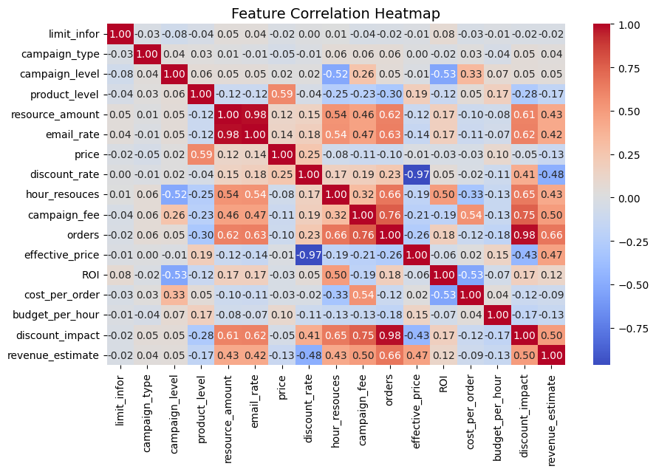
Feature & Performance Visualizations
ROI, orders, and revenue_estimate are strongly correlated — showing consistent campaign relationships.”
First Quadrant Labs Internship Project • Mohammed Zayd Quadri

Slide 11
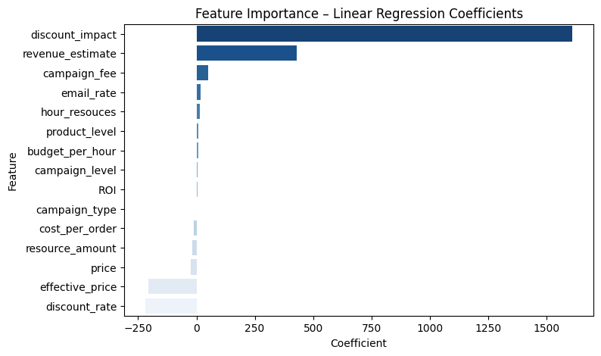
Feature & Performance Visualizations
Discount_impact, revenue_estimate, and campaign fee have the strongest impact on order predictions.”
First Quadrant Labs Internship Project • Mohammed Zayd Quadri

Slide 12
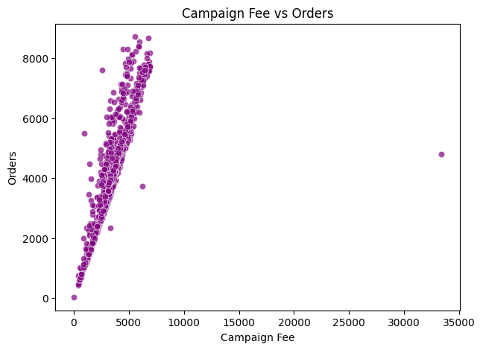
Insights & Recommendations
• Campaigns with moderate fees yield high returns; very high spend gives diminishing orders.
• ROI is mainly driven by price and discount balance — over-discounting reduces profit even with more orders.
• Resource allocation and email rate targeting strongly influence campaign success.
• Recommendations:
• Use the model to guide budget distribution across campaigns.
• Optimize discount rate and price mix to maximize ROI.
• Continuously monitor ROI vs Fee to spot inefficient campaigns early.
First Quadrant Labs Internship Project • Mohammed Zayd Quadri

Slide 13
Conclusion & Next Steps
Final Model: Linear Regression (R² = 0.999)
Dataset: 731 records, feature-engineered, processed, modelled
Model validated with multiple techniques, no overfitting detected
Next steps: integrate engagement & impression data, deploy dashboard (Power BI) for real-time forecasting and campaign optimisation.
First Quadrant Labs Internship Project • Mohammed Zayd Quadri

Slide 14
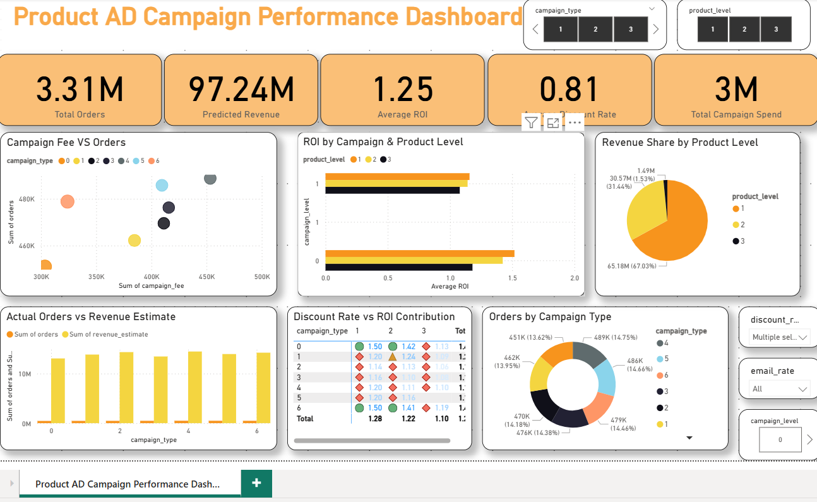
Dashboard Overview

