Slide 1
HamSkill: Run Haskell Anywhere
with ANTLR and Scala
Zayd Hammoudeh
May 9, 2016

Slide 2
Haskell and the JVM
Two Major Cross-Platform Paradigms:
Write Once, Compile Anywhere
Benefit: Often superior performance
Examples: C/C++, Haskell
Write Once, Run Anywhere
Benefit: Greater machine independence
Examples: Java, JavaScript, Squeak
Developers have leveraged the JVM’s “run anywhere” architecture for languages other than Java.
Examples: Python, Ruby, R, Scala
Project Goal: Develop HamSkill, a transpiler architecture that allows Haskell programs to run inside the JVM.
Notes:
Tree can be very large

Slide 3
Key Goals for HamSkill
Runnable in the JVM: This is the primary goal; by using the JVM, Haskell will become more machine independent.
Minimal JVM Requirements: Allow the architecture to be as standalone as possible even within the JVM.
Identical Inputs and Outputs between Haskell and the JVM: Used to overcome any language/implementation specific differences when running in the JVM.
Human Readable Output Code – Not a requirement for the system to function, but this can greatly improve the utility of the tool.

Slide 4
Key HamSkill Architecture Components
ANTLR – A Java-based LL(*) parser that parses a structured corpus based off a user-defined grammar. HamSkill uses two separate grammars, namely:
Haskell.g4 – Defines how to parse Haskell code
ScalaOutput.g4 – Defines how to reformat HamSkill’s default output to match Haskell’s standard output
HamskillMain – Java class that extends an ANTLR listener class to transpile Haskell code to Scala.
Scala – JVM-based, functional programming language whose feature set overlaps well with Haskell.
ScalaOutput – Java class that extends an ANTLR listener class to format the output from Scala to match the formatting of Haskell.

Slide 5
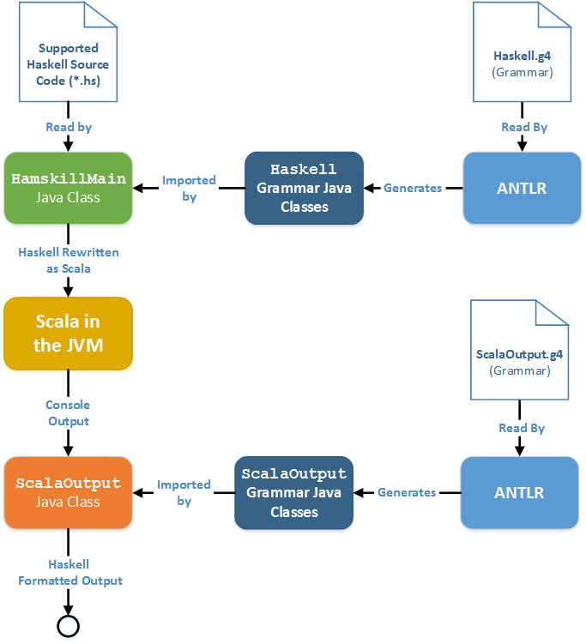
HamSkill Software Architecture

Slide 6
One Good Decision
and One Bad Decisin

Slide 7
Parsing Using ANTLR – A Good Decision
Why the Decision was Good
Runs inside the JVM
Simple interface through grammar files
Easy to learn and use
High flexibility
Grammars can be quickly extended
Reasons why the Decision may be Poor
Reduced low level control and flexibility
Performance is not optimized for this specific application/grammar

Slide 8
Transpiling to Scala – A Bad Decision
Why the Decision is Poor
Architecture dependent on the implementation of another language
Reduced low level control and flexibility
Requires additional libraries be deployed with the tool
Reasons why the Decision may be Good
Simpler
Quicker to implement basic features
A Better Approach
Compile to a lower level language like Java bytecode

Slide 9
Interested in my Work?
If you want to get the source code, run
the tool for yourself, or are just bored,
visit my GitHub repository:
https://github.com/ZaydH/haskell_in_the_jvm.git

Slide 10
Questions?

Slide 11
Appendix

Slide 12
Testing Strategy and Architecture
HamSkill’s architecture has components written in Java, Haskell, Scala, bash, and ANTLR.
The heterogeneous components complicate testing.
Solution: Perform black-box system-level testing where code is run in Haskell and HamSkill and the outputs compared.
Key Requirement: Make testing as easy and painless as possible.
Test Architecture:
bash Script
Each test case is a single Haskell program.
To add a new test case, only need to add a single line to the bash file.
As each major feature is added, rerun the entire test bench as a means of regression testing.

