Slide 1
HamSkill: Run Haskell Anywhere
with ANTLR and Scala
Zayd Hammoudeh
May 9, 2016

Slide 2
Haskell and the JVM
Two Major Cross-Platform Paradigms:
Write Once, Compile Anywhere
Benefit: Often superior performance
Examples: C/C++, Pascal
Write Once, Run Anywhere
Benefit: Greater machine independence
Examples: Java (via the Java Virtual Machine – JVM), JavaScript, Squeak (A Smalltalk dialect)
Developers have leveraged the JVM’s “run anywhere” architecture for languages other than Java.
Examples: Python, Ruby, R, and Scala
Project Goal: Develop HamSkill, an architecture to run Haskell programs inside the JVM.
Notes:
Tree can be very large

Slide 3
Key Goals for HamSkill
Runnable in the JVM: This is the primary goal; by using the JVM, Haskell will become more machine independent.
Minimal JVM Requirements: Allow the architecture to be as standalone as possible even within the JVM.
Identical Inputs and Outputs between Haskell and the JVM: Used to overcome any language/implementation specific differences when running in the JVM.
Human Readable Output Code – Not a requirement for the system to function, but this can greatly improve the utility of the tool.

Slide 4
Key HamSkill Architecture Components
ANTLR – A Java-based LL(*) parser that parses a structured corpus based off a user-defined grammar. HamSkill uses two separate grammars, namely:
Haskell.g4 – Defines how to parse Haskell code
ScalaOutput.g4 – Defines how to reformat HamSkill’s default output to match Haskell’s standard output
HamskillMain – Java class that extends an ANTLR listener class to transpile Haskell code to Scala.
Scala – JVM-based, functional programming language whose feature set overlaps well with Haskell.
ScalaOutput – Java class that extends an ANTLR listener class to format the output from Scala to match the formatting of Haskell.

Slide 5
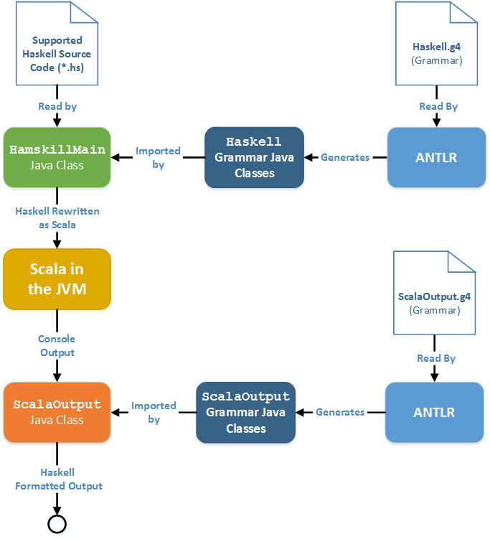
HamSkill Software Architecture

Slide 6
HamSkill: A Haskell Dialect
HamSkill is a dialect of Haskell meaning it supports only a subset of Haskell’s features (with special formatting). Haskell features that are supported by HamSkill include:
Currying Calling a function (complicated by Haskell’s lack of explicit argument notation) Higher Order Functions Partially Applied Functions Lambda (Anonymous) Functions Conversion of Haskell Functions (e.g. show) to Scala Object Methods (e.g. toString) | module-Based Scoping case Statements if / then / else Conditionals Maybe Monad Lazy Evaluation and Immutability $ Right Associative Operator Comment Preservation for Increased Readability

Slide 7
A Simple Example

Slide 8
HamSkill: A Haskell Dialect
HamSkill is a dialect of Haskell meaning it supports only a subset of Haskell’s features (with special formatting). Haskell features that are supported by HamSkill include :
Currying Calling a function (complicated by Haskell’s lack of obvious argument notation) Higher Order Functions Partially Applied Functions Lambda (Anonymous) Functions Conversion of Haskell Functions (e.g. show) to Scala Object Methods (e.g. toString) | module-Based Scoping case Statements if / then / else Conditionals Maybe Monad Lazy Evaluation and Immutability $ Right Associative Operator Comment Preservation for Increased Readability

Slide 9
Example Haskell Monad Code
maybeAddOne :: Int -> (Maybe Int)
maybeAddOne x = if (x < 0)
then (Nothing)
else (Just (x + 1))
doubleIncrementMonad :: Int -> (Maybe Int)
doubleIncrementMonad x = do
y <- maybeAddOne (x)
z <- maybeAddOne (y)
return z
main :: IO ()
main = do
putStrLn $ show $ doubleIncrementMonad(3)
putStrLn $ show $ doubleIncrementMonad(-1)

Slide 10
Example Monad Code Transpiled to Scala
object maybe_monad {
private def maybeAddOne (___0___ : Int) : Option[Int] = (___0___) match {
case (x) => if(x < 0)
{
None
}
else{
Some((x + 1))
}
} // End of function
private def doubleIncrementMonad (___0___ : Int) : Option[Int] = (___0___) match {
case (x) => (for {
y <- (maybeAddOne (x))
z <- (maybeAddOne (y))
}
yield(z))
} // End of function
def main(args : Array[String]){
println ((doubleIncrementMonad (3)).toString()) // Haskell function to object method
println ((doubleIncrementMonad (-1)).toString())
} // End of function
}

Slide 11
Converting the Output from Scala to Haskell
The output of the program in Scala is:
Some(5)
None
This is run through the ScalaOutput grammar and Java class to convert the output to Haskell format:
Just 5
Nothing

Slide 12
Testing and Future Improvements

Slide 13
Testing Strategy and Architecture
HamSkill’s architecture has components written in Java, Haskell, Scala, bash, and ANTLR.
These heterogeneous components complicate testing.
Solution: Perform black-box system-level testing where code is run in Haskell and HamSkill and the outputs compared.
Key Requirement: Make testing as easy and painless as possible.
Test Architecture:
bash Script
Each test case is a single Haskell program.
To add a new test case, only need to add a single line to the bash file.
As each major feature is added, rerun the entire test bench as a means of regression testing.

Slide 14
Future Improvements
Ideal Improvement: Rather than transpiling to Scala, compile the Haskell code to Java bytecode.
This would eliminate the dependence on the whims of a third-party, high level language (Scala)
Provide maximum feature support with the least number of limitations.
Useful features that could be added to the current architecture (in approximate order of importance):
A user-friendly code analyzer that can detect incompatibilities in the input Haskell code
Support for multiple, linked Haskell files
Command-line support similar to GHCi

Slide 15
Interested in my Work?
If you want to get a copy of the source code, run the tool for yourself, or are just bored, visit my GitHub repository:
https://github.com/ZaydH/haskell_in_the_jvm.git

Slide 16
Questions?

Slide 17
Appendix
17

Slide 18
Run HamSkill, Run
Scala is a compiled language and has limited support in Java for runtime compilation. To best handle this limitation, HamSkill has two run modes:
HamSkill Standard: Uses Twitter’s util-eval library to perform runtime compilation. Benefits of this approach include:
Scala does not need to be installed in the user’s environment.
All HamSkill functionality incorporated into a single command line call.
HamSkill+: Output the transpiled Scala code to a text file. Then compile and run that text file using Scala command line operations (e.g. scalac and scala).
No reliance on a third-party library and developers (e.g. Twitter)
Increased feature set

