Slide 1
Creating an Advanced Automated Stratego Player
By: Steven Walton & Zayd Hammoudeh
Week 3: April 19, 2019

Slide 2
Project Overview Review
Stratego: Two player, competitive deterministic board game with imperfect information
Stratego’s Complexity:
Standard Version of Stratego: 10¹¹⁵ states
Chess: 10⁵⁰
Go (19x19): 10¹⁷¹
Project Plan: Implement our algorithm on a simplified version of the game:
Smaller board (8x8 instead of 10x10)
Reduced Piece Set

Slide 3
Last Week’s Action Item
Goal: Get the Stratego program to the point where a complete game with valid moves is (human) playable
We felt this was an ambitious stretch goal while ensuring sufficient quality
Good News: We not only achieved it but exceeded it
Significantly expanded the testing architecture
Supports randomized computer players for detecting further issues and ensuring significant coverage depth
Total Time Investment into Base Game: ~50 hours

Slide 4
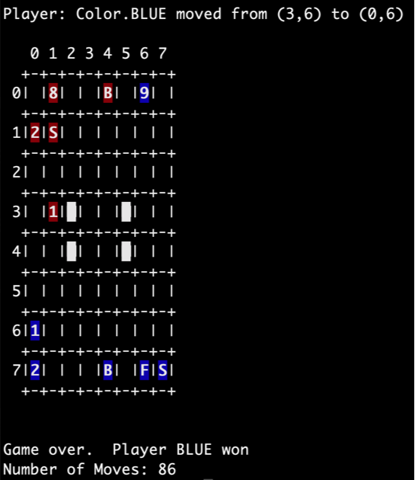
Simple Screen Shot

Slide 5
Demo?

Slide 6
Takeaways
Random player is significantly worse than expected even on very simple setups
Takes hundreds of moves on average for either player to win
Significantly fewer moves should be required
Original idea to use a random baseline instead of heuristics to judge move quality is probably not going to work
Need more sophisticated approaches for estimating state quality

Slide 7
Next Steps
Although Stratego has imperfect information, we expect that at least the early stages of the project will loosen that assumption
Enables superior reasoning about the game and will provide a meaningful baseline for performance analysis
Depending on overall progress, we will decide whether to restore the assumption
Next Week’s Goal: Implement a rule-based agent
This should help to build intuition about constraints as we go to more complex agent models

