Slide 1
Creating an Advanced Automated Stratego Player
By: Steven Walton & Zayd Hammoudeh
Week 2: April 12, 2019

Slide 2
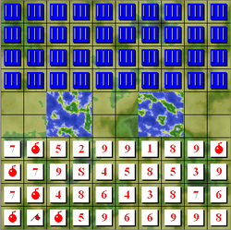
What is Stratego?
Two player board game
Adversarial “capture the flag”
Harder Than Chess:
State Space: 10¹¹⁵ vs 10⁵⁰
Standard Board
10 rows by 10 columns
40 pieces per player (of varying abilities)
Imperfect Information: At start only know location of own pieces
Small versions (e.g. 10 pieces per player) vexists (which we may use)
Branching Factor: ~220 (Upper Bound)

Slide 3
Additional Challenges of Stratego
Limited Feedback: Games take hundreds of moves with only a win/loss/draw result at the end
Two Game Stages
Stage #1: Piece Placement
Stage #2: ”Main” gameplay
Stage #1 has high variability significantly increasing training requirements

Slide 4
Outline of our Development Plan
High Level: Focus on gameplay not on placement
Stage 1: Build the “Arena”
Construct the rules and fundamental gameplay mechanics
Stage 2: Construct simple learners
Possible Strategies: Uniform-random, Rule-based, POMDP
Stage 3: Basic Reinforcement Learner
Possible Strategies: Q-learner, R-learner
Stage 4: Deep Reinforcement (Time Allowing)

Slide 5
Efficiency Planning
Reinforcement learning requires millions of actions to train a competent learner

Slide 6
Current Status
Source Code: We can give you access if you want
https://github.com/ZaydH/stratego
Stage 1: Ongoing
Piece system implemented
Board mechanics implemented
Continuous integration architecture in place with numerous tests

Slide 7
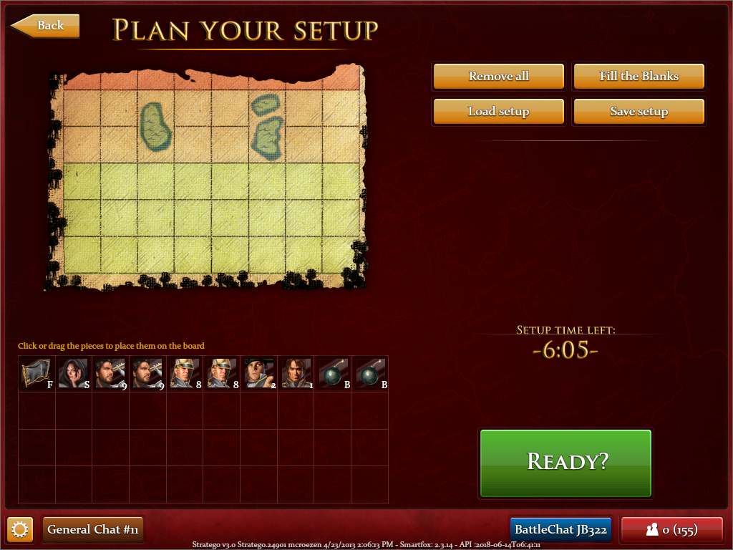
Test from linux

