Slide 1
LAB 3: Microcode
Moinuddin K Qureshi

Slide 2
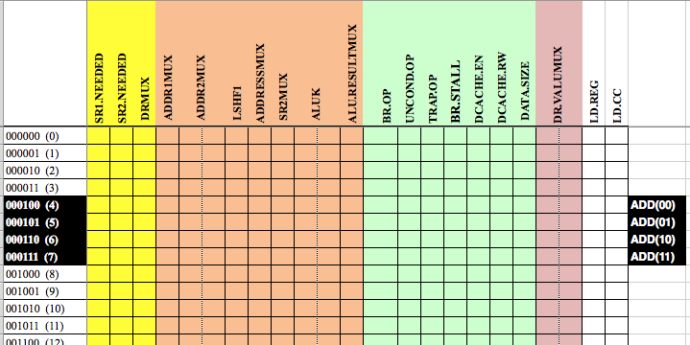
Control Store: Regulates Pipeline
64 rows x 23 columns
64 rows x 23 columns (signals needed in different stages, hence colored)
Indexed by 6 bits { IR[15:12], IR[11], IR[5] } ➔ {OPCODE X Y}

Slide 3
Consider the ADD instruction
For the ADD instruction, the opcode is 0001
ADD comes in two flavors: REG (IR[5]=0) or Immediate (IR[5]=1)
IR[11] is not a steering bit for ADD, so ADD should do the same
thing irrespective of whether IR[11] is 0 or 11
ADD will map to four rows:
0001 00 ➔ Row 4 ➔ ADD REG (IR[11] happens to be 0)
0001 01 ➔ Row 5 ➔ ADD IMM(IR[11] happens to be 0)
0001 10 ➔ Row 6 ➔ ADD REG ( IR[11] happens to be 1)
0001 11 ➔ Row 7 ➔ ADD IMM( IR[11] happens to be 1)
COPY

Slide 4
Row 4, ADD REG (IR[11]=0)
1
1
1
1
1
1
1
This ADD instruction needs to read both REGs
DECODE: SR1 is needed (1) and SR2 is needed (1)
AGEX: ALU RESULTMUX should select ALU and not SHFT (1)
SR: DR VALUE should come from ALU result (11)
This instruction writes to REG (LDREG) and condition code (LDCC)
64 rows x 23 columns
Note: ALUK=00 is ADD by default

Slide 5
Row 5, ADD IMM(IR[11]=0)
1
1
1
1
1
1
1
1
0
1
1
1
1
1
1
This ADD instruction needs only SR1, so two changes:
DECODE: SR1 is needed (1) and SR2 is needed (0)
AGEX: SR2MUX should get value from SEXT(imm5) ➔ 1
(other signals same as Row 4)
64 rows x 23 columns

Slide 6
Row 6 is IDENTICAL to Row 4 Row 7 is IDENTICAL to Row 5

Slide 7
Hint: XOR and AND should be quite easy now

