Slide 1
LAB 3: Pipelined Machine
Moinuddin K Qureshi

Slide 2
Announcements
Gist of the mid semester class survey:
We seem to be doing okay with lectures/exams
Would be nice to have a 3-5 min break during the lecture
Labs are tough (35/45) ➔ We learn a lot, but need more help
Split the lab into two or more parts, with staggered deadline
Verilog/VHDL instead of C ➔ Will increase debug time by ~4x
Lab 3 is split into two parts:
Microcode due this Friday
Datapath due on Tuesday
We will provide a test harness and test cases for the datapath
We will go over the Pipeline lab today, and get started with Caches

Slide 3

Warning!!
This course requires heavy programming
We assume you are already comfortable with C programming (4 Labs, all in C)
If you do not have the right programming skills, these labs will take forever
“For a 3 hour credit class, I was spending nearly ~40 hours on each assignment.”
“In many assignments, there were times where I needed to write over 1000+ or 2000+ lines of code.”
“Because I had an error in 5 or 6 lines, I got a 20% on it. This was extremely unfair.”
“Most of the effort involved went into debugging extremely complex C code.”

Slide 4
Lab1 as touchstone (5% of grade)
Already posted on T-square, due this Friday 1pm
A shortened version of one of the labs
Should take about 3-4 hours (and ~150 lines) for solution
We will provide a test harness so that you know what score to expect from your submission
If you find yourself spending 10+ hours or writing more than 1000 lines of code, and still not getting the right score, you may not have the right programming background ➔ rethink about taking this course
Note: No collaboration, you cannot look at each other’s code.
Cheating Cases Dealt Seriously: course grade drop + report to dean

Slide 5
Unfortunately …
It has come to our attention that some students obtained solution from unauthorized means: previous years, online, other students
We will check all Lab 2/Lab 3 submissions with plagiarism detection script:
Measure of Software Similarity (MOSS): http://theory.stanford.edu/~aiken/moss/
Detects “substantial” similarity in code (robust to naming/spacing)
In last three years, out of 40 detections, not a single student contested
If you obtained the code by unauthorized means, you have two choices:
(a) By this Friday, withdraw your Lab2 – no questions asked, will have option for re-grade for 50% of the assignment credit after Midterm 2
(b) If not, and if we detect plagiarism:
Zero on the lab assignment (no option for Re-grade)
+ One grade drop in the final course grade
+ Reporting to the dean of students (goes as academic warning in file)

Slide 6
LAB 3: Pipelined Machine

Slide 7
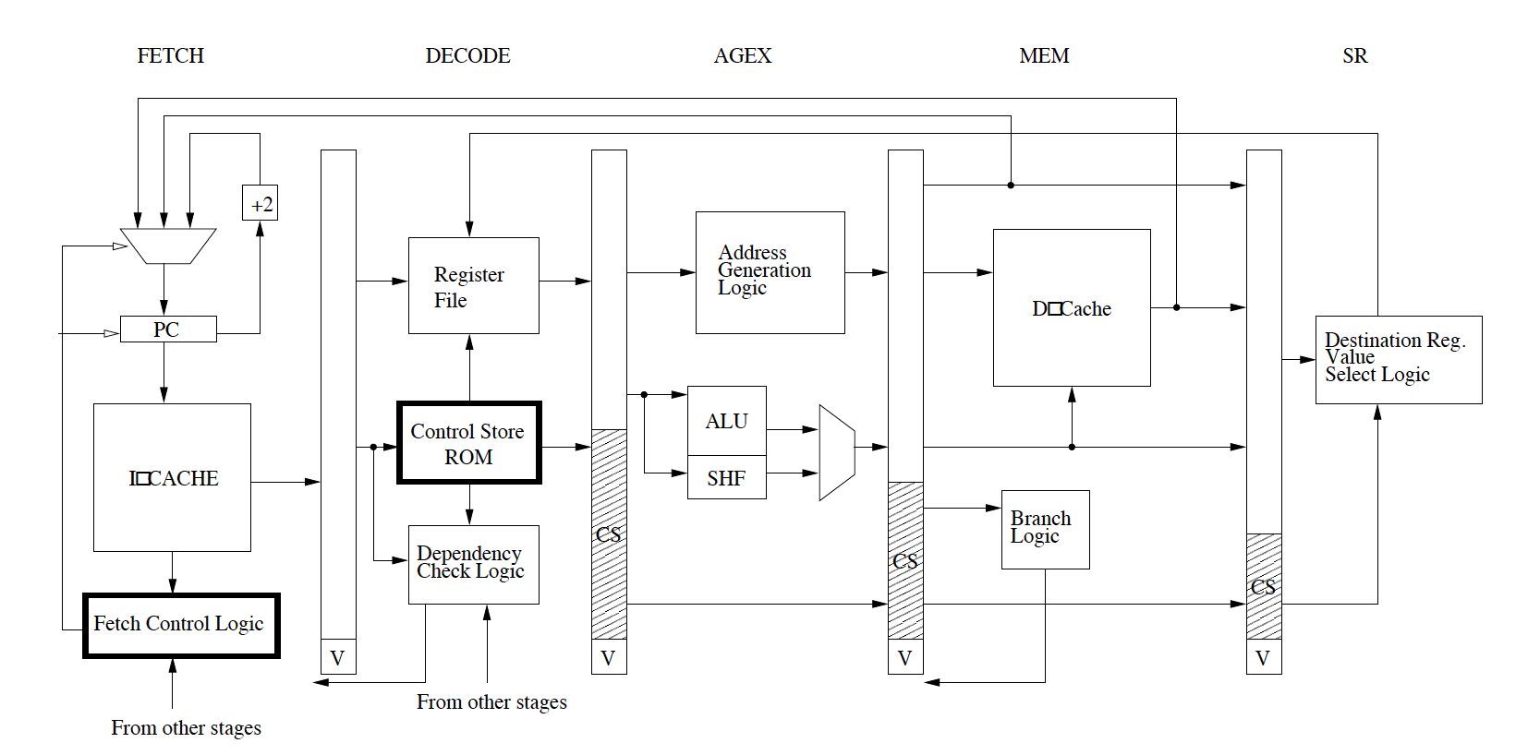
Overview

Slide 8
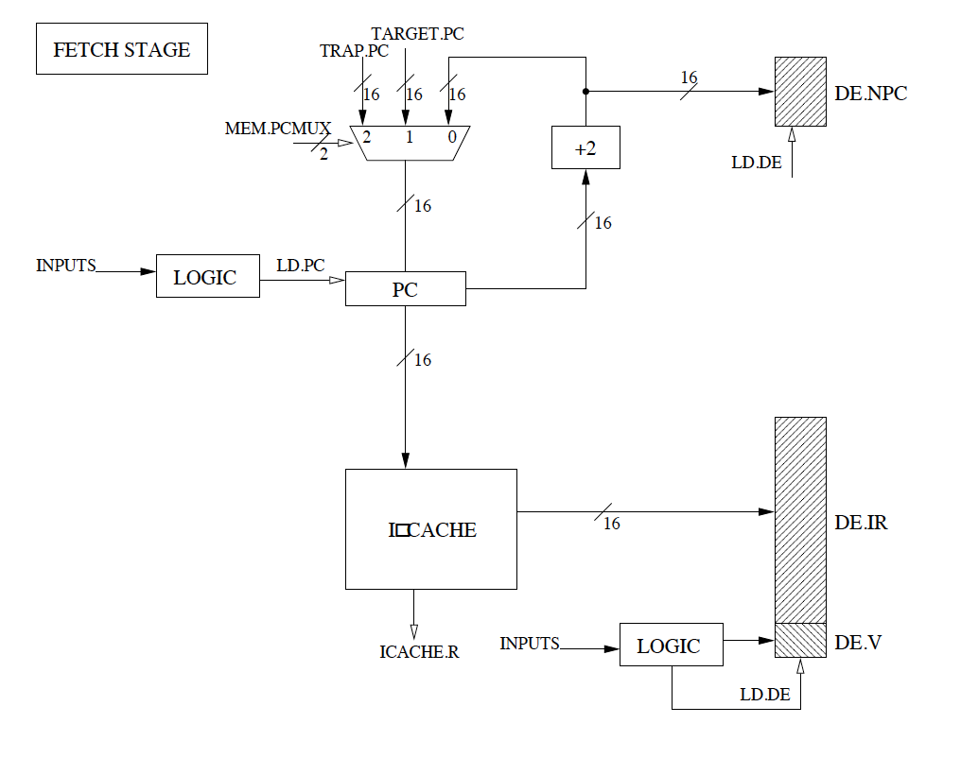
FETCH Stage

Slide 9
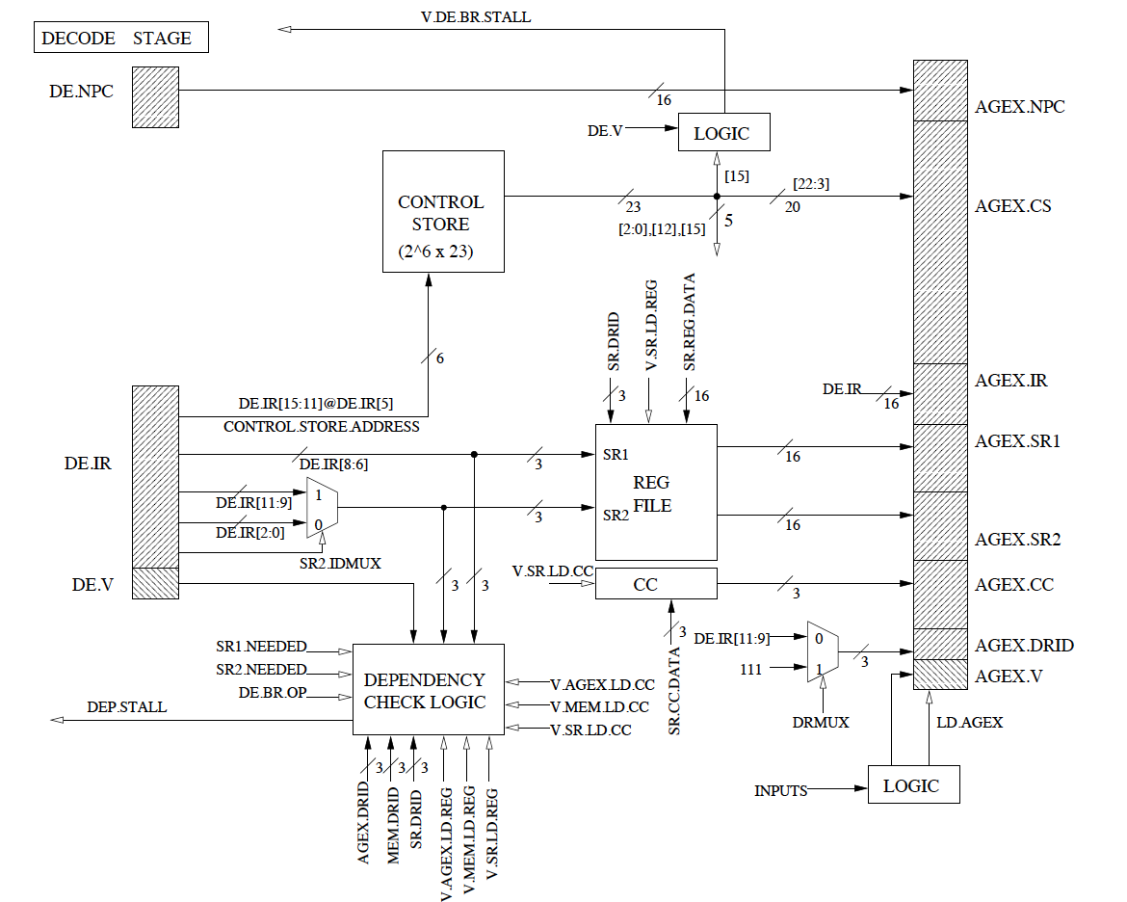
DECODE Stage

Slide 10
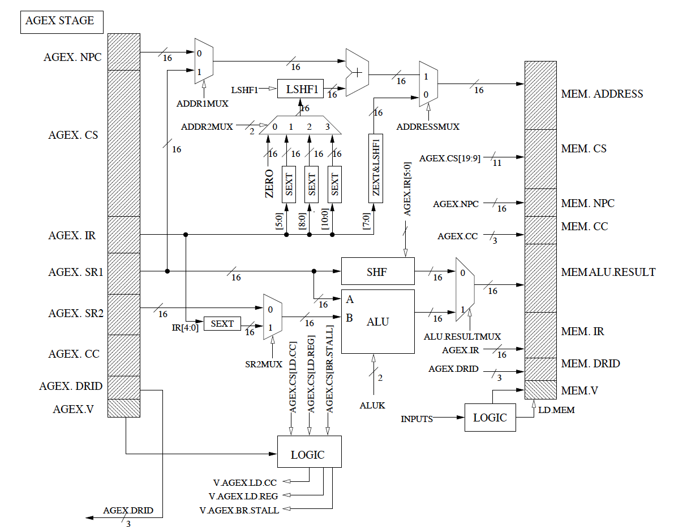
AGEX Stage

Slide 11
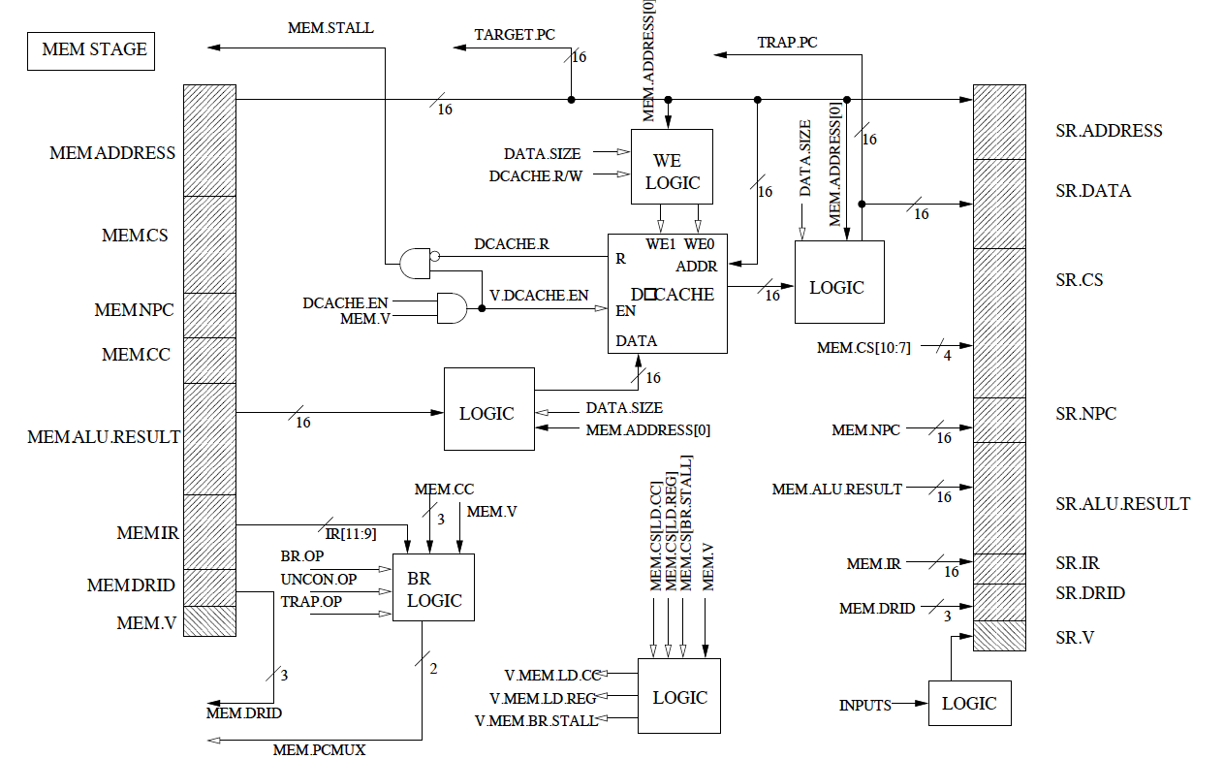
MEM Stage

Slide 12
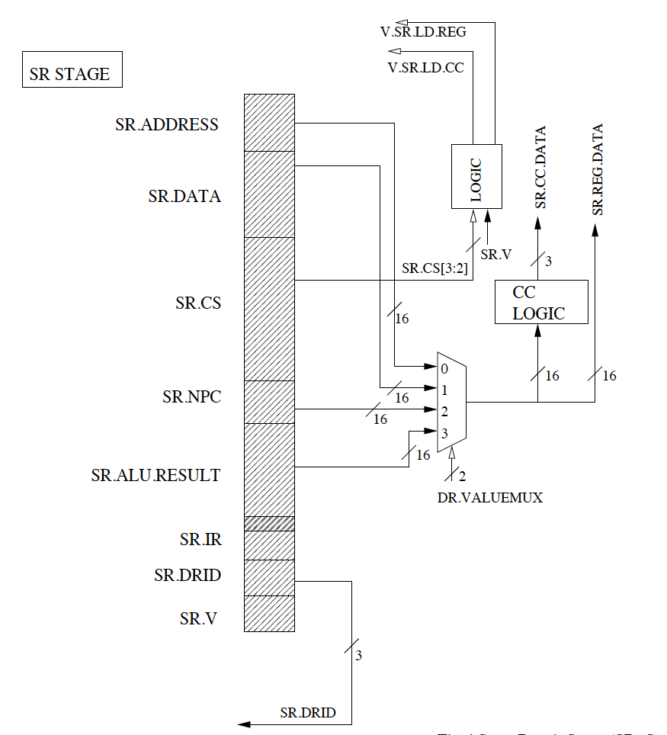
STORE RESULT (WRITEBACK) Stage

Slide 13
How to go about doing the Lab?
Writing software is an art, as much it is engineering
Break complex task into smaller (easier) sub tasks:
Write Microcode for all instructions (become familiar with design)
Model the datapath without any dependencies (No stalls ➔ LD=1)
Assume branches are never taken
Cache always gives R=1 (change %13 or %9 to %1)
No data dependencies (test instructions without data dep)
Can still have bubbles when the pipeline is filling up ➔ VLD=0
Now start adding the stalls
Add the memory related stalls (cache gives R=0, back to %13)
Data Dependencies (RAW only, why?)
Branch stalls (fetch is stalled for control flow instructions)

Slide 14
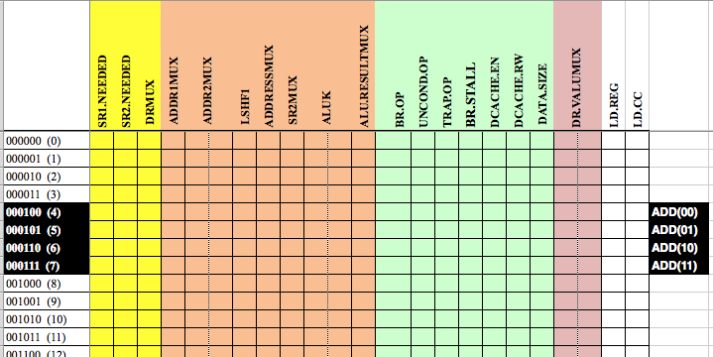
Control Store: Regulates Pipeline
64 rows x 23 columns
64 rows x 23 columns (signals needed in different stages, colored)
Indexed by 6 bits { IR[15:12], IR[11], IR[5] } ➔ {OPCODE X Y}

Slide 15
Consider the ADD instruction
For the ADD instruction, the opcode is 0001
ADD comes in two flavors: REG (IR[5]=0) or Immediate (IR[5]=1)
IR[11] is not a steering bit for ADD, so ADD should do the same
thing irrespective of whether IR[11] is 0 or 1
ADD will map to four rows:
0001 00 ➔ Row 4 ➔ ADD REG (IR[11] happens to be 0)
0001 01 ➔ Row 5 ➔ ADD IMM(IR[11] happens to be 0)
0001 10 ➔ Row 6 ➔ ADD REG ( IR[11] happens to be 1)
0001 11 ➔ Row 7 ➔ ADD IMM( IR[11] happens to be 1)
COPY

Slide 16
Row 4, ADD REG (IR[11]=0)
1
1
1
1
1
1
1
This ADD instruction needs to read both REGs
DECODE: SR1 is needed (1) and SR2 is needed (1)
AGEX: ALU RESULTMUX should select ALU and not SHFT (1)
SR: DR VALUE should come from ALU result (11)
This instruction writes to REG (LDREG) and condition code (LDCC)
64 rows x 23 columns
Note: ALUK=00 is ADD by default

Slide 17
Row 5, ADD IMM(IR[11]=0)
1
1
1
1
1
1
1
1
0
1
1
1
1
1
1
This ADD instruction needs only SR1, so two changes:
DECODE: SR1 is needed (1) and SR2 is needed (0)
AGEX: SR2MUX should get value from SEXT(imm5) ➔ 1
(other signals same as Row 4)
64 rows x 23 columns

Slide 18
Row 6 is IDENTICAL to Row 4 Row 7 is IDENTICAL to Row 5
Hint: XOR and AND should be quite easy now

Slide 19
Datapath: No stalls, dependencies
Consider ADD R0, R1, R2
Cycle: 1

Slide 20
DECODE: No stalls, dependencies
IGNORE FOR RIGHT NOW
Consider ADD R0, R1, R2
Cycle: 2

Slide 21
AGEX: No stalls, dependencies
Consider ADD R0, R1, R2
Cycle: 3

Slide 22
MEM: No stalls, dependencies
Why is there no LD.SR?
Consider ADD R0, R1, R2
Cycle: 4

Slide 23
SR: No stalls, dependencies
Actual writing to REGFILE
Must happen in DECODE stage in cycle 5
Consider ADD R0, R1, R2
Cycle: 5

Slide 24
Now Add Dependencies and Stalls
1. Cache not ready (in FETCH and MEM) ➔ stall, and insert bubble
2. Data dependencies (check inputs to block in DECODE stage)
3. Control dependencies (Decoded a control instruction? stall fetch)

