Slide 1
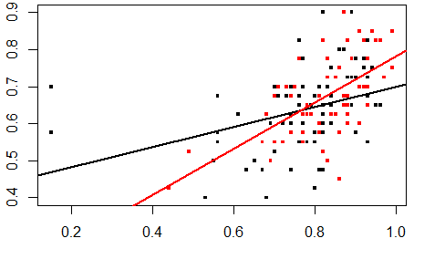
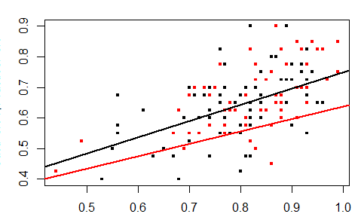
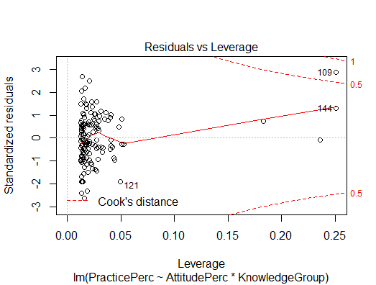
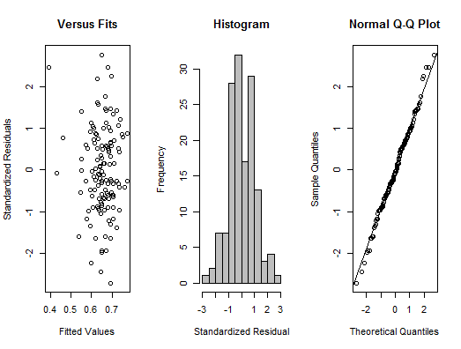

MATH 325
Practice as a Function of Attitude and Knowledge: Evidence from the Sustainability Program at Dickinson College
Zayed Shahjahan, Minh Tran, Yu Fu
Methods
Model 1 Model 2
The regression equation is given by: Practice = $β_{0}+β_{1}$Attitude + $β_{2}$KnowledgeGroup + $β_{3}$Attitude*KnowledgeGroup
the equation remains the same for both Models.
Results
Attitude, Knowledge Group and the interaction term between the two are all statistically significant and explain 26.45% of the variation in Practice scores when Model 1 is used. A 1% increase in Attitude score entails a 27% increase in Practice scores in this model.
Only Attitude score is statistically significant in Model 2 and it explains 33.4% of the variation in Practice Scores. A 1% increase in Attitude score entails a 52.3% increase in Practice score according to this model.
The difference
The interaction term in the regression is what produces the different slopes for the two knowledge groups. A person in the High Knowledge group will have a larger increase in practice scores per percentage increase in attitude score as opposed to someone in the Low Knowledge Group. In Model 1 that is.
Upon inspection of the diagnostic plots, it was revealed that two points in Model 1 exerted considerable influence on the regression equation. These points are highlighted in the graph of Model 1.
We obtain Model 2 after taking out the two points. In doing so we discover that the slopes for the High Knowledge Group and the Low Knowledge Group are far more similar than what was previously surmised.
The diagnostic plots support the decision of using a linear regression model to study the relationship between the three variables. The graph of the Residuals vs. Fitted highlights on of the two influential points which was removed in Model 2 (this is point 109).
Conclusions
Based on the analysis of the data certain conclusions can be drawn:
Attitude plays a far greater role than knowledge when it comes to sustainable practices, at least in the context of this survey
The two influential points can be interpreted as individuals who have unsavory attitudes towards sustainability, yet who have very sustainable lifestyles (opinion)
Taking the anomalous points out, we are left with a result that speaks even more strongly to the effect of attitude on sustainable practices
Taking the points out downplays knowledge even further
Drawbacks
The total undergraduate population at Dickinson College is around 2400 students. This survey was completed by only 145 of those students. Therefore any conclusion that is drawn from this data must be restricted to the respondents of the survey and must not be extrapolated to the rest of the college
At the same time, there is the issue of self-selection. People who usually complete these surveys tend to be the kind of people who care about these issues, as a result it is very difficult to get people who do not care about these issues. Therefore we can never have 100% representative sample of the college population
Objectives
Aim of the research was to explore the relationship between practice, attitude and knowledge in the domain of sustainability education at a small liberal arts institution, Dickinson College
This is to be done using data from survey administered by the college’s Center for Sustainability Education in the Spring of 2018
The main statistical tool to be used is the simple multivariable regression with Practice as the dependent variable and Attitude and Knowledge as the independent variables.
Level of knowledge is to be treated as factor and processed as an interaction term with attitude in order to gain a better understanding of the interplay between knowledge and attitudes pertaining to sustainability issues.
Red=HighKnowledge
Black=LowKnowledge
Influential points
Practice points as percentage of total
Practice points as percentage of total
Attitude points as a percentage of total score
Attitude points as a percentage of total score
Diagnostic Plots:
Introduction
Completed responses totaled 145 (N=145)
Survey questions are divided into 3 groups: Practice, Attitude and Knowledge
12 Knowledge Qs worth 1 point each. This totaled 12 points
10 Practice Qs with responses on a Likert scale converted to a numerical scale from 1 to 4. This totaled 40 points
20 Attitude Qs with responses on a Likert scale converted to a numeric from 1 to 5, totaling 100
These are the raw Knowledge, Practice and Attitude scores
Analysis was done on percentages of raw scores.
HighKnowlege comprised of students who scored more than 6
References:
Student Sustainability Survey [Excel] / auth. Dickinson College Center for Sustainability Education. - Carlisle : [s.n.], 2018.
Probability and Statistics for Engineers and Scientists 9th Edition[pdf]/ auth. Walpole, Myers, Myers, Ye. Pearson Education Boston MA 2012
Notes:
Copyright Colin Purrington (http://colinpurrington.com/tips/academic/posterdesign).

