Slide 1


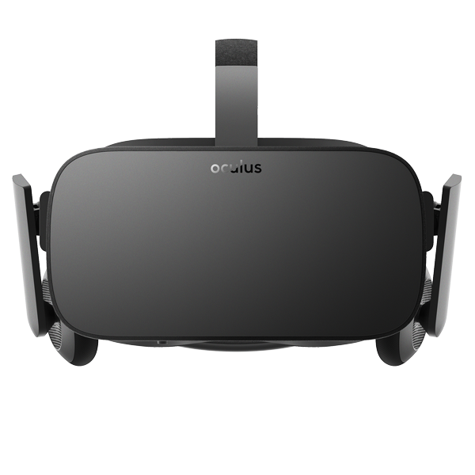
ACM – SpaceX Alumni
Saturday, April 7, 2018
Derek Hoyt will be joining us to talk about his work and experience at SpaceX
Bring your own device or try one out!
??? Room at 4 pm

