Slide 1

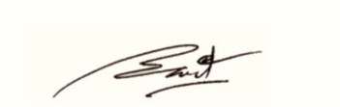
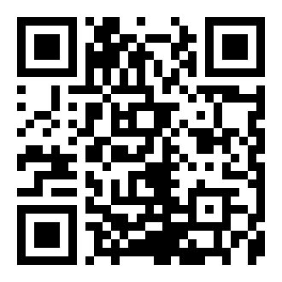
CERTIFICATE
OF PUBLICATION
This certificate is proudly awarded to
Zaynobiddin Shoxobiddinov
is recognition of the paper publication entitled”jahs sadfjaf ladf afalfd sdfla asfdjahs sadfjaf ladf afalfd sdfla asfd" published online on MURA (Millat Umidi Research Archive)
Vol. 1 No. 11 (2025)
01.11.2025
Date
I.I.Kuchkarov

