Slide 1

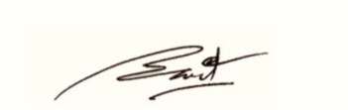
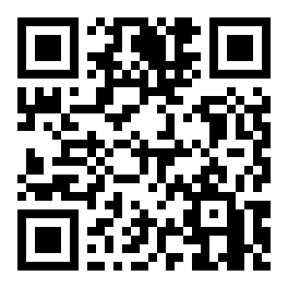
CERTIFICATE
OF PUBLICATION
This certificate is proudly awarded to
Zaynobiddin Shoxobiddinov
is recognition of the paper publication entitled”Understanding Quantum Neural Networks" published online on MURA (Millat Umidi Research Archive)
Vol. 1 No. 11 (2025)
01.11.2025
Date
I.I.Kuchkarov

