Slide 1


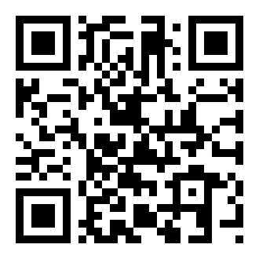
CERTIFICATE
OF PUBLICATION
This certificate is proudly awarded to
Amirsaid Samigjanov
is recognition of the paper publication entitled”Yangi Maqola" published online on MURA (Millat Umidi Research Archive)
Vol. 1 No. 11 (2025)
03.11.2025
Date
I.I.Kuchkarov

