Slide 1


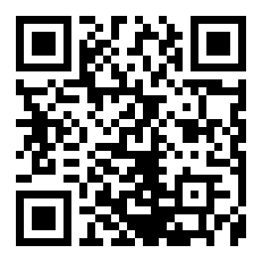
CERTIFICATE
OF PUBLICATION
This certificate is proudly awarded to
Zaynobiddin Shoxobiddinov
is recognition of the paper publication entitled”Thi is nothing so nothing is good Thi is nothing so nothing is good " published online on MURA (Millat Umidi Research Archive)
Vol. 1 No. 11 (2025)
02.11.2025
Date
I.I.Kuchkarov

