Slide 1


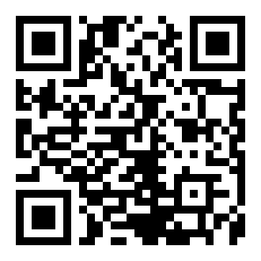
CERTIFICATE
OF PUBLICATION
This certificate is proudly awarded to
Inomjon Qo'chqorov
is recognition of the paper publication entitled”hello, hello hello hello hello" published online on MURA (Millat Umidi Research Archive)
Vol. 1 No. 11 (2025)
03.11.2025
Date
I.I.Kuchkarov

