Slide 1

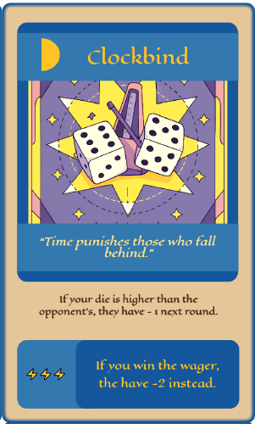
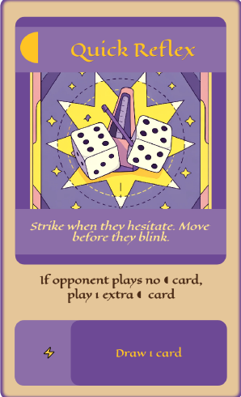
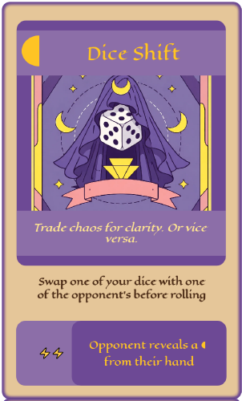
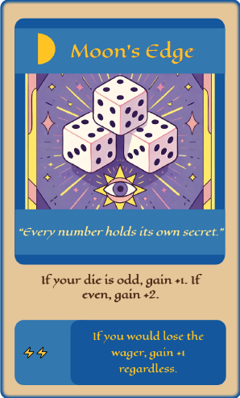
Opponent Trap Card
Opponent Phase 2 Card
Opponent Phase 1 Card
Round Flow
Opponent Discard Pile
Opponent Deck
⚡ Choose Wager
◖ Phase 1 or Trap (Pre-Roll)
🎲 Roll Dice
◗ Phase 2 or Trap (Post-Roll)
⚖️ Resolve Totals & Wager
🗑 Cleanup
Dice Rolls
Opponent Wager Card
Player Wager Card
Player Deck
Player Discard Pile
Player Phase 1 Card
Player Phase 2 Card
Player Trap Card

