Slide 1
Spring Framework
Intro

Slide 2
About Spring
Create in 2002 by Rod Johnson (Interface21)
  Expert One-on-One J2EE Design and Development
Current version 4.3 (ongoing)
Open Source, Apache License
  Free sources, for commercial use, even derivates
Perfect documentation (HTML + javadoc)
High quality API + extensions
Owned and supported by VMWare

Slide 3
Introduction
What is Spring (container + modules)
Library – JAR file(s)
  Standalone + helpers components
Container
  Component lifecycle
    Instantiate
    Wire them to together (Dependency Injection)
    Supply with services (transation, exception handling...)
Spring Tool Suite

Slide 4
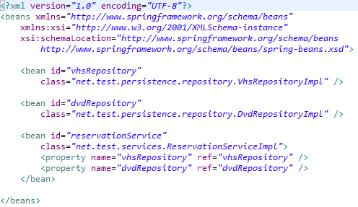
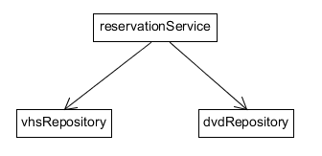
Spring Container - definition
https://github.com/zbynekvavros/spring-intro.git

Slide 5
Spring Container - instantiate
Instantiate Spring components
  Spring instantiates all components
Look-up the components

Slide 6
Dependencies
Property → setter
Constructor
  Mandatory vs optional
Other values
  NULL
  Primitives
  Collections
  Properties
  etc

Slide 7
Terminology
Component
  Every <bean>
  No need for JavaBeans only (contructor)
  Ideally with interface
Inversion of Control
  Design pattern
  Difference between main() and Servlet
Dependency injection
  Components doesn't perform the injection

Slide 8
Advantages of DI
No instantiation (new operator)
Eliminates lookup (Service Locator)
Prohibits cyclic references
Help and encourages unit testing
Ideally with interfaces
  Easier implementation replacement
  Forces developer to better code design

Slide 9
Additional lifecycle management
Initialization
  InitializingBean, init-method, @PostConstruct
Closing
  DisposableBean, destroy-method, @PreDestroy
Scopes
  Singleton, Prototype, Session, Custom

Slide 10
Component scan + Autowiring
No need to configure each bean in XML
No need for <property> or <constructor-arg>

Slide 11
Java Config
Completely without XML
Allows more customization
May need time to get used to

Slide 12
Pros / Cons
Scaling, large API, documentation, integration
Uses and forces right design pattern
No magic :)
No need to change code
Not a JSR standard
Evolution can be confusing

