Slide 1
Week06 Project
ZhiChao Peng

Slide 2
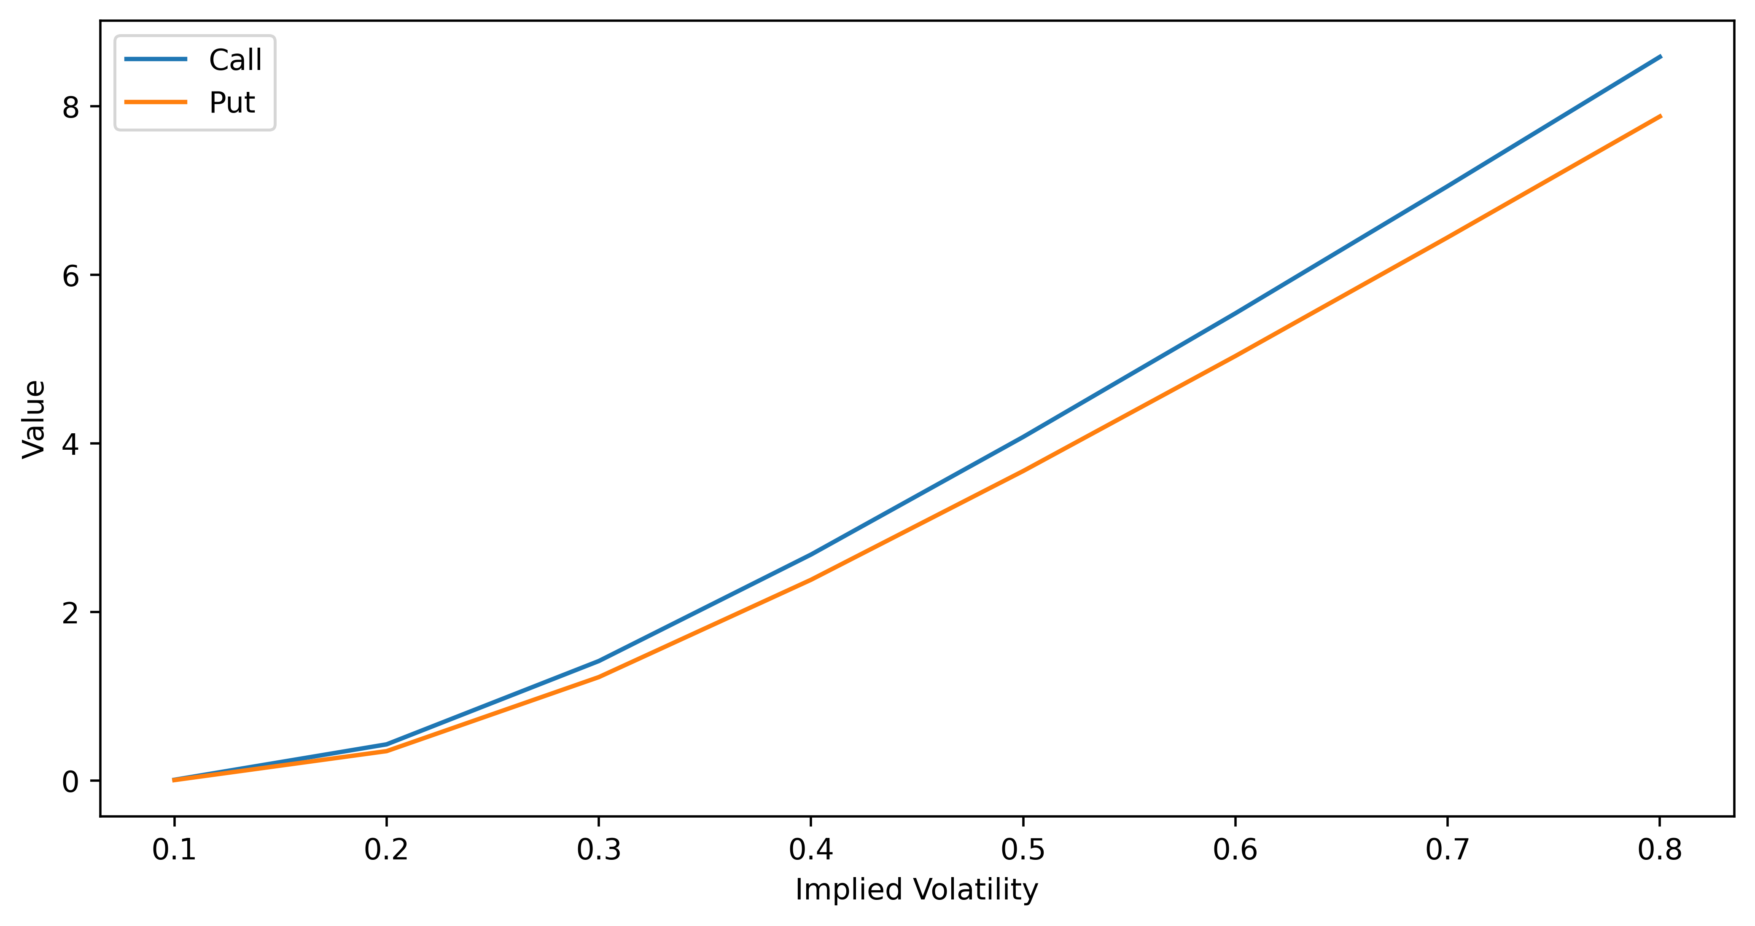
Problem 1

Slide 3
As the implied volatility increases, the value for both call and put increases. The increase in demand and decrease in supply will cause the option value(price) to increase. This indicates that as demand increases or supply decreases, the implied volatility will increase, and vice versa.

Slide 4
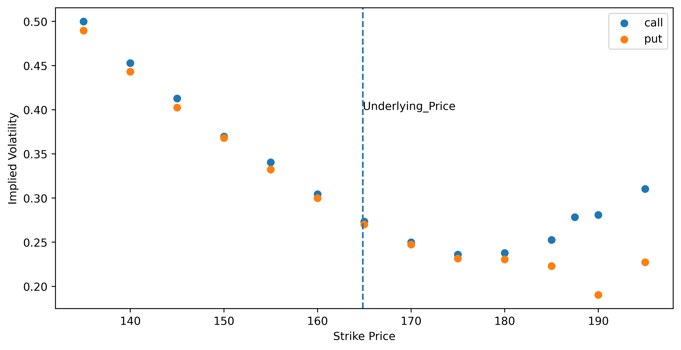
Problem 2

Slide 5
From the graph, we can see that at-money options have lower implied volatility compared to out-of-money or in-money options. This indicates that the implied volatility has a "volatility smile". The implied volatility is higher when the Strike Price is lower. This could happen when investors are having a bear view of the market and are panic about the probability for the market to crash, they then buy puts to try to hedge their risk.

Slide 6
Problem3

Slide 7




Thank You!

