Slide 1
Week07 Project
ZhiChao Peng

Slide 2
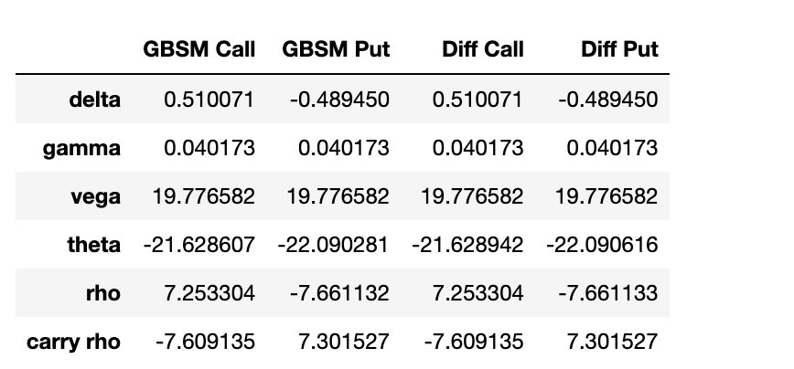
Problem 1

Slide 3
From the above, we see that the values between two methods for both a call and a put are the same, which indicates that our implementation for both methods is correct. Black Scholes method can provide the most accurate Greeks, but the finite difference method is able to give a good approximation on Greeks given small enough changes of impact. It can be used as an alternative while it is not possible to use Black Scholes method.

Slide 4
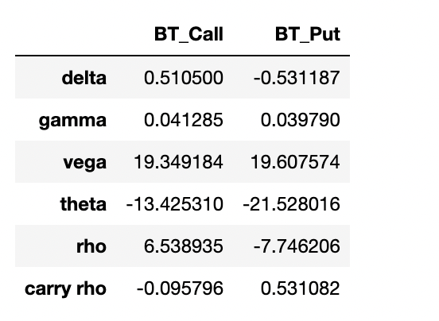
The graph above shows Greeks for BT call and BT put, the call price is 3.8147 and the put price is 4.4469. The carry rho represents the sensitivity. As the dividend of the underlying asset increase by $1, the American call price decrease by $0.095796, and the American put price increase by $0.531082.

Slide 5
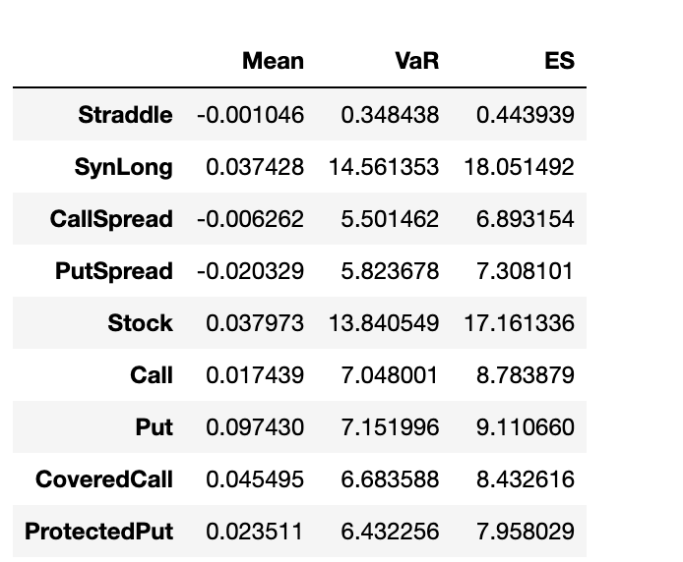
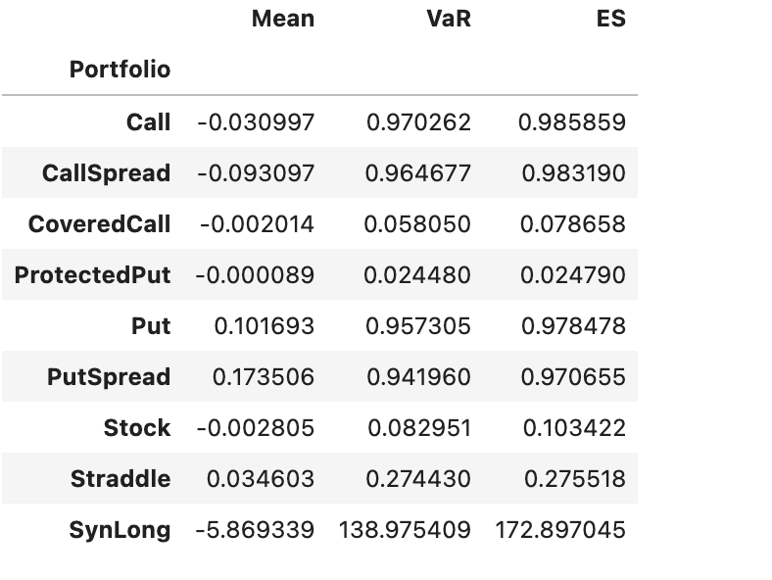
Problem2

Slide 6
The left graph is from this week’s project, and the right graph is from last week’s project. As we can see, most of the values in the two graphs are like each other. But it seems that portfolios created from American Options tend to be riskier than portfolios created from European Options.

Slide 7
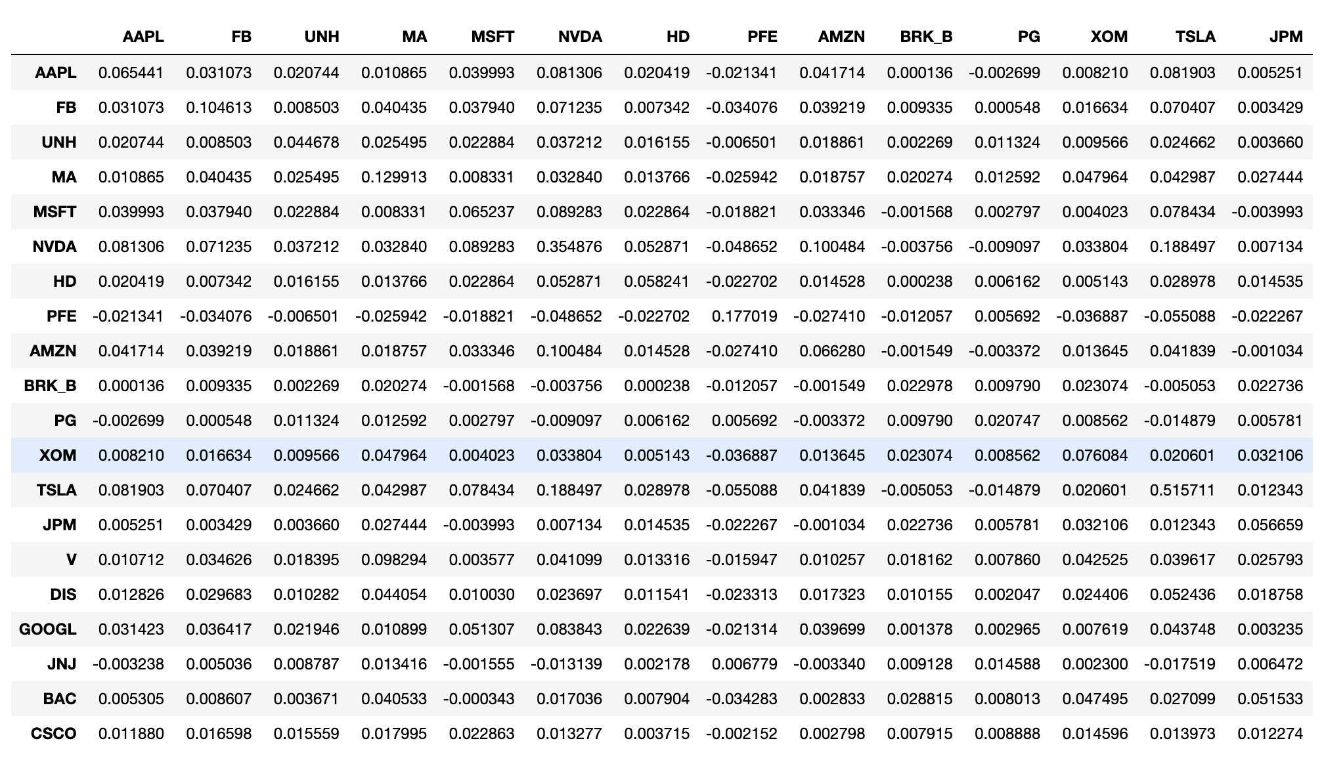
Problem 3

Slide 8
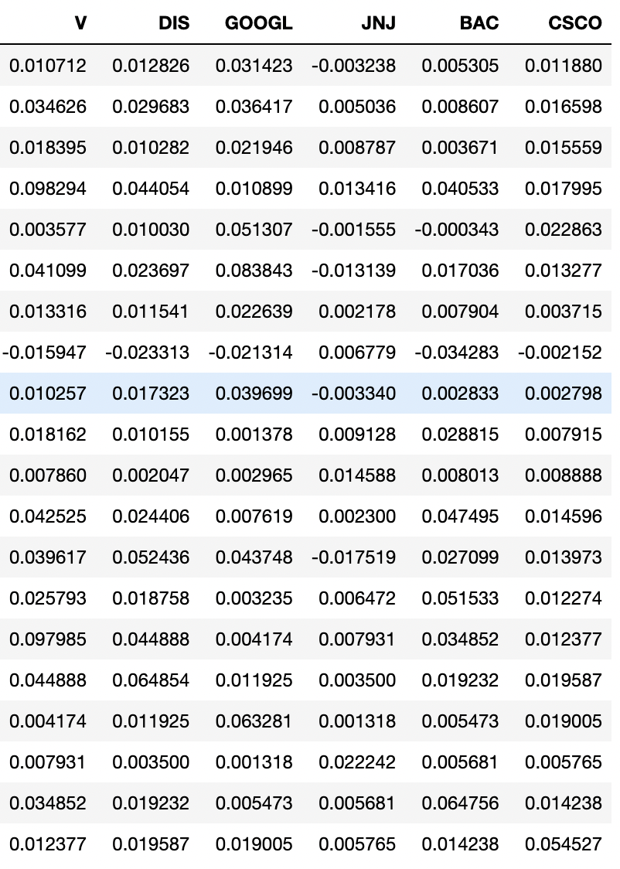

Slide 9
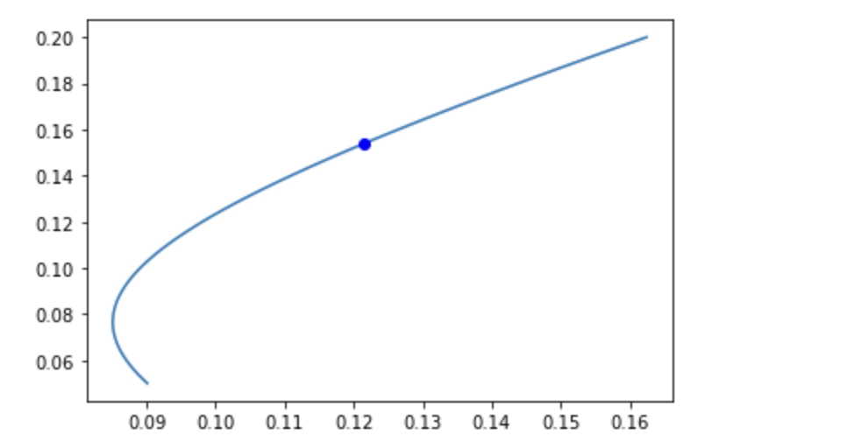

Slide 10




Thank You!

