Slide 1
Week05 Project
ZhiChao Peng

Slide 2
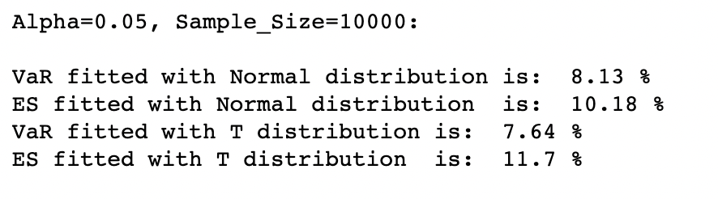
Problem 1

Slide 3
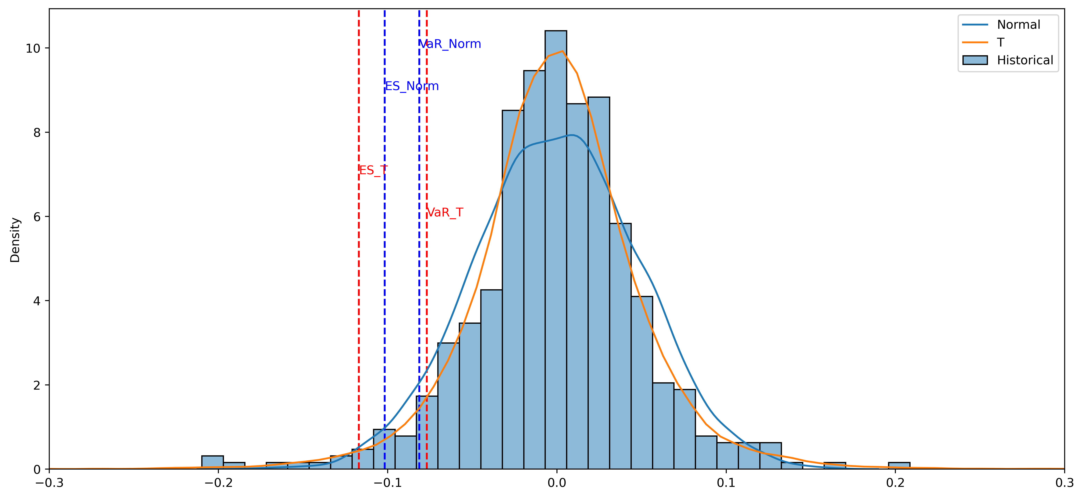

Slide 4
From the graph, we can see that the t distribution matched the data pattern better compared to the normal distribution. The VaR from t distribution is higher than the VaR from a normal distribution, while the ES from t distribution is smaller than the ES from the normal distribution.

Slide 5
Problem 2 https://github.com/ZcPFred/FT590/blob/main/Week05/Project05.ipynb

Slide 6
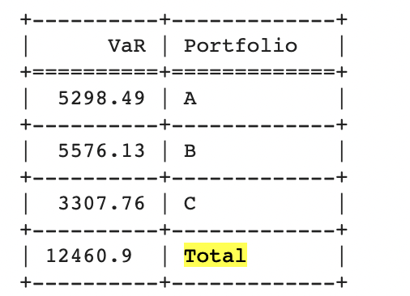
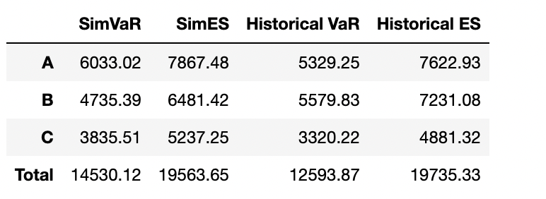
Proble3

Slide 7
The first graph from below is from Week04, and the second is from this week.
By comparing these two graphs we see that VaR calculated are similar between Copula method and delta normal method, where Copula method has a relatively larger VaR. I think that since Copula method has less dependency on the standard normal distribution assumption, it is a better method to use to calculate VaR.

Slide 8




Thank You!

