Slide 1
Week03 Project
ZhiChao Peng

Slide 2
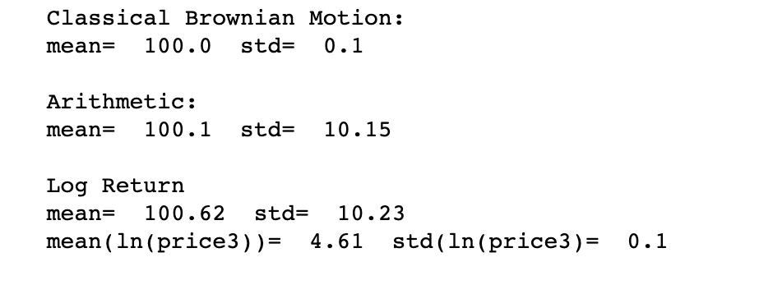
Problem 1

Slide 3
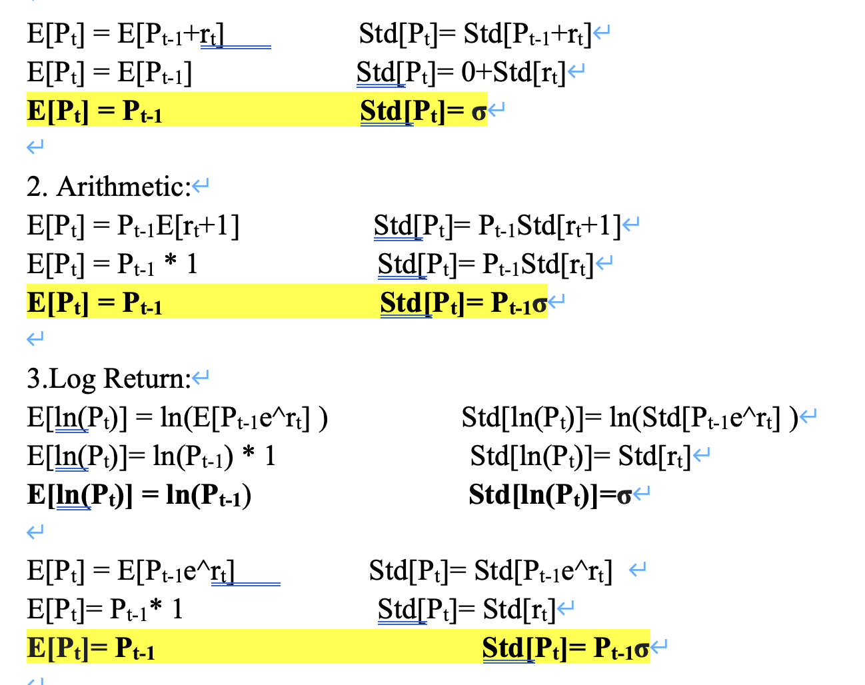

Slide 4
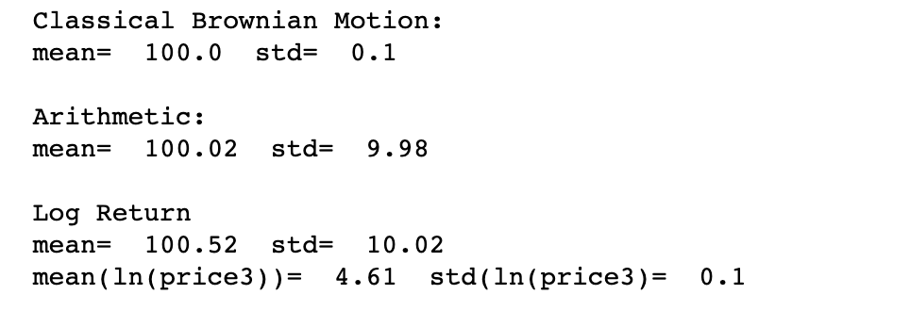
Suppose σ=0.1, P_{t-1} =100, r~N(0,0.1):
Then we know:
1. Classical Brownian Motion:
Mean=100, Std=0.1
2. Arithmetic:
Mean=100, Std=10
3.Log Return:
ln(Mean)=ln(100)=4.6, ln(Std)=0.1
Mean =100, Std=10

Slide 5
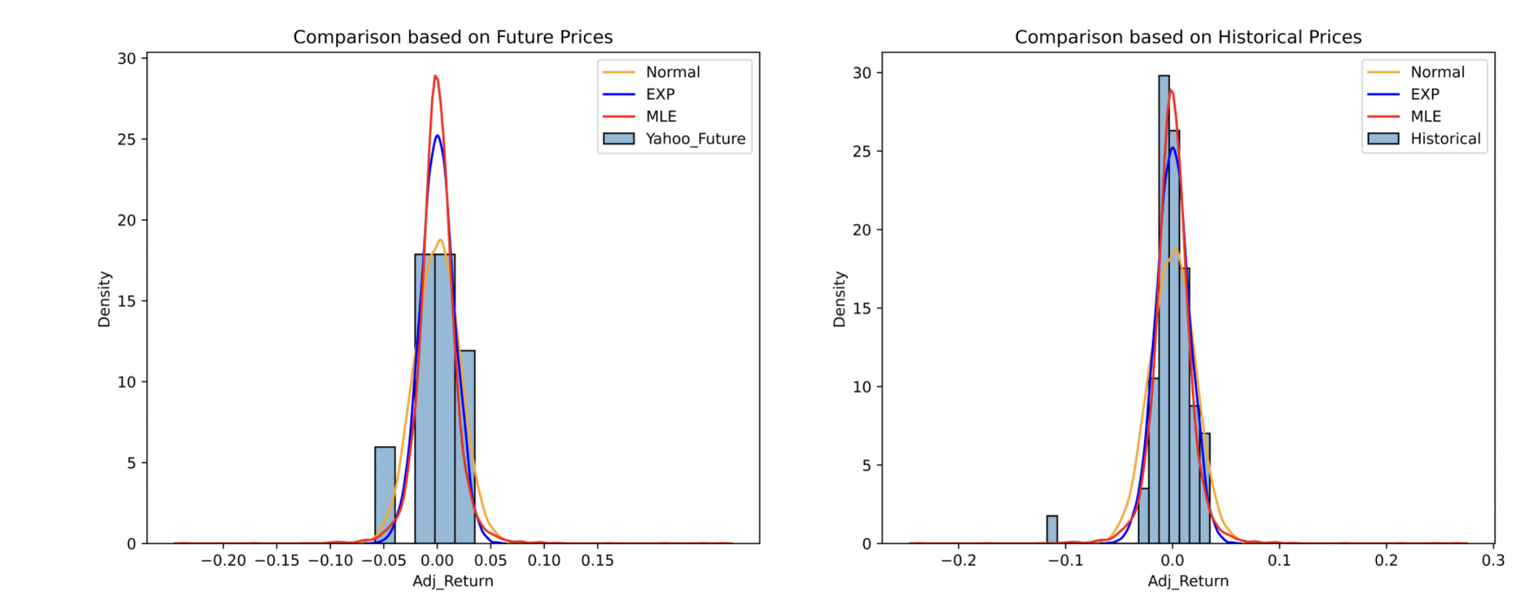
Problem 2

Slide 6
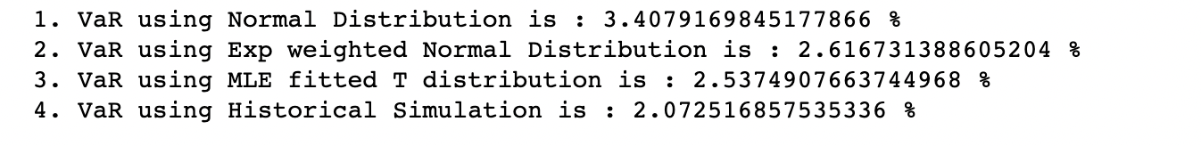
Summary
MLE method has the best ability to describe the empirical risk in this stock, whereas Normal Distribution method has the worst.
Meanwhile, the Normal Distribution method has the best ability to describe the future risk in this stock, whereas MLE method has the worst.

Slide 7
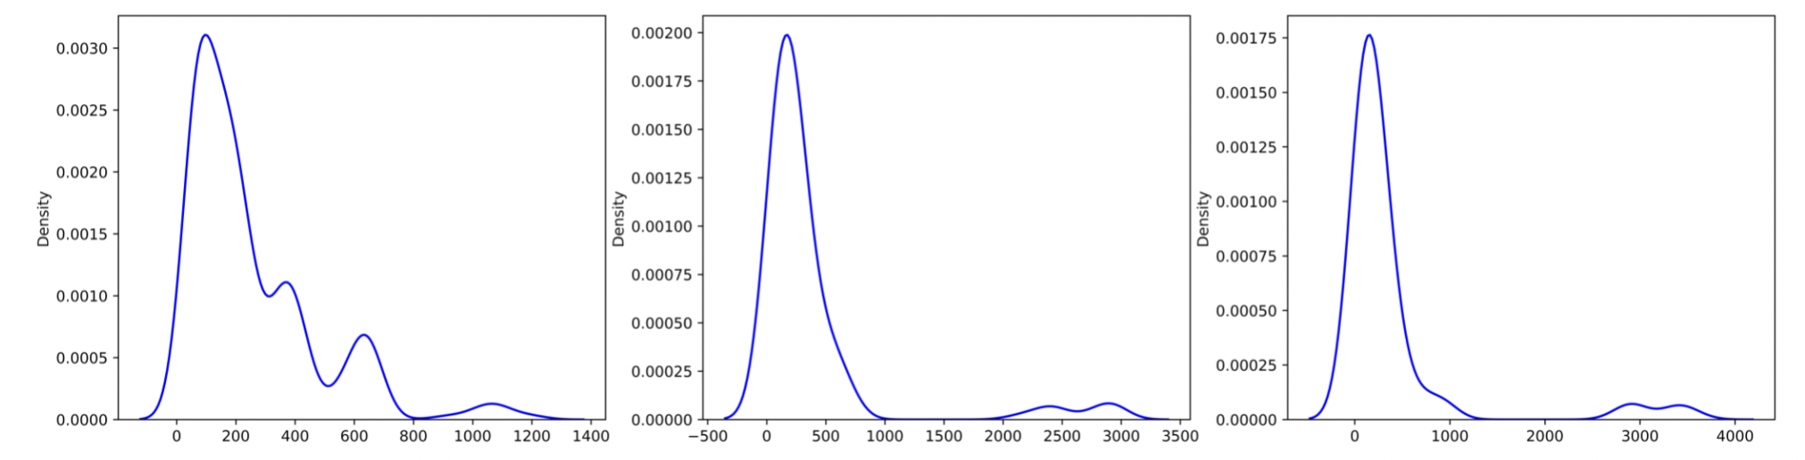
Problem 3

Slide 8
Summary
I chose to use historical simulation
Acceptable result
Less Assumptions
Easy Implementation
Obvious from the graph that their returns are not normally distributed
There are huge left skewness
historical simulation method might be better than other methods.

Slide 9




Thank You!

