Slide 1
Week06 Project
ZhiChao Peng

Slide 2
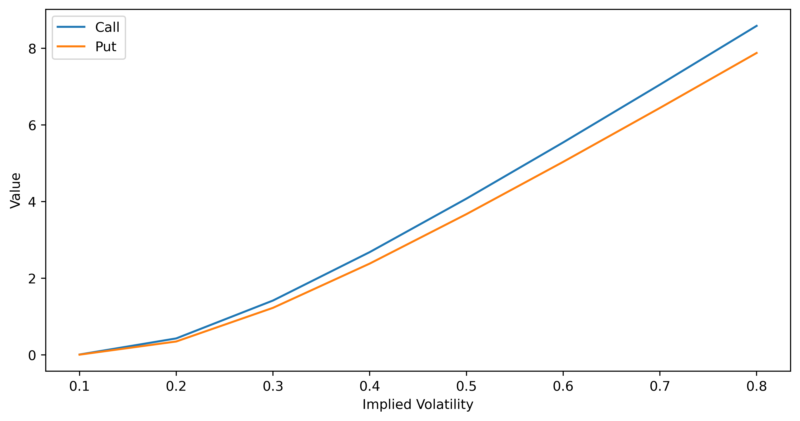
Problem 1

Slide 3
As the implied volatility increases, the value for both call and put increases. The increase in demand and decrease in supply will cause the option value(price) to increase. This indicates that as demand increases or supply decreases, the implied volatility will increase, and vice versa.

Slide 4
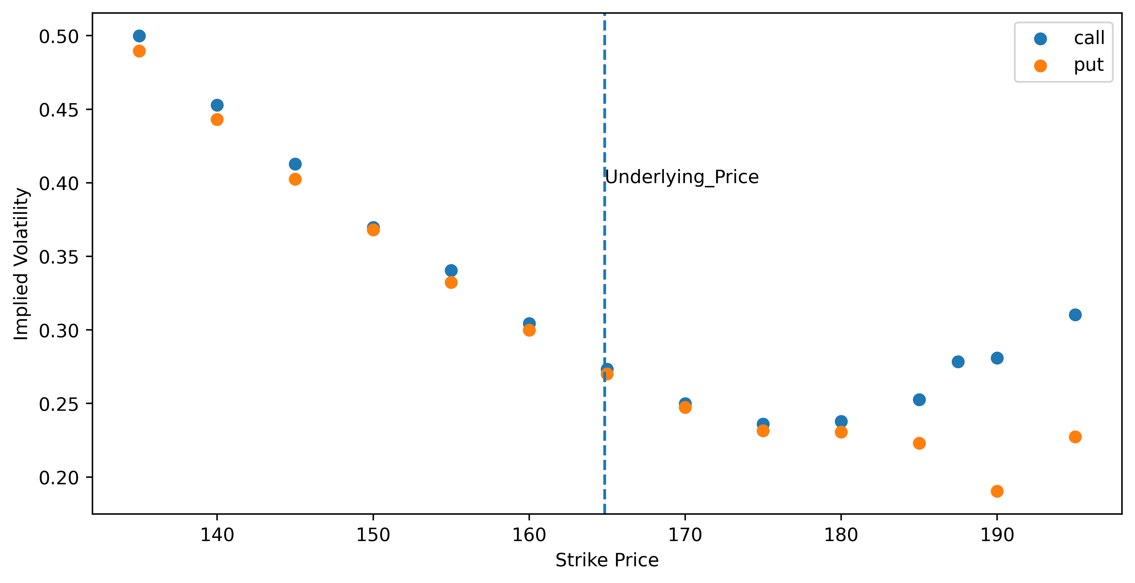
Problem 2

Slide 5
From the graph, we can see that at-money options have lower implied volatility compared to out-of-money or in-money options. This indicates that the implied volatility has a "volatility smile". The implied volatility is higher when the Strike Price is lower. This could happen when investors are having a bear view of the market and are panic about the probability for the market to crash, they then buy puts to try to hedge their risk.

Slide 6
Problem3

Slide 7
Call: make money when strike price < underlying asset’s price.
Call Spread: +1 Call, -1 Call with the higher strike price. You will earn when the price goes up and lose when the price goes down, with limited risk.
Covered Call: +1 stock, -1 Call. Have the same shape with shorting 1 Put.
Protected Put: +1 stock, +1 Put. Have the same shape with longing a Call.
Put: make money when strike price > underlying asset’s price.
Put Spread: +1 Put, -1 Put with a lower strike. Opposite shape with a Call spread.
Stock: make money when the price goes up.
Straddle: +1 Call, +1 Put. Make money when the price goes down or up.
SynLong: +1 Call, -1 Put. Make money when the price goes up, and lose when the price goes down, but to a greater extent compared with holding regular Call/Put

Slide 8
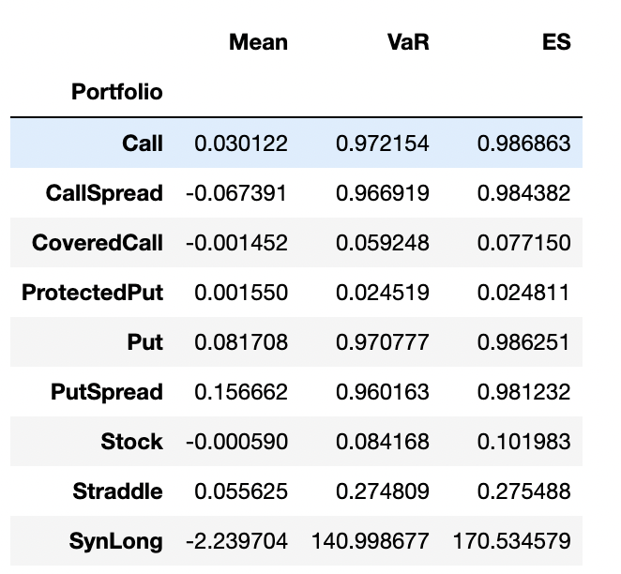

Slide 9
All portfolios/strategies have nearly zero mean return, except for SynLong. It has extremely high VaR and ES compared to other strategies and therefore is extremely risky. Straddle has a positive mean return and relatively low VaR and ES. Covered Call has a similar shape as shorting a Put, but it has a much smaller risk, with its possible return being limited. Similarly, Protected Put has a similar shape with longing a Call, but it has a much smaller risk, with its possible return being limited. Call/Put spread has slightly lower VaR and ES compared to pure Call/Put option, but they also have slightly lower expected return.

Slide 10




Thank You!

