Slide 1
Week02 Project
ZhiChao Peng

Slide 2
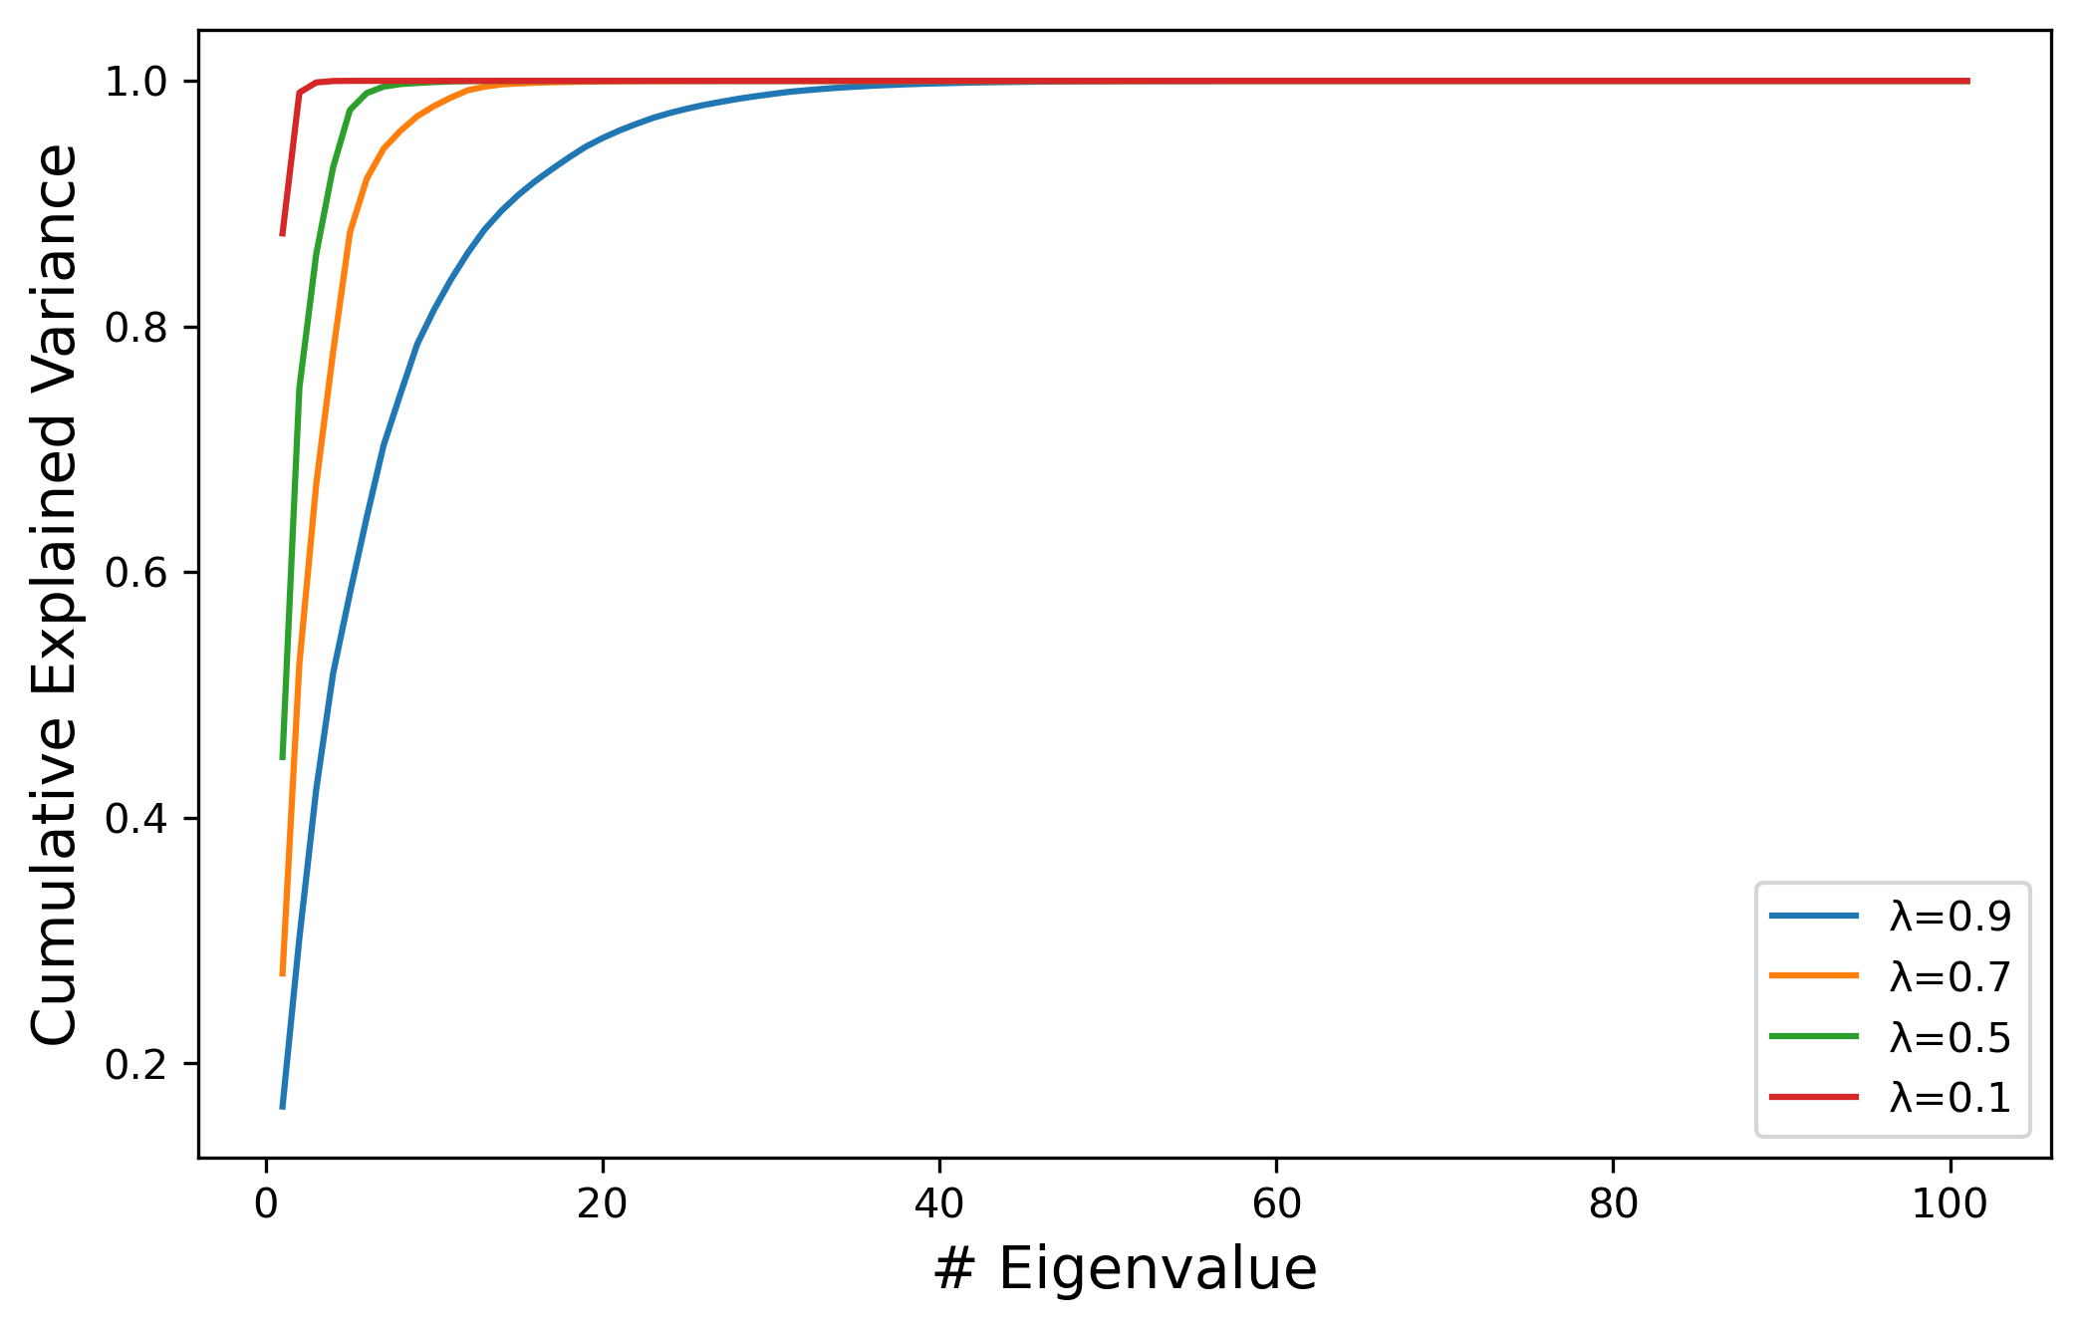
Problem 1

Slide 3
Summary
The greater the λ is, the weights are more equally assigned to each time period.
When λ is closer to 0, the fewer principal components will explain the variance of the exponentially weighted covariance matrix
When λ is closer to 1, we get more principal components that explained significant amount of variance.

Slide 4
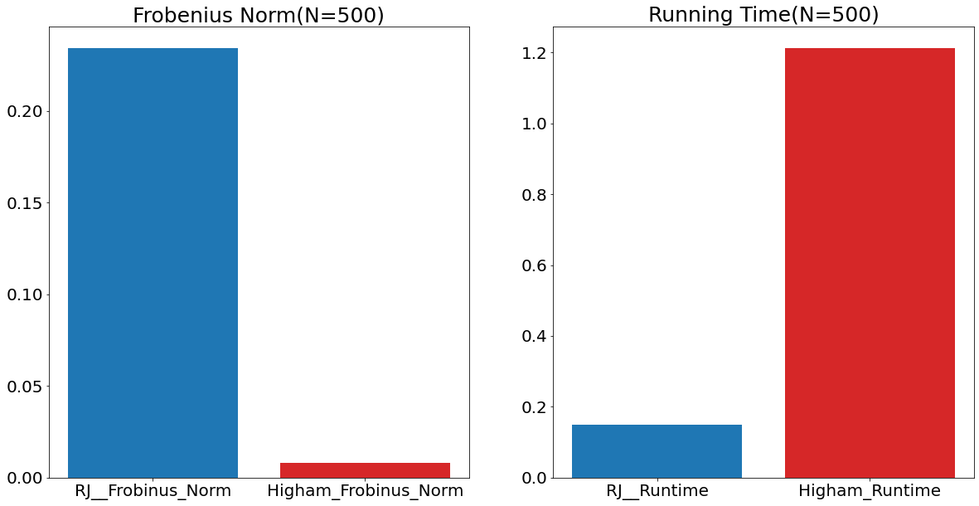
Problem 2

Slide 5
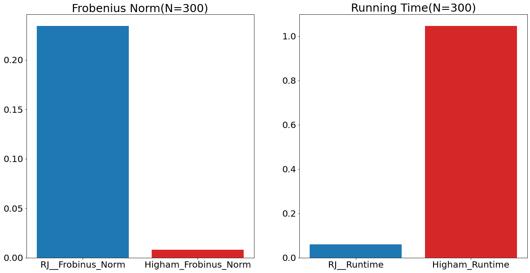

Slide 6
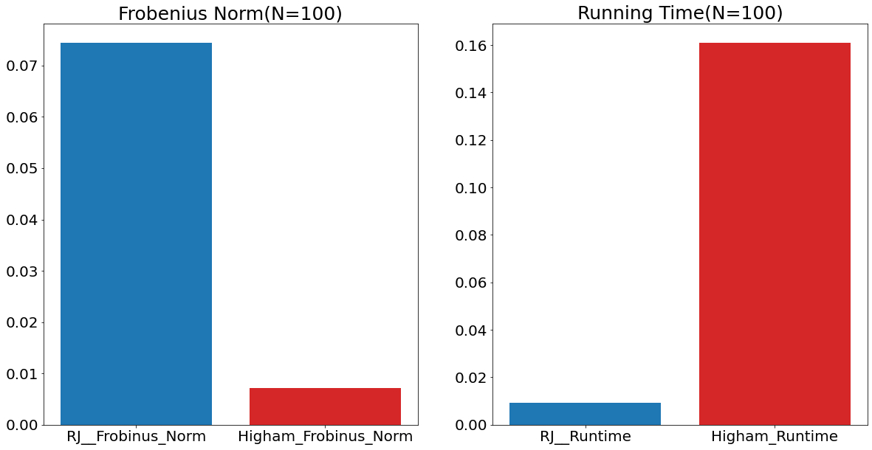

Slide 7
Summary
We could say that :
The Rebonato & Jackel’s method is fast but relatively inaccurate.
The Higham’s method is accurate but relatively slow.
There is not much difference between the two when handeling small matrix(ex. N=100). But we must make a choice between accuracy and running time when dealing with larger size of matrix.

Slide 8
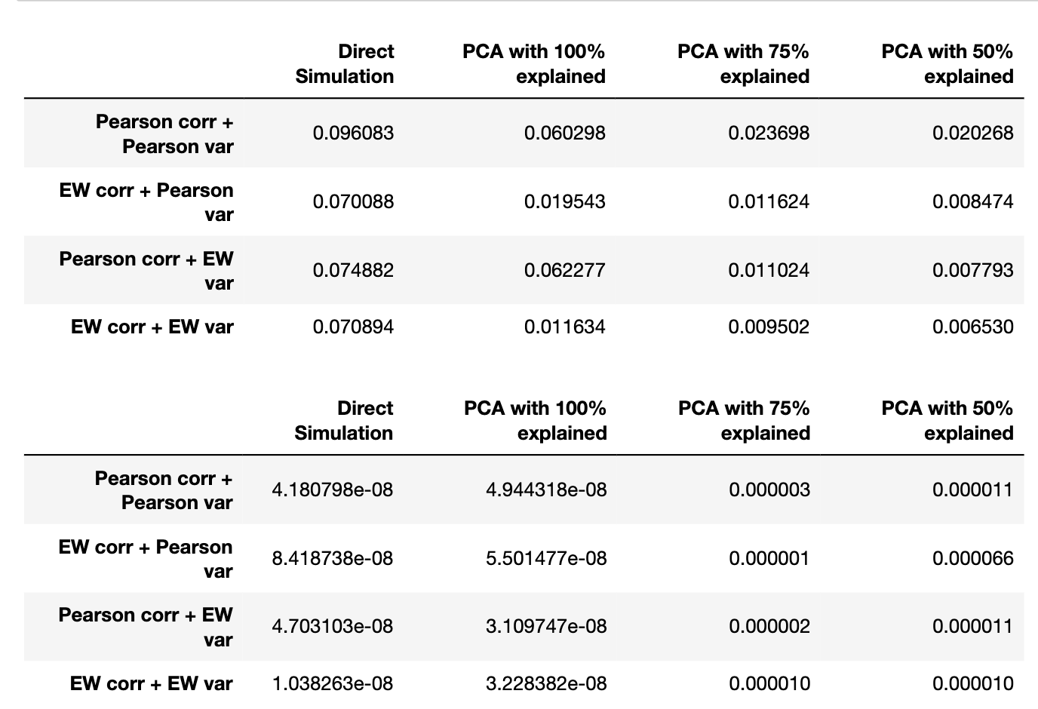
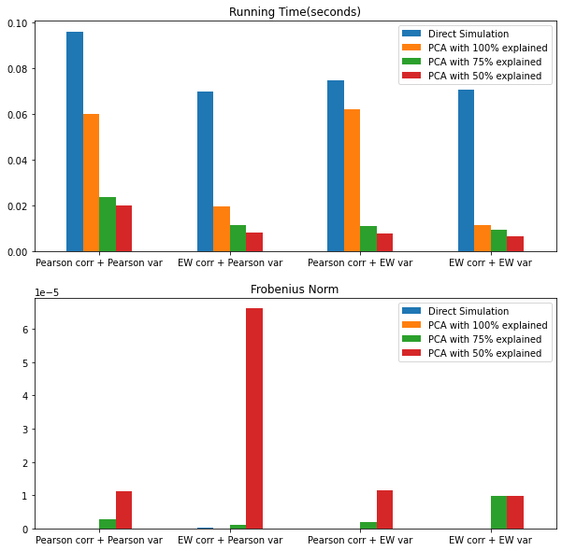

Slide 9
Summary
Notice that although we can be 5-10 times faster by using PCA with 50% and 75% variance explained, we will suffer from hundreds of times larger Frobenius Norms.
The cost of accuracy we is too large
The speed-up we get from it is relatively small
Should we use PCA with low percentage explained ?

Slide 10
Conclusion
Maintain enough information while chasing a relatively optimal running time.

Slide 11




Thank You!

