Slide 1
Lattice Diamond Software Simulation and Reveal Tools

Slide 2
Topic
Use Simulation Wizard tool to simulate the design
Use Reveal tool to debug the design

Slide 3
Simulation

Slide 4
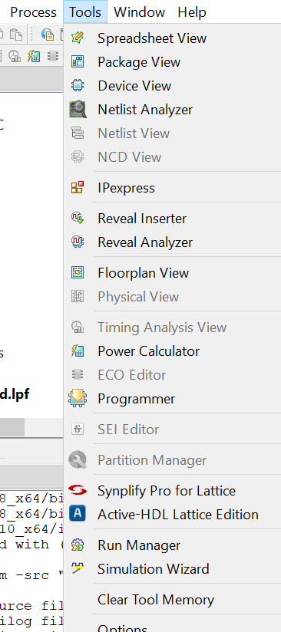
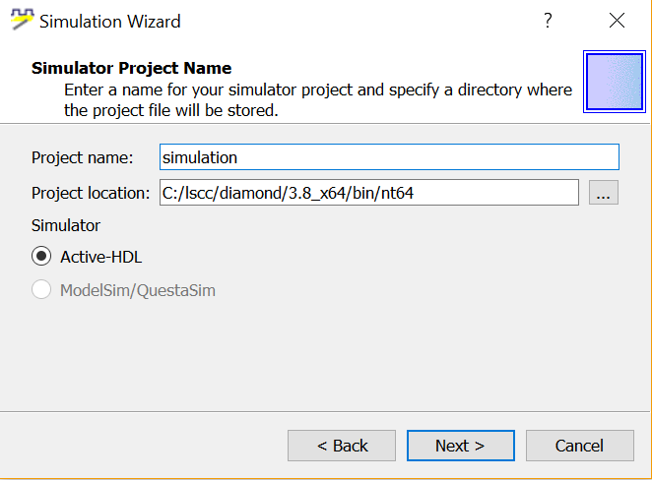

Simulation Wizard
Either way

Slide 5
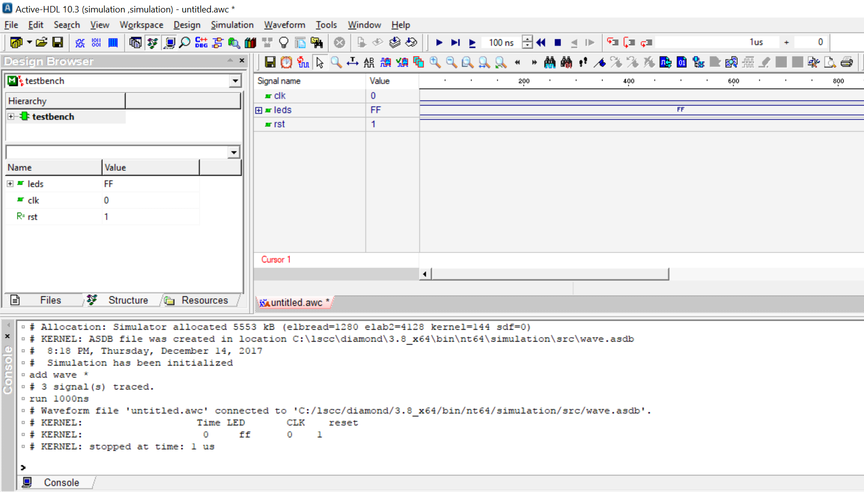
Simulation Wizard
Variables in the testbench
Waveforms
Writing commands or reading displays

Slide 6
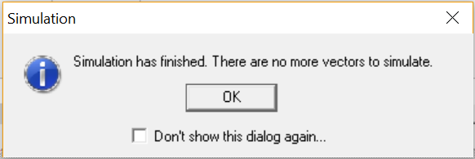

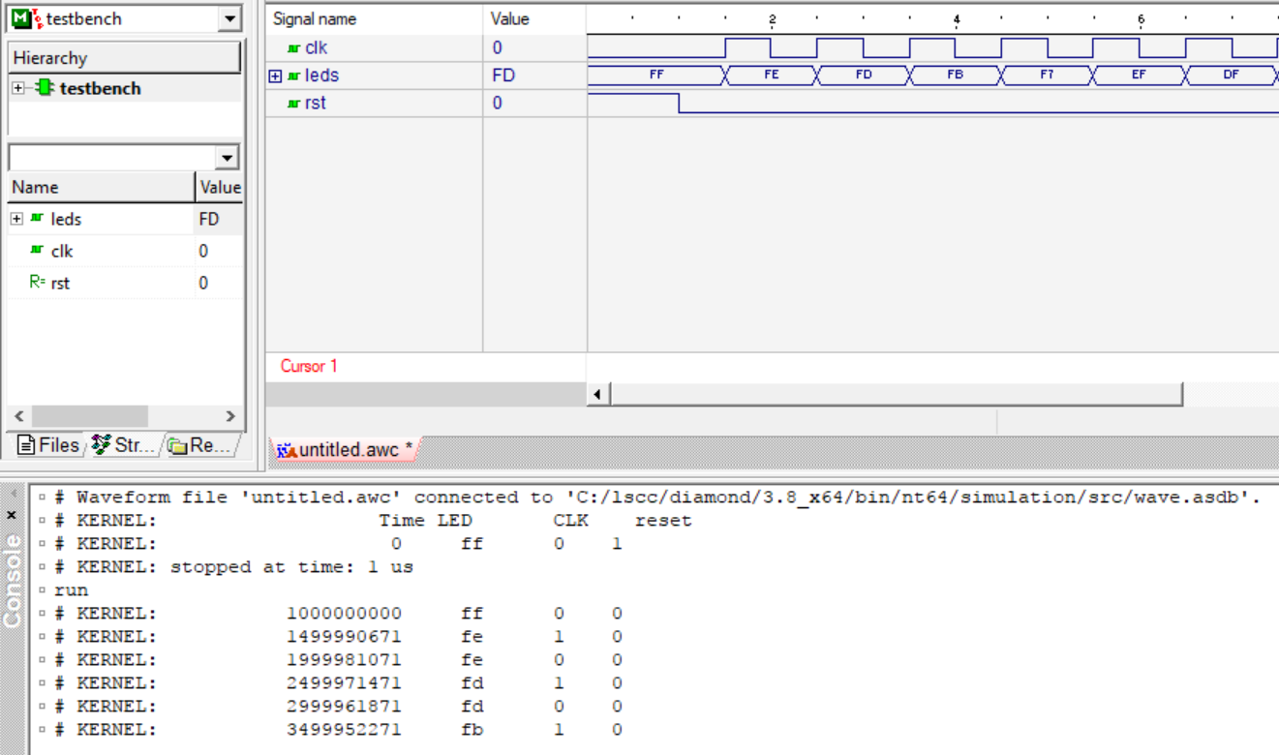
Simulation Wizard
“stop” button
Hit the “run” button

Slide 7
Reveal

Slide 8
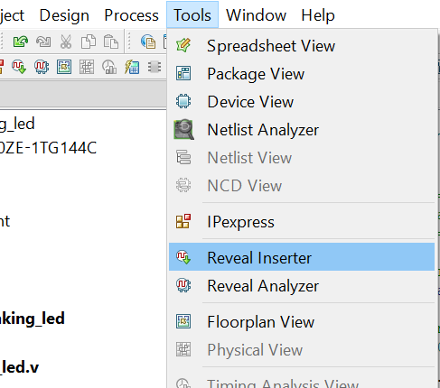
Reveal
Either way

Slide 9
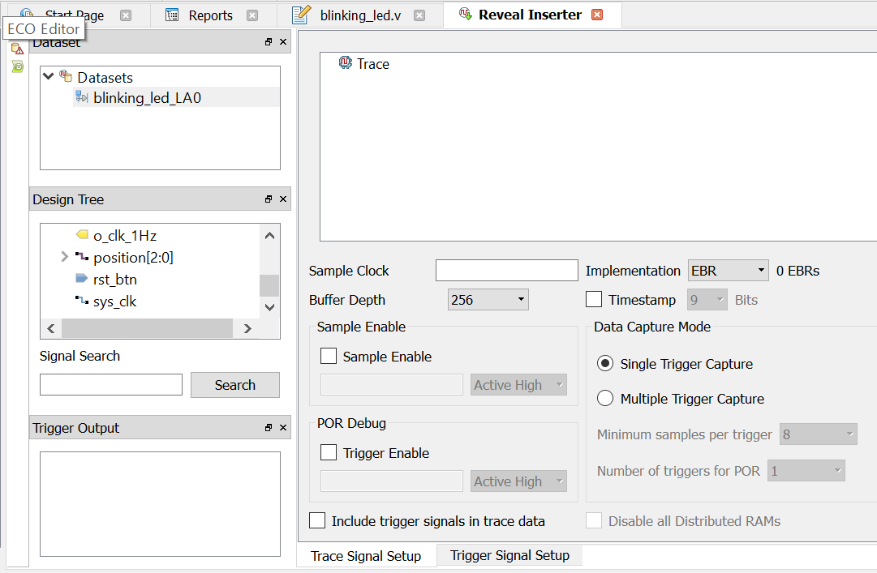
Reveal
Signals you want to look at
Drag and drop
The “Sample Clock” is the clock for Reveal tool (must run faster or equal JTAG clock)

Slide 10
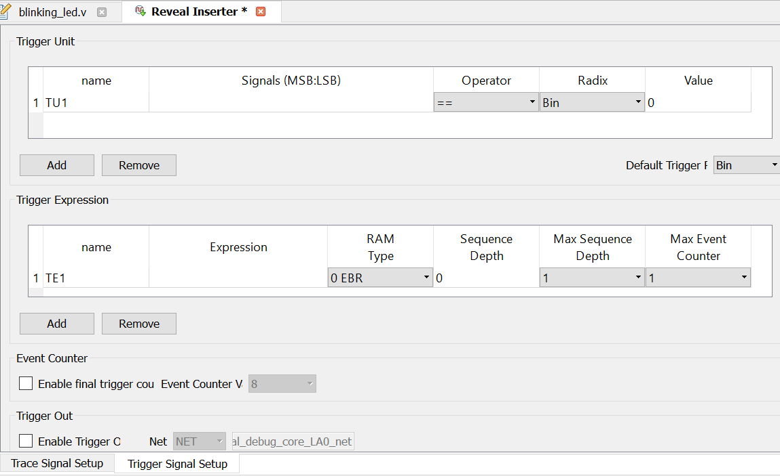
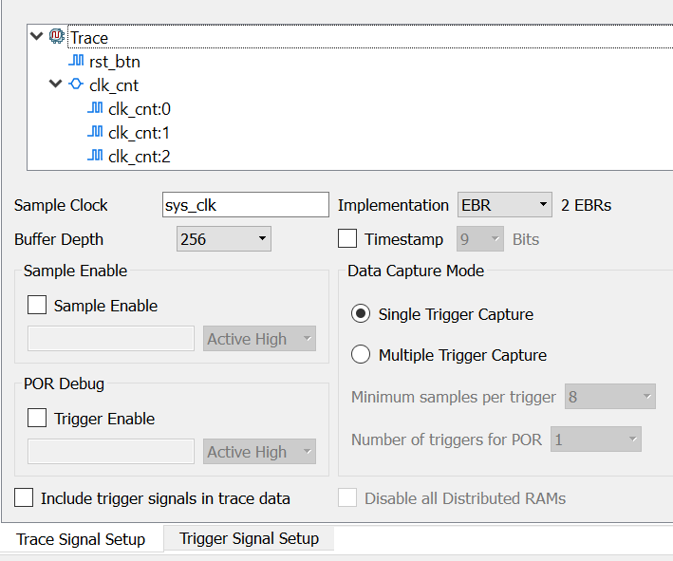
Reveal
Trigger types

Slide 11
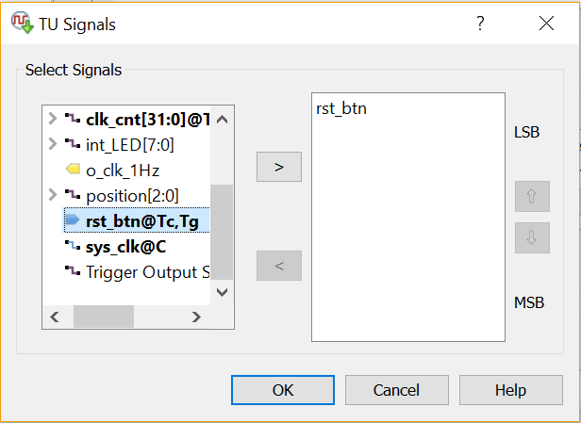
Reveal
Double Click
(3)
(2)
(1)
(4)

Slide 12
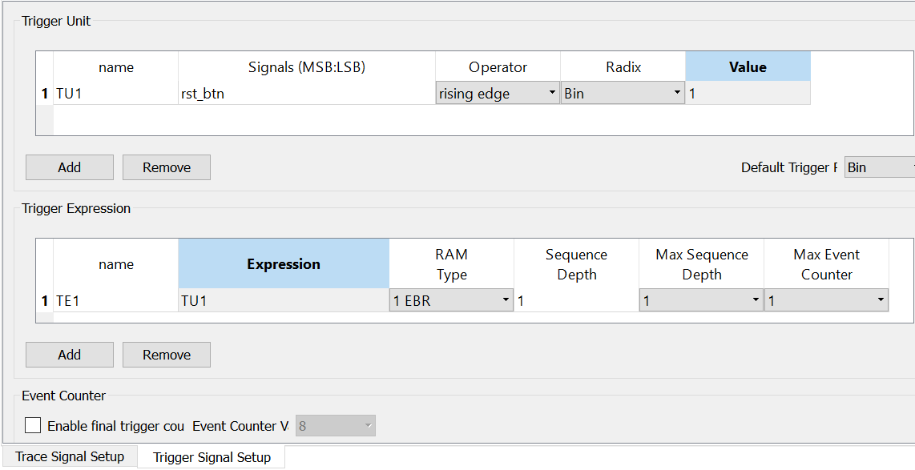
Reveal
The “Value” will indicate what bit control the trigger. For example, if the signal is 4-bit type, setting “Value” to “1100” will tell the Reveal to trigger on the rising edge of the 2 MSB.
Set trigger on rising edge
Powerful option, but we don’t use it in this tutorial. Setting TU1 to be the only trigger unit in Expression

Slide 13
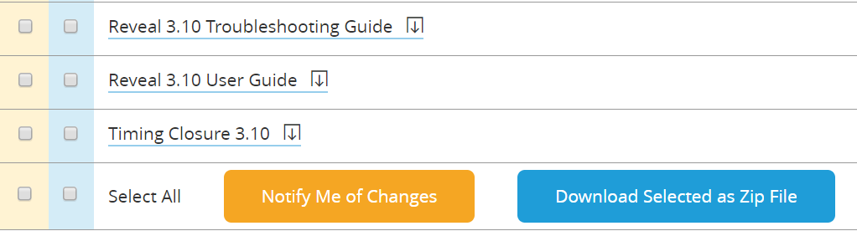
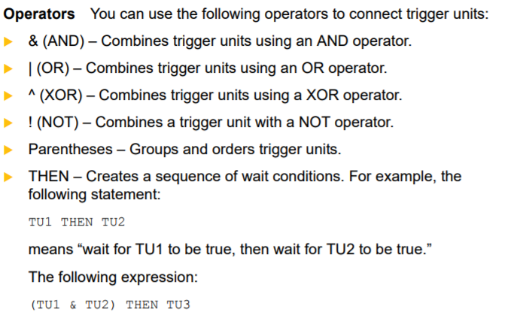
Reveal
http://www.latticesemi.com/en/Products/DesignSoftwareAndIP/FPGAandLDS/LatticeDiamond.aspx
Page 31

Slide 14
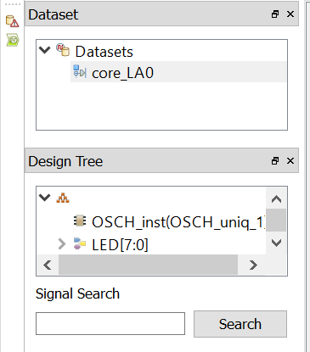
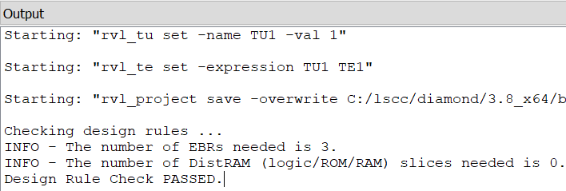
Reveal
Click on “Design Rule Check”
Click on “Insert Debug” after passing the “Design Rule Check”

Slide 15
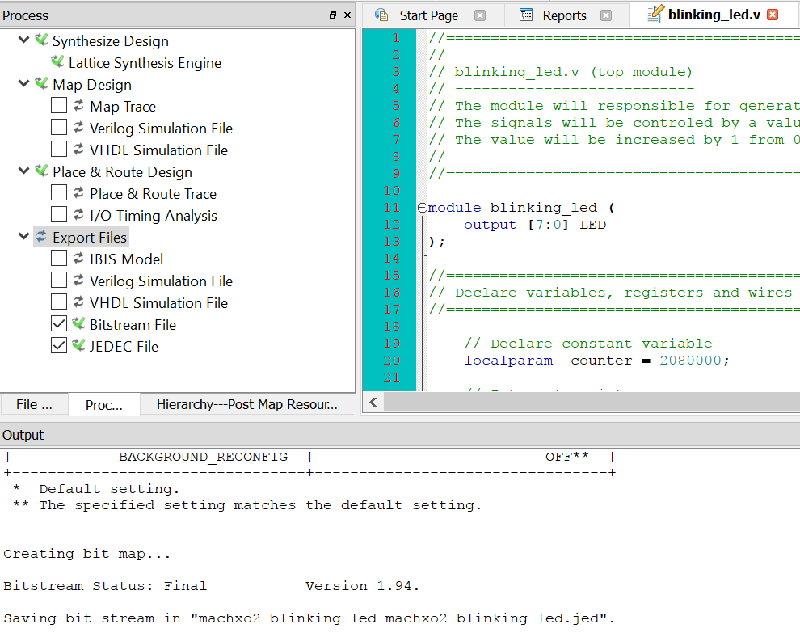
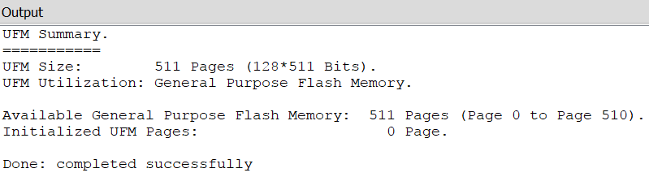
Reveal
Double Click to re-generate the .bit and .jed files
Re-program the MachXO2

Slide 16
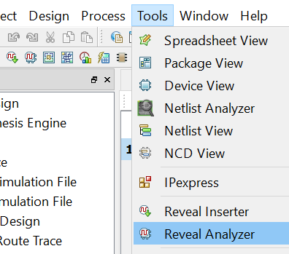
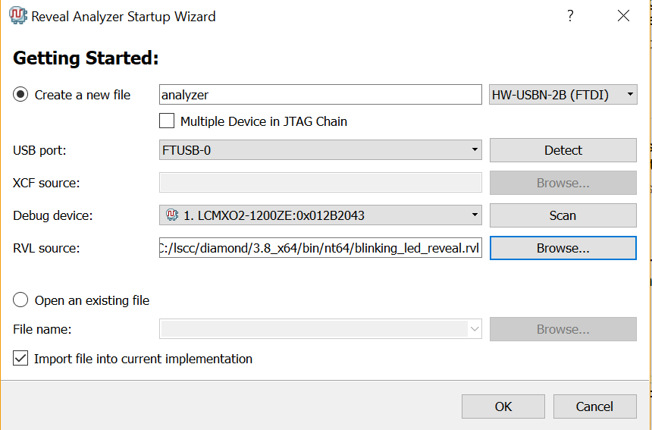
Reveal
Either way
(1)
(2)
(3)
(4)
(5)

Slide 17
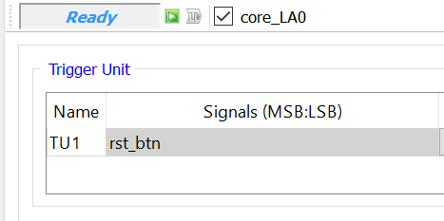
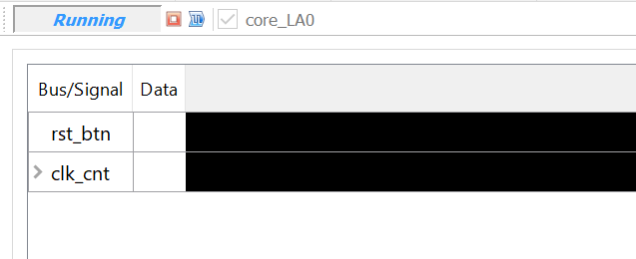
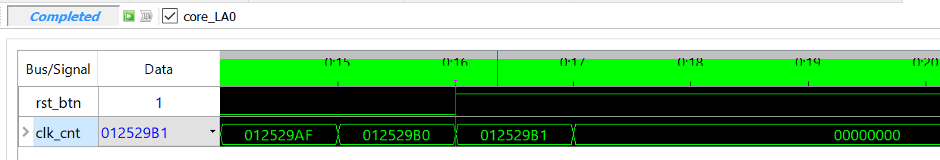
Reveal
Click to run
Wait for trigger signal
Click to trigger again

