Slide 1
Lattice Diamond Tutorial (Basic Hello Word)

Slide 2
Topic
Download Lattice Diamond Software and request for the license
Use Lattice Diamond Software for writing Verilog code
Use Lattice Diamond Software for signal assignments
Use Lattice Diamond Software for generate bitstream
Use Lattice Programmer to program MachXO2 FPGA chip

Slide 3
Lattice Diamond Software

Slide 4
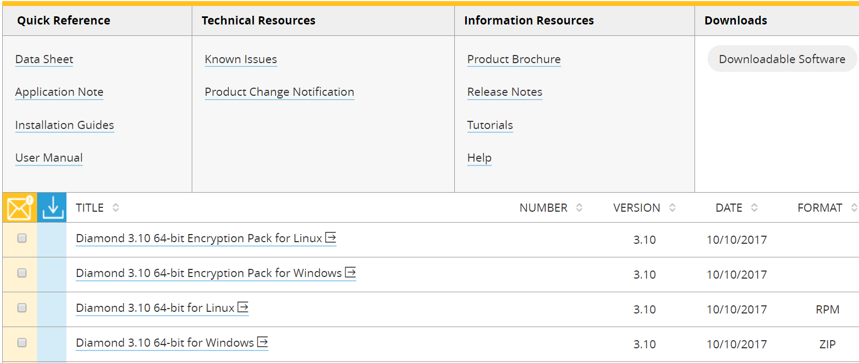
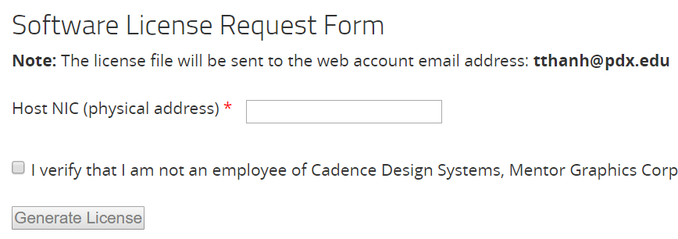
Download Lattice Diamond and request a license
A Lattice account is required to download software, documentations or request licenses
Download Lattice Diamond
http://www.latticesemi.com/en/Products/DesignSoftwareAndIP/FPGAandLDS/LatticeDiamond.aspx
Request a license
http://www.latticesemi.com/en/Support/Licensing/DiamondAndiCEcube2SoftwareLicensing/DiamondFree.aspx

Slide 5
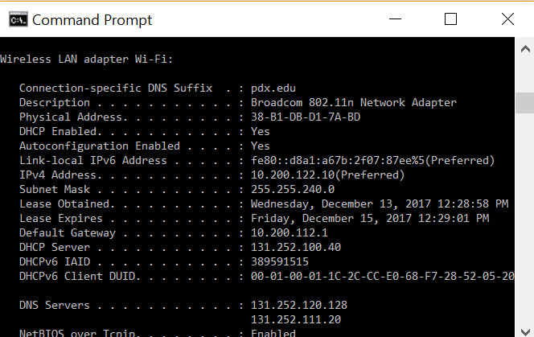
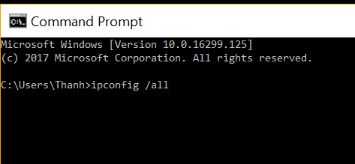
Get your MAC address

Slide 6
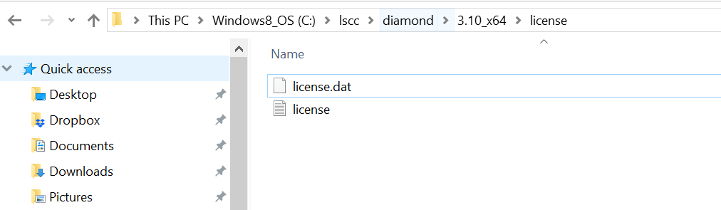
Activate Lattice Diamond With The License
Installation path

Slide 7
Hello World With MachXO2 Breakout Board

Slide 8
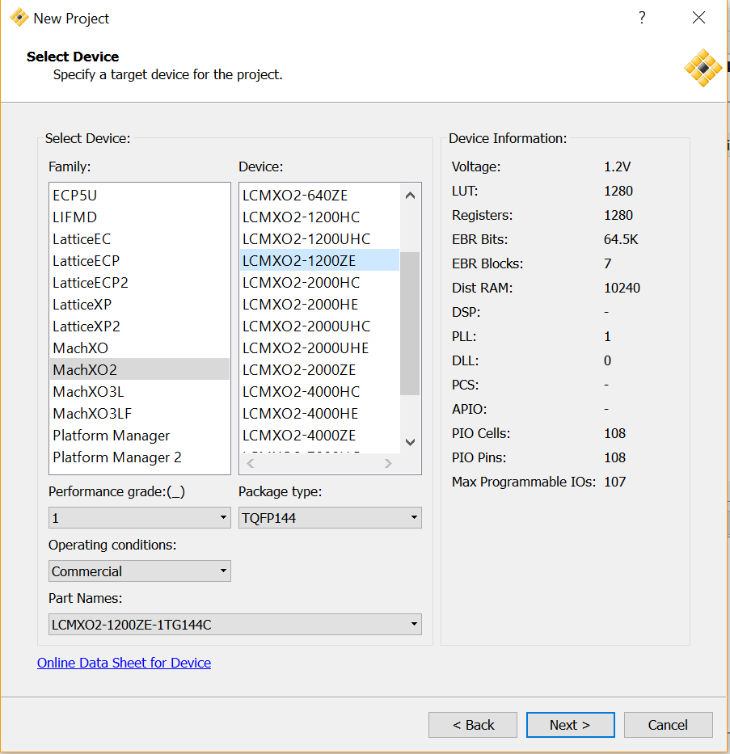
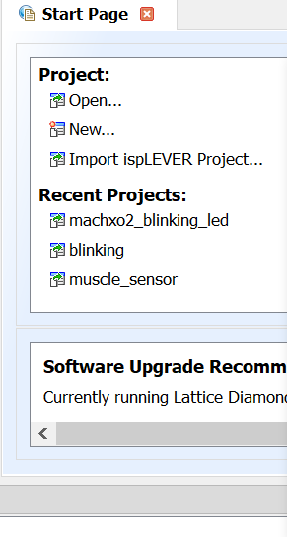
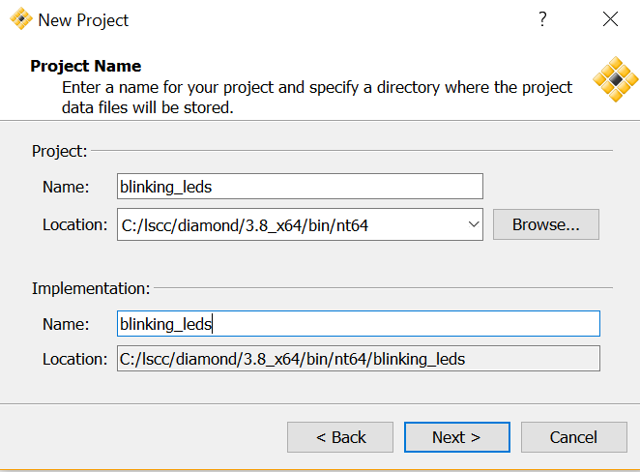
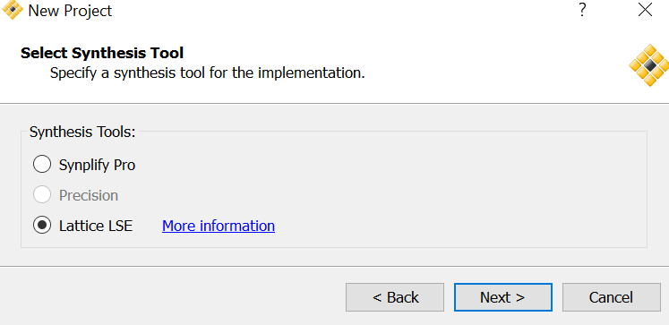
Create Working Directory
Found these info on Lattice’s website

Slide 9
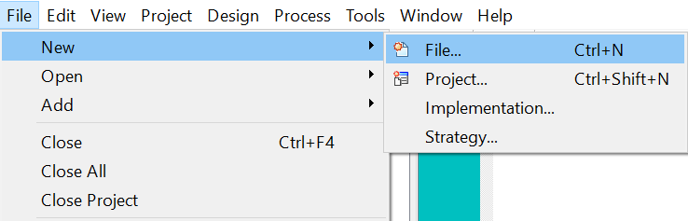
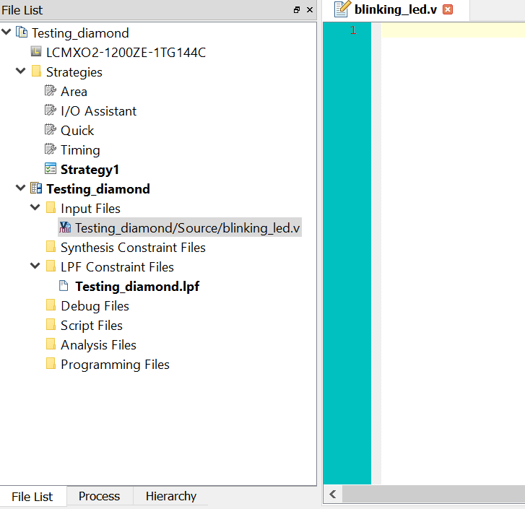
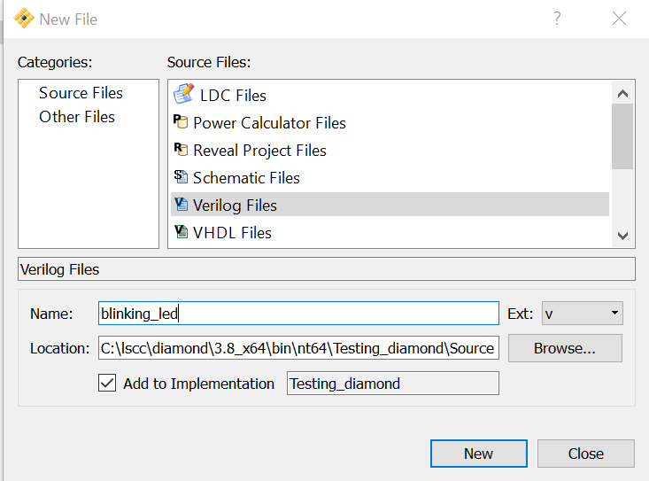
Adding Verilog files

Slide 10
Writing Verilog Code And Program MachXO2 FPGA Chip

Slide 11
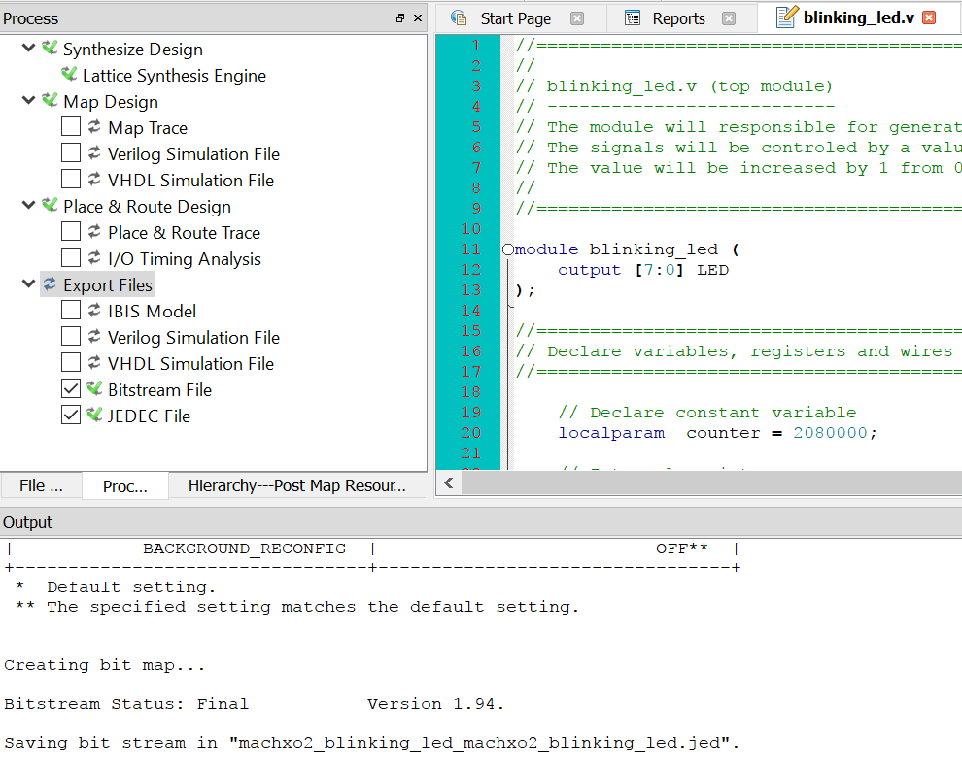
Run Synthesizer
Double Click (2)
Click (1)

Slide 12
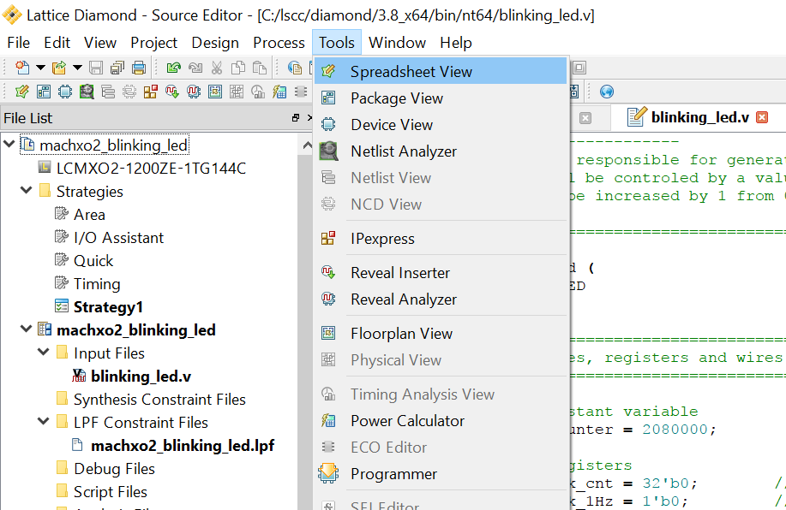
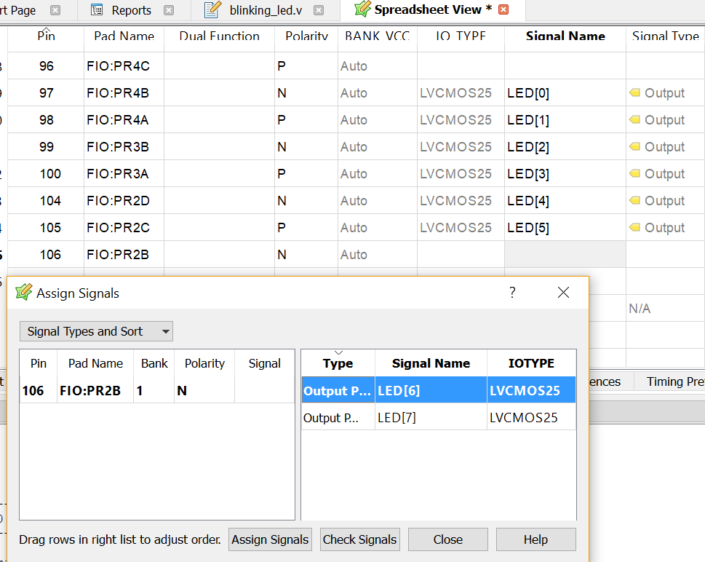
Signal assignments (Pin assignments – Opt 1)

Slide 13
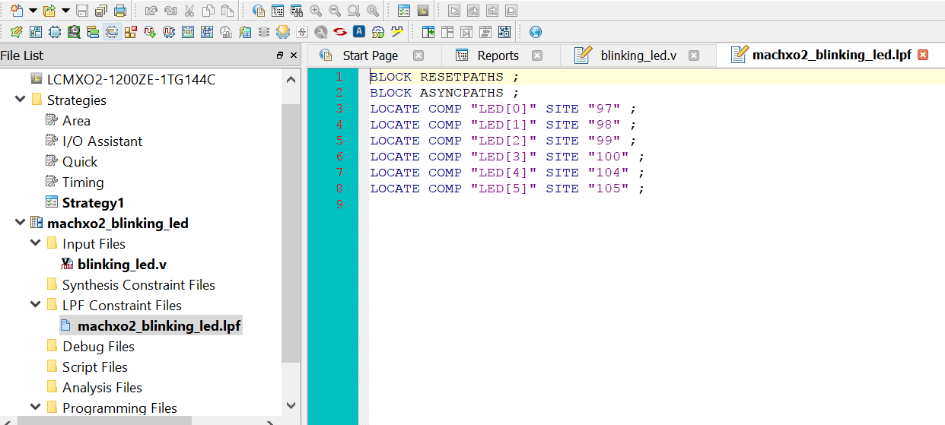
Signal assignments (Pin assignments – Opt 2)
Double click
If you know the syntax

Slide 14
Generating a Bitstream and a JEDEC file
Check if you want to look at the report
Double Click (3)
Check (2)
Click (1)
Bitstream and JEDEC are generated

Slide 15
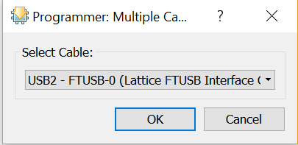
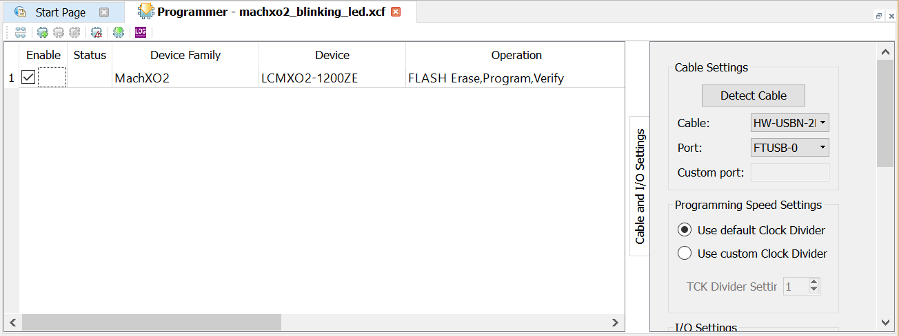
Program MachXO2 FPGA Chip
If the software can’t recognize the connected device
Make sure that info of the device and type of operation are correct

Slide 16
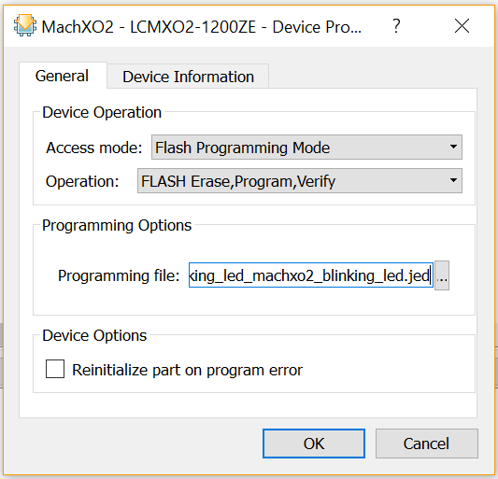
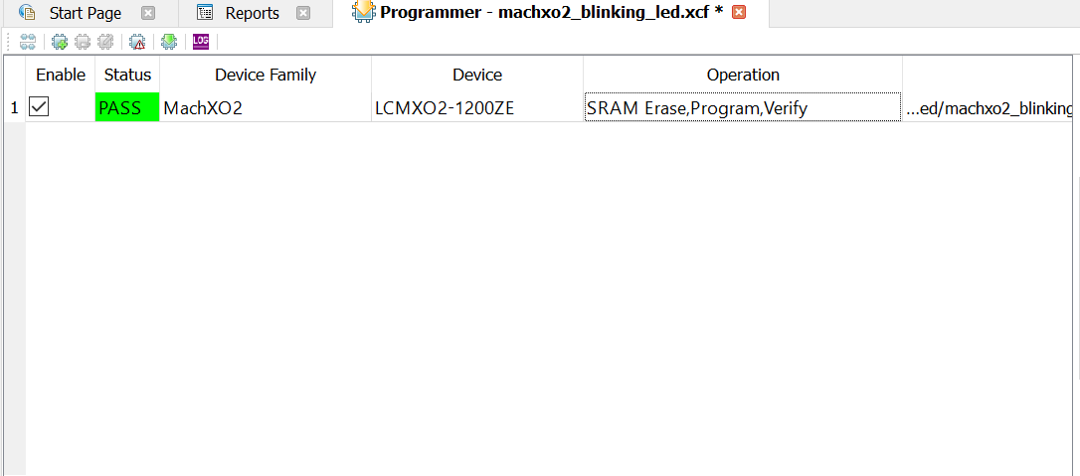
Programming Flash
Double Click

Slide 17
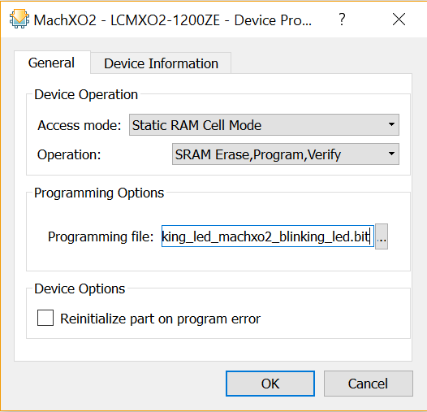
Programming SRAM
Double Click

Slide 18
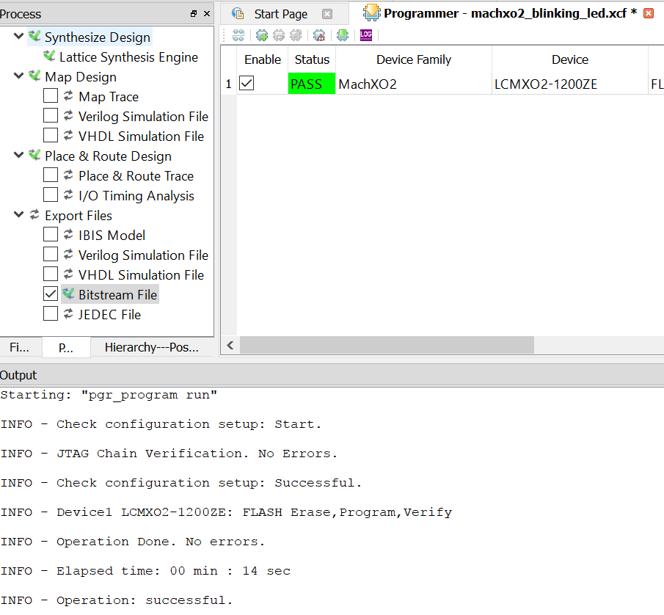
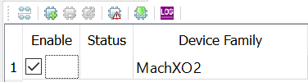
Program MachXO2 FPGA Chip
Click to program
Successfully program the FPGA chip

