Slide 1
Advanced Operating Systems Lab Tools Intro
Lab intro
www.ce.unican.es
vpuente@unican.es

Slide 2
Environment
(Some) current tools as a “regular” user
Virtual Machine deployment/provisioning system (vagrant)
Version control system (git)

Slide 3
Vagrant
It’s a abstraction layer on top of any virtualization layer
Works with VirtualBox, Vmware, Hyper-V, …, lxc, docker, etc…
Although the lab work can be done with plain VirtualBox, vagrant is recommended to avoid the hassle of crude virtual machines (VM)
Used as a “simplification” tool for VM handling
Recipe
Install vagrant and VirtualBox (Linux/Windows/OSX)
mkdir myWorkingDir
vagrant init debian/jessie64
vagrant up
vagrant ssh !

Slide 4
How to work with vagrant
Boxes != instances
List boxes
vagrant box list
Create a new instance (persistent)
mkdir directory; cd directory; Vagrant init some_box
File interaction
Use the shared dir and work in the host
/vagrant directory is working directory in host
Requires VirtualBox utils installed in the VM (version number should match)
Beware clock-skew between VM and host (might affect make/git)
Use x11 forwarding (required a X11 server)
Use rdp (requires Windows host and a rDesktop/VNC client)
Use VirtualBox interface
Notes:
Follow https://www.vagrantup.com/docs/virtualbox/boxes.html to update VirtualBox utils if there is there is version missmatch

Slide 5
Other useful commands
To handle instances
To inspect the system status
vagrant global-status
To delete instances, use “vagrant destroy” (never delete a VM from virtualBox interface!)
To handle boxes
vagrant box list -- List versions installed, that might me updated in remote server
vagrant box update -- To download updated versions of the box (v.gr. if the box is upgraded on atlas.hashicorp.com)
vagrant box remove vpuente/AOSUC --box-version 1.22 -- cleans old version for that box

Slide 6
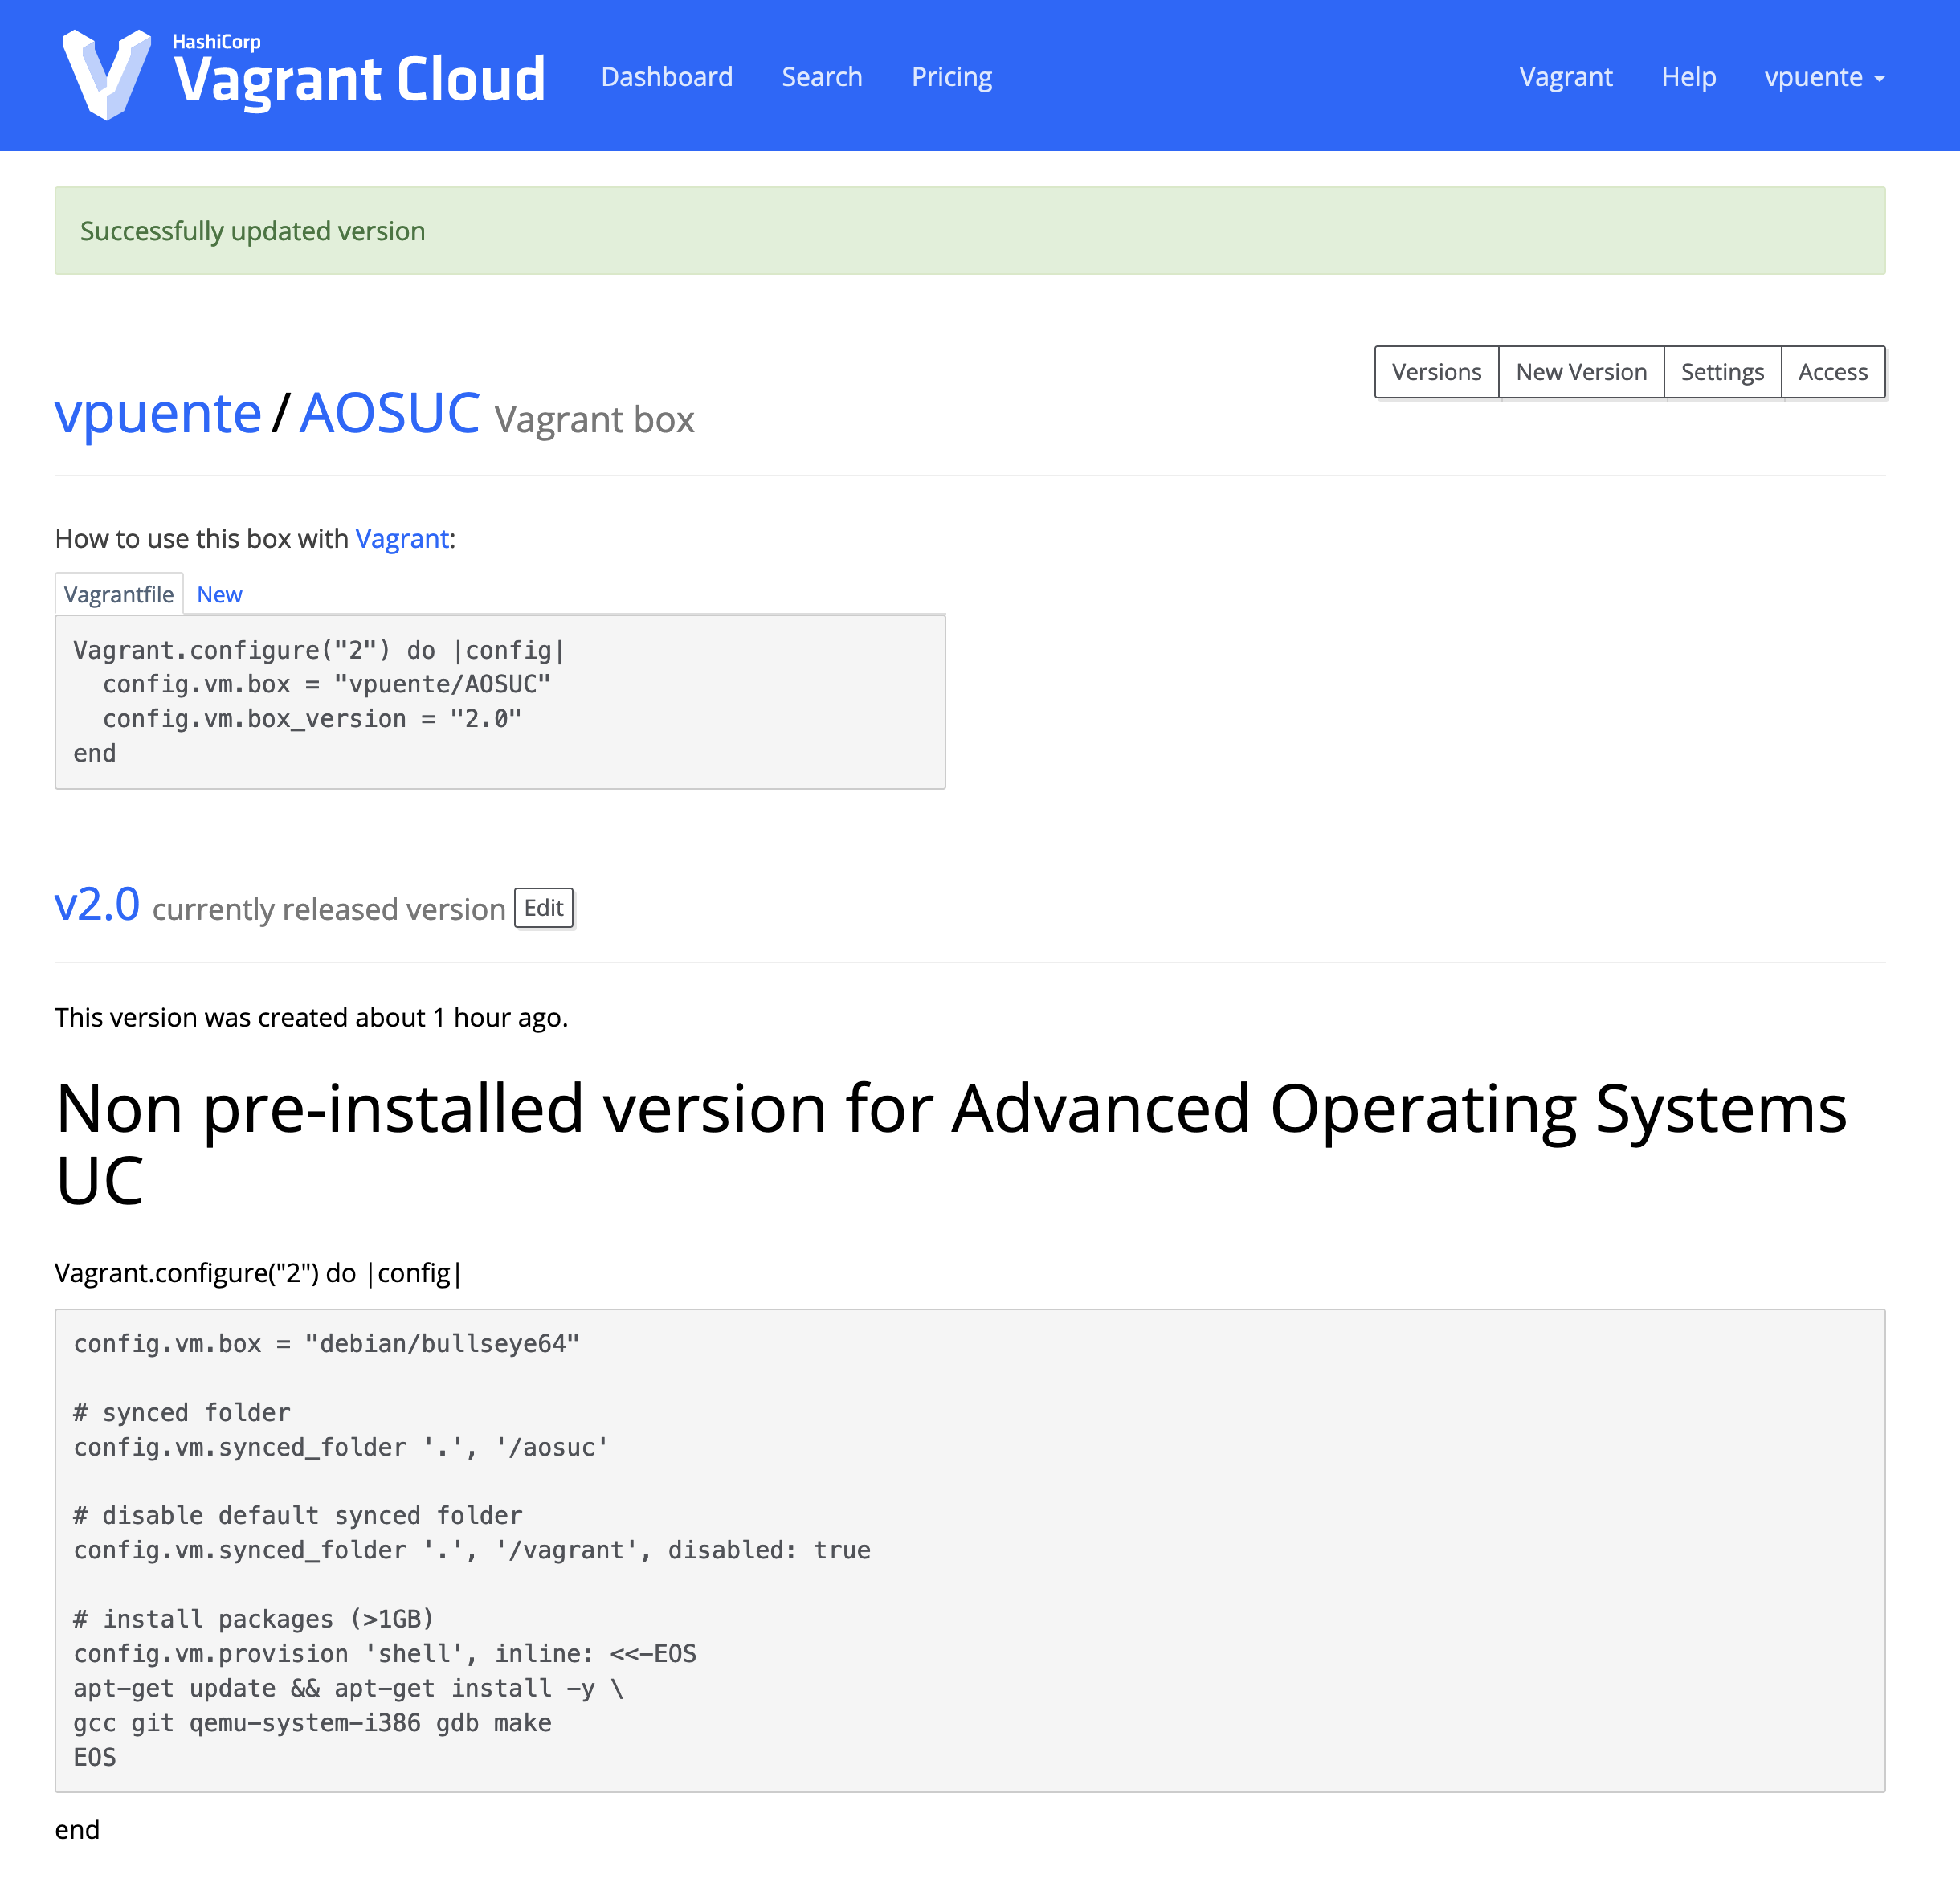
AOS Vagrant Box: vpuente/AOSUC (vagrant init vpuente/AOSUC)

Slide 7
Advantages
Allow to provision the Environment without tinkering with the files
Download the box “once”! (not each time you install it)
Use it many times in many different contexts (v.gr. a particular lab or section)
Share the changes (labs, exams, etc…)
Allows to run the box to any provider (beyond VirtualBox)
Local (i.e., hyper-v, kvm, …) or external (i.e., Cloud provider such as AWS, GCE, Azure)
A higher level of automation are Chef and Puppet (automated delivery and provisioning)
Plays nice with Docker, CI systems (github, gitlab), …
Only used as a tool!
Interesting in learning more?: Sistemas Virtualización y Seguridad

Slide 8
There are other options?
It’s possible to do the lab natively in:
Linux (ugh)
Windows 10
Using Windows Subsystem Linux 2 (WSL2)
https://msdn.microsoft.com/es-es/commandline/wsl/install_guide
osX
Using port or brew
https://stackoverflow.com/questions/39052271/compile-xv6-on-mac
My advice?
Pick your choice…

Slide 9
Others
Code editor
Vim ☺
Visual Studio Code (o VSCodium)
SublimeText
Atom
…
Debugger
Remote-debug (to QEMU)
gdb http://beej.us/guide/bggdb/
Other gdb frontends (ddd, VSCode, etc…)

Slide 10
Lab work
All lab material will be available in git lab repository
git clone https://gitlab.com/AOSUC/Lab.git
Material
Where you must work
Reference
OSTEP original material (ostep.org)
We will work using a simple git branch+upstream based workflow
https://www.atlassian.com/git/tutorials/what-is-git

Slide 11
Personal Work tracking
Git repo contains a “chain” of atomic changes called commits
Branching will be used to track personal work
Lab Guides
Personal Work
Lab Guides
Personal Work

Slide 12
Workflow
Create an account in gitlab.com
Create a private repository (for lab)
Fork https://gitlab.com/AOSUC/Lab.git on web interface
Invite vpuente@gmail.com to such repository
Start working
git clone https://username@gitlab.com/AOSUC/Lab.git
git branch <DNI>
git checkout <DNI>
START WORKING THERE / COMMIT AS MUCH AS U NEED!!!
git add NEW_FILES DO NOT MODIFY ALREADY PRESENT FILES (merge conflicts)
<WORK>
git commit <WORK> git commit <WORK> git commit <WORK> …
git push
git pull https://username@gitlab.com/AOSUC/Lab.git

Slide 13
Updating of Guides (Pull)
Merging updates in material
Allow the professor to track your work
Allow to automatize C&P detection
Personal Work
Lab Guides

Slide 14
Download changes from the common repo
How to integrate changes from mainline in my fork?
git checkout master
git pull https://gitlab.com/AOSUC/Lab
git checkout <DNI>
git rebase master
This process might fail if done in “non” reliable clock environment
For example, if we have clock-skew between system and files (v.gr. Virtual Box and host shared directory in some old windows)
Personal Work
Personal Work
Lab Guides
Lab Guides

Slide 15
Next level (not required but advised to try at least)
Create additional branches for a particular work
Merge with DNI branch when done
Only use the Web interface to merge
Command line tool are not easy to use (especially when conflicts appears)
Allows to work on multiple tasks at once (and do not have a chaos in hands)
Use kanban/issue boards to track your issues/progress

Slide 16

Git can be quite powerfull (and complex!)
https://nvie.com/posts/a-successful-git-branching-model/ (👍)
https://news.ycombinator.com/item?id=11190310 (👎)

Slide 17
Summary
https://ohshitgit.com/

Slide 18
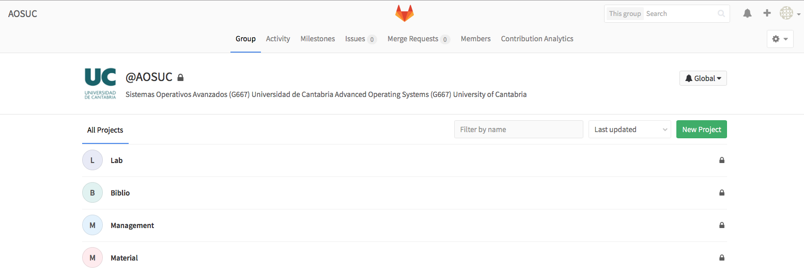
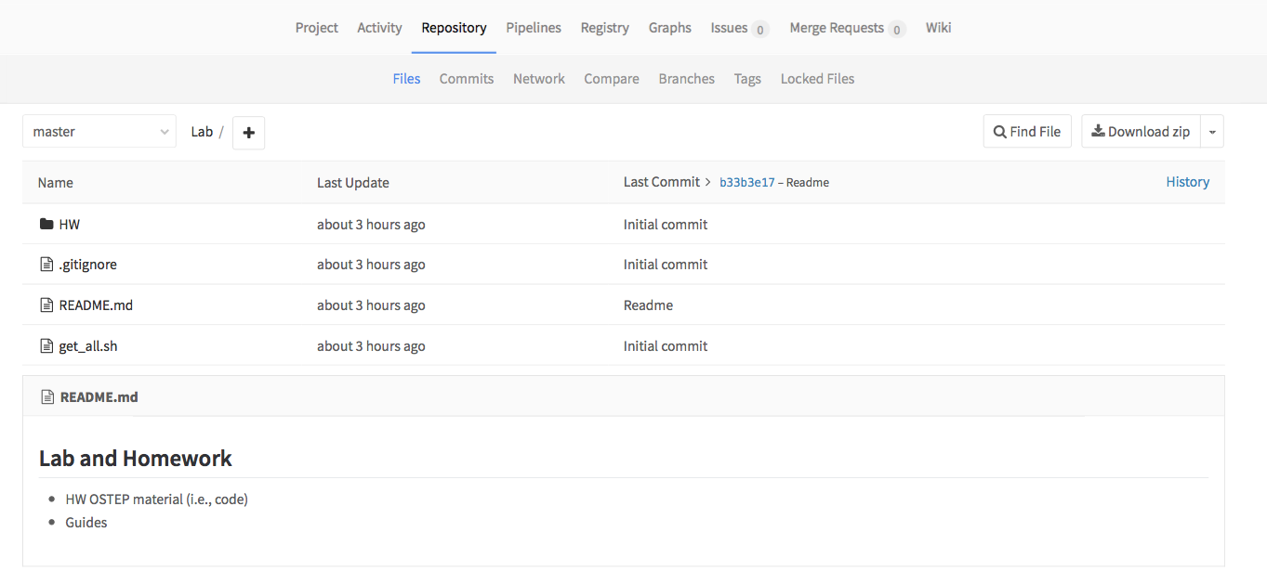
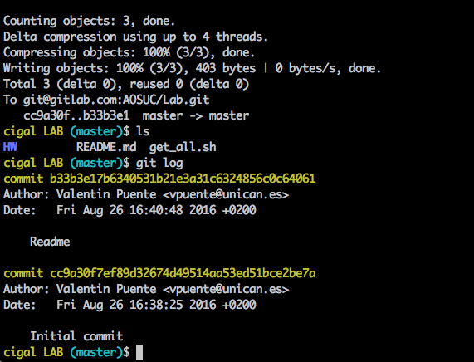
Gitlab Interface (not needed git deep understanding)

Slide 19
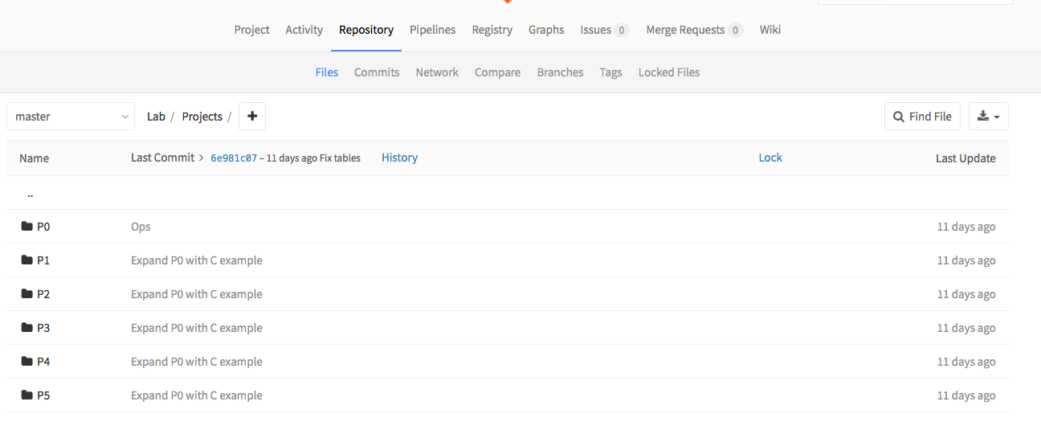
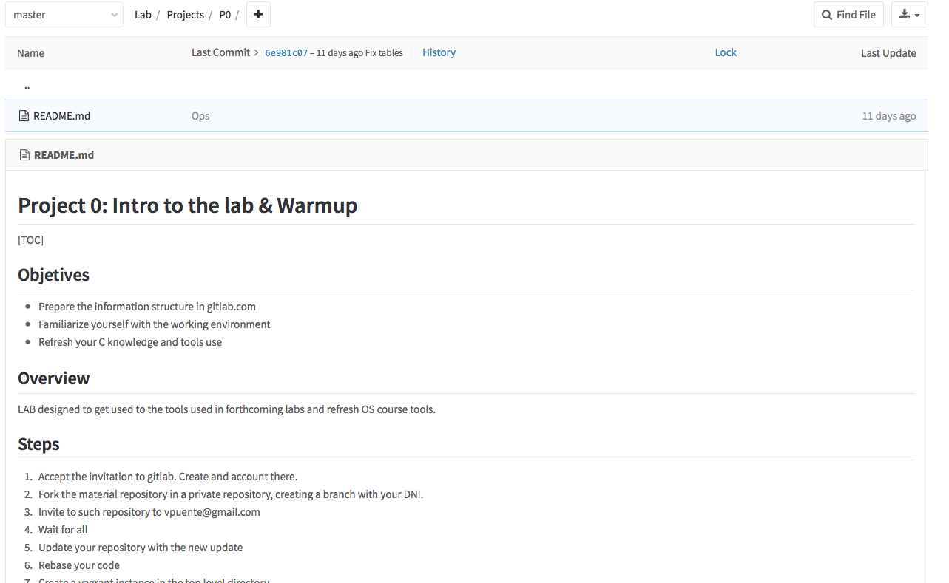
GitLab interface (Demo)

Slide 20
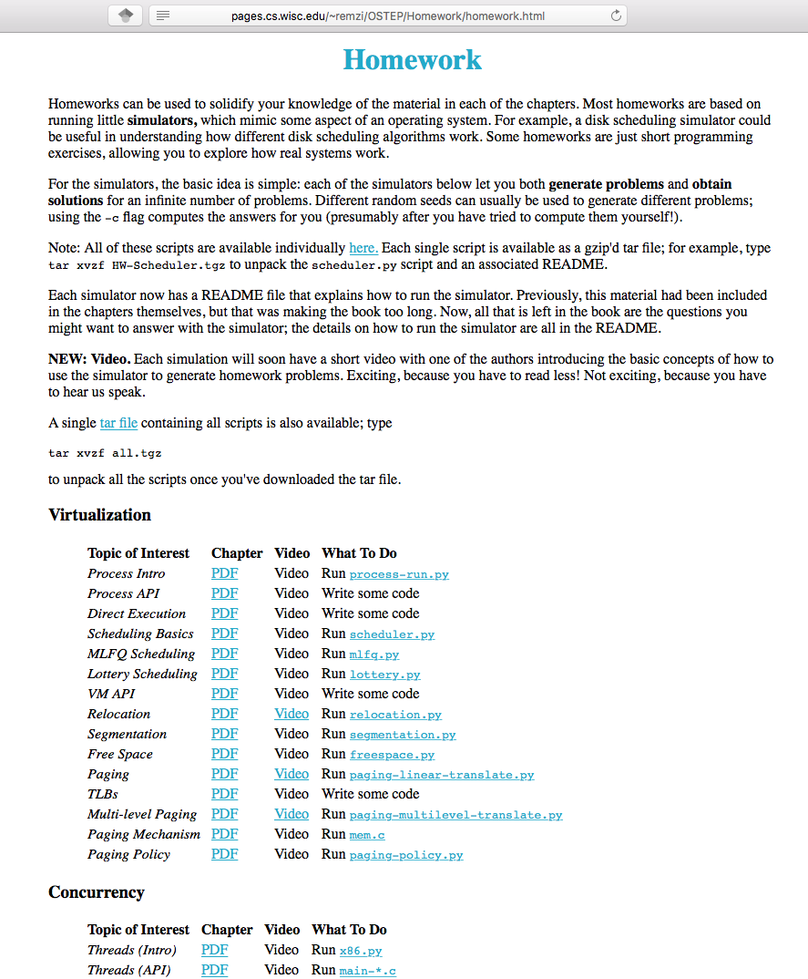
Structure of the repository (Demo)
Homework's
Book material
Projects
Develop here. Commit progressively
Tests
Auto tests for the projects

Slide 21
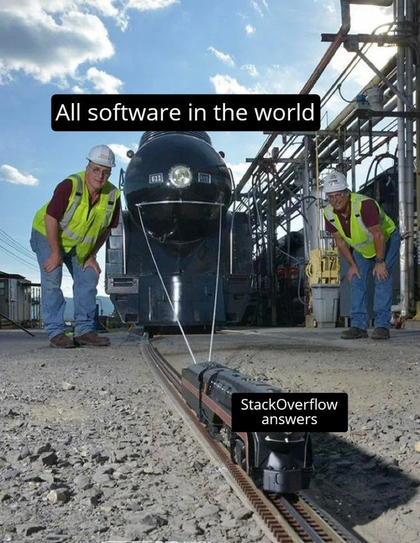
Cautionary Tale
“good artists copy, great artists steal” --Picasso
r/ProgrammerHumor

