Slide 1
Tool Stack Recomended

Slide 2
Approach
Tries to mimic a “usual” scheme: develop local, run remote
Use local machine to “edit” code
Use a remote machine to “run” it
Employ “state-of-the-art” tools
Remote development Visual Studio Code + Vagrant

Slide 3
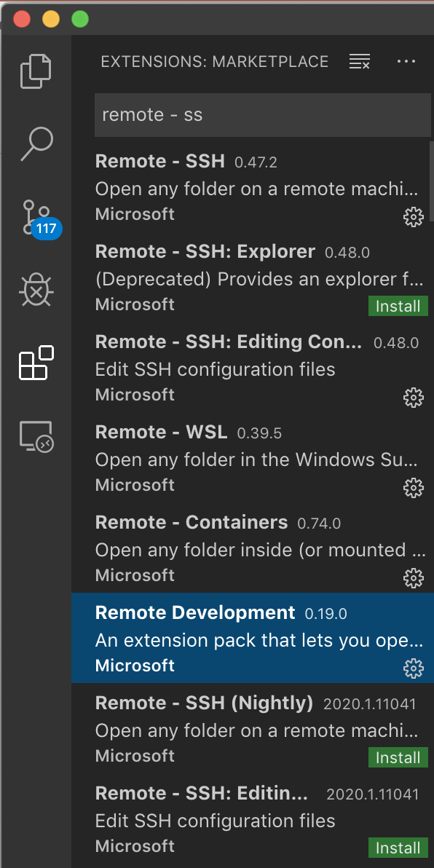
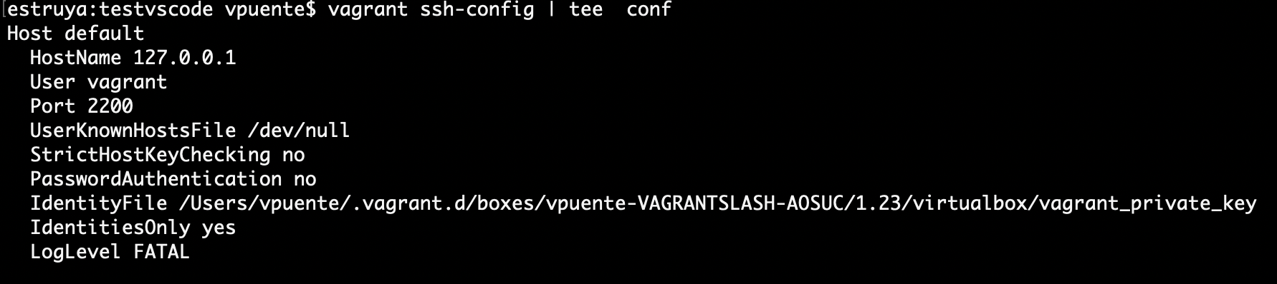
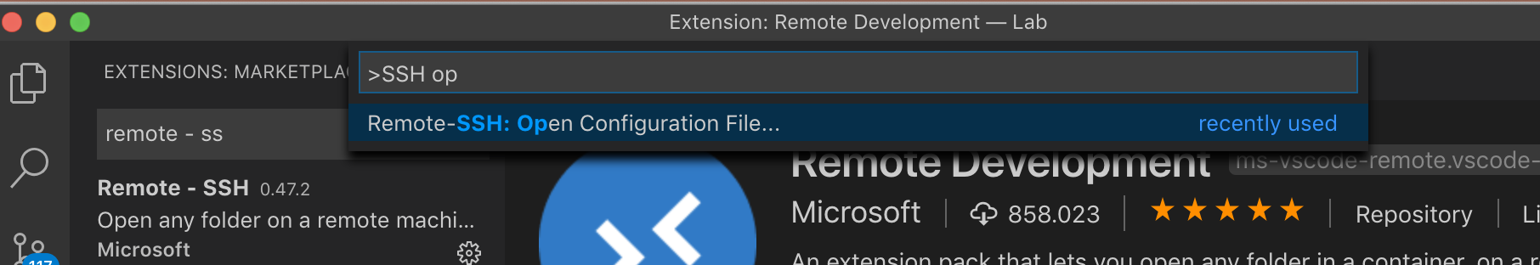
Install procedure
Install Remote development tools in VSC
Remote development
Remote SSH
Capture vagrant conf (in windows generate noise)
Import file into VSC (F1)

Slide 4
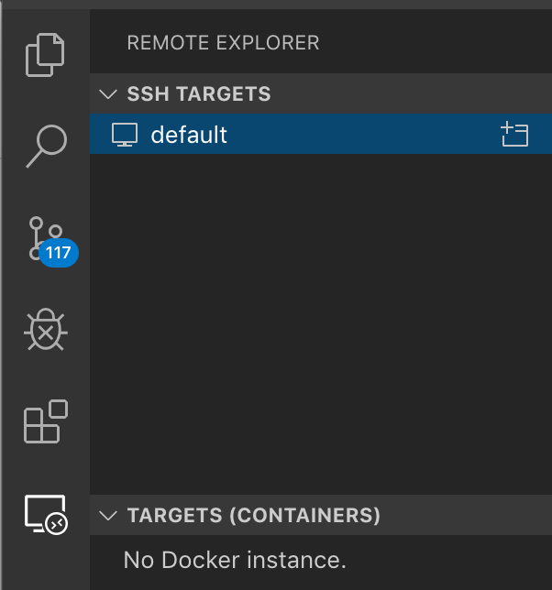
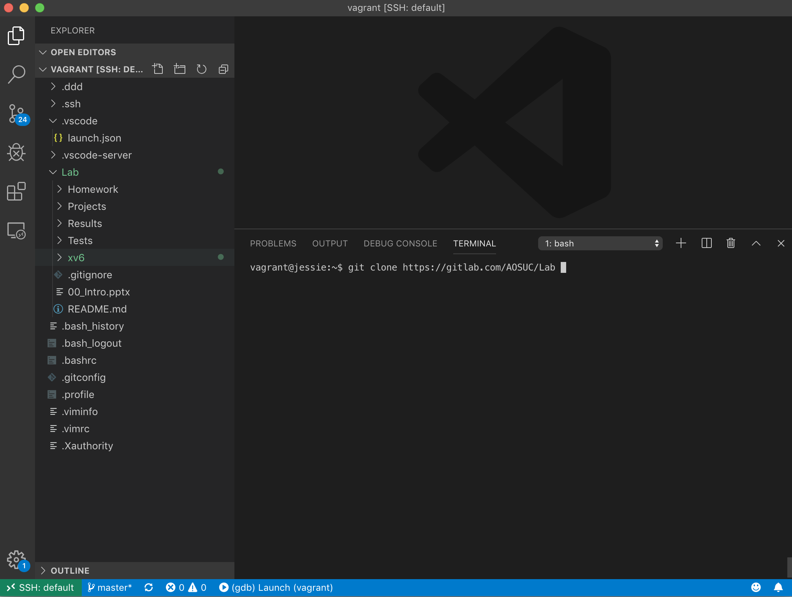
Work on the virtual machine (no need for external ssh)

Slide 5
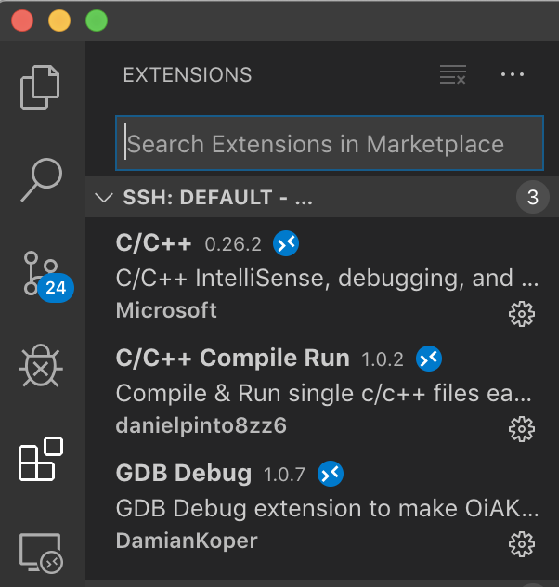
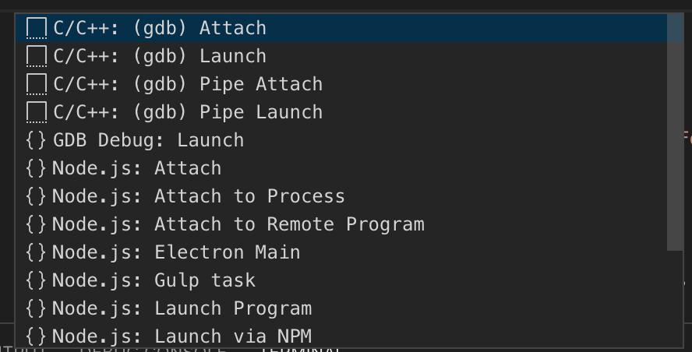
Compile and debug
Install the extensions for C/C++
Create a new debug config with gdb “attach”

Slide 6
.vscode/Debug json (place always the worksplace in PXX dir)
{
{
"version": "0.2.0",
"configurations": [
{
"name": "(gdb) Launch Remote Debugging of xv6",
"type": "cppdbg",
"request": "launch",
"program": "${workspaceRoot}/xv6/kernel/kernel",
"miDebuggerServerAddress": "localhost:26000",
"args": [],
"stopAtEntry": false,
"cwd": "${workspaceRoot}",
"environment": [],
"externalConsole": true,
"linux": {
"MIMode": "gdb"
},
"osx": {
"MIMode": "gdb"
},
"windows": {
"MIMode": "gdb"
}
}
]
}

